Slide 1
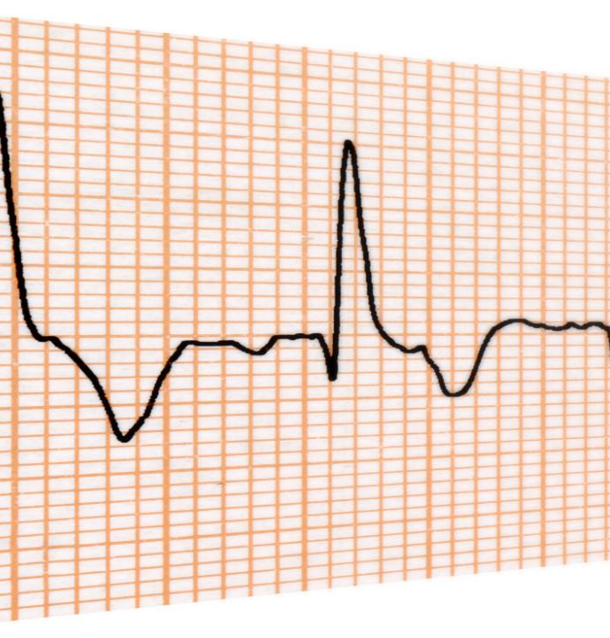
EEG Noise and Artifact Removal
Key methods to improve EEG signal quality effectively
Soroush Gholizadeh jouryabi / 12454591
Notes:
AI-generated content may be incorrect. ---

Slide 2
Motivation and Context for EEG Artifact Removal
Notes:
Why EEG Recordings Require Careful Preprocessing, General Categories of EEG Noise and Artifacts

Slide 3

Why EEG Recordings Require Careful Preprocessing
Susceptibility to Noise
EEG signals are weak and easily contaminated by physiological and environmental noise sources.
Artifacts Distort Signal
Artifacts like eye blinks and muscle activity distort EEG waveforms and can mask true brain signals.
Importance of Preprocessing
Preprocessing removes artifacts to preserve genuine neural information for accurate analysis and interpretation.
Challenges in Validation
True clean EEG signals are unknown, making artifact removal evaluation reliant on indirect measures and expert review.
Notes:
Electroencephalography (EEG) measures very small electrical potentials generated by neural activity and recorded at the scalp, typically in the range of only a few microvolts. Because these signals are weak and measured non-invasively, EEG recordings are highly susceptible to contamination from non-neural sources. As a result, raw EEG data are almost never a pure representation of brain activity; instead, they are a mixture of neural signals, physiological artifacts, and environmental or instrumental noise. This makes preprocessing and artifact removal a fundamental step before any meaningful analysis can be performed. Without proper cleaning, artifacts can dominate the signal, distort its temporal waveform, alter its frequency spectrum, and create misleading spatial patterns across electrodes. For example, a large eye blink can appear as a slow, high-amplitude deflection in frontal channels, masking genuine neural responses, while muscle activity can introduce high-frequency components that resemble cognitive-related beta or gamma activity. These effects can severely bias downstream analyses such as brain–computer interface (BCI) classification, event-related potential (ERP) studies, frequency-tagging or steady-state visual evoked potential (SSVEP) analysis, and clinical interpretation. Another important challenge is that, in real EEG recordings, the true underlying “clean” brain signal is unknown. This lack of ground truth makes it difficult to objectively evaluate how well a given artifact-removal method performs. Researchers must therefore rely on indirect metrics, expert visual inspection, or controlled simulations. The literature consistently emphasizes that EEG preprocessing is not optional but a necessary prerequisite for reliable results. Across laboratory, clinical, and wearable EEG settings, artifact removal is best understood as a systematic effort to improve signal quality while preserving as much genuine neural information as possible, rather than as a single optional filtering step. This motivation underpins all the papers reviewed in this presentation.

Slide 4
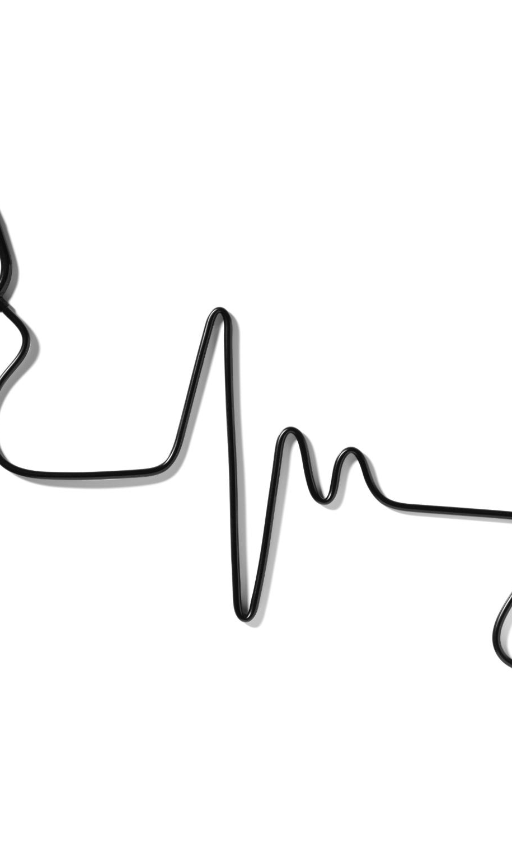
General Categories of EEG Noise and Artifacts
Physiological Artifacts
Physiological artifacts originate from non-brain biological activities like eye blinks, muscle movement, heartbeats, and body motion.
Non-Physiological Artifacts
Non-physiological artifacts arise from recording setup issues and environmental noise, such as electrode problems and electromagnetic interference.
Artifact Characteristics
Artifacts have unique temporal, spectral, and spatial properties that influence the choice of removal techniques in EEG analysis.
Artifact Removal Techniques
Understanding artifact types guides the use of methods like filtering, source separation, wavelet decomposition, and machine learning.
Notes:
EEG artifacts are commonly divided into physiological and non-physiological categories, a distinction that helps clarify their origins and appropriate removal strategies. Physiological artifacts arise from biological processes other than cortical brain activity. The most prominent examples are ocular artifacts, produced by eye blinks and eye movements, which generate large electrical potentials that spread across the scalp. Muscular or myogenic artifacts originate from facial, jaw, neck, or scalp muscles and often have a broad frequency spectrum, overlapping with neural EEG bands. Cardiac artifacts, related to the electrocardiogram (ECG), can appear as rhythmic components synchronized with the heartbeat. Movement-related artifacts, such as head or body motion, are also physiological in nature and can be particularly problematic in populations like infants or in mobile EEG recordings. Non-physiological artifacts stem from the recording setup or environment rather than the body. These include instrumental artifacts such as bad or flat channels caused by poor electrode contact, electrode displacement, cable movement, amplifier saturation, or impedance imbalance. Environmental noise, especially electromagnetic interference, is another major category; a classic example is power-line noise at 50 Hz in Europe or 60 Hz in other regions. Each artifact category has distinct temporal, spectral, and spatial characteristics, which is why no single removal method works optimally for all cases. The reviewed literature shows that understanding the type of artifact present is crucial, because it determines whether simple filtering is sufficient or whether more advanced techniques such as source separation, wavelet decomposition, or machine learning are required. This taxonomy provides the conceptual foundation for evaluating and comparing artifact-removal pipelines across different EEG applications.

Slide 5
Paper 1: Zhang et al. (2021) — EEGdenoiseNet
Notes:
EEGdenoiseNet: Motivation and Dataset Design, Artifact Types and Denoising Methods in EEGdenoiseNet

Slide 6
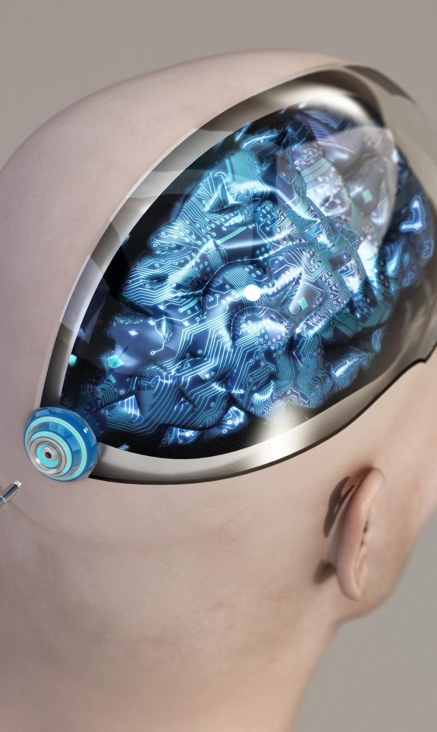
Paper 1: Zhang et al. (2021) — EEGdenoiseNet
Dataset/problem → artifacts/noise → denoising approach
Dataset / problem
EEGdenoiseNet benchmark dataset
4514 clean EEG segments, 3400 ocular artifacts, 5598 muscular artifacts
Goal: create noisy EEG with known clean ground truth
Artifacts / noise
EOG: eye blinks and eye movements
EMG: muscle / myogenic artifacts
Denoising approach
Clean EEG + artifact segment → synthetic noisy EEG
Deep learning models: FCNN, CNN, 1D-ResCNN, RNN/LSTM
Notes:
Arpaia et al. (2025) present a systematic review of artifact detection and artifact category identification in wearable EEG systems. Wearable EEG differs from traditional laboratory EEG in several fundamental ways. It often relies on dry or semi-wet electrodes, uses fewer channels, and is designed for mobile or real-world environments rather than controlled laboratory settings. These characteristics make wearable EEG more susceptible to artifacts and noise. The review provides a comprehensive taxonomy of artifact types encountered in wearable EEG, including ocular artifacts, muscular artifacts, movement artifacts, instrumental artifacts, cardiac artifacts, and electromagnetic interference such as power-line noise. Ocular artifacts are reported as the most frequently studied category, followed by muscular and movement-related artifacts. Instrumental artifacts, such as electrode displacement or cable movement, are also common in wearable systems due to user motion and less stable electrode attachment. A key insight from the review is that many methods focus on detecting whether data are contaminated, but relatively few attempt to identify the specific artifact category. This distinction is important because knowing the artifact type can inform the choice of removal method. For example, power-line noise can be addressed with a notch filter, while movement artifacts may require ASR or sensor-assisted approaches. The paper emphasizes that wearable EEG introduces constraints—such as low channel count—that limit the applicability of traditional source separation techniques, motivating the need for adaptive and lightweight algorithms.

Slide 7
Paper 2: Kumaravel et al. (2022) — NEAR Pipeline
Notes:
Challenges of Artifact Removal in Newborn EEG, NEAR Pipeline: LOF-Based Channel Detection and ASR

Slide 8
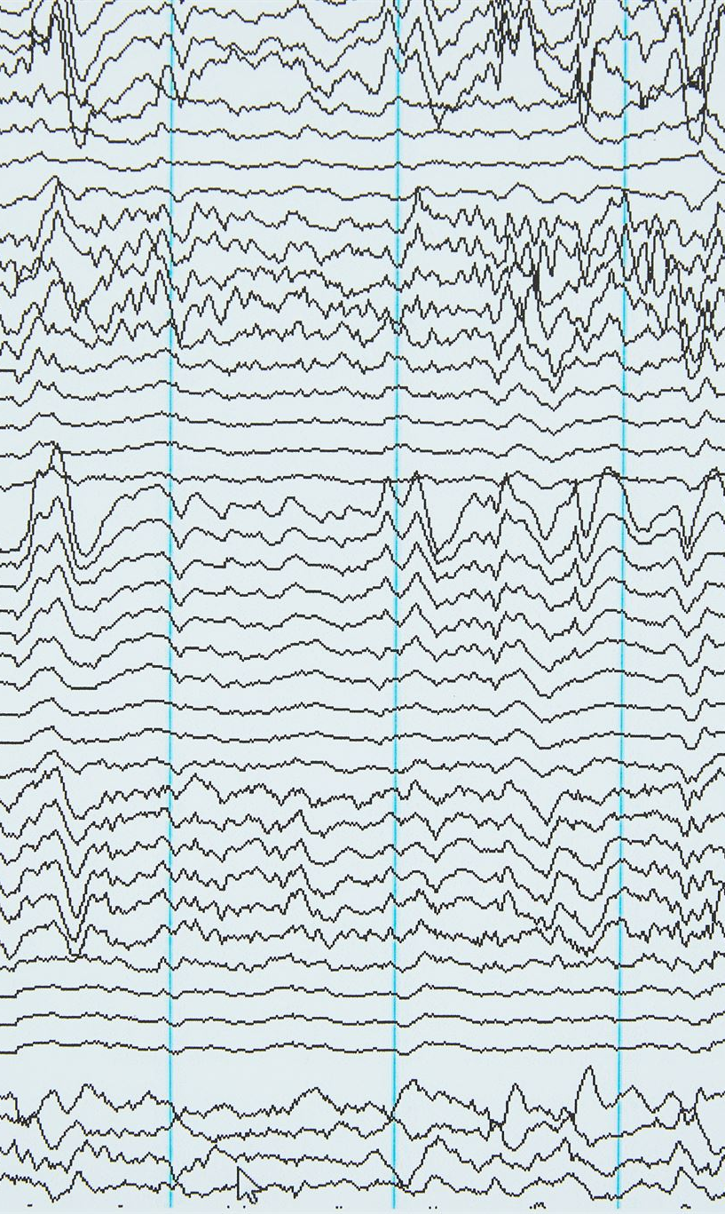
Paper 2: Kumaravel et al. (2022) — NEAR
Newborn EEG artifact-removal pipeline
Dataset / problem
Newborn and infant EEG; simulated and real developmental EEG
Recordings are short, noisy, and affected by movement
Artifacts / noise
Movement artifacts, bad/flat channels, unstable electrode contact
Non-stereotyped newborn artifacts
Pipeline / approach
Filtering → segmentation
LOF bad-channel detection
ASR artifact removal → interpolation → re-referencing
Notes:
The EEGdenoiseNet paper focuses primarily on two major physiological artifact types: ocular artifacts and muscular, or myogenic, artifacts. Ocular artifacts are caused by eye blinks and eye movements, which generate strong electrical potentials due to the dipole formed by the cornea and retina. These artifacts typically appear as large-amplitude, low-frequency deflections, most prominently in frontal EEG channels such as Fp1 and Fp2. Muscular artifacts, on the other hand, originate from electrical activity in muscles of the face, jaw, neck, or scalp. They tend to have a broad frequency spectrum and often contribute high-frequency components that overlap with neural beta and gamma bands, making them particularly difficult to remove using simple frequency-based filters. Zhang et al. review several traditional artifact-removal approaches, including regression-based correction using reference channels, adaptive filtering techniques that adjust filter parameters over time, and blind source separation (BSS) methods such as independent component analysis (ICA). However, the main emphasis of the paper is on deep learning approaches. The authors benchmark multiple neural network architectures, including fully connected neural networks, convolutional neural networks, residual convolutional networks, and recurrent neural networks with long short-term memory units. These models learn a direct mapping from contaminated EEG to clean EEG in a supervised manner. The results demonstrate that deep learning methods can outperform traditional techniques under controlled conditions, particularly when sufficient training data are available. This paper therefore illustrates both the potential and the limitations of data-driven EEG denoising, highlighting the importance of matching algorithm complexity with dataset quality and size.

Slide 9
Paper 3: Arpaia et al. (2025) — Wearable EEG Review
Notes:
Wearable EEG: Artifact Taxonomy and Challenges, Methods and Evaluation Metrics in Wearable EEG Studies

Slide 10
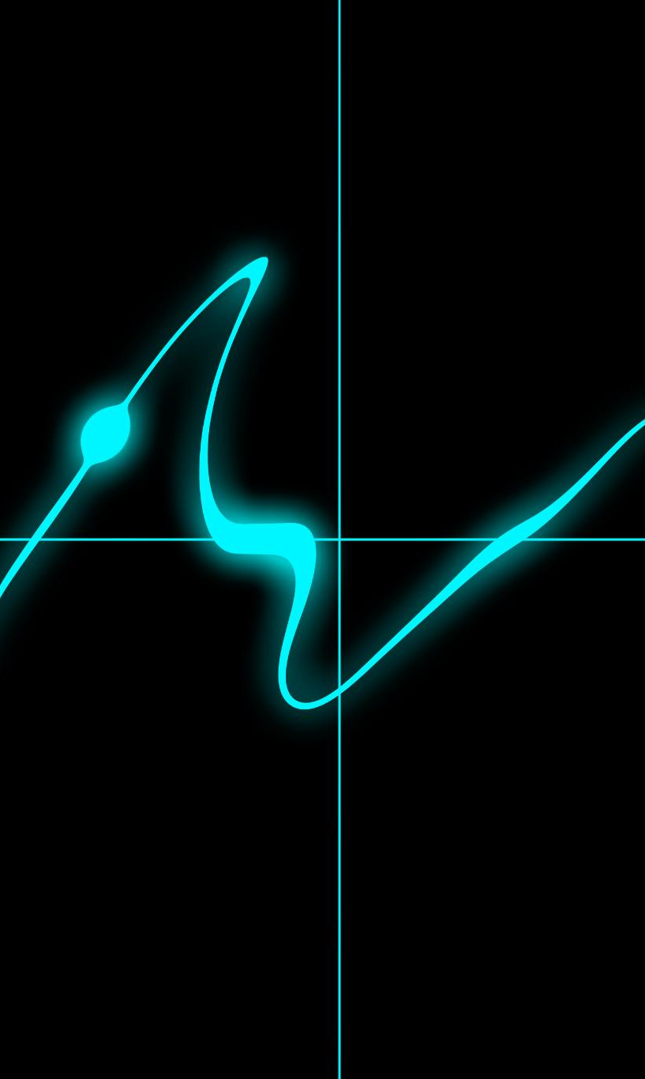
Paper 3: Arpaia et al. (2025) — Wearable EEG Review
Systematic review of wearable EEG artifact detection
Dataset / scope
Systematic review, not one dataset
58 studies on wearable EEG artifact detection
Artifacts / noise
Ocular, muscular, movement, instrumental, cardiac artifacts
Electromagnetic interference / power-line noise
Reviewed methods
Filtering, ICA/BSS, wavelets, EMD, ASR
Machine learning and deep learning
Notes:
The NEAR pipeline, which stands for Newborn EEG Artifact Removal, is designed as a complete, multi-step preprocessing workflow rather than a single algorithm. A central component of NEAR is automatic bad-channel detection using the Local Outlier Factor (LOF) algorithm. LOF is an unsupervised, density-based outlier detection method that identifies data points—or, in this case, EEG channels—that behave very differently from their neighbors. Channels with abnormal amplitude distributions, excessive noise, or flat signals are flagged as outliers and marked as bad. This approach is more adaptive than simple global thresholding, which can be too strict or too lenient in noisy newborn recordings. After bad channels are identified, NEAR applies Artifact Subspace Reconstruction (ASR) to address transient, high-amplitude artifacts. ASR works by learning the statistical properties of relatively clean EEG data and then identifying time windows or subspaces that deviate strongly from this reference. These contaminated segments can be corrected or removed, depending on parameter settings. A critical parameter in ASR is the cutoff value, often denoted as k, which controls how aggressively artifacts are removed. Kumaravel et al. emphasize that this parameter must be calibrated for the specific dataset and population, as default values may not be appropriate for newborn EEG. Following ASR, bad channels are interpolated using neighboring electrodes, and the data are re-referenced. The NEAR pipeline demonstrates that effective artifact removal requires coordinated handling of channel quality, transient artifacts, and signal reconstruction.

Slide 11
Paper 4: Zangeneh Soroush et al. (2022) — Hybrid Artifact Removal
Notes:
Hybrid Pipeline Using SOBI, Nonlinear Dynamics, and Machine Learning, Stationary Wavelet Transform and Key Lessons

Slide 12
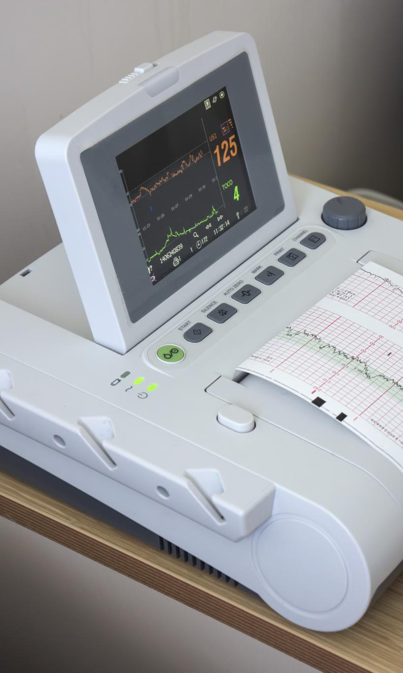
Paper 4: Zangeneh Soroush et al. (2022)
Hybrid artifact removal: SOBI + nonlinear features + ML + SWT
Dataset / evaluation
Simulated EEG, semi-simulated EEG, and real EEG recordings
Evaluated with quantitative metrics and visual inspection
Artifacts / noise
ECG, EMG, EOG, eye blinking, white noise
Pipeline / approach
SOBI source separation
Nonlinear feature extraction + ML component classification
SWT wavelet denoising → EEG reconstruction
Notes:
Kumaravel et al. (2022) focus on a particularly challenging EEG application: recordings from human newborns. Newborn EEG differs substantially from adult laboratory EEG in several important ways. First, recordings are typically short because infants cannot remain still or attentive for long periods. Second, newborns move unpredictably, producing frequent and often severe artifacts due to head movement, limb movement, frowning, sucking, or changes in posture. Third, electrode contact is often unstable, leading to bad or flat channels and sudden amplitude jumps. A key concept emphasized in this paper is that many newborn artifacts are non-stereotyped. Unlike eye blinks in adults, which tend to have a consistent shape and spatial distribution, newborn movement artifacts can vary widely from event to event. This variability reduces the effectiveness of traditional ICA-based methods, which rely on repeated, statistically independent sources. As a result, standard adult EEG preprocessing pipelines often perform poorly on newborn data. The authors argue that artifact removal in this context must be robust, adaptive, and capable of handling transient, high-amplitude disturbances without relying heavily on assumptions about artifact structure. This motivation leads to the development of NEAR, a dedicated preprocessing pipeline tailored specifically to the characteristics of newborn EEG. In the broader literature overview, this paper highlights the importance of adapting artifact-removal strategies to the population and recording conditions, rather than assuming that a single adult-oriented pipeline will generalize to all EEG scenarios.

Slide 13
Implementation
EEG noise-removal pipeline
Focus: exact dataset justification → preprocessing → synthetic artifacts → bad-channel detection/interpolation → ICA blink removal
LP Praktikum Informatik 1 | Updated Implementation | 1

Slide 14
Dataset Used: S001R01.edf
Exact data description and justification
Source and exact experiment
PhysioNet EEG Motor Movement/Imagery Dataset (EEGMMIDB)
File: S001R01.edf → Subject 1, Run 1
Run 1 = baseline eyes-open recording
64 EEG channels, 160 Hz sampling rate, ~61 seconds duration
Why this data?
Public, small, MNE-compatible, realistic multichannel EEG
Suitable for demonstrating preprocessing steps without task-classification complexity
Important limitation
No labeled EOG/EMG/bad-channel artifacts; original sample mainly supports line-noise/basic filtering demonstration
Solution to limitation: controlled synthetic artifacts were added for blink, muscle noise, flat channel, and noisy channel demonstrations.
LP Praktikum Informatik 1 | Updated Implementation | 2

Slide 15
Pipeline
Parts 4–12 of the notebook
Raw inspection
Filter + notch + CAR
Synthetic artifacts
Global bad-channel metrics
Epoch-wise bad detection
Persistent bad channels
ICA blink removal
Interpolation
LP Praktikum Informatik 1 | Updated Implementation | 3

Slide 16
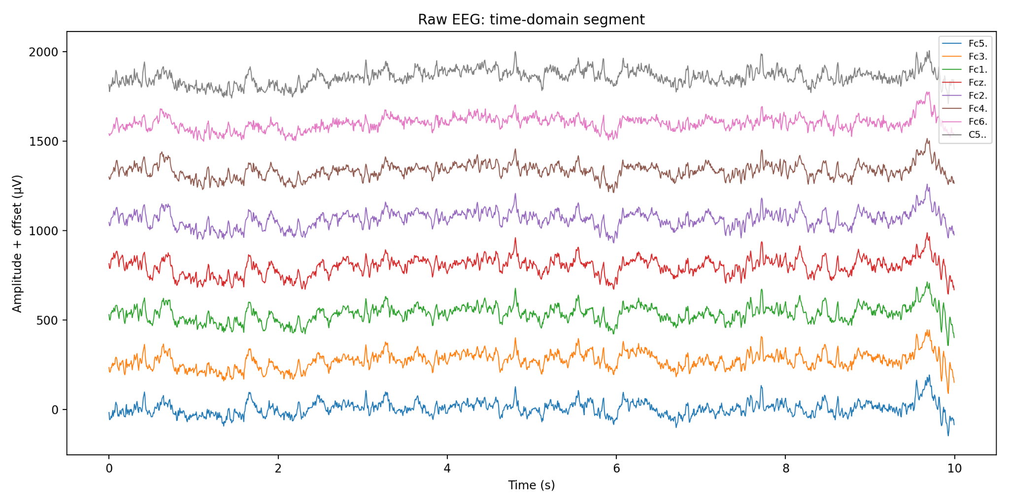
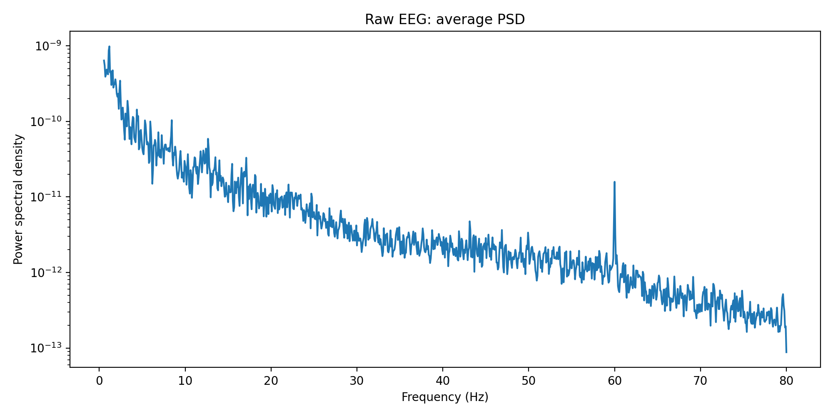
Raw Data Inspection
Original EEG before preprocessing
Time-domain plot
Shows selected EEG channels over time.
“Amplitude + offset” means channels are vertically shifted only for readability.
PSD plot
Shows power distribution over frequencies.
Raw PSD helps identify line noise and high-frequency components before filtering.
Takeaway: raw inspection justifies the next preprocessing steps and shows why both time-domain and frequency-domain views are useful.
LP Praktikum Informatik 1 | Updated Implementation | 4

Slide 17
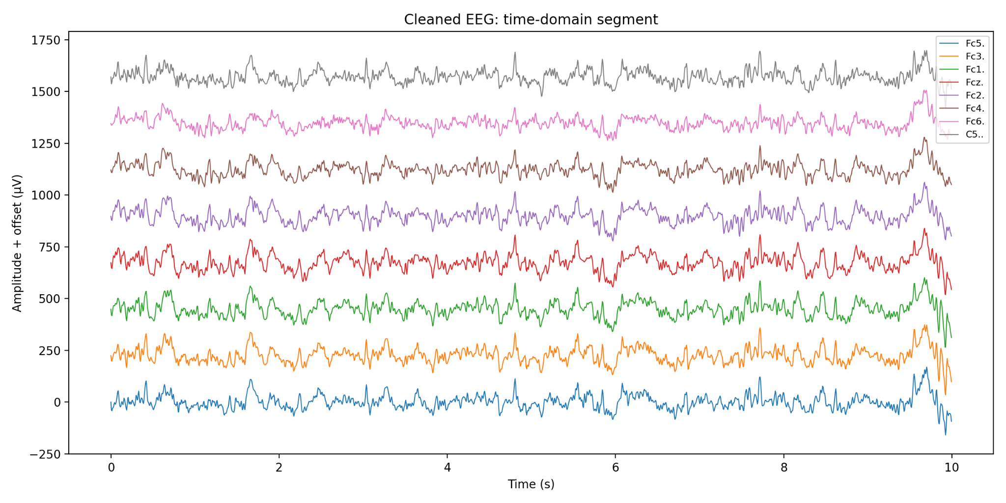
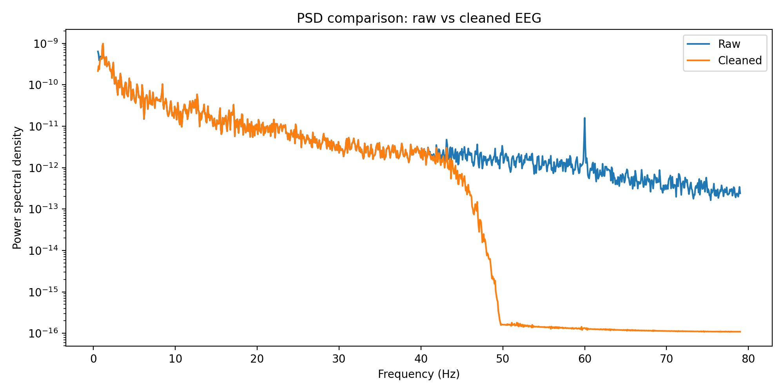
Basic Preprocessing
1–40 Hz band-pass + 50 Hz notch + common average reference
Operations applied
1 Hz high-pass: reduces slow drift / baseline movement.
40 Hz low-pass: suppresses high-frequency noise and muscle-like activity.
50 Hz notch: included as standard power-line-noise step.
Common average reference: subtracts average EEG activity from all channels.
Observation
PSD shows strong attenuation above the 40 Hz low-pass region.
Note: The dataset shows a visible peak around 60 Hz. With a 40 Hz low-pass, this region is already strongly attenuated; a 60 Hz notch would be more targeted if preserving >40 Hz frequencies was needed.
LP Praktikum Informatik 1 | Updated Implementation | 5

Slide 18
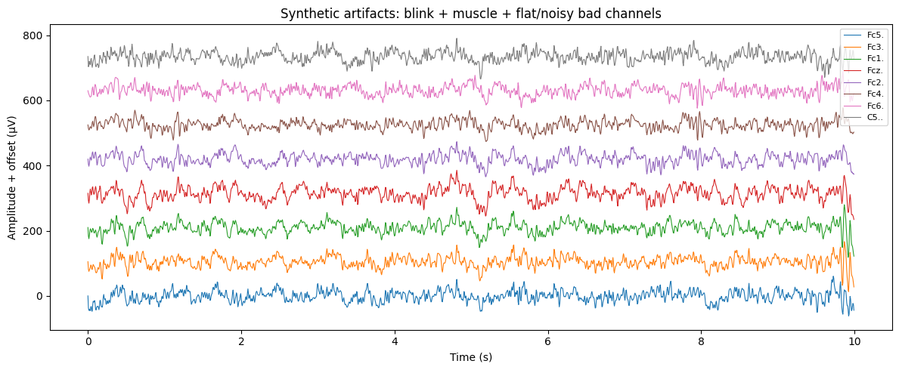
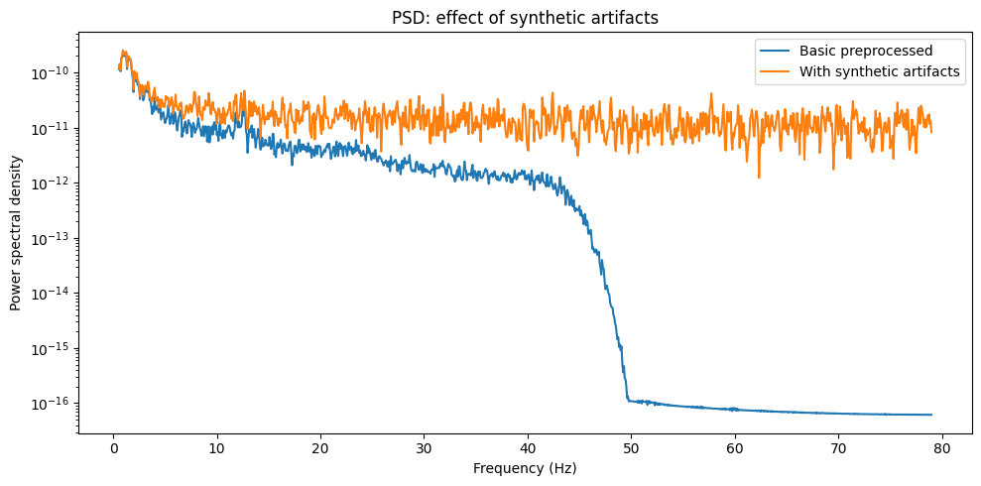
Synthetic Artifact Demonstration
Controlled artifacts added because the original file has no labeled artifact examples
Why synthetic artifacts?
Original S001R01.edf is baseline eyes-open and not labeled for EOG/EMG/bad-channel examples.
Synthetic artifacts allow controlled before/after demonstration.
Added artifacts
Blink-like slow wave → frontal channels Fp1, Fpz, Fp2.
Muscle-like high-frequency noise → temporal channels T7, T8, FT7, FT8.
Flat channel → Pz.
Noisy channel → O1.
Interpretation: synthetic artifacts increase signal power and create controlled examples for detection, interpolation, and ICA.
LP Praktikum Informatik 1 | Updated Implementation | 6

Slide 19
Global Bad-Channel Detection Metrics
Detect suspicious channels across the whole recording
Metrics per channel
Standard deviation: high = noisy; very low = flat.
Peak-to-peak amplitude: high = abnormal large swings.
Mean correlation with other channels: low = unusual behavior.
Robust z-score = 0.6745 × (value − median) / MAD.
Example output interpretation
Pz: flat synthetic channel → std = 0, peak-to-peak = 0.
O1: noisy synthetic channel → very high STD and peak-to-peak.
Fp1/Fp2/AF8: suspicious due to blink-like high-amplitude frontal activity.
Important distinction: “suspicious” does not always mean broken electrode. Blink-contaminated frontal channels should usually be handled by ICA, not interpolation.
LP Praktikum Informatik 1 | Updated Implementation | 7

Slide 20
Epoch-Wise Bad-Channel / Bad-Epoch Detection
Automatically tag channel-epoch pairs and full bad epochs
Method
Continuous EEG is split into 2-second epochs.
For each channel in each epoch: STD, peak-to-peak, and correlation with median signal are computed.
A channel is bad in an epoch if it is flat, noisy, high-amplitude, or poorly correlated.
An entire epoch is bad if >20% of channels are bad.
Observed output
30 epochs from ~61 seconds of EEG.
109 bad channel-epoch pairs.
Bad epochs: none → artifacts are local channel problems, not whole-recording failures.
LP Praktikum Informatik 1 | Updated Implementation | 8

Slide 21
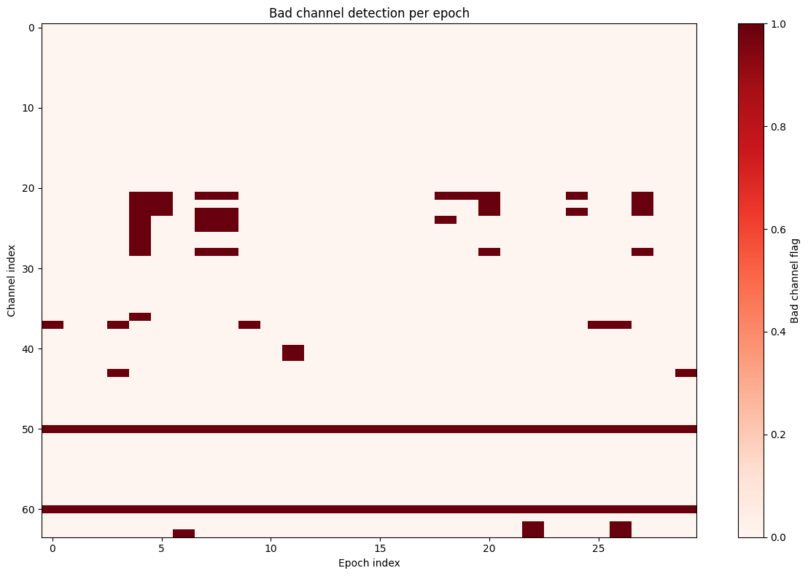
Visualizing Epoch-Wise Detection
Heatmap of bad channel flags over time
How to read the heatmap
x-axis = epoch index; y-axis = channel index.
Red = channel marked bad in that epoch; light = channel normal.
Horizontal red lines = persistent bad channels.
Scattered red blocks = temporary channel-specific artifacts.
No full vertical red bands = no full bad epochs.
LP Praktikum Informatik 1 | Updated Implementation | 9

Slide 22
Persistent Bad Channels
Deciding which channels are bad often enough to interpolate
Definition
A persistent bad channel is bad in more than 30% of epochs.
With 30 epochs, this means bad in more than ~9 epochs.
Why this step matters
Prevents interpolating a good channel because of one temporary artifact.
Separates temporary artifacts from structural/persistent channel problems.
Expected result in the synthetic example
Pz: flat channel → persistent.
O1: noisy channel → persistent.
Blink-affected frontal channels should usually go to ICA, not interpolation.
LP Praktikum Informatik 1 | Updated Implementation | 10

Slide 23
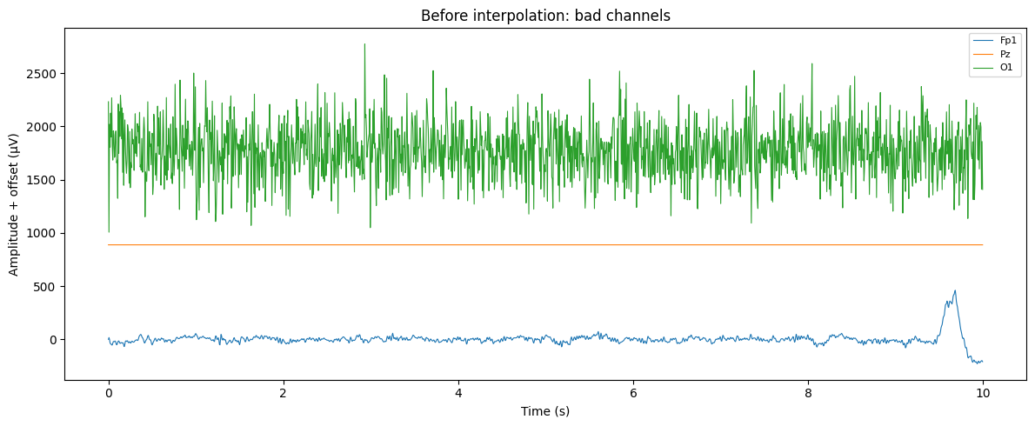
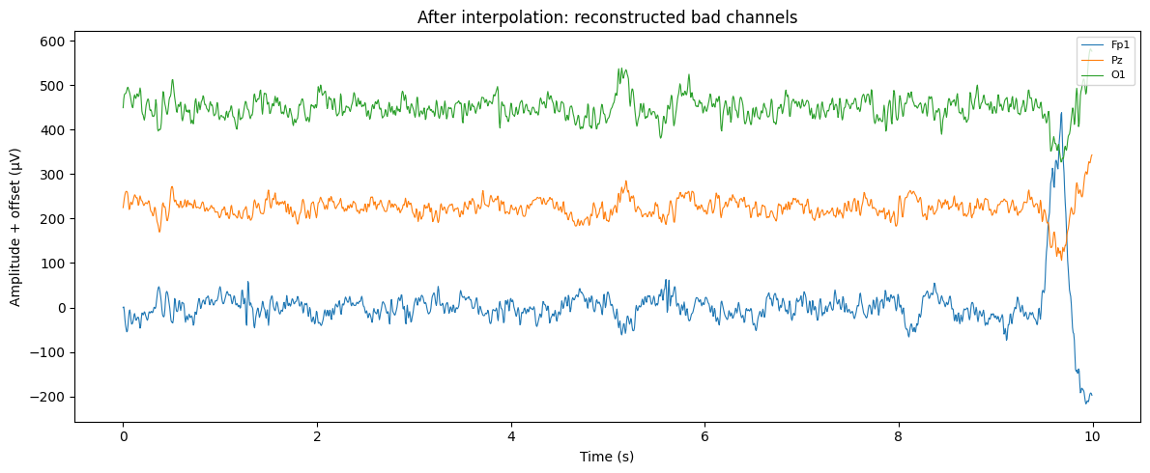
Bad-Channel Interpolation
Reconstruct structural/persistent bad channels from neighboring electrodes
Interpolation idea
Bad channel signal is estimated from neighboring good electrodes.
Requires montage/electrode positions; channel names were cleaned to match standard_1020 montage.
Example
Before: Pz is flat, O1 is extremely noisy, Fp1 has blink-like high amplitude.
After: bad channels are reconstructed and MNE bad list is reset.
Caveat
Pz/O1 are good interpolation examples; Fp1 is more artifact-contaminated and better handled with ICA in a real pipeline.
LP Praktikum Informatik 1 | Updated Implementation | 11

Slide 24
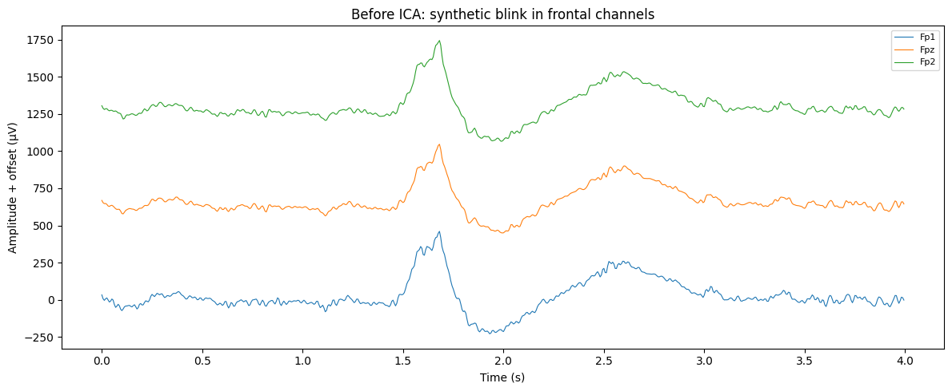
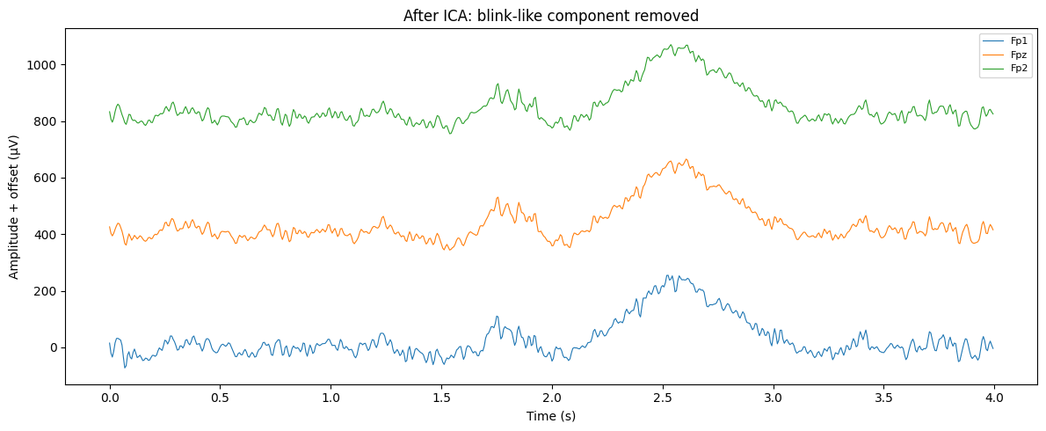
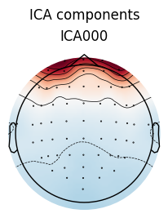
ICA Blink-Removal Example
Component-based removal of a synthetic frontal blink
How ICA is used
Add synthetic blink to Fp1, Fpz, Fp2.
Run ICA on multichannel EEG.
Select component most correlated with the frontal blink signal.
Remove that component and reconstruct EEG.
Interpretation
Blink-like ICA component should show a strong frontal topography.
After removal, the large frontal blink deflection is reduced.
LP Praktikum Informatik 1 | Updated Implementation | 12

Slide 25
Summary
1- Dataset
2- Preprocessing / Demonstration Pipeline
Raw EEG + PSD inspection
1–40 Hz band-pass + 50 Hz notch
Common Average Reference
Synthetic blink / muscle / bad-channel examples
Global channel-quality metrics
Epoch-wise bad-channel detection
Persistent bad-channel selection
Bad-channel interpolation
ICA blink-component removal
S001R01.edf
PhysioNet EEGMMIDB
64 EEG channels, 160 Hz, ~61 s
Baseline eyes-open recording
3- Main Outputs
Before/after time-domain plots
Before/after PSD plots
Bad-channel epoch heatmap
Interpolation comparison
ICA before/after comparison
EEG preprocessing: inspect → filter / re-reference → detect → interpolate / remove → compare
LP Praktikum Informatik 1 | Updated Implementation | 13

