Slide 1
Post-training: Instruction Tuning, Alignment, and Test-Time Compute

Slide 2
Why Post-training Matters
- Base LLMs are trained only to predict the next token
- They often ignore instructions, hallucinate, or generate harmful content
Post-training makes models more helpful, safe, and controllable

Slide 3
Two Core Problems of Base Models
- Not sufficiently helpful: fail to follow user instructions
- Not sufficiently safe: may produce harmful, false, or toxic outputs
Post-training aligns model behavior with human goals

Slide 4
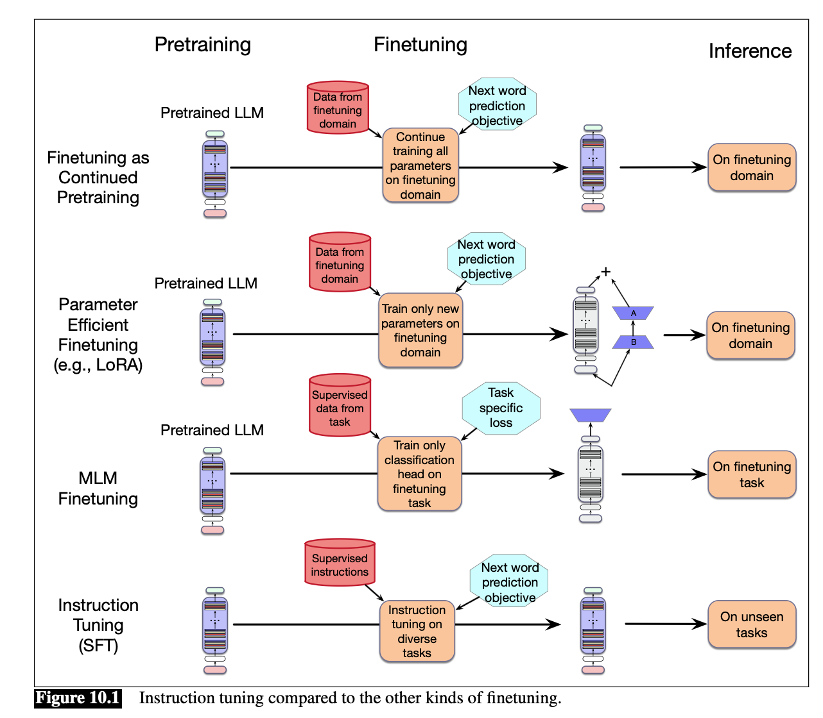
Instruction Tuning Compared to Other Finetuning Methods

Slide 5
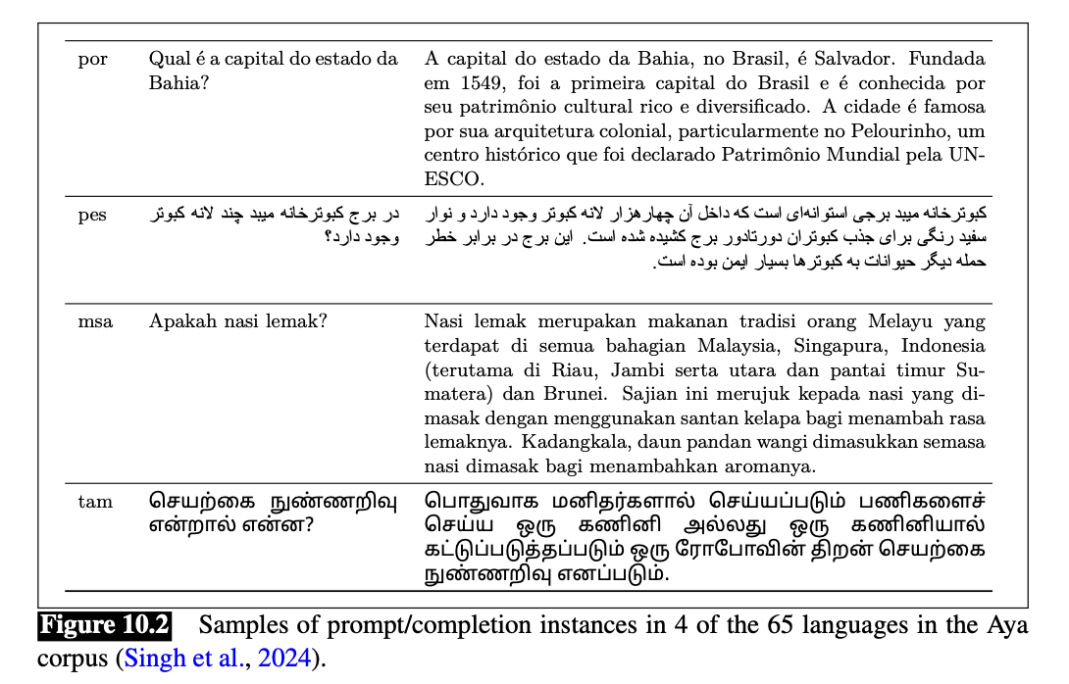
Instruction Examples from the Aya Dataset
Instruction Tuning (SFT)
Finetune a pretrained model on instruction-response pairs
Still uses the next-token prediction objective
The model learns to follow instructions across many tasks

Slide 6
Where Instruction Data Comes From
Evaluating Instruction-Tuned Models
- Human-written instructions and demonstrations
- Existing NLP datasets converted into prompts
- Crowdsourcing guidelines reused as prompts
- Synthetic instructions generated by language models
- Goal: generalize to unseen tasks
- Leave-one-task-cluster-out evaluation
- Held-out task families test true instruction following

Slide 7
Learning from Preferences
Preference Data
- Instruction tuning is not enough for alignment
- Preference learning teaches models what humans prefer
- Targets helpfulness, harmlessness, honesty, and correctness
- Humans compare alternative model outputs
- Data may come from annotators, social media votes, or other LLMs
- Chosen response vs rejected response creates supervision
Bradley-Terry Preference Model
Reward Models
- Preference probability is modeled using a logistic sigmoid
- The preferred output should receive a higher reward score
- Differences in reward scores determine preference probabilities
- A reward model predicts how good a response is Initialize from a pretrained LLM
- Replace the language-model head with a scalar reward head

Slide 8
Reward Model Loss
- Train with cross-entropy over chosen vs rejected responses
- The loss encourages preferred outputs to get higher scores
- This reward signal is later used for alignment
RLHF Pipeline
Step 1: Start with a pretrained base model
Step 2: Apply supervised finetuning (SFT)
Step 3: Train a reward model from preferences
Step 4: Optimize the aligned model with reinforcement learning
Direct Preference Optimization (DPO)
- Alternative to RLHF
- Optimizes preferences directly without explicit RL
- Often simpler and more stable than PPO-based RLHF

Slide 9
Test-Time Compute
- Extra computation at inference can improve quality
- Examples: chain-of-thought, self-consistency, tree search
- No retraining required
Chain-of-Thought Reasoning
- Prompt the model to reason step by step
- Improves arithmetic, logic, and planning tasks
- Encourages explicit intermediate reasoning
Tradeoffs in Post-training
- Better alignment improves helpfulness and safety
- More compute increases latency and cost
- Practical systems balance quality, speed, and reliability

Slide 10
Key Takeaway
- Pretraining creates a language model
- Post-training creates an assistant
- Instruction tuning, alignment, and test-time compute are all essential

