Slide 1
Introduction to Network Theory and Methods
Michael T. Heaney
University of Michigan
June 14, 2017
10th Annual Political Networks Conference
and Workshops
The ohio state university, Columbus, ohio

Slide 2
Objectives for Today
Understand what network analysis is
Overview methodological approaches
Introduce basic concepts
Introduce major theories
Consider trends
Please ask LOTS of questions!

Slide 3
Introduction

Slide 4
Introduction
Definition
Motivation
Data Gathering
Relational Thinking

Slide 5
What Are Networks?
Networks are patterns of relationships that connect individuals, institutions, or objects (or leave them disconnected).

Slide 6
What Are Networks?
Networks are patterns of relationships that connect individuals, institutions, or objects (or leave them disconnected).
EXAMPLES
The lineage of a family
Giving and receiving grooming among gorillas
Patterns of contracts among firms
Individuals’ co-memberships in organizations
A computer system that allows people to form friendships or meet potential mates

Slide 7
Why Study Networks?
Networks are substantive phenomena we care about (e.g., Facebook, a health care network, a policy network)
We may theorize that access to networks affects an outcome we care about (e.g., Does access to social support through family networks affect mothers’ success in raising their infants?)
Network analysis may provide a methodological approach that solves a research problem (e.g., Which worker at an office has access to the most timely information?)

Slide 8
When to Study Networks?
All human activity is embedded within networks, so anything could be studied using network analysis.

Slide 9
When to Study Networks?
All human activity is embedded within networks, so anything could be studied using network analysis.
But just because network analysis is possible does not mean that it is desirable.

Slide 10
When to Study Networks?
All human activity is embedded within networks, so anything could be studied using network analysis.
But just because network analysis is possible does not mean that it is desirable.
The question we want to ask is: When in the network aspect of phenomenon particularly pertinent to the social dynamics that matter to us?

Slide 11
Some Good Opportunities for Network Analysis
When then the informal organization of a system competes with or replaces formal organization

Slide 12
Some Good Opportunities for Network Analysis
When then the informal organization of a system competes with or replaces formal organization
When formal organization has multiple levels or complex formal inter-relationships (e.g., government agency interaction in a federal system)

Slide 13
Some Good Opportunities for Network Analysis
When then the informal organization of a system competes with or replaces formal organization
When formal organization has multiple levels or complex formal inter-relationships (e.g., government agency interaction in a federal system)
When access to information is especially important to the outcomes in question (e.g., understanding why some voters switch their candidate preferences during an election)

Slide 14
Some Good Opportunities for Network Analysis
When then the informal organization of a system competes with or replaces formal organization
When formal organization has multiple levels or complex formal inter-relationships (e.g., government agency interaction in a federal system)
When access to information is especially important to the outcomes in question (e.g., understanding why some voters switch their candidate preferences during an election)
Coordination, cooperation, or trust is a key part of a process (e.g., understanding the composition of cross-party coalitions among legislators)

Slide 15
Some Good Opportunities for Network Analysis
When then the informal organization of a system competes with or replaces formal organization
When formal organization has multiple levels or complex formal inter-relationships (e.g., government agency interaction in a federal system)
When access to information is especially important to the outcomes in question (e.g., understanding why some voters switch their candidate preferences during an election)
Coordination, cooperation, or trust is a key part of a process (e.g., understanding the composition of cross-party coalitions among legislators)
When social status is a dominant motivation for behavior

Slide 16
Data-gathering Approaches
Multiple data-gathering approaches are valid:
Ethnography
Interviews
Surveys
Experiments
Archival analysis (which includes web crawling)

Slide 17
Example: Ethnography
Mario Luis Small, Unanticipated Gains: Origins of Network Inequality in Everyday Life (Oxford 2009)
Observation of and interviews with mothers whose children were enrolled in New York City childcare centers. Qualitative analysis.
Argues that “how much people gain from their networks depends fundamentally on the organizations in which those networks are embedded.” (iv)
Networks matter not only because of size, but because of “the nature, quality, and usefulness of people’s networks.”
Demonstrates the development of social capital.

Slide 18
Example: Interviews
Mildred A. Schwartz, The Party Network: The Robust Organization of Illinois Republicans (Wisconsin, 1990).
Interviews with 200 informants within the Illinois Republican Party. One-hour interviews repeated up to three times with each informant.
Argues that although hierarchy is a part of a party structure, they do not function as a single hierarchy or oligarchy. They are decentralized and loosely coupled.
Networks are critical to party adaptation over time.

Slide 19
Example: Surveys
Mark Granovetter, Getting a Job: A Study of Contacts and Careers (Chicago, 1974)
A random sample of residents of Newton, Massachusetts. Asked for information about how they learned about job opportunities.
Found that new information about job opportunities was more likely to be obtained by people with who respondents had “weak ties” rather than “strong ties.”
“Weak ties” are more useful for communicating new information, while “strong ties” tend to communicate redundant information.

Slide 20
Example: Experiments
David W. Nickerson, “Is voting contagious? Evidence from two field experiments,” American Political Science Review (February 2008).
A field experiment within two different get-out-the-vote campaigns. Examined how the voting behavior of other persons in a household is affected by communication with one person in the household.
Found that 60% of the increased propensity to vote (from the get-out-the-vote campaign) is passed onto the other member of the household.

Slide 21
Example: Archival Analysis
John W. Mohr, “Soldiers, Mothers, Tramps and Others: Discourse Roles in the 1907 New York City Charity Directory,” Poetics (June 1994).
Examined types of eligible clients in the 1907 New York City Charity Directory. Examined how identities emerged based on similarities of which social categories were grouped together.
Treatment depended on whether status was achieved (e.g., soldiers) or ascribed (e.g., mothers). Distinctions were commonly made based on deservingness and gender.

Slide 22
Methods of Analysis Vary
Qualitative
Observe how some actors use their networks differently than others.
Graphical
Graph a network structure and talk about its implications.
Quantitative – Descriptive
Describe the size of networks and what types of actors are contained in them.
Quantitative – Analytical
Include measures of network structure as independent variables in regression analysis.
Make the existence of a network tie the dependent variable in a regression.
Test whether theoretical construction of a network is consistent with its empirical realization (e.g., should a network be centralized, decentralized?)

Slide 23
Relational Thinking
Much of social science emphasizes the individual as a unit of analysis.
Why do some nations fight more wars than others?
Network analysis tends to place a strong emphasis on the relationship (or “the dyad”) as a unit of analysis.
Why explains whether nations A and B fight wars with one another?
It is sometimes difficult to get our minds around a relational approach to theorizing.
Individual thinking: “It’s not you, its me.”
Relational thinking: “Its neither you nor me, it’s us.”
Mustafa Emirbayer, “Manifesto for a Relational Sociology” American
Journal of Sociology (September 1997).

Slide 24
Questions / Comments ?

Slide 25
Key Concepts

Slide 26
Key Concepts
Graphs
Matrices
Modes
Basic Network Statistics

Slide 27
Graphs

Slide 28
Graphs
Social networks can be represented as graphs.
Graphs are made up of nodes (i.e., actors) that are connected by links (i.e., relationships).
LINK
NODE

Slide 29
Nodes and Links
Node = Point, Vertex, Actor, Individual
Examples: Person, Nation-State, City, Organization, Word, Article
Link = Line, Edge, Tie, Connection, Relationship
Examples: Communication, Animosity, Citation, Marriage, Sex, Fighting a War, Co-membership

Slide 30
Types of Links
Undirected vs. directed links
Dichotomous vs. Valued Links

Slide 31
Undirected Links
Undirected links, denoted with a simple straight line, are used whenever it is impossible that there is asymmetry in a relationship. The relationship is inherently symmetric.
If A is married to B, then B must be married to A. It is not possible for A to be married to B without B being married to A.
A
B

Slide 32
Directed Links
Directed links, denoted with arrowheads, are used whenever it is possible that there is asymmetry in a relationship:
A gives money to B, but B gives nothing to A.
B gives money to A, but A gives nothing to B.
A and B give money to each other.
A
B
A
B
A
B

Slide 33
Dichotomous vs. Valued Links
Dichotomous – either a link exists or it doesn’t (e.g., either we are friends or we’re not, either two nations are at war or they’re not, either we are married or we are not). Represent with the presence of a line:
Valued – links vary in their strength (e.g., our friendship may be strong or weak; we may have one friend in common or 3). Represent with varied line formats:

Slide 34
Complete Graphs and Connectivity
Complete Graph – all possible ties exist:
Not a Complete Graph, but a Connected Graph
Not a Connected Graph

Slide 35
Components
Component – the set of all points that constitutes a connected subgraph within a network
Main component – the largest component within a network
Minor component – a component that is smaller than the main component – there may be many minor components

Slide 36
Components
MINOR COMPONENT
MAJOR COMPONENT

Slide 37
Pendants and Isolates
Pendant – a node that only as one link to a network
Isolate – a node that has no links to a network

Slide 38
Key Parts of a Graph
MINOR COMPONENT
PENDANT
ISOLATE
MAJOR COMPONENT

Slide 39
Matrices

Slide 40
Matrices
Networks may be represented as matrices
The most basic matrix is an adjacency matrix
A 1 indicates the presence of a link, while a 0 indicates the absence of a link.
 | Fabio | Riham | Ayshea | Vikram
Fabio | 1 | 0 | 1 | 0
Riham | 0 | 1 | 1 | 0
Ayshea | 1 | 1 | 1 | 0
Vikram | 0 | 0 | 0 | 1

Slide 41
Symmetric Matrices
If matrices are symmetric, they may be represented by upper or lower triangle only.
The diagonal may be omitted in this case because it is reflexive.
 | Fabio | Riham | Ayshea | Vikram
Fabio
Riham | 0
Ayshea | 1 | 1
Vikram | 0 | 0 | 0

Slide 42
Modes

Slide 43
Modes
A mode is a class of nodes in a network.
Network analysis typically involves only one mode.
For example, friendships among a group of students would usually be modeled using one mode.

Slide 44
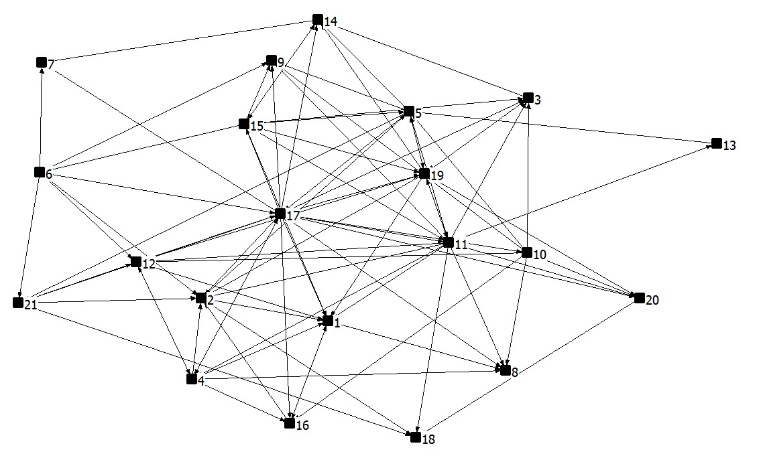
Example: One-Mode Network
Friendship Network of workers at a high-tech company (Krackhardt 1992)

Slide 45
Two Modes
Sometimes we want to know how one class of nodes relates to another class of nodes.
Examples:
Mode 1 | Mode 2
Mentor | Mentee
People | Events
Citizens | Civic Organizations
Interest Groups | Coalitions
Legislators | Caucuses
Nation States | Treaties

Slide 46
One-Mode vs. Two-Mode Models
One-mode models are simpler and more parsimonious.
Two-mode data are more realistic but less parsimonious
We want to think about the trade offs of modeling our data using one mode versus two modes.

Slide 47
From Two Modes to One Mode
Ronald L. Breiger, "The Duality of Persons and Groups," Social Forces (1974).
If data have two modes, it is possible to reduce the dimensionality of the data using either mode.
Example: If two-mode data have people (Mode X) and organizations (Mode Y), it is possible to reduce them to either people only or organizations only.
Mode X: People linked by their co-membership in organizations.
Mode Y: Organizations linked by common members.

Slide 48
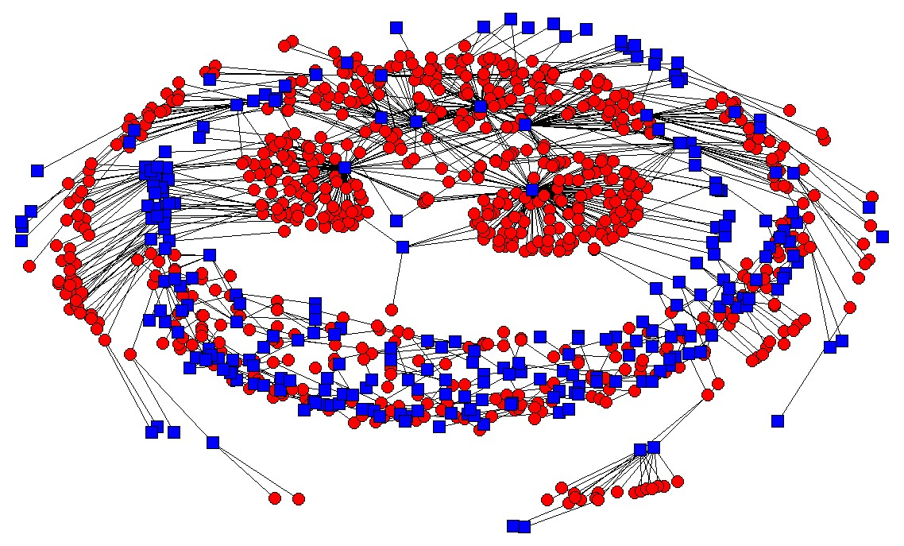
Example: People and Organizations in the Antiwar Movement
Two-mode network (Circles=People; Squares=Orgs)

Slide 49
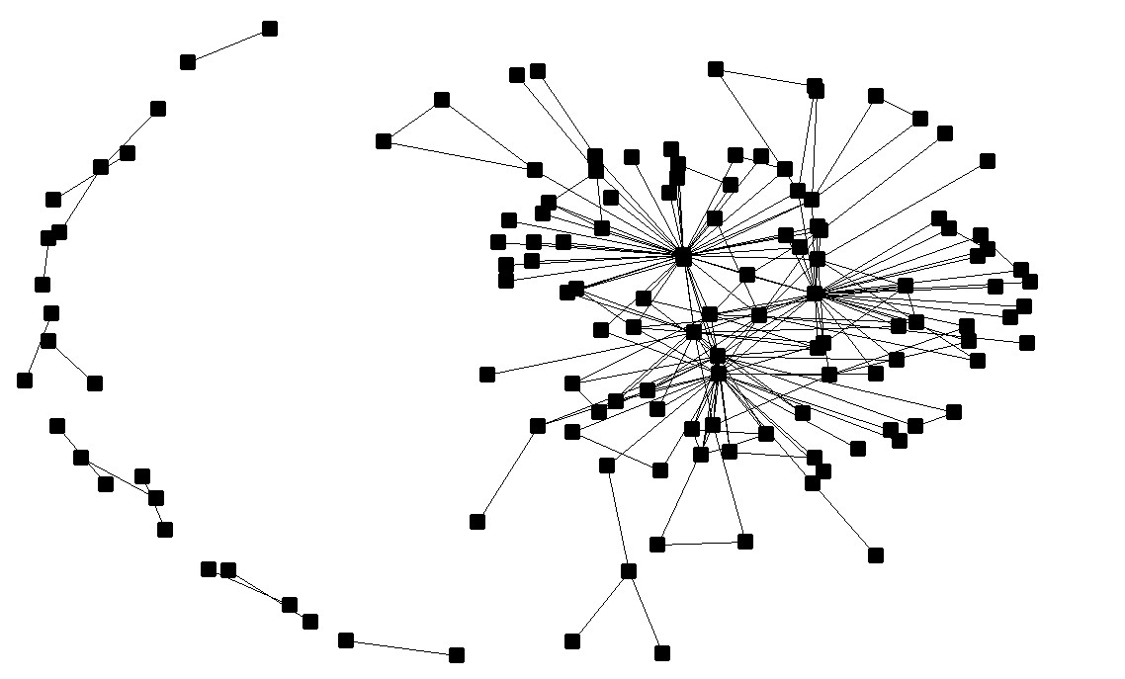
Organizations Linked by Common Members
One-Mode Network

Slide 50
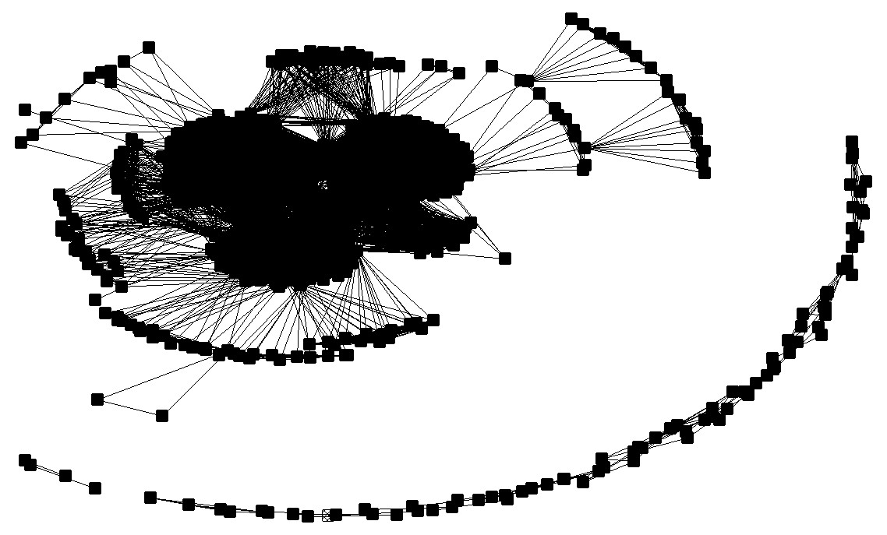
People linked by Organizational Co-membership
One-mode network

Slide 51
Discussion: Which Graph is Most Revealing?

Slide 52
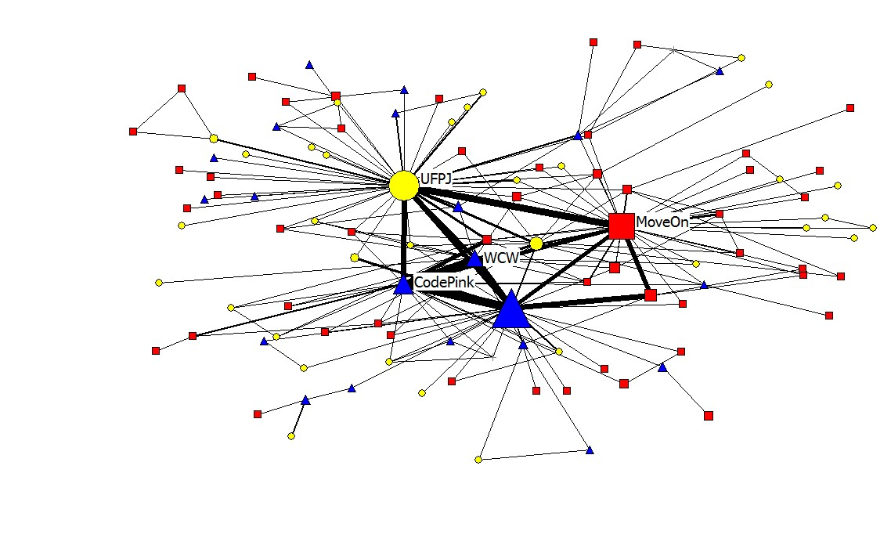
A Polished Example

Slide 53
Advantages vs. Disadvantages
Advantages of Going from 2-mode to 1-mode
Reduce the dimension of the data
Make it easier to visualize
Focus on what really matters
Disadvantages of going from 2-mode to 1-mode
Lose information
Confuse the reader
Eliminate the important relationships
Depends entirely on your case

Slide 54
Converting Data From One Mode to Two Modes
Try it by hand – it’s easy!
 | Calculus | Physics | Politics | Spanish
Fabio | 1 | 1 | 0 | 0
Riham | 0 | 0 | 1 | 1
Ayshea | 0 | 1 | 1 | 0
Vikram | 1 | 1 | 0 | 1
This two-mode
network:
Can be reduced to this one-mode matrix:
Or this one:
 | Fabio | Riham | Ayshea | Vikram
Fabio
Riham
Ayshea
Vikram
 | Calculus | Physics | Politics | Spanish
Calculus
Physics
Politics
Spanish

Slide 55
Converting Data From One Mode to Two Modes
 | Calculus | Physics | Politics | Spanish
Fabio | 1 | 1 | 0 | 0
Riham | 0 | 0 | 1 | 1
Ayshea | 0 | 1 | 1 | 0
Vikram | 1 | 1 | 0 | 1
This two-mode
network:
Can be reduced to this one-mode
matrix:
 | Fabio | Riham | Ayshea | Vikram
Fabio | 2
Riham | 0 | 2
Ayshea | 1 | 1 | 2
Vikram | 2 | 1 | 1 | 3
 | Calculus | Physics | Politics | Spanish
Calculus | 2
Physics | 2 | 3
Politics | 0 | 1 | 2
Spanish | 1 | 1 | 1 | 2
Or this one:
These are affiliation networks – the valued ties can be represented as thickness.

Slide 56
Converting Data From One Mode to Two Modes
When we are working with matrices, this transformation is even easier.
One-Mode Network by Rows = Two-Mode Network * (Two-Mode Network)^{T}
One-Mode Network by Columns = (Two-Mode Network)^{T} * Two-Mode Network

Slide 57
More than Two Modes
It is possible for network data to have more than two modes.
Example
Mode 1: People
Mode 2: Organizations
Mode 3: Ideologies

Slide 58
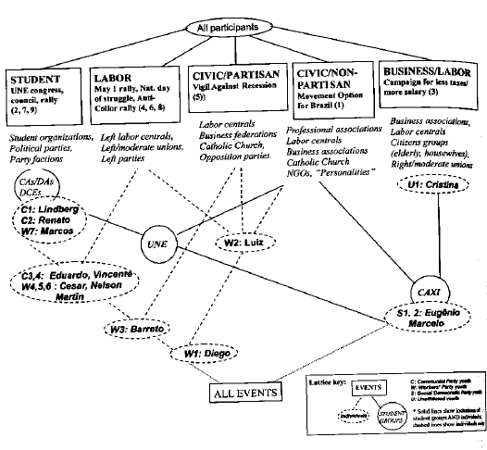
Lattices are often used to depict and analyze higher-order modal models
Ann Mische, Partisan Publics: Communication and Contention across Brazilian Youth Activist Networks (Princeton, 2008).

Slide 59
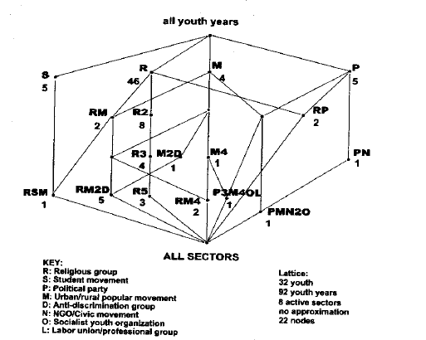
Another Lattice from Ann Mische

Slide 60
The Limits of Multi-Modal Analysis
Almost all network analysis can be conducted using when one-mode data is on hand.
In many network software programs two-mode measures (e.g., centrality) can be easily generated. But progress in this area is still moving forward.
Extant models of three-mode data is generally are confined to lattices and other relatively complex mathematical forms.
Higher-order modes are conceivable, but work needs to be done to make their analysis practical for social scientists.

Slide 61
Questions / Discussion about Modes?

Slide 62
Basic Network Statistics

Slide 63
Degree
Degree is a property of a node.
The degree of a node is equal to the number of links that it has.
Example: Person’s “degree” is the number of contacts that she or he has in a social network.
A has a degree of 5.
What is the degree of F?
B
F
C
A
E
D

Slide 64
Degree Distribution
A degree distribution a property of a network.
A degree distribution is the number of nodes of a network that have each degree level.
A degree distribution may be a good way of summarizing the activity of nodes in a network.
May be a good way of comparing networks to one another.

Slide 65
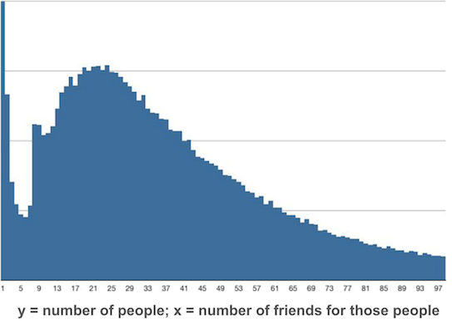
Example: Degree Distribution of Facebook Friends
http://www.deviantbits.com/blog/social-graphs-vs-interest-graphs.html

Slide 66
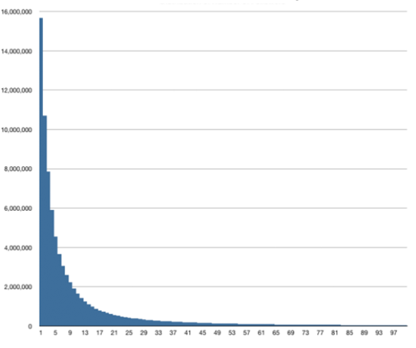
Example: Degree Distribution of Twitter Followers
http://www.deviantbits.com/blog/social-graphs-vs-interest-graphs.html

Slide 67
Indegree and Outdegree
Directed networks only
Indegree – The number of links that a node receives in a directed network (e.g., the number of people who say that I am their friend).
Outdegree – The number of links that a node sends in a directed network (e.g., the number of people who I cite as friends).
Comparing the indegree distribution and the outdegree distribution may be a good way to summarize a network, especially if there is a difference between the two. Giving a citation and receiving a citation mean very different things.

Slide 68
Indegree vs. Outdegree for Influence Cites

Slide 69
Calculating Degree
What is A’s degree What is B’s indegree,
outdegree?
A
B

Slide 70
Path
Path – route from one node to another
ABEDHG is a path from a A to G
Note that there are multiple paths from A to G.
F
G
I
A
E
B
H
C
D

Slide 71
Path Length
Path length is the number of steps in a path.
The path length of ABEDHG is 5.
F
G
I
A
E
B
H
C
D

Slide 72
Geodesic
Geodesic – the shortest path from one node to another
ABEG is the geodesic from A to G
F
G
I
A
E
B
H
C
D

Slide 73
Distance
Distance – the length of the shortest path from one node to another
This distance from A to G is 3 steps.
F
G
I
A
E
B
H
C
D

Slide 74
Geodesic vs. Distance
“Geodesic” and “Distance” are highly similar concepts, but don’t confuse them!
A geodesic is a path – e.g., DEFG.
A distance is a number – e.g., 3

Slide 75
Density
Density is a property of a network.
Density is the general level of linkage in the network
Density = # of Lines / # of lines in a complete graph
Density = # of lines / [ (n (n-1))/2 ]

Slide 76
Example of Density Calculations
Suppose a graph has 4 lines and 4 nodes
Density = 4 / [ (4 ( 4-1))/2]
= 4 / 6
= 0.66667
This graph has two-thirds of all possible links.

Slide 77
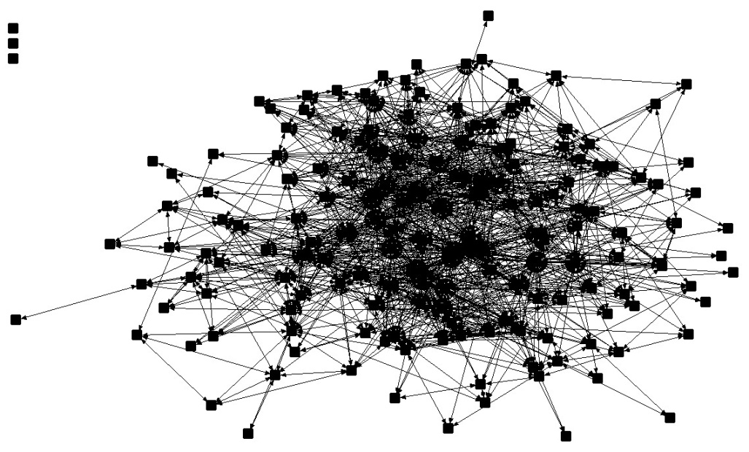
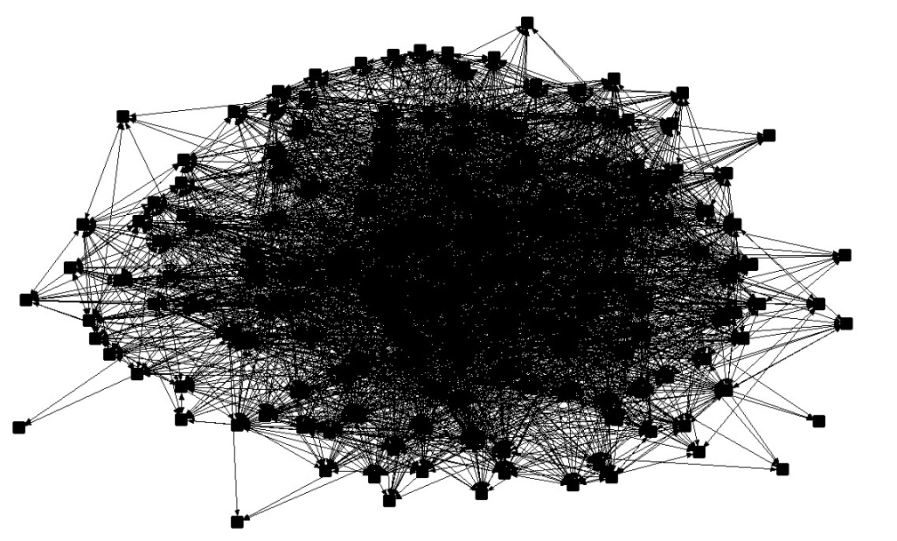
Low Density vs. High Density
Relatively Low Density
Relatively High Density
Density = 0.098
Density = 0.268
James Fowler et al., “Causality in Political Networks,” American Politics Research (March 2011).

Slide 78
Centrality vs. Centralization

Slide 79
What is Centrality?
It is a property of a node in a graph – that is, the property of an individual or unit under study.
It is a measure of the prominence of that one point relative to other points.
There are different conceptions of what it means to be “central”.

Slide 80
What is Centralization?
It is a property of the graph as a whole.
Refers to the overall cohesion or integration of the graph.
Compares most central point to all other points. Ratio of the actual sum of differences to the maximum possible sum of differences.

Slide 81
Why are Centrality and Centralization Important?
Access to information and ideas
Interaction among members of the network
Control the flow of information, resources, and other network content
Visibility
Ability to act together collectively

Slide 82
Multiple Ways to Calculate Centrality
Degree
Closeness
Betweenness
Eigenvector

Slide 83
Calculating Centrality
Degree – Proportional to the number of other nodes to which a node is links – Number of links divided by (n-1).

Slide 84
Calculating Centrality
Degree – Proportional to the number of other nodes to which a node is links – Number of links divided by (n-1).
Closeness – The sum of geodesic distances (shortest paths) to all other points in the graph. Divide by (n-1), then invert.

Slide 85
Calculating Centrality
Degree – Proportional to the number of other nodes to which a node is links – Number of links divided by (n-1).
Closeness – The sum of geodesic distances (shortest paths) to all other points in the graph. Divide by (n-1), then invert.
Betweenness – The extent to which a particular point lies ‘between’ other points in the graph; how many shortest paths (geodesics) is it on? A measure of brokerage or gatekeeping.

Slide 86
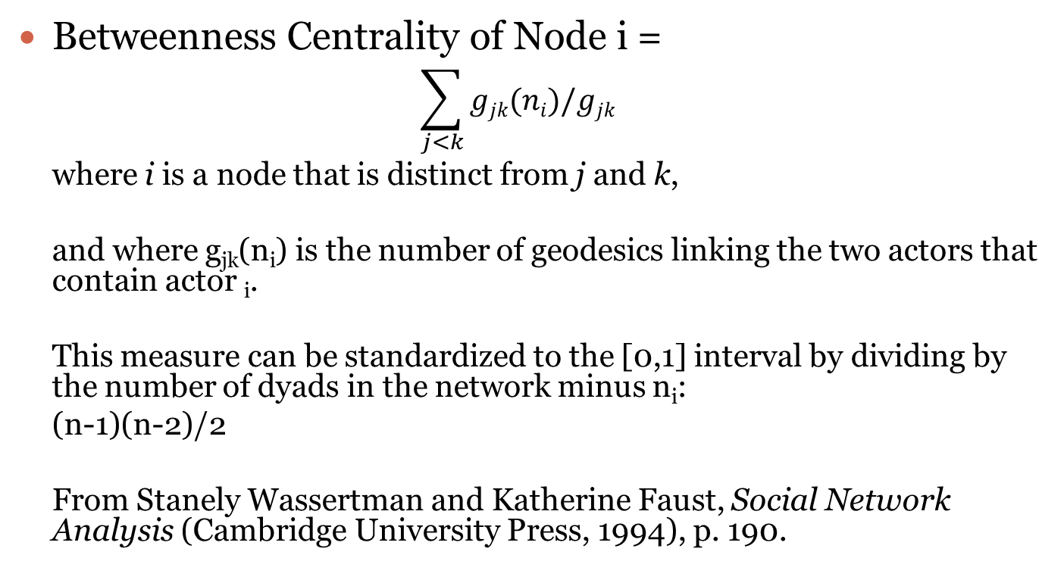
Betweenness Centrality
Betweenness Centrality of Node i =
$$\sum_{j<k}{gjk(ni)/gjk}$$
where i is a node that is distinct from j and k,
and where g_{jk}(n_{i}) is the number of geodesics linking the two actors that contain actor _{i}.
This measure can be standardized to the [0,1] interval by dividing by the number of dyads in the network minus n_{i}:
(n-1)(n-2)/2
From Stanely Wassertman and Katherine Faust, Social Network Analysis (Cambridge University Press, 1994), p. 190.

Slide 87
Calculating Centrality
Degree – Proportional to the number of other nodes to which a node is links – Number of links divided by (n-1).
Closeness – The sum of geodesic distances (shortest paths) to all other points in the graph. Divide by (n-1), then invert.
Betweenness – The extent to which a particular point lies ‘between’ other points in the graph; how many shortest paths (geodesics) is it on? A measure of brokerage or gatekeeping.
Eigenvector– A weighted measure of centrality that takes into account the centrality of other nodes to which a node is connected. That is, being connect with other central nodes increases centrality. E.g., secretary of powerful person. Google’s page rank algorithm is based on a variation of this approach.

Slide 88
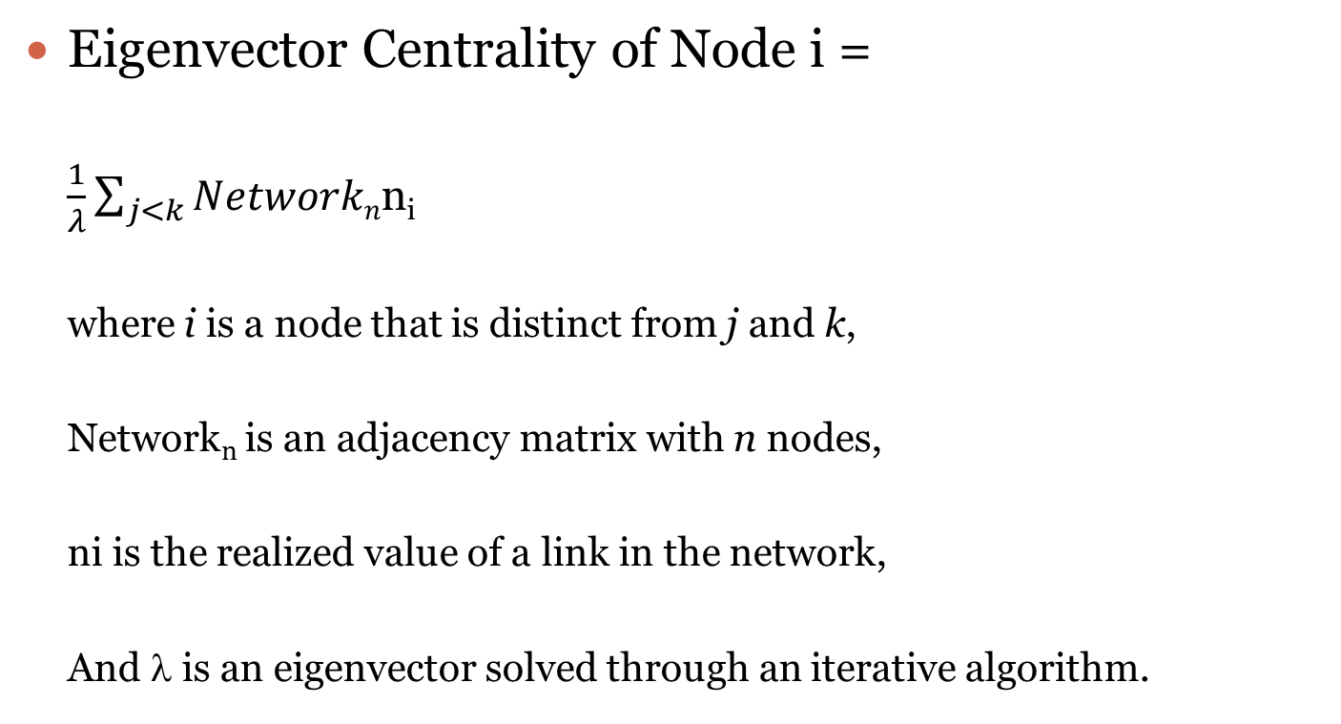
Eigenvector Centrality
Eigenvector Centrality of Node i =
$\frac{1}{λ}\sum_{j<k}{Networkn}$n_{i}
where i is a node that is distinct from j and k,
Network_{n} is an adjacency matrix with n nodes,
ni is the realized value of a link in the network,
And λ is an eigenvector solved through an iterative algorithm.

Slide 89
Other Centrality Measures
There are a large number of other possible measures of centrality.
For example, there are various ways to measure centrality in directed networks.
K-step reach, average recipient distance, etc., etc.
Different measures are often highly correlated

Slide 90
Triad
A triad is any set of three nodes.
Four possible structures in an undirected graph.
Sixteen possible structures in a directed graph.
Triads have a special place in network theory because some of the earliest network analysis (George Simmel, “The Triad”)

Slide 91
Transitivity
Transitivity is a property of triads.
A triad is transitive if i→j and j→k implies i→k
If Shreya & Carlos are friends and Carlos & Jana are friends, then Shreya & Jana are friends.
The percentage of transitive triads in a network may be a property of interest.

Slide 92
Questions / Comments ?

Slide 93
Network Regression

Slide 94
Network Regression
Ordinary Regression
Quadratic Assignment Procedure
Exponential Random Graph Models
Latent Space Models
Endogenous Network Regression
Missing Data
Causality

Slide 95
Ordinary Regression
We may want to use network variables as independent variables in a regression.
Network degree is a common independent variable.
Network centrality is a common independent variable.
Brokerage measures
Michael T. Heaney, “Brokering Health Policy: Coalitions, Parties, and Interest Group Influence,” Journal of Health Politics, Policy and Law (2006).

Slide 96
Network Regression
The network tie is the dependent variable.
Why do two nations form an alliance? Why do they break the alliance?
Chief problem: The independence assumption is severely violated.
AB
AC
AD
AE
BC
BD
BE

Slide 97
Quadratic Assignment Procedure
David Krackhardt, “QAP Partialling as a Test of Spuriousness." Social Networks (1987).
A method of resorting the data
Permute the dependent variable and merge back with the independent variables
Run the estimation with the new merged data set, and save the results
Repeat the permutation and estimation to generate an empirical sampling distribution

Slide 98
Exponential Random Graph Models (ERGMs)
The basic idea is that in estimating a regression model, we have to take account of network structures that would occur randomly, given certain features, such as density.
Example: If a network has a density of 75%, then ties between any two nodes are highly likely at random. This is less true if density is only 10%.
Takes into account the endogenous process of network formation in estimating the regression.
Looking for a data generating structure that “is consistent with” the data.

Slide 99
The Meta Theory behind ERGMs
Social networks are locally emergent (e.g., preferential attachment)
Tie formation depends both on the formation of other ties (i.e., network dependence) and on attributes of actors, ties, and other exogenous factors.
Patterns in networks are part of ongoing social processes.
Multiple processes can operate simultaneously (e.g., homophily and triadic closure).
Networks are both structured and stochastic.

Slide 100
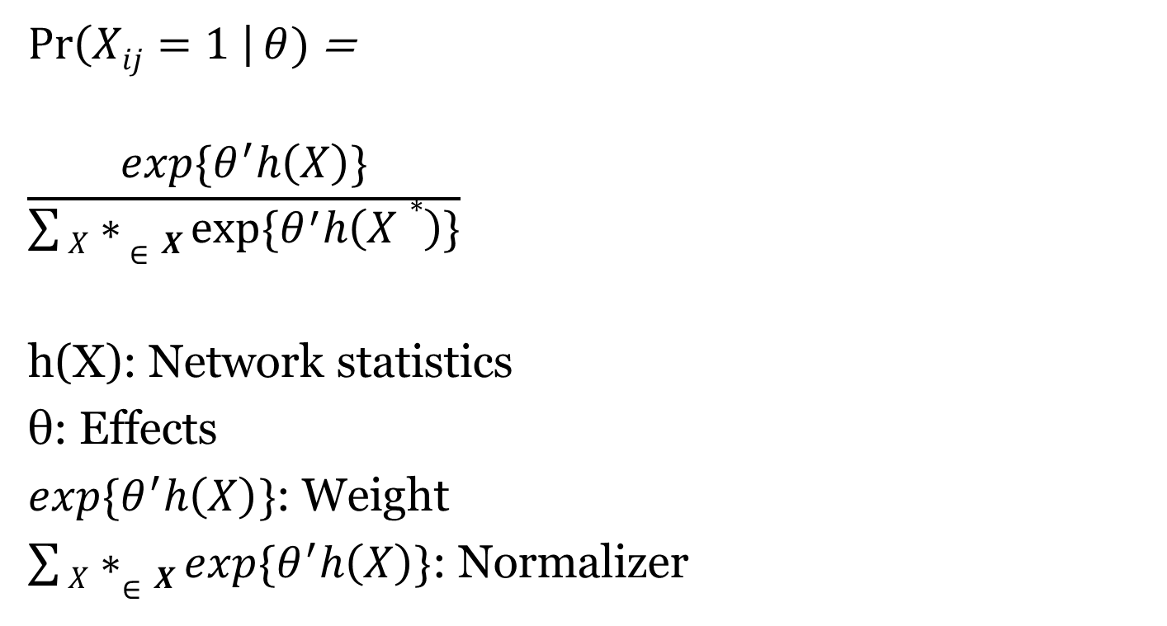
Exponential-Family Random Graph Models
$\operatorname{Pr}\left(Xij=1 \right|θ)$ =
$$\frac{exp\{θ^{′}h\left(X\right)\}}{\sum{X∗ ∈X}exp⁡\{θ^{′}h\left(X∗\right)\}}$$
h(X): Network statistics
θ: Effects
$exp\{θ^{′}h\left(X\right)\}$: Weight
$\sum{X∗∈X}exp\{θ^{′}h\left(X\right)\}$: Normalizer

Slide 101
Readings on ERGMs
Dean Lusher, Johan Koskinen, and Garry Robins. 2013. Exponential Random Graph Models for Social Networks. New York: Cambridge University Press.
Garry Robins et al., “An introduction to exponential random graph (p*) models for social networks,” Social Networks (2007).
Skyler J. Cranmer et al., “Navigating the Range of Statistical Tools for Inferential Network Analysis,” American Journal of Political Science, 2017.
Philip Leifeld and Volker Schneider, “Information Exchange in Policy Networks,” American Journal of Political Science, 2012.
Michael T. Heaney, “Multiplex Networks and Interest Group Influence Reputation: An Exponential Random Graph Model,” Social Networks, 2014.
Michael T. Heaney and Philip Leifeld, “Contributions by Interest Groups to Lobbying Coalitions,” Journal of Politics, April 2018.

Slide 102
Latent Space Models
Dependencies between nodes in a network are represented as distances in a latent space.
The probability of a pair of nodes being connected depends on the distance in that social space.
These models do not require an explicit model of the network dependencies as is the case with ERGMs.
Skyler J. Cranmer et al., “Navigating the Range of Statistical Tools for Inferential Network Analysis,” American Journal of Political Science, 2017.
Peter D. Hoff and Michael D. Ward, “Modeling Dependencies in International Relations Networks,” Political Analysis, 2004

Slide 103
Endogenous Regression
Builds a fully-specified network regression model using temporal network data and instrumental variables.
Robert Franzese et al., “A Spatial Model Incorporating Dynamic, Endogenous Network Interdependence: A Political Science Application,” Statistical Methodology (2010)

Slide 104
Missing Data
Missing data is a major problem in network regression that is rarely addressed adequately.
A Bayesian approach may be helpful
Carter T. Butts, “Network inference, error, and informant (in)accuracy: A Bayesian approach,” Social Networks (2003).

Slide 105
Causal Inference
Very difficult to assess whether networks are a cause or an effect of behavior.
This is a very thorny issue in the review process.
Some Partial solutions include:
Use of multiple measures
Longitudinal observation
Experiments (if possible)
Simulation
James Fowler et al., “Causality in Political Networks,” American Politics Research (2011).

Slide 106
Research Design and Data

Slide 107
Research Design and Data
Whole Networks vs. Ego Networks
Boundary Specification
Questionnaire Design
Data Formats

Slide 108
Whole Networks vs. Ego Networks

Slide 109
Whole Networks vs. Ego Networks
Whole networks – observer has information about all nodes and links in the network – all network-level statistics can be computed

Slide 110
Whole Networks vs. Ego Networks
Whole networks – observer has information about all nodes and links in the network – all network-level statistics can be computed
Ego Networks – observer only has information about the links to a sample of the nodes – network-level statistics cannot be computed – e.g., we know about the properties of the first-degree contacts, such as sex, age, etc.

Slide 111
Whole Networks vs. Ego Networks
Whole networks – observer has information about all nodes and links in the network – all network-level statistics can be computed
Ego Networks – observer only has information about the links to a sample of the nodes – network-level statistics cannot be computed – e.g., we know about the properties of the first-degree contacts, such as sex, age, etc.
It is not the networks themselves that differ, but our ability to collect information about them.

Slide 112
Whole Networks vs. Ego Networks
Whole networks – most common in the study of elites and institutions
Ego Networks – most common in the study of individual behavior

Slide 113
Whole Networks vs. Ego Networks
Whole networks – all network analysis techniques can be used
Ego Networks – analysis techniques involve analysis of the alters of focal persons

Slide 114
Snowball Sampling
Snowball sampling creates an intermediate network that is somewhere between an ego network and a whole network.
Procedure:
1. Select a random sample from the population
2. Ask each respondent in the random sample about network alters.
3. Contact those alters and request information on those alters.
4. Contact the alters of the alters.
5. Continue….

Slide 115
Problems with Snowball Sampling
Snowball sampling selects a sample on the basis of the network structure.
As a result, snowball sampling yields networks that appear to be more closely connected and cliquey than they really are.
Snowball sampling inherently has huge selection bias problems

Slide 116
Legitimate Uses of Snowball Sampling
Snowball sampling may be useful if the statistical models account for the snowballing in the estimation process (i.e., respondent-driven sampling)
This method may be especially effective in studying small populations when the snowballing exhausts the total population (i.e., there is no selection bias if the entire population is selected).
May work for political elites, IV-drug users.
Douglas D. Heckathorn, "Respondent-Driven Sampling: A New Approach to the Study of Hidden Populations," Social Problems (1997).

Slide 117
Boundary Specification
Edward O. Laumann et al, “The Boundary Specification Problem in Network Analysis.” In Research Methods in Social Network Analysis (1989).
Networks do not have “natural” boundaries.
Networks are constructed by the researcher with a research purpose in mind.
Best practice is to use multiple, “objective” data sources to identify nodes for analysis.

Slide 118
Questionnaire Design

Slide 119
Take Out a Sheet of Paper (not turned in)
Write down the names of your closest friends.
Write down the names of people who you talk to about politics.
Write down the names of the people you drink beer with.
Write down the names of the people you have been on a date with in the last year. (Use initials if you like.)

Slide 120
Goals for Measuring the Network
Whole Network – attempting to look at how every actor is connected with every other – small social systems
Ego Network – attempting to look only at part of the network – perhaps, what are the kinds of people you are connected with (e.g., how many of your friends are men, women) – large social system

Slide 121
Two Basic Question Formats
Fixed List (analogous to closed-ended questions)
Name generator (analogous to open-ended questions)

Slide 122
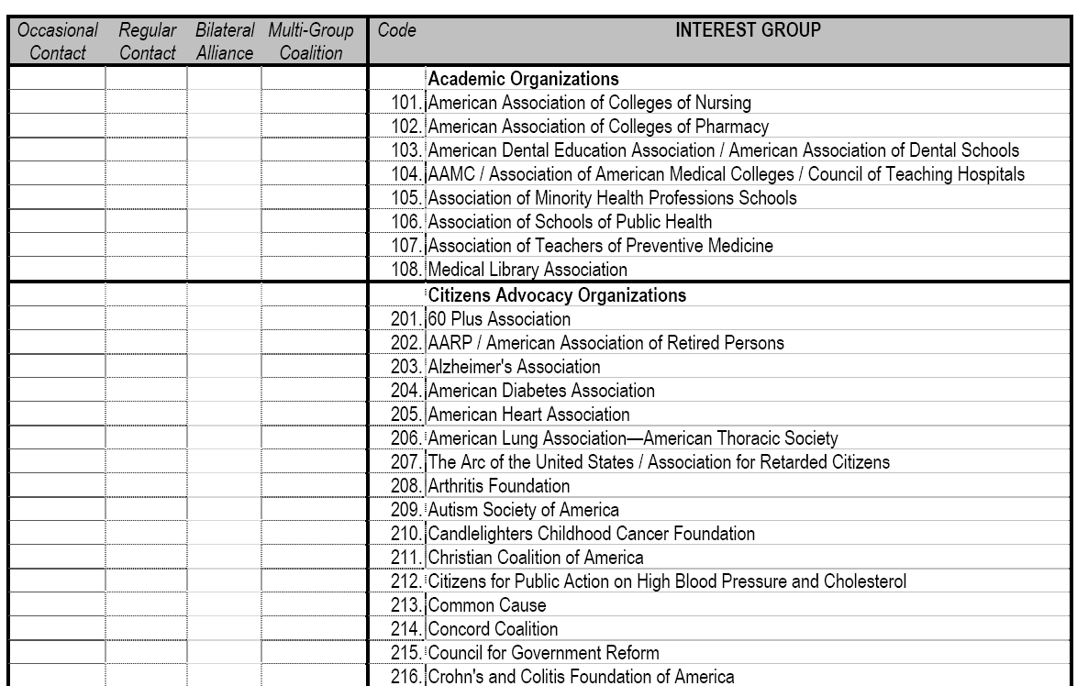
Fixed List

Slide 123
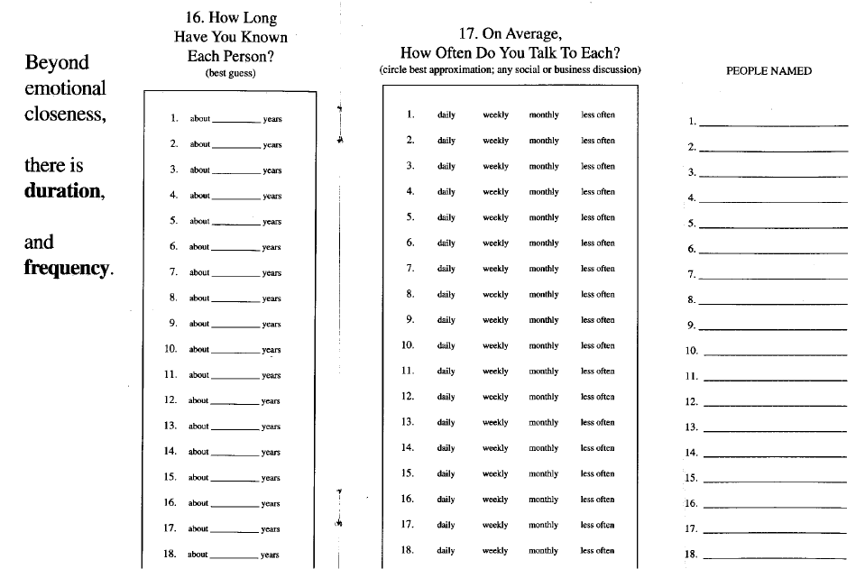
Name Generator
See
Merrill
Lynch
survey.

Slide 124
Fixed list: Advantages / Disadvantages
Advantages
-- People are less likely to “forget” social ties
-- Clearly defined network boundaries
-- Works well when the social system is small or when analyzing elites
-- Usually the approach when measuring whole network (but not always)

Slide 125
Fixed list: Advantages / Disadvantages
Disadvantages
-- Important network contacts may not be on the list
-- Difficult and time-consuming to go through entire list (fatigue effects)
-- Real network may be ill defined
-- Must have the “whole list” – works only in small networks – or elite networks

Slide 126
Name Generator: Advantages / Disadvantages
Advantages
-- Flexibility: people can name anyone they like
-- Efficiency: it is easy to ask for a large amount of information in a small space
-- Efficacy: Accommodates large social networks
-- Usually the approach when measuring ego networks (but not always)

Slide 127
Name Generator: Advantages / Disadvantages
Disadvantages
-- Forgetting is a major problem
-- Variance from person to person in threshold for listing
-- Measuring network degree may be highly unreliable

Slide 128
Tricks for Name Generators
Constrain the number of alters list (e.g., name your top three best friends) – highly problematic because it artificially constrains network degree
Multiple asking of the same (or similar) question
Allow respondents to revise their answers.
Prompt people with something concrete (e.g., who do you meet for coffee rather than who are your friends)

Slide 129
Types of Questions
Existence of Ties (e.g., Who are your friends?)
Frequency of ties (e.g., How often do you meet?)
Evaluation of ties (e.g., Who is your best friend? Who is most influential?)
Types of ties (e.g., What types of people are you tied to? Are your friends old, young, poli sci majors?)

Slide 130
Data Formats: Edgelist vs. Adjacency Matrix

Slide 131
Data Formats
Adjacency Matrix / Spreadsheet -- GOOD FOR SMALL NETWORKS
A B C D
A 1 0 1 0
B 0 1 0 1
C 1 0 1 0
D 0 1 0 1
Edgelist – GOOD FOR LARGE NETWORKS
AC
BD
EF
An adjacency matrix can be converted to an edgelist, and vice versa

Slide 132
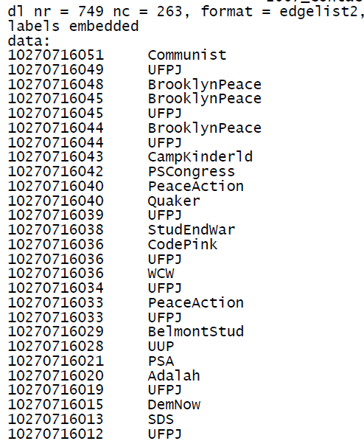
A Real Edgelist

Slide 133
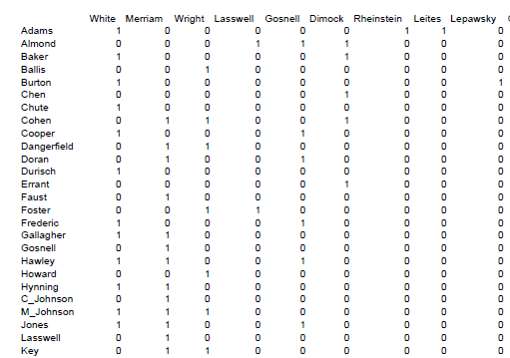
A Real Adjacency Matrix

Slide 134
Questions / Comments ?

Slide 135
Major Theories

Slide 136
Major Theories
Balance Theory
Embeddeness
Brokerage Theory
Status Signals
Homophily
Multiplexity
Small World Theory

Slide 137
The Need for Theory
Network analysis can be a cool toy.
It is easy to get lost in data crunching and forget about why we care about networks.
You must develop a theory of why and how networks matter in your case.
What are the mechanisms at work?
If larger degrees matter, why is that the case? If centrality helps, why is that the case? If centrality hurts, why is that the case?

Slide 138
Balance Theory
Fritz Heider, The Psychology of Interpersonal Relations (John Wiley and Sons, 1958).
The enemy of my enemy is my friend.
Applied to triads.
Multiply the valence of a legs of a triad by one another. Positive values imply balance, negative values imply imbalance.
Prediction: Imbalanced triads tend to adjust toward balance.
Entire networks can be assessed as balanced or imbalanced.
Potentially useful in the study of alliances, friendship.

Slide 139
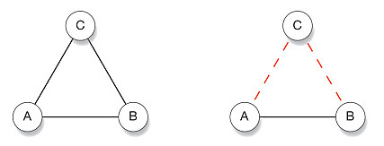
Balance Theory
Two balanced triangles

Slide 140
Balance Theory
Unbalanced triangles

Slide 141
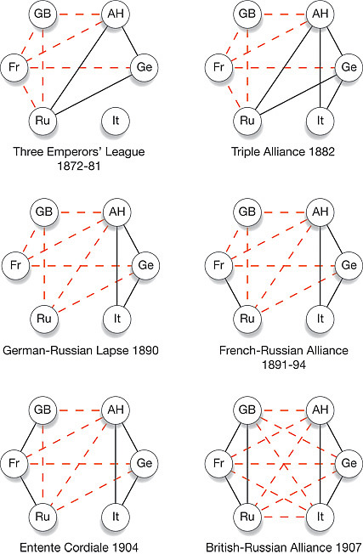
The Emergence of World War I (Steven Strogatz)

Slide 142
Strength of Ties
Mark Granovetter, “The Strength of Weak Ties,” American Journal of Sociology (1973)
Also a kind of embeddedness theory.
What kind of information is communicated in a relationship depends on the strength of the tie.
Prediction: Weak ties are better at communicating new information because they are less likely to be redundant.
Prediction: Strong ties are better at communicating sensitive information.

Slide 143
Brokerage
Brokers are actors who facilitate exchange among actors.
Brokerage may be necessary because actors who want to connect don’t know each other.
Or, actors may know each other, but may require brokerage because they don’t trust each other.
Example: Relationship between the U.S. and North Korea. Who is the broker?

Slide 144
Key to Brokerage
Brokerage is about crossing a boundary that is hard to cross
What kinds of boundaries are hard to cross?
Partisan boundaries
Industry boundaries
Gender boundaries
Other boundaries?

Slide 145
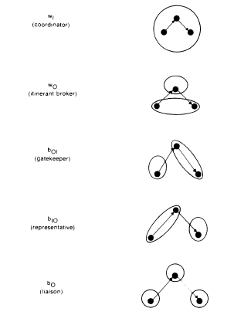
Types of Brokers
Roger V. Gould and Roberto M. Fernandez, “Structures of Mediation: A Formal Approach to Brokerage in Transaction Networks," Sociological Methodology (1989)

Slide 146
Structural Holes

Slide 147
Structural Holes
Ronald S. Burt, Structural Holes: The Social Structure of Competition (Harvard, 1992).
Structural hole theory is a specific type of brokerage theory.
It specifies that the type of boundary that it is valuable for brokers to cross.
Prediction: Brokers will add greater value when they build personal networks that are not redundant and are free of constraint. It is a way of becoming the unique contact across structural holes.

Slide 148
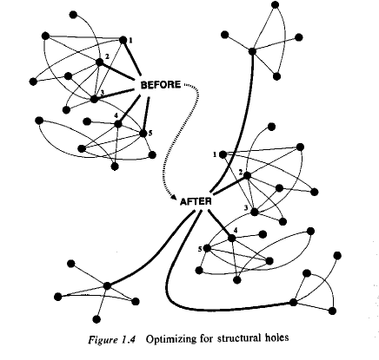

Slide 149
Status Signals
Joel M. Podolny, “Networks as the pipes and prisms of the market,” American Journal of Sociology (2001).
Networks do more than channel information and resources (cf. resource dependency theory), they also inform us about status.
Who we are connected to tells us something about our quality.
Prediction: It may be difficult to raise our status, given our network contacts.

Slide 150
Homophily

Slide 151
Homophily
Miller McPherson et al., “Birds of a Feather: Homophily in Social Networks,” Annual Review of Sociology (2001).
Prediction: Similarity in individual characteristics causes the formation of network ties.
Example: People form friends with people who share the same hobbies.
Implication: Creates difficulties in assessing the causal effect of social networks, since people may develop similar interests because they are friends or may become friends because they have similar interests. Obviously, it is both, but it is difficult to parse the difference empirically.

Slide 152
Measures of Homophily
Percent homophilous
E-I Index: Given a partition of a network into a number of mutually exclusive groups then the E-I index is the number of ties external to the groups minus the number of ties that are internal to the group divided by the total number of ties. This value can range from 1 to -1.
Need to account for the overall composition of the population. Is the population divided 90/10 or 50/50?
Lots other measures: e.g., Yules Q, Cohen Kappa

Slide 153
Multiplexity

Slide 154
Multiplexity
David Krackhardt, “The Strength of Strong Ties: The Importance of Philos in Organizations.” In Networks and Organization: Structure, Form, and Action (Harvard, 1992)
Action takes place in multiple, overlapping social networks. Family, business, friendship, political, sexual, etc.
Prediction: Ties in one kind of network affect ties in other kinds of networks.
Implication: Multiplexity may be an important explanation for coevolution.

Slide 155
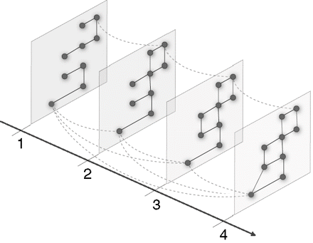
Visualizing Multiplexity

Slide 156
Working and Dating
Would you like to work with someone that you dated? Why or why not?

Slide 157
Working and Dating
Working and dating are two very different types of social relationships. The relationships of co-worker and boyfriend/girlfriend have very different ROLES.
As a result there are potentially unique advantages of combining these roles as well as potentially unique costs.

Slide 158
Working and Dating
Advantages
-- The two of you get to see one another more regularly.
-- You know that you have someone that you can trust and count on at work. You have an ally in the workplace.
Disadvantages
-- Dating and working together are very different roles.
-- Dating is about equality and seeking intrinsic goods (e.g., love, security, enjoyment)
-- Working together is often/usually about hierarchy and seeking extrinsic goods (e.g., career advancement, salary, producing a good)
-- These roles can direction come into conflict

Slide 159
Small World Theory

Slide 160
Small World Theory
Duncan Watts, Small Worlds (Princeton, 1999).
Is a theory about the macro structure of a network based on its micro structure.
All points in a network are “reachable” in a short number of steps.
Reachability exists because a small number of actors form bridges that span great distances.
Hubs – actors with especially high degree – are especially important in creating bridges – in part through processes of preferential attachment.

Slide 161
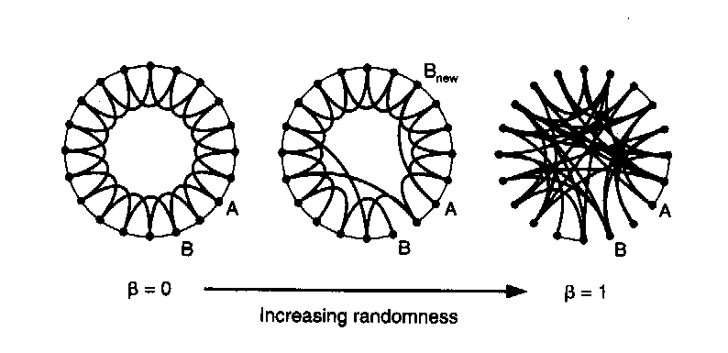
Watts’ Concept of the Small World
Caveman World
Small World
Neighborhood / Clique

Slide 162
Small Worlds Generally Follow Power Laws
The 80/20 rule
Exist when statistical distributions are “scale free”
That means that “relationships do not change if length scales are multiplied by a common factor (k).”
f(x) = ax^{k}
log (f(x)) = k log (x) + log (a)

Slide 163
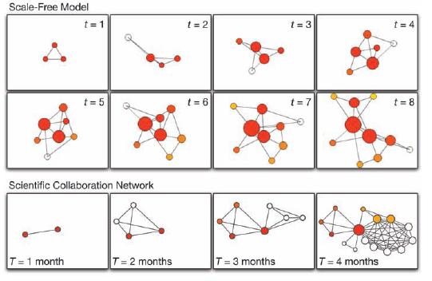
Preferential Attachment
Alberto-Laszlo Barabasi, Linked (Penguin, 2003)

Slide 164
The Triviality of Small Words
Whether a world is “small” depends heavily on how links are defined and measures. The smallness of the world is constructed by the researcher.
The social implications of small worlds are often unclear.
Potential for Future Research: Look at network dynamics – are worlds becoming bigger or smaller given a constant definition of ties? What difference does it make?

Slide 165
Building Your Own Theory

Slide 166
Questions / Comments ?

Slide 167
New Directions for the Study of Networks

Slide 168
The Edges of the Field
Multi-modal analysis
Valued data
Missing data
Multiplexity
Evolutionary models
Game-theoretic models

Slide 169
Challenges for the Study of Political Networks

Slide 170
Challenges for the Study of Political Networks
High-quality data
Data collection over time
Statistical innovation
Computing power

Slide 171
Questions / Comments ?

Slide 172
Good Introductory Readings
Albert-Laslo Barabasi, Linked (Penguin 2003).
Stephen P. Borgatti et al., Analyzing Social Networks (Sage 2013)
Peter J. Carrington et al., Models and Methods in Social Network Analysis (Cambridge 2005).
Nicolas A. Christakis and James H. Fowler, Connected (Little, Brown 2009).
Skyler J. Cranmer et al., “Navigating the Range of Statistical Tools for Inferential Network Analysis,” American Journal of Political Science, 2017.
Lincton C. Freeman, “Centrality in Social Networks: I. Conceptual
Clarification,” Social Networks (1979).
Linton C. Freeman, The Development of Social Network Analysis (Empirical Press 2004).
Matthew O. Jackson, Social and Economic Networks (Princeton 2008).
John Levi Martin, Social Structures (Princeton 2009)
Mark Newman, Networks: An Introduction (Oxford 2010).
Mark Newman et al., The Structure and Dynamics of Networks (Princeton 2006).
John Scott, Social Network Analysis: An Handbook (Sage, 2000.
Stanley Wasserman and Katherine Faust, Social Network Analysis: Methods and Applications (Cambridge 1994).
Issues of these journals: Social Networks, Network Science, and the Journal of Social Structure.

Slide 173
Recent Books on Political Networks
Betsy Sinclair, The Social Citizen
Meredith Rolfe, Voter Turnout
Casey Klofsted, Civic Talk
John Padgett and Walter Powell, The Emergence of Organizations and Markets
Zeev Maoz, Networks of Nations
Nils Ringe and Jennifer Nicoll Victor, Bridging the Information Gap
Michael T. Heaney and Fabio Rojas, Party in the Street: The Antiwar Movement and the Democratic Party after 9/11
Jennifer Hadden, Networks in Contention

Slide 174
First Steps
Make friends!
Lot’s of people here will help out. They’ll answer your questions and give you feedback on your ideas. They’ll be willing to answer your questions in the future.
Collaborate with someone that you meet this week. If you have a research question that’s networks related, invite a more experienced network scholar to join your project. If you don’t have a question, ask to join someone else’s project.
Join the Political Networks Section.

Slide 175
Thank You for Taking this Workshop!
Please evaluate the session if asked to do so.

