Slide 1

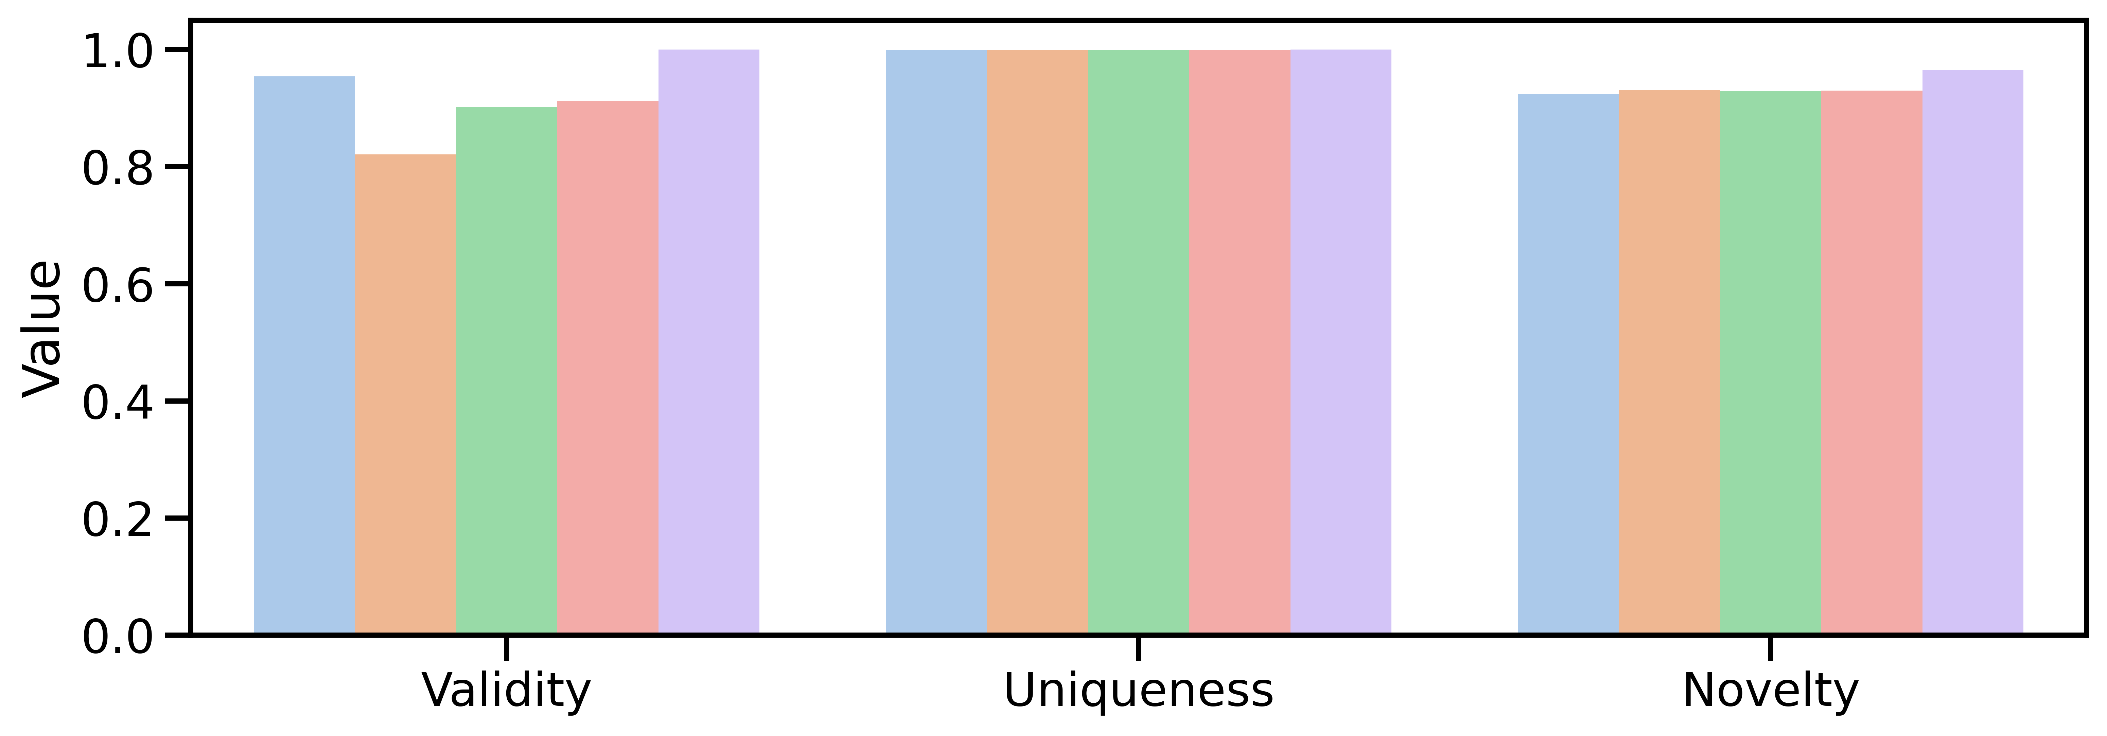
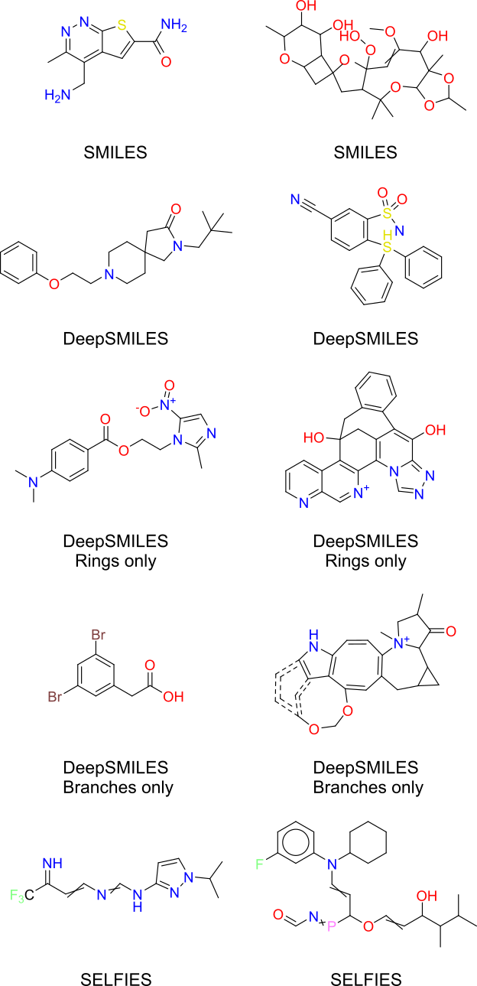
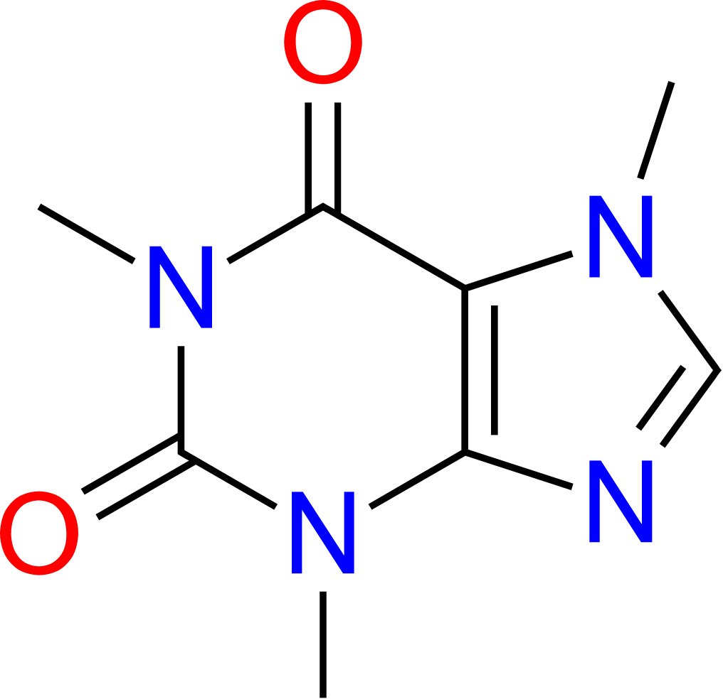
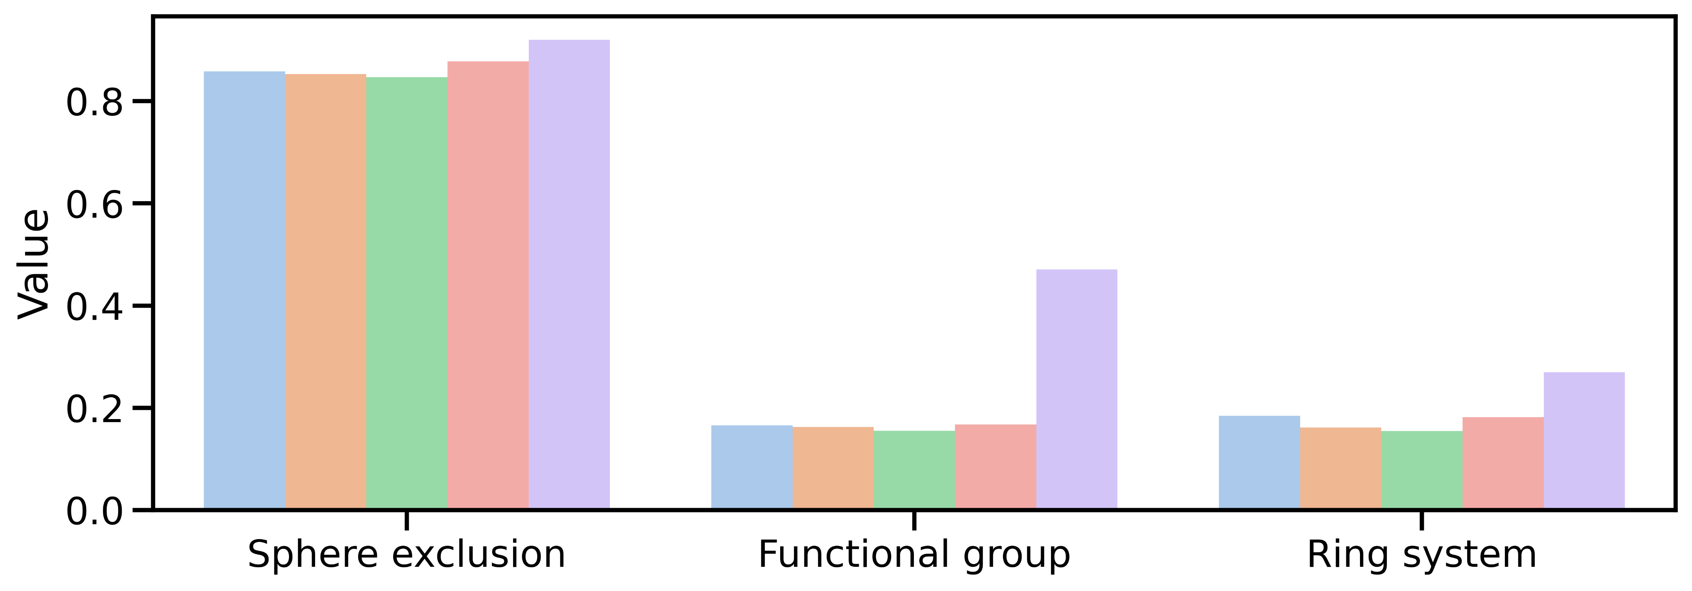
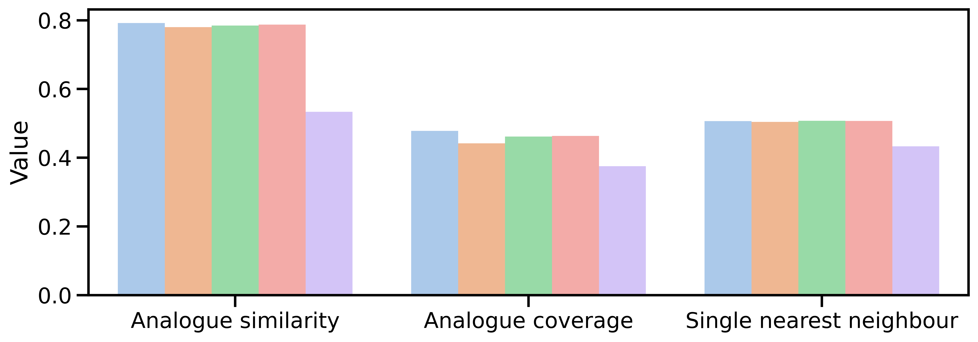
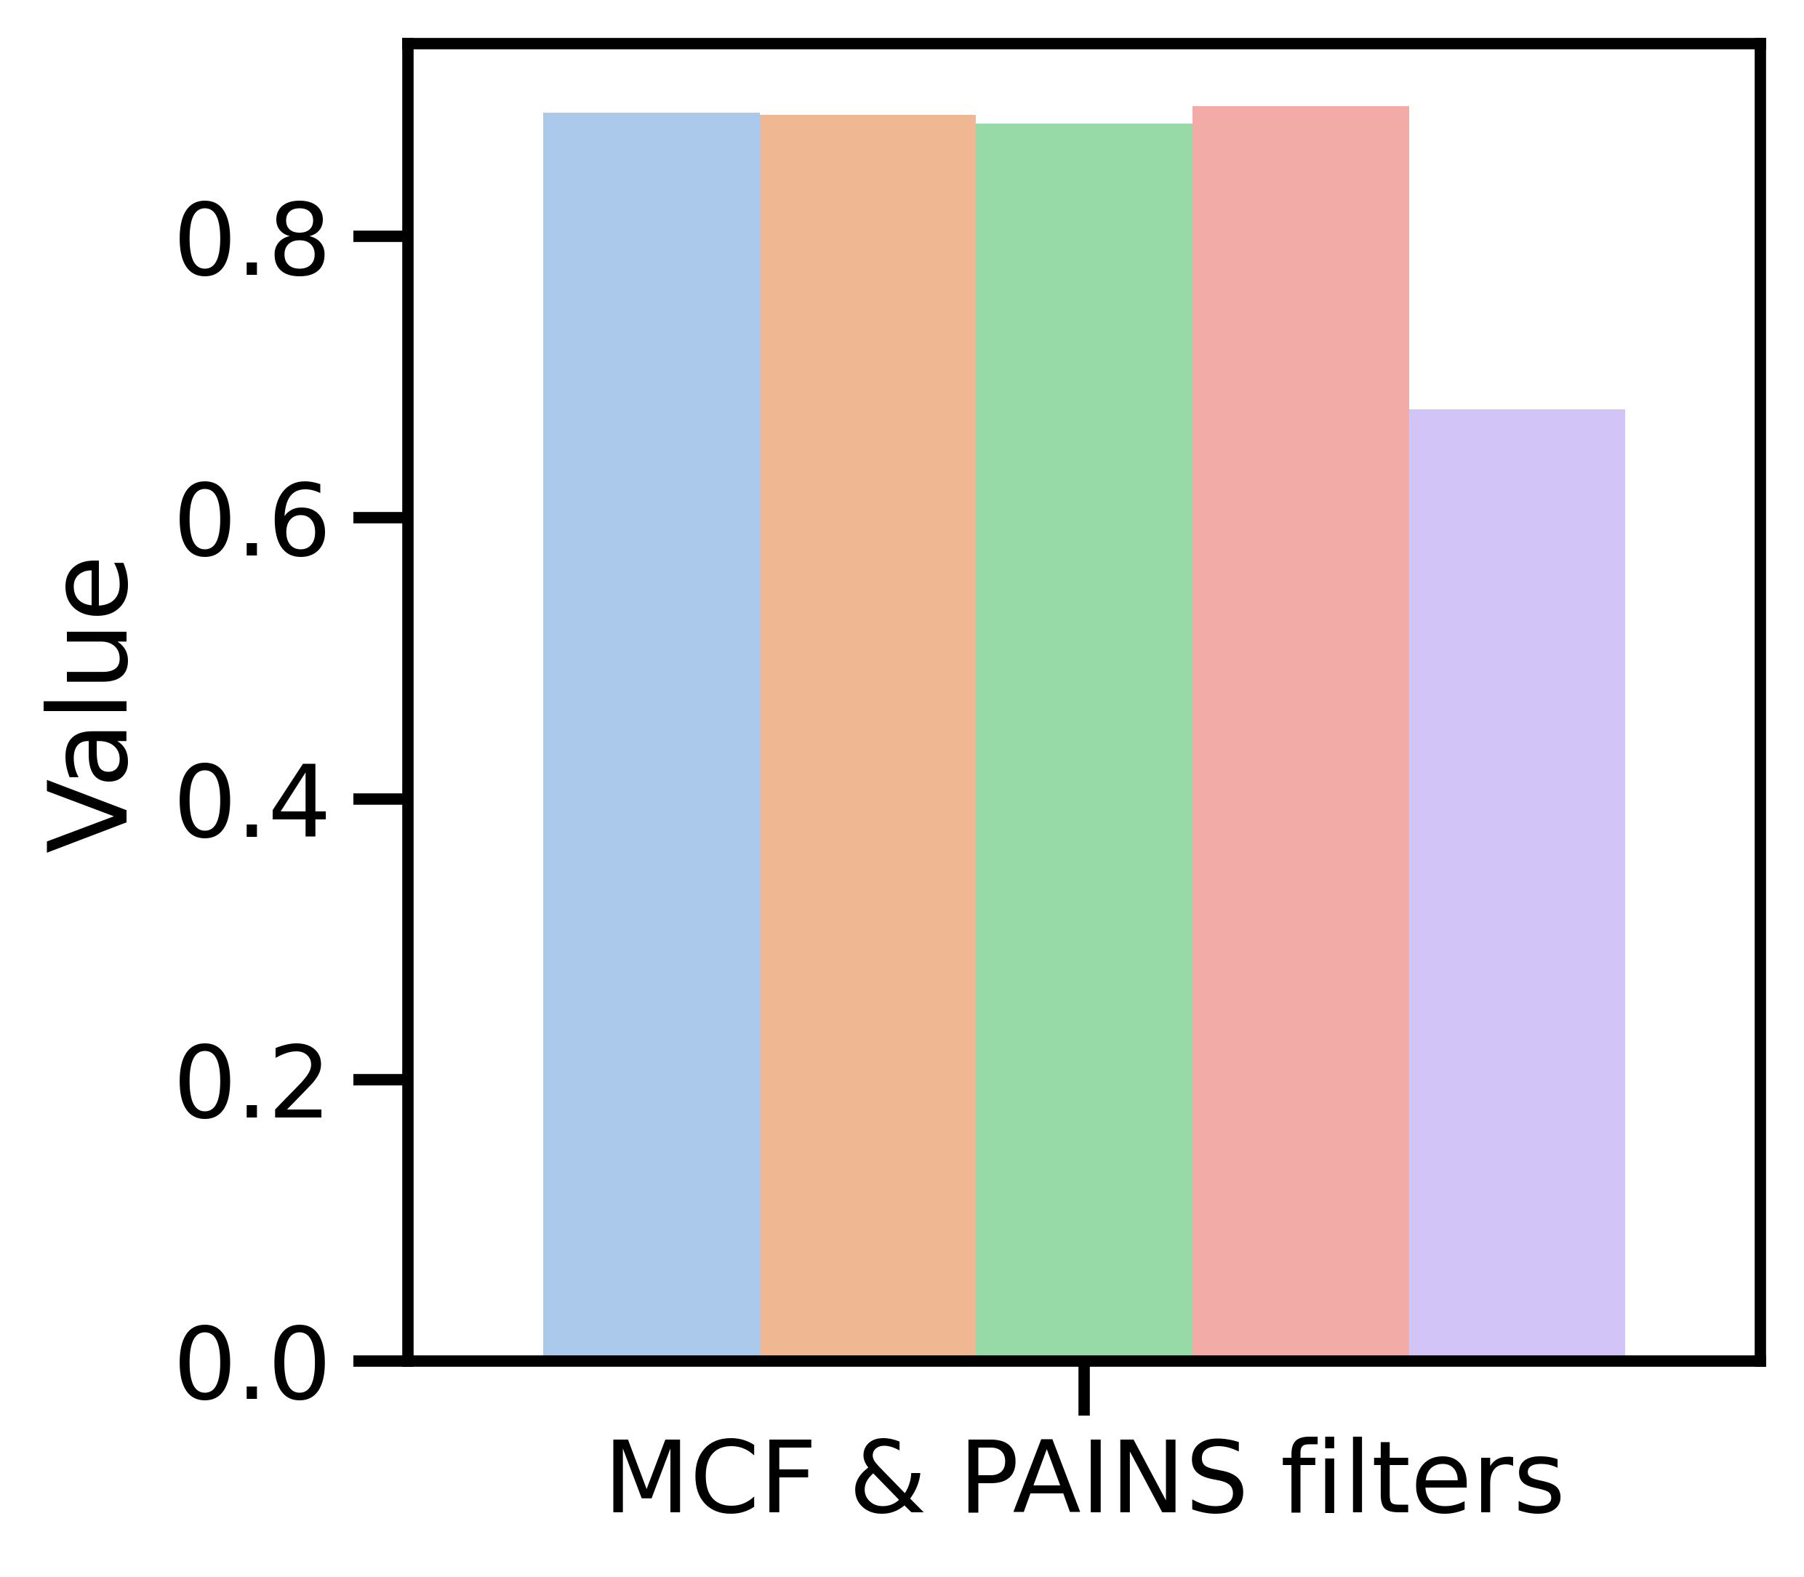
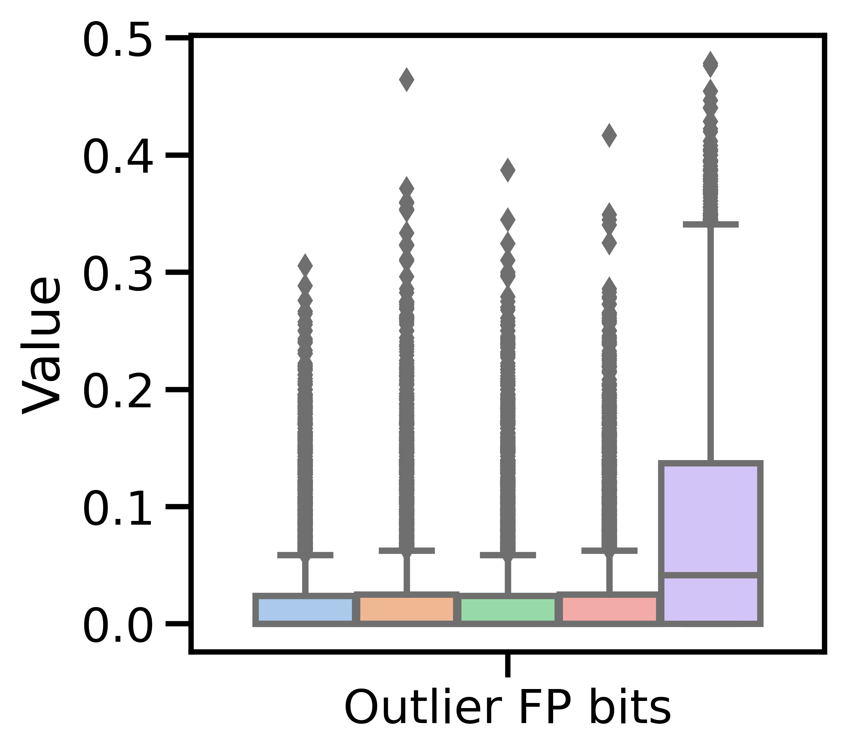
Application of DeepSMILES to machine-learning of chemical structures
Noel M. O’Boyle¹, Andrew Dalke², Morgan Thomas^{3*}, Andreas Bender³ and Chris de Graaf¹
¹ Sosei Heptares, Cambridge, UK; ² Andrew Dalke Scientific AB, Trollhättan, Sweden, ³ Centre for Molecular Informatics, University of Cambridge, UK. *Funded by Sosei Heptares
Introduction
DeepSMILES for generative models of chemical structures
There is continuing interest in the use of deep neural networks for de novo design of molecules with desired properties, for example modulation of the activity of a disease-relevant GPCR. A common approach is to train a generative model on SMILES strings and then use this to generate SMILES strings for molecules with a desired property. Unfortunately, these SMILES strings are often not syntactically valid due to elements of SMILES syntax that must occur in pairs. DeepSMILES is a SMILES-like syntax that addresses two of the main problems.
To test the effect of the syntax simplification, we chose a Recurrent Neural Network (RNN) as the language-based molecule generator [7,8], given recent improvements in optimization algorithms using Augmented Hill-Climb [9]. The model was trained on ChEMBL28 using SMILES, DeepSMILES and SELFIES. Three possible syntax simplifications were used for DeepSMILES (both encodings, rings only or branches only). SELFIES [3] is a new molecular grammar designed for use in generative models. This grammar is context-free and consequently almost always results in syntactically valid molecules. However, small changes in the SELFIES can result in large structural changes.
DeepSMILES
SMILES
DeepSMILES
DeepSMILES
Rings only
DeepSMILES
Branches only
SELFIES
DeepSMILES [1, 2] introduces two changes that can be combined or used independently:
1. Ring encoding uses a single syntax element instead of two:
SMILES - a ring opening number and a corresponding ring closure number
DeepSMILES - a single ring closure number that indicates the ring size
2. Branch encoding uses a single syntax element instead of two:
SMILES - branches are indicated by an open parenthesis followed by a close
DeepSMILES - the open parenthesis is omitted; the branch end is marked by multiple parentheses (or a number and a parenthesis) indicating the branch length
Recurrent Neural Network
c1ccccc1C(=O)Cl SMILES
cccccc6C(=O)Cl DeepSMILES (Rings encoded)
Sample 10,000 de novo molecules
Validity, Uniqueness & Novelty
Random
“Silly”
c1ccccc1C(=O)Cl SMILES
c1ccccc1C=O)Cl DeepSMILES (Branches encoded)
SMILES
DeepSMILES
Molecular diversity
Fig 1: An A2a receptor antagonist
Fig 2.: Round-tripping preserves structure including stereochemistry
Similarity to ChEMBL
Cn1cnc2c1c(=O)n(c(=O)n2C)C SMILES
Cncncc5c(=O)n(c(=O)n6C)C Rings encoded
Cn1cnc2c1c=O)nc=O)n2C)))C Branches encoded
Cncncc5c=O)nc=O)n6C)))C Both encoded
DeepSMILES
Medicinal chemistry likeness
Applications of DeepSMILES
The robustness of DeepSMILES relative to SMILES has been shown by Krenn et al [3], who found that a single random character mutation is less likely to result in a syntactically invalid string (58.9% vs 26.6%).
Henault et al [4] applied DeepSMILES in a string-based genetic algorithm and found that it outperformed SMILES for 2 out of the 3 tasks. Berenger and Tsuda [5] found that assembling a SMILES string from fragment SMILES was simplified using DeepSMILES compared to SMILES. We ourselves (AD) have found DeepSMILES very useful to fuzz test RDKit’s SMILES parser since the underlying evolutionary algorithm is less likely to generate syntactically invalid strings.
In contrast, Arús-Pous [6] found that SMILES performed better than all forms of DeepSMILES when building a generative model using a Deep Neural Net. Here we explore this question further and compare the performance to that using SELFIES [3].
Source of errors
 | DeepSMILES errors |  | SMILES errors
 | Parens | Ring Symbols | Parens | Ring Symbols | Kekulization | Valence
SMILES | - | - | 7 | 13 | 22 | 1
DeepSMILES | 11 | 1 | 0 | 0 | 39 | 145
Conclusions
In theory, DeepSMILES offers advantages over SMILES by presenting a simpler syntax to machine-learning models. While genetic algorithms appear to work better with this syntax, RNNs do not. In particular, valence errors are a problem.
One possibility is that this is due to the nature of a typical RNN architecture which is built around predicting what comes next in the SMILES string. This is at odds with DeepSMILES, where the earlier symbol (which may have been used to guide prediction) has been removed in favour of the later symbol.
These results have prompted some ideas about how to overcome these shortcomings which we are currently investigating.
References
O'Boyle NM, Dalke A. ChemRxiv. doi: 10.26434/chemrxiv.7097960.v1
DeepSMILES GitHub repository. https://github.com/baoilleach/deepsmiles
Krenn M, Häse F, Nigam A, Friederich P, at al. Mach. Learn. Sci. Technol. 2020, 1, 045024.
Henault ES, Rasmussen MH, Jensen JH. PeerJ Phys. Chem. 2020, 2, e11.
Berenger F, Tsuda K. J. Cheminf. 2021, 13, 88.
Arús-Pous J, Johansson SV, Prykhodko O, Bjerrum EJ, Tyrchan C, Reymond J-L, Chen H, Engkvist, O. J. Cheminf. 2019, 11, 71.
Segler MHS, Kogej T, Tyrchan C, Waller MP. ACS Cent. Sci. 2018, 4, 120.
Thomas M, Smith RT, O’Boyle NM, de Graaf C, Bender A. J. Cheminf. 2021, 13, 39.
Thomas M, O’Boyle NM, Bender A, de Graaf C. ChemRxiv. doi: 10.26434/chemrxiv-2022-prz2r
© 2022 Sosei Heptares
Disclaimer: Sosei Heptares is a trading name. Sosei and the logo are Trade Marks of Sosei Group Corporation, Heptares is a Trade Mark of Heptares Therapeutics Limited. StaR® is a Trade Mark of Heptares Therapeutics Limited
J.

