Slide 1
ALBEF
Align before Fuse: Vision and Language
Representation Learning with Momentum Distillation

Slide 2
Previous Methods Problem
Modelling the interactions between image and text features with transformerbased multimodal encoders require high-resolution input images and pre-trained object detectors;
Focusing on learning separate unimodal encoders for image and text(CLIP and ALIGN) lackes the ability to model more complex interactions between image and text for other V+L tasks.

Slide 3
Main Contribution
Introduce a contrastive loss to ALign the image and text representations BEfore Fusing (ALBEF) them through cross-modal attention, which does not require bounding box annotations nor high-resolution images;
Propose momentum distillation, a self-training method which learns from pseudo-targets produced by a momentum model to improve learning from noisy web data.

Slide 4
Question: what is Fusion?
It is used in Dual-Network

Slide 5
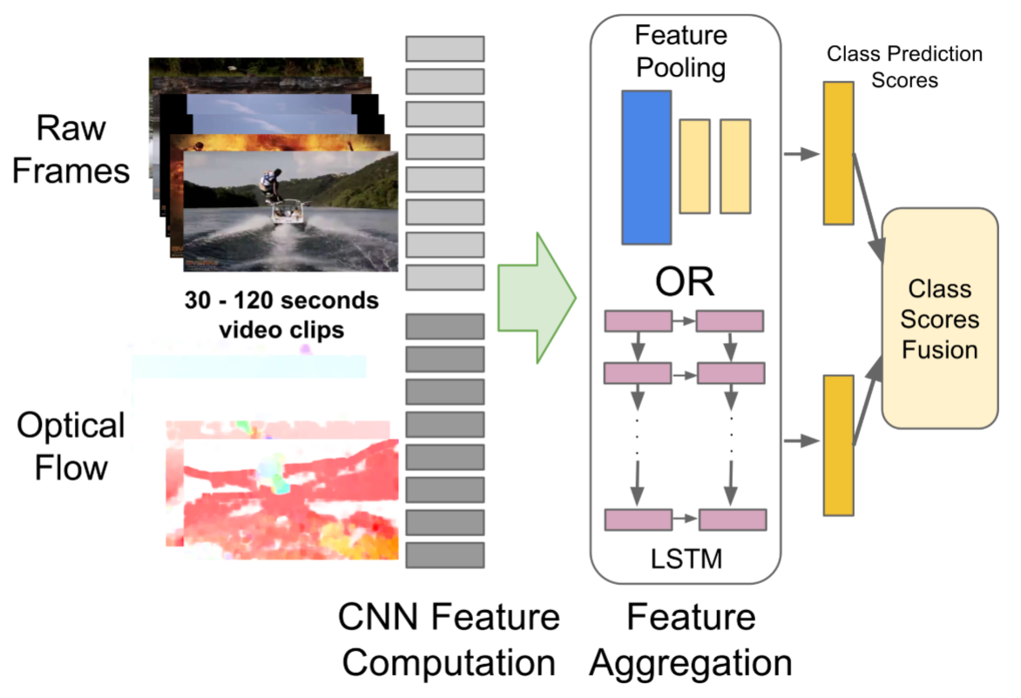
Fusion
Beyond Short Snippets: Deep Networks for Video Classification
(https://arxiv.org/abs/1503.08909)

Slide 6
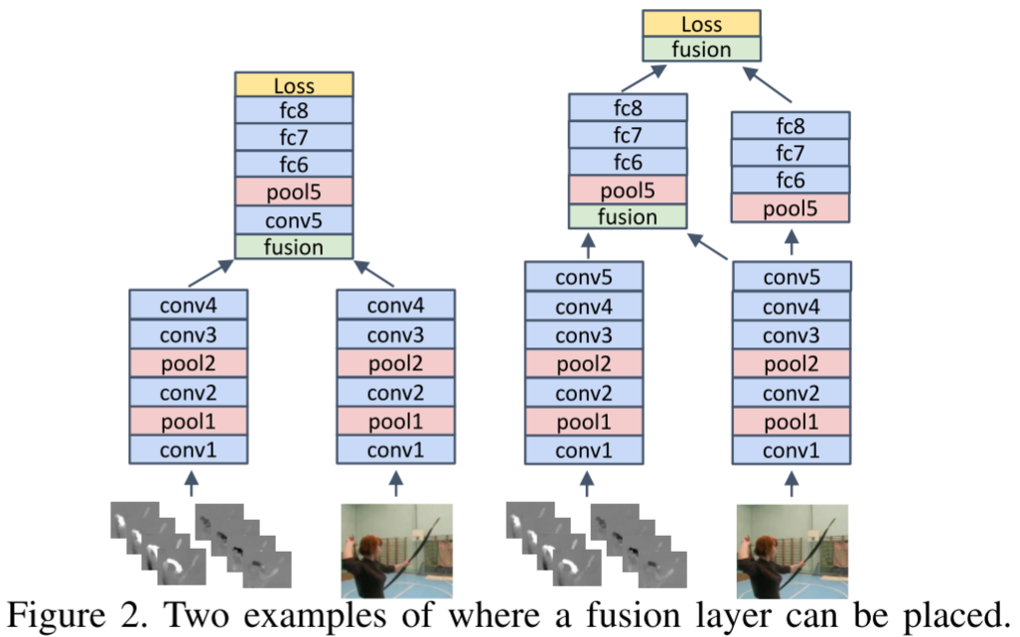
Fusion
Convolutional Two-Stream Network Fusion for Video Action Recognition
(https://arxiv.org/abs/1604.06573)

Slide 7
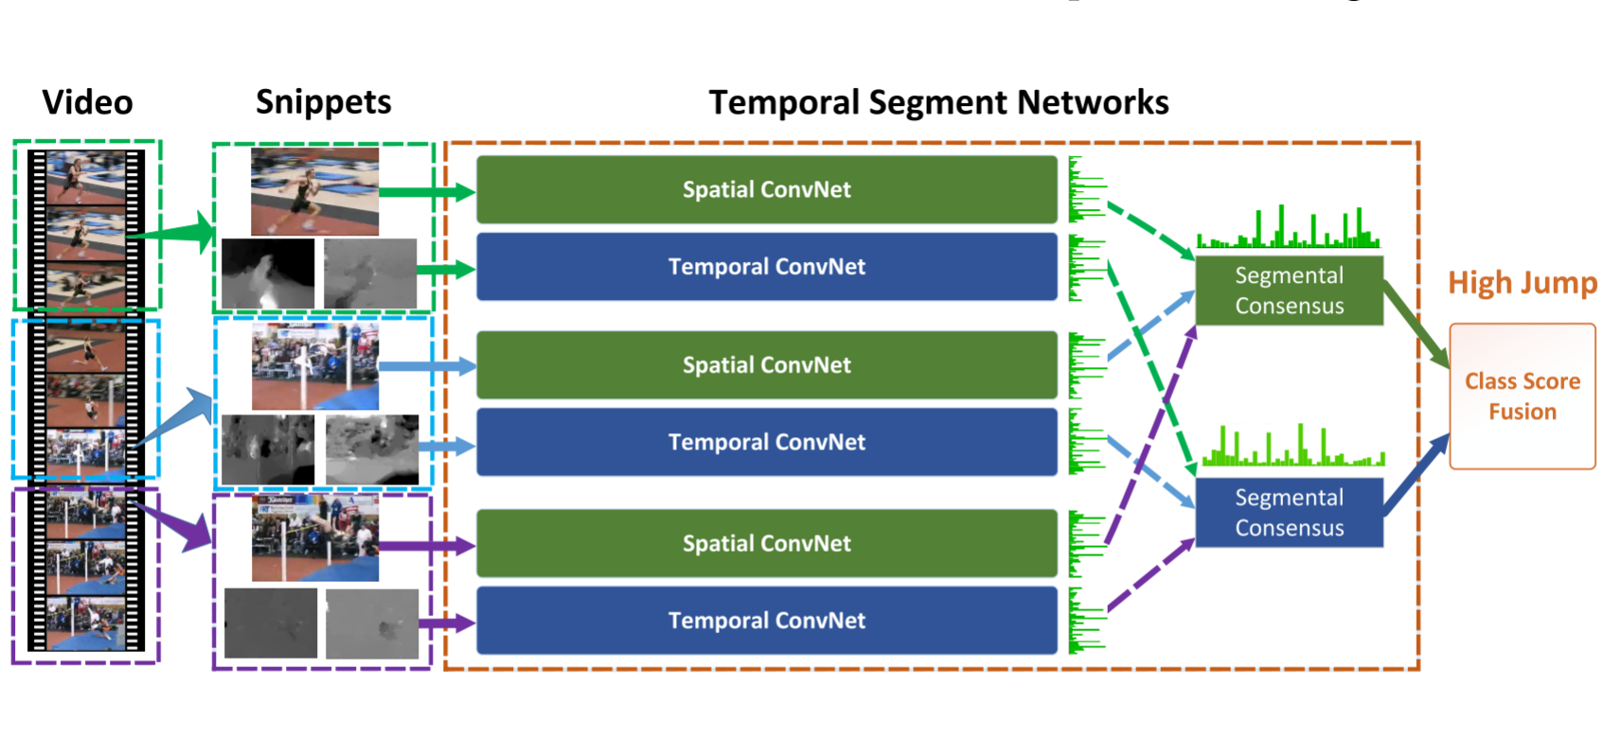
Fusion
Temporal Segment Networks: Towards Good Practices for Deep Action Recognition
(https://arxiv.org/abs/1608.00859)

Slide 8
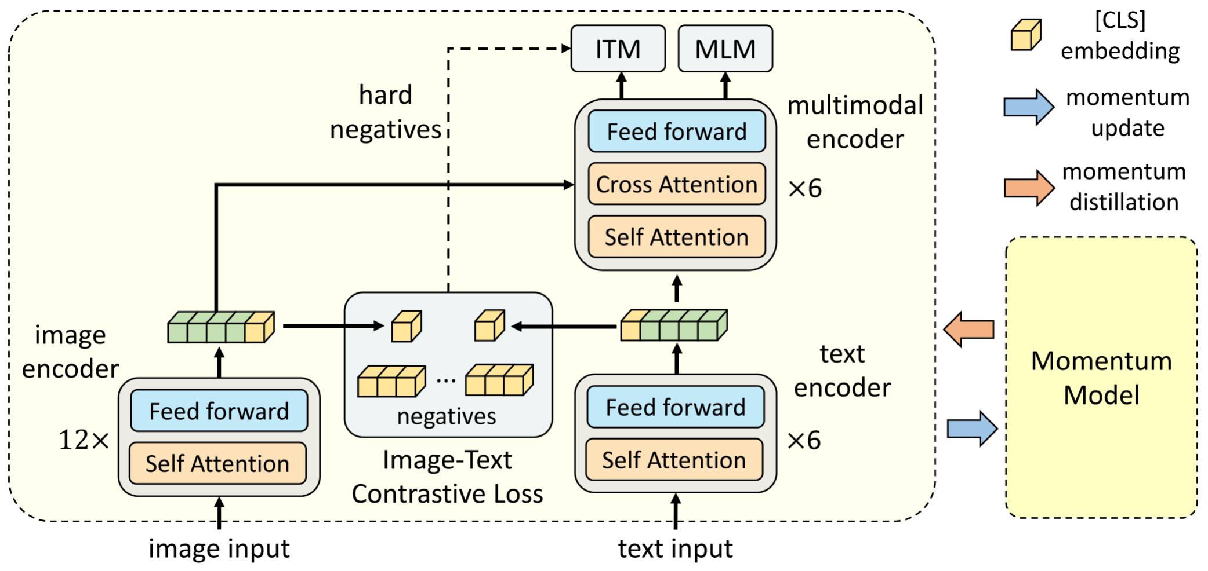
ALBEF Overview

Slide 9
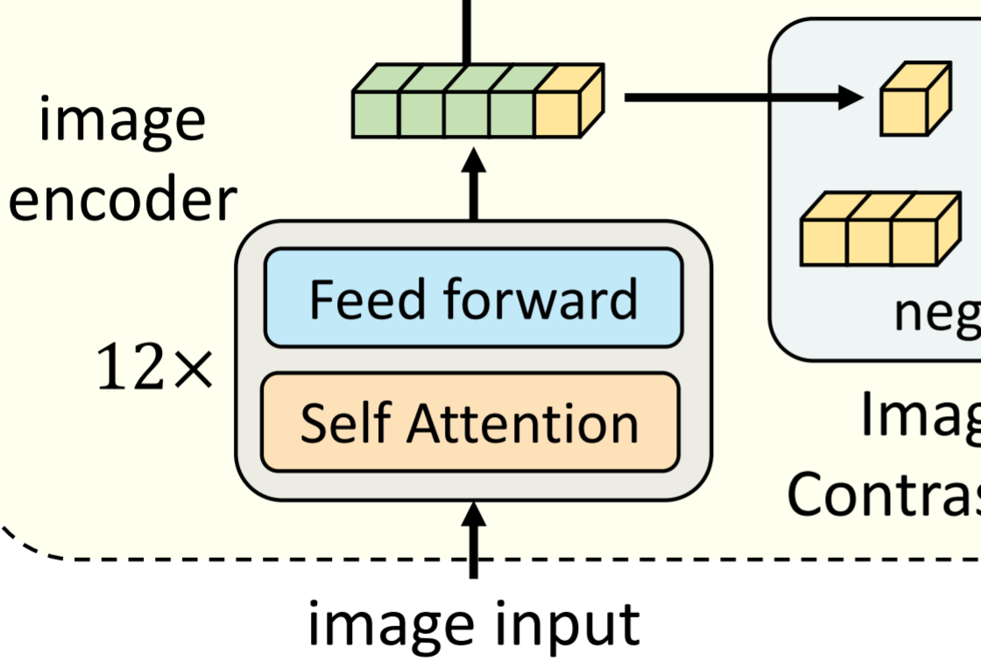
Image Encoder
Initialized using 12-layer visual transformer ViT-B/16
Pre-trained on ImageNet-1k
v_cls is the embedding of the [CLS] token

Slide 10
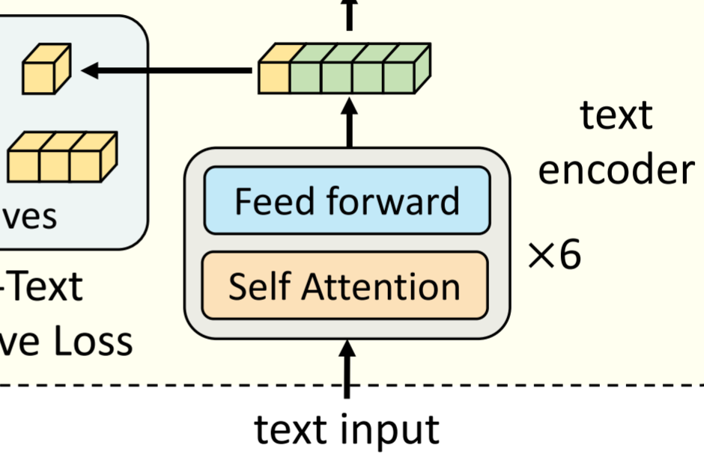
Text Encoder
Initialized using the first 6 layers of the BERTbase model

Slide 11
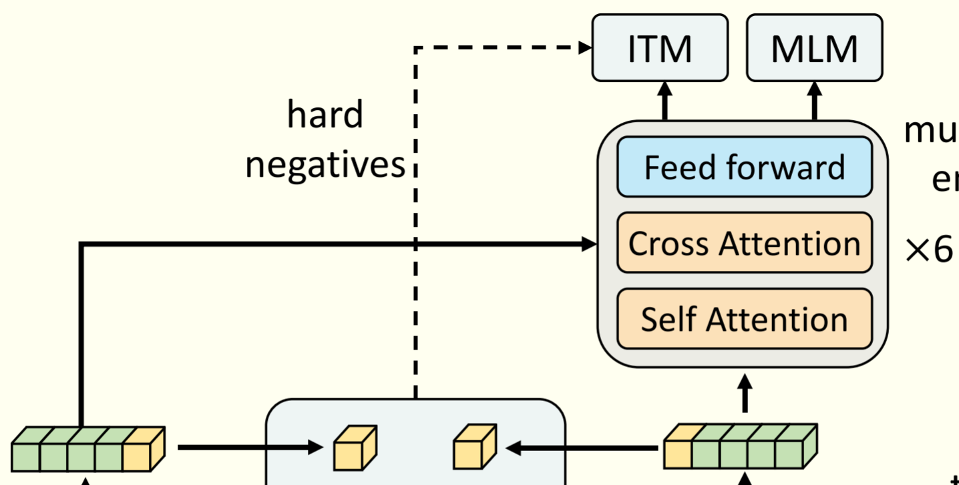
Multimodal Encoder
Initialized using the last 6 layers of the BERTbase
Question: How to do cross attention

Slide 12
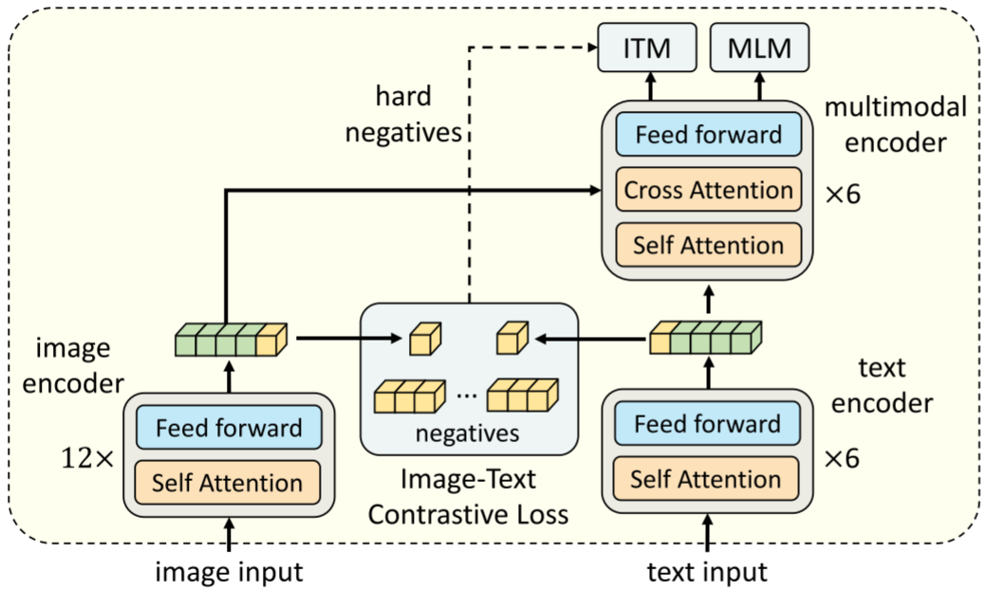

Loss Function
ITC: Image-Text Contrastive
MLM: Masked Language Modeling
ITM: Image-Text Matching
Notes:
Hard Negative: the most similar negative sample other than the positive sample pair.
Easy Negative: samples that are significantly mismatched to positive samples .

Slide 13
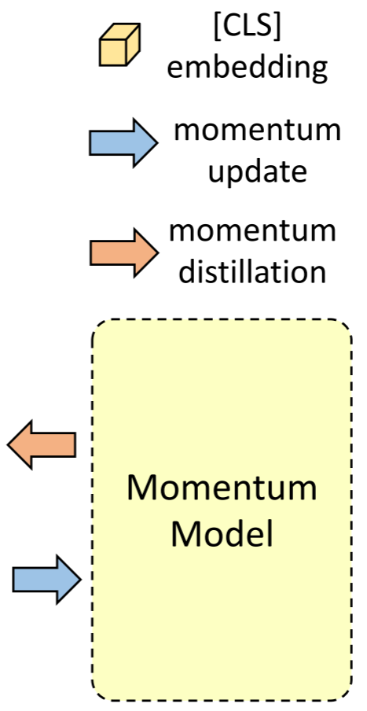
Momentum Distillation
Positive pairs are usually weakly-correlated
Idea from MoCo
The ITC_MoD loss is defined as:
the MLMMoD loss is:

Slide 14
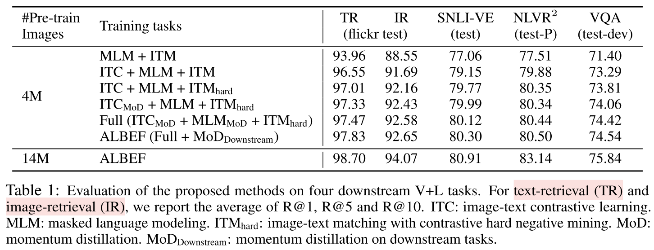
Ablation Experiments

Slide 15
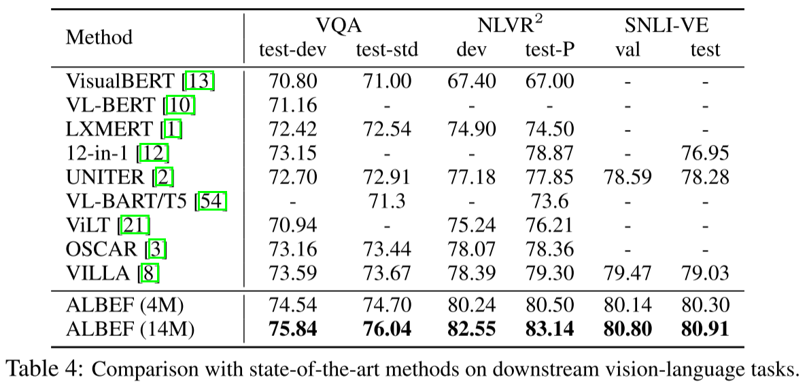
Comparison with SOTA

Slide 16
Links
Beyond Short Snippets: Deep Networks for Video Classification (https://arxiv.org/abs/1503.08909)
Convolutional Two-Stream Network Fusion for Video Action Recognition (https://arxiv.org/abs/1604.06573)
Temporal Segment Networks: Towards Good Practices for Deep Action Recognition (https://arxiv.org/abs/1608.00859)
Align before Fuse: Vision and Language Representation Learning with Momentum Distillation (https://arxiv.org/abs/2107.07651)
Momentum contrast for unsupervised visual representation learning. (https://arxiv.org/abs/1911.05722)

Slide 17
Question

