Slide 1
An Empirical Study of Training End-to-End Vision-and-Language Transformers
Zi-Yi Dou*, Yichong Xu, Zhe Gan, Jianfeng Wang,
Shuohang Wang, Lijuan Wang, Chenguang Zhu, Pengchuan Zhang,
Lu Yuan, Nanyun Peng, Zicheng Liu, Michael Zeng
University of California, Los Angeles, Microsoft Corporation
{zdou,violetpeng}@cs.ucla.edu
{yicxu,zhgan,jianfw,shuowa,lijuanw,chezhu,penzhan,luyuan,zliu,nzeng}@microsoft.com

Slide 2
This Work is a Empirical Study
Dissect the model designs along multiple dimensions:
Vision encoders (e.g., CLIPViT, Swin transformer)
Text encoders (e.g., RoBERTa, DeBERTa)
Multimodal fusion module (e.g., merged attention vs. co-attention)
Architectural design (e.g., encoder-only vs. encoder-decoder)
Pre-training objectives (e.g., masked image modeling)
https://github.com/zdou0830/METER

Slide 3
Question 1: How we do Multimodal Fusion?

Slide 4
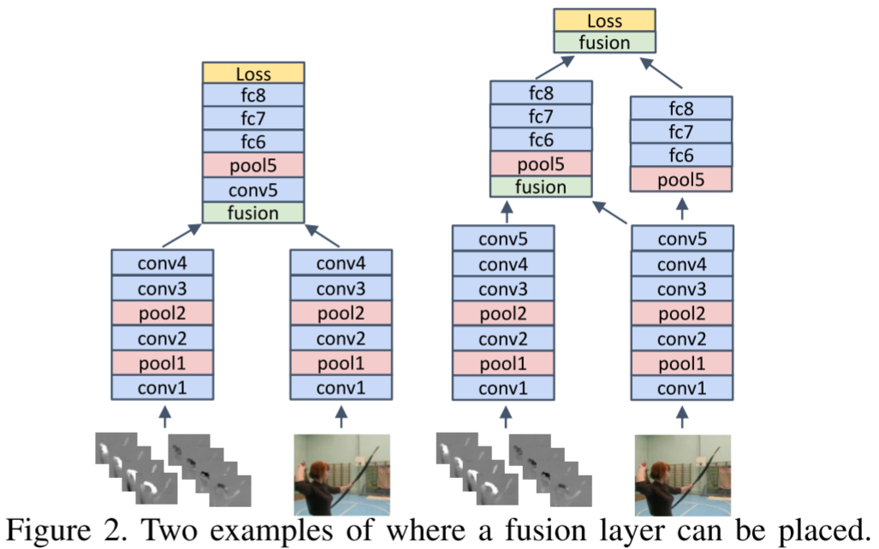
Fusion
Convolutional Two-Stream Network Fusion for Video Action Recognition
(https://arxiv.org/abs/1604.06573)

Slide 5
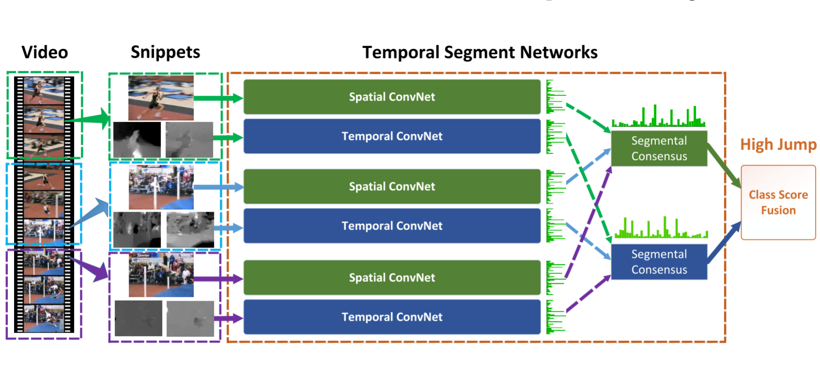
Fusion
Temporal Segment Networks: Towards Good Practices for Deep Action Recognition
(https://arxiv.org/abs/1608.00859)

Slide 6
Question 1: How we do Multimodal Fusion in Attention-based Model?

Slide 7
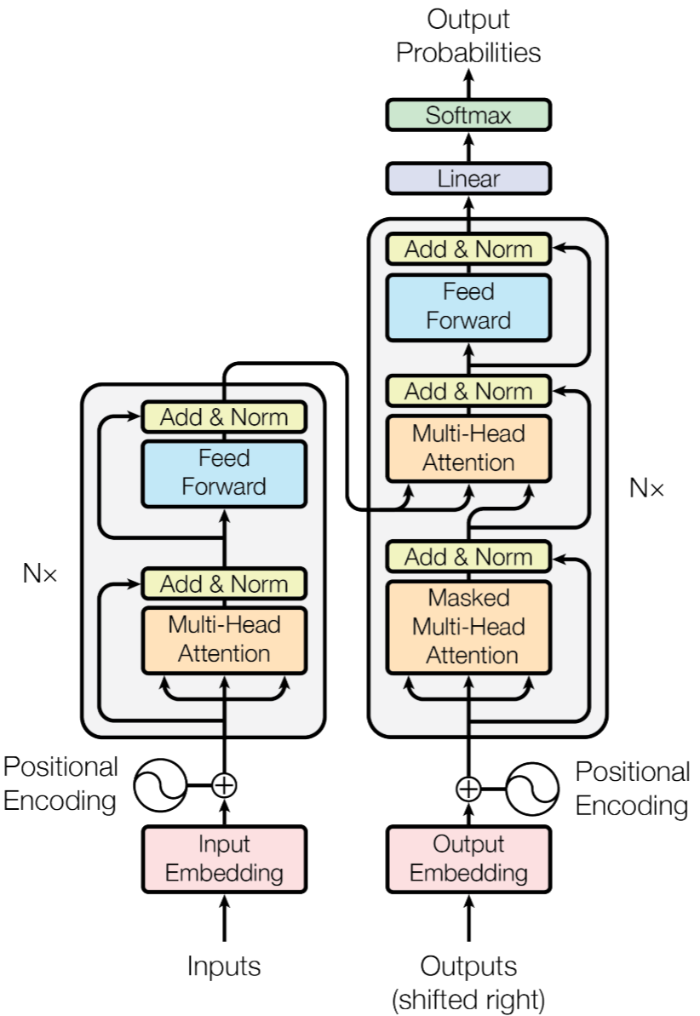
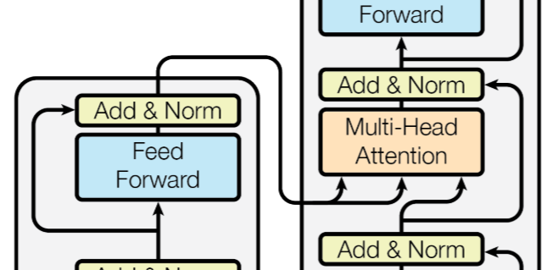
Transformer

Slide 8
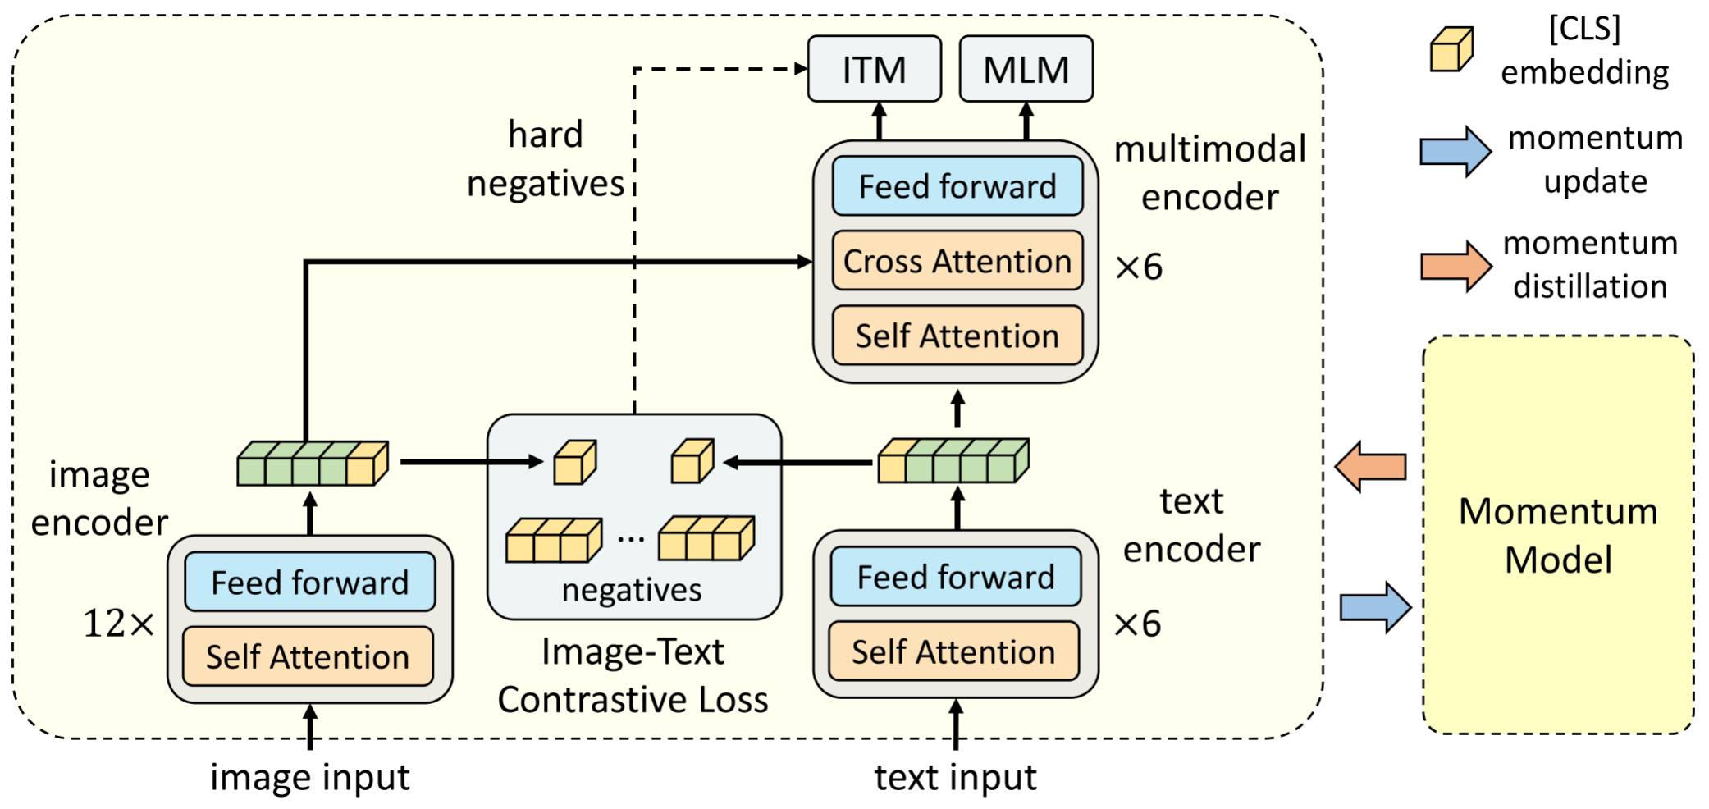
ALBEF

Slide 9
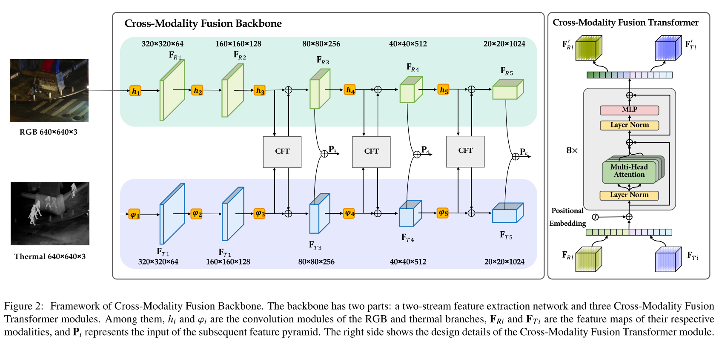
Cross-Modality Fusion Transformer for Multispectral Object Detection

Slide 10
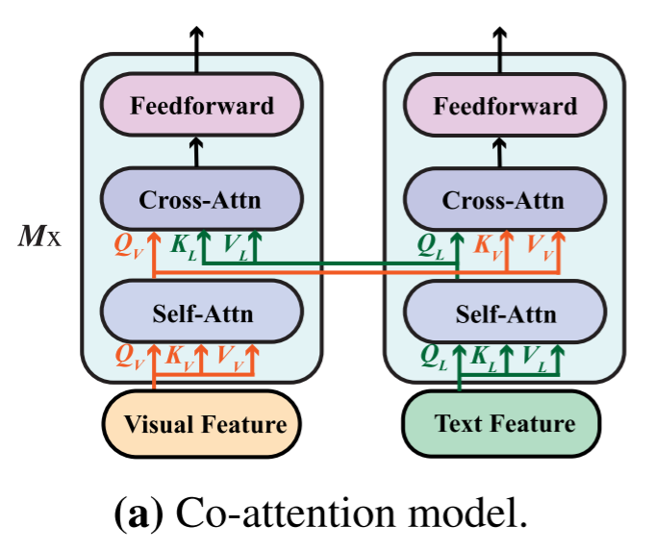
Co-attention model
Text and visual features are fed into different transformer blocks independently
Cross-attention are used to enable crossmodal interaction.

Slide 11
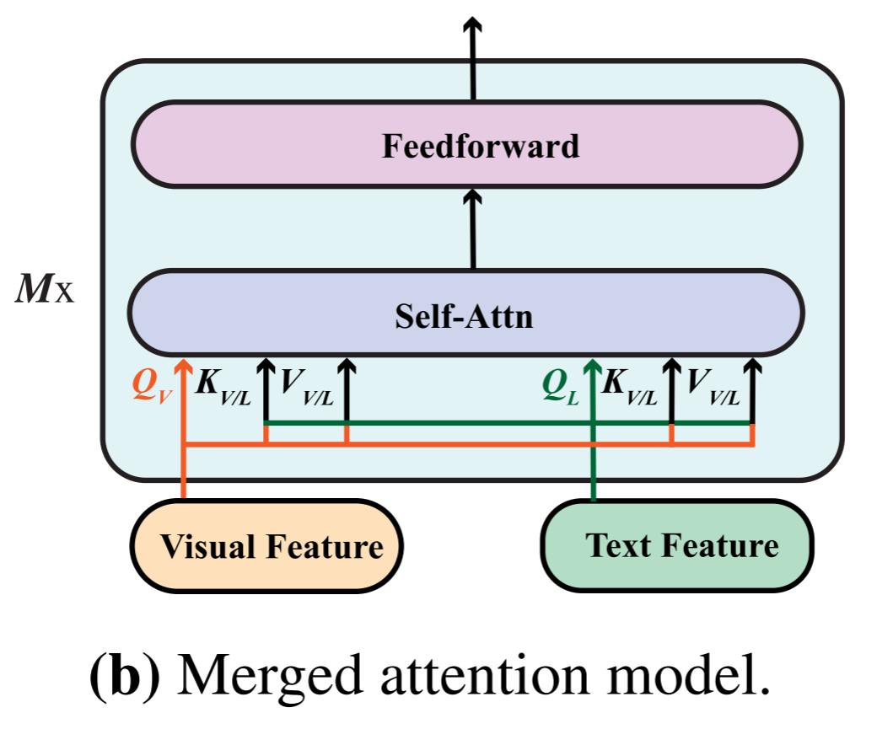
Merged attention model
Text and visual features are simply concatenated together
Fed into a single transformer block.

Slide 12
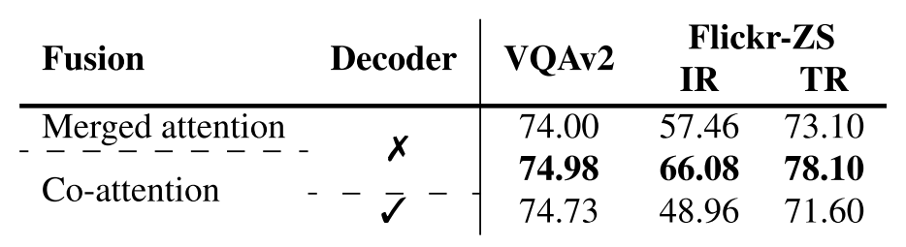
Ablation Experiments
The co-attention model performs better than the merged attention model in our setting, indicating that it is important to have different sets of parameters for the two modalities.

Slide 13
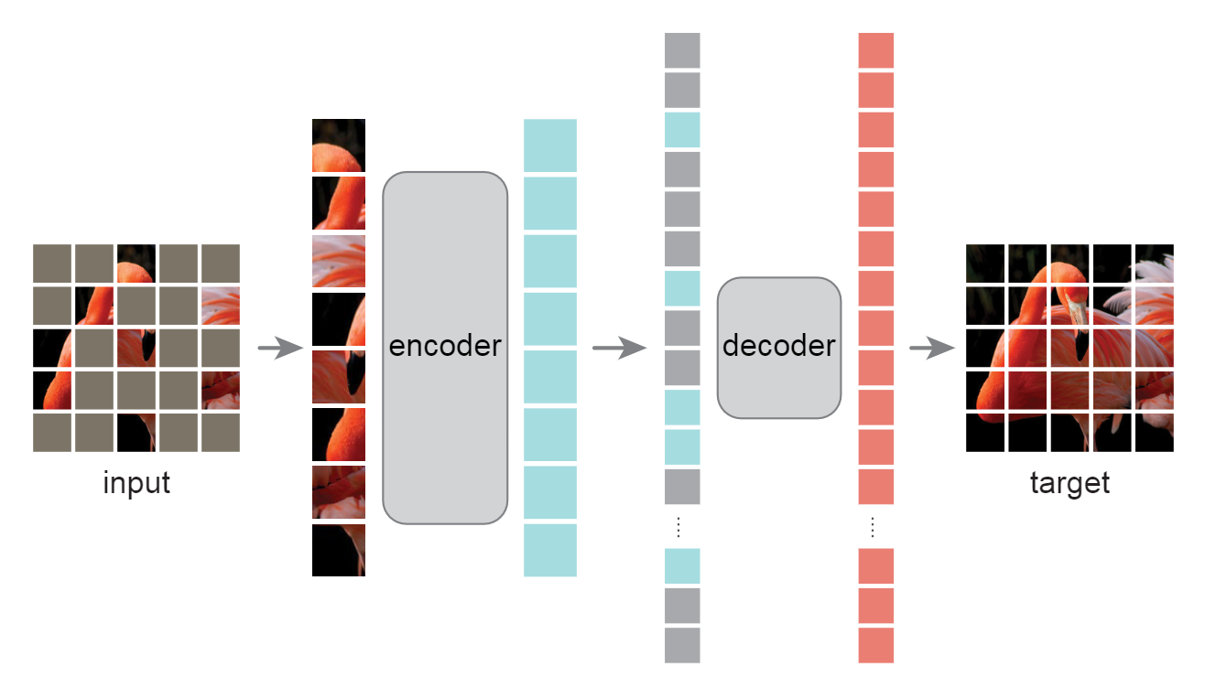
Masked Autoencoders Are Scalable Vision Learners

Slide 14
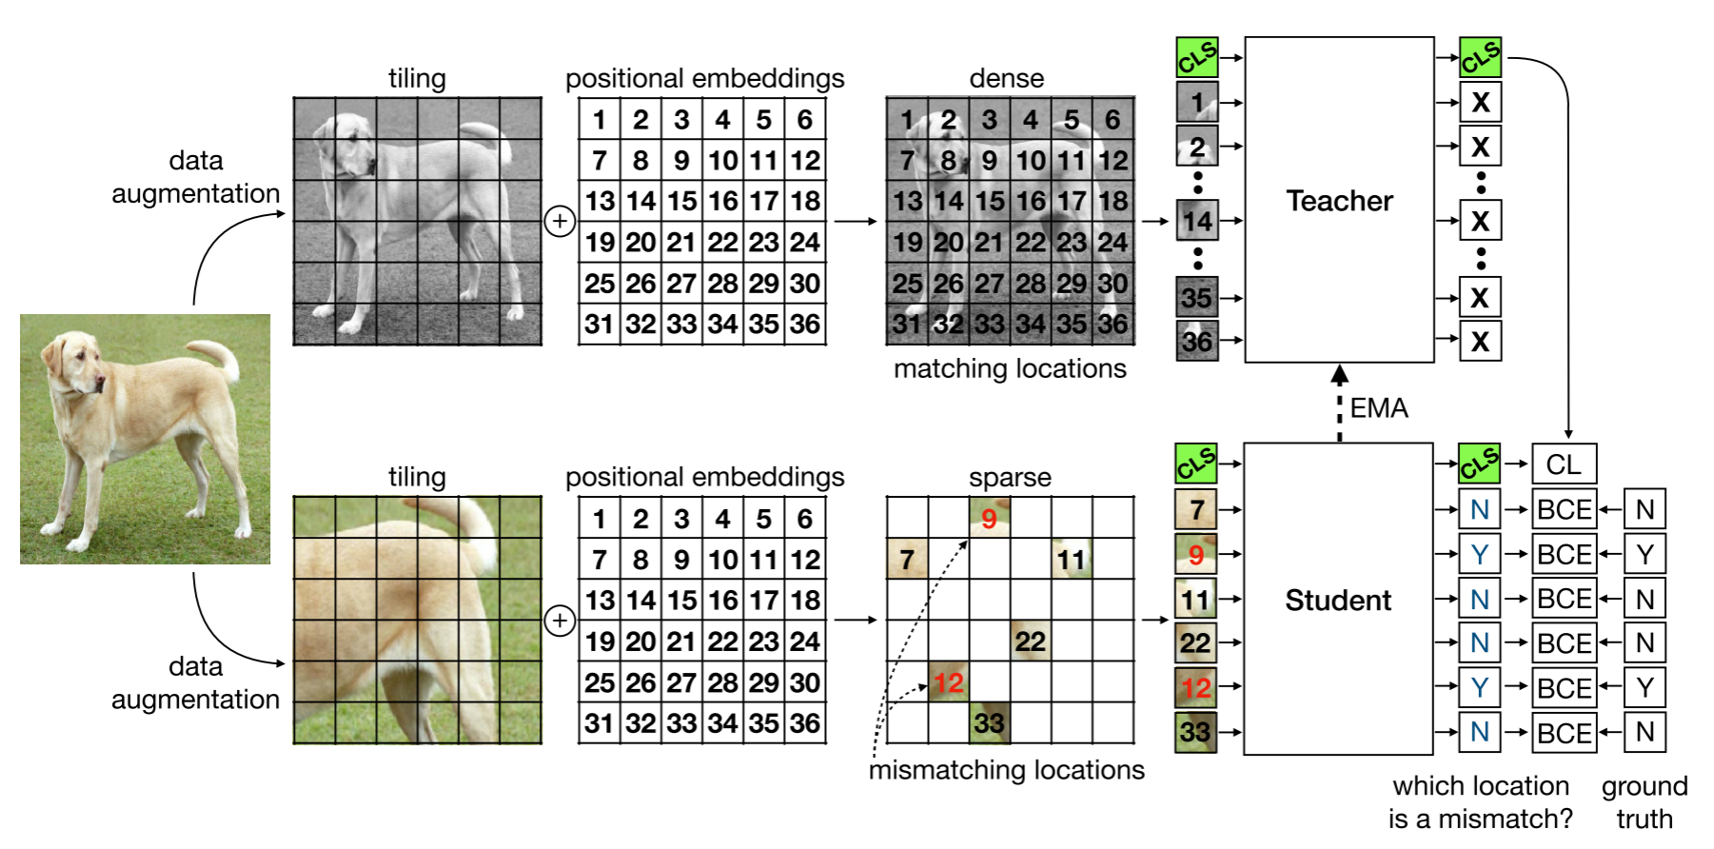
Representation Learning by Detecting Incorrect Location Embeddings

Slide 15
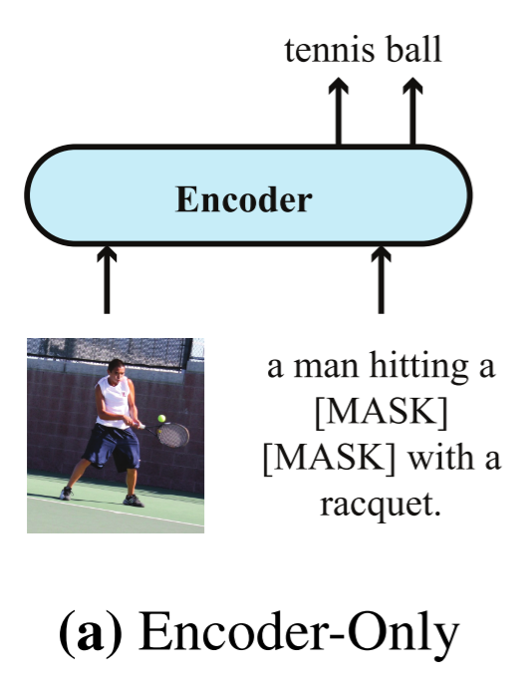
Encoder-Only

Slide 16
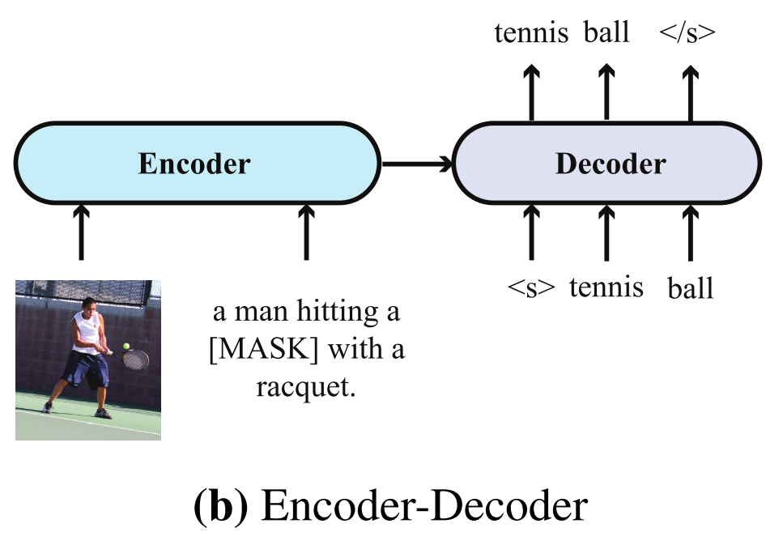
Encoder-Decoder

Slide 17
Ablation Experiments
Encoder-only model can outperform the encoder-decoder model on our two discriminative tasks
However, it should be noted that the encoder-decoder architecture is more flexible, as it can perform tasks such as image captioning which may not be that straightforward for an encoder-only model to be applied to.

Slide 18
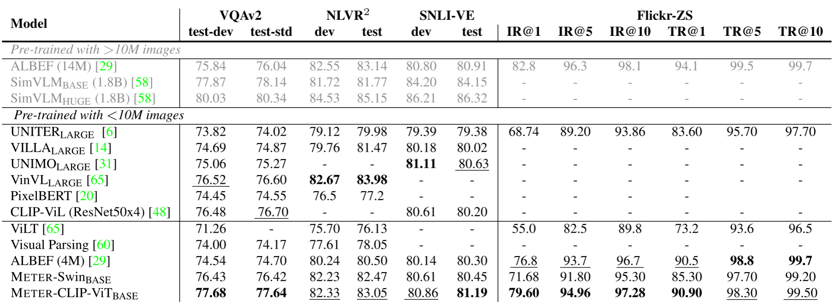
Result

Slide 19
Links
Convolutional Two-Stream Network Fusion for Video Action Recognition (https://arxiv.org/abs/1604.06573)
Temporal Segment Networks: Towards Good Practices for Deep Action Recognition (https://arxiv.org/abs/1608.00859)
Align before Fuse: Vision and Language Representation Learning with Momentum Distillation (https://arxiv.org/abs/2107.07651)
Cross-Modality Fusion Transformer for Multispectral Object Detection(https://arxiv.org/abs/2111.00273)
Attention Is All You Need(https://arxiv.org/abs/1706.03762)
Masked Autoencoders Are Scalable Vision Learners(https://arxiv.org/abs/2111.06377)
Representation Learning by Detecting Incorrect Location Embeddings(https://arxiv.org/abs/2204.04788)

Slide 20
Question

