Slide 1
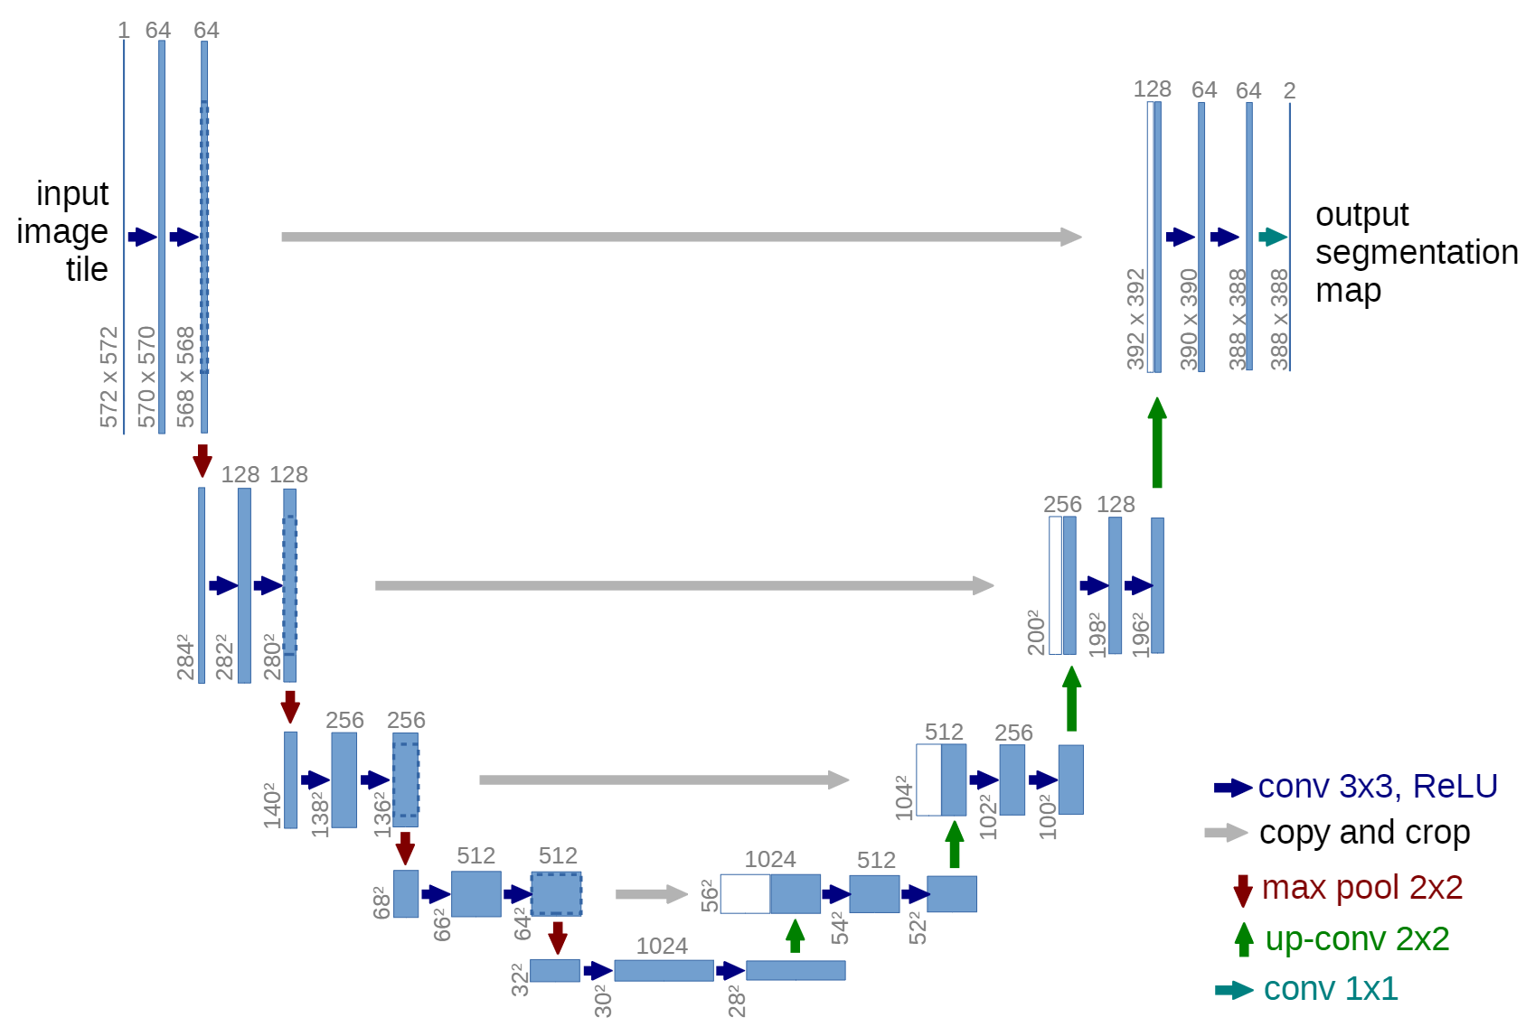
Dataset
3-channel
tensor
UNet
Matrics for evaluate
IoU
Preprocessing
Training Process
Output
F1 Score
Preprocessing
GT
1-channel
label image
Loss
Function
FN + FP
Loss

