Slide 1
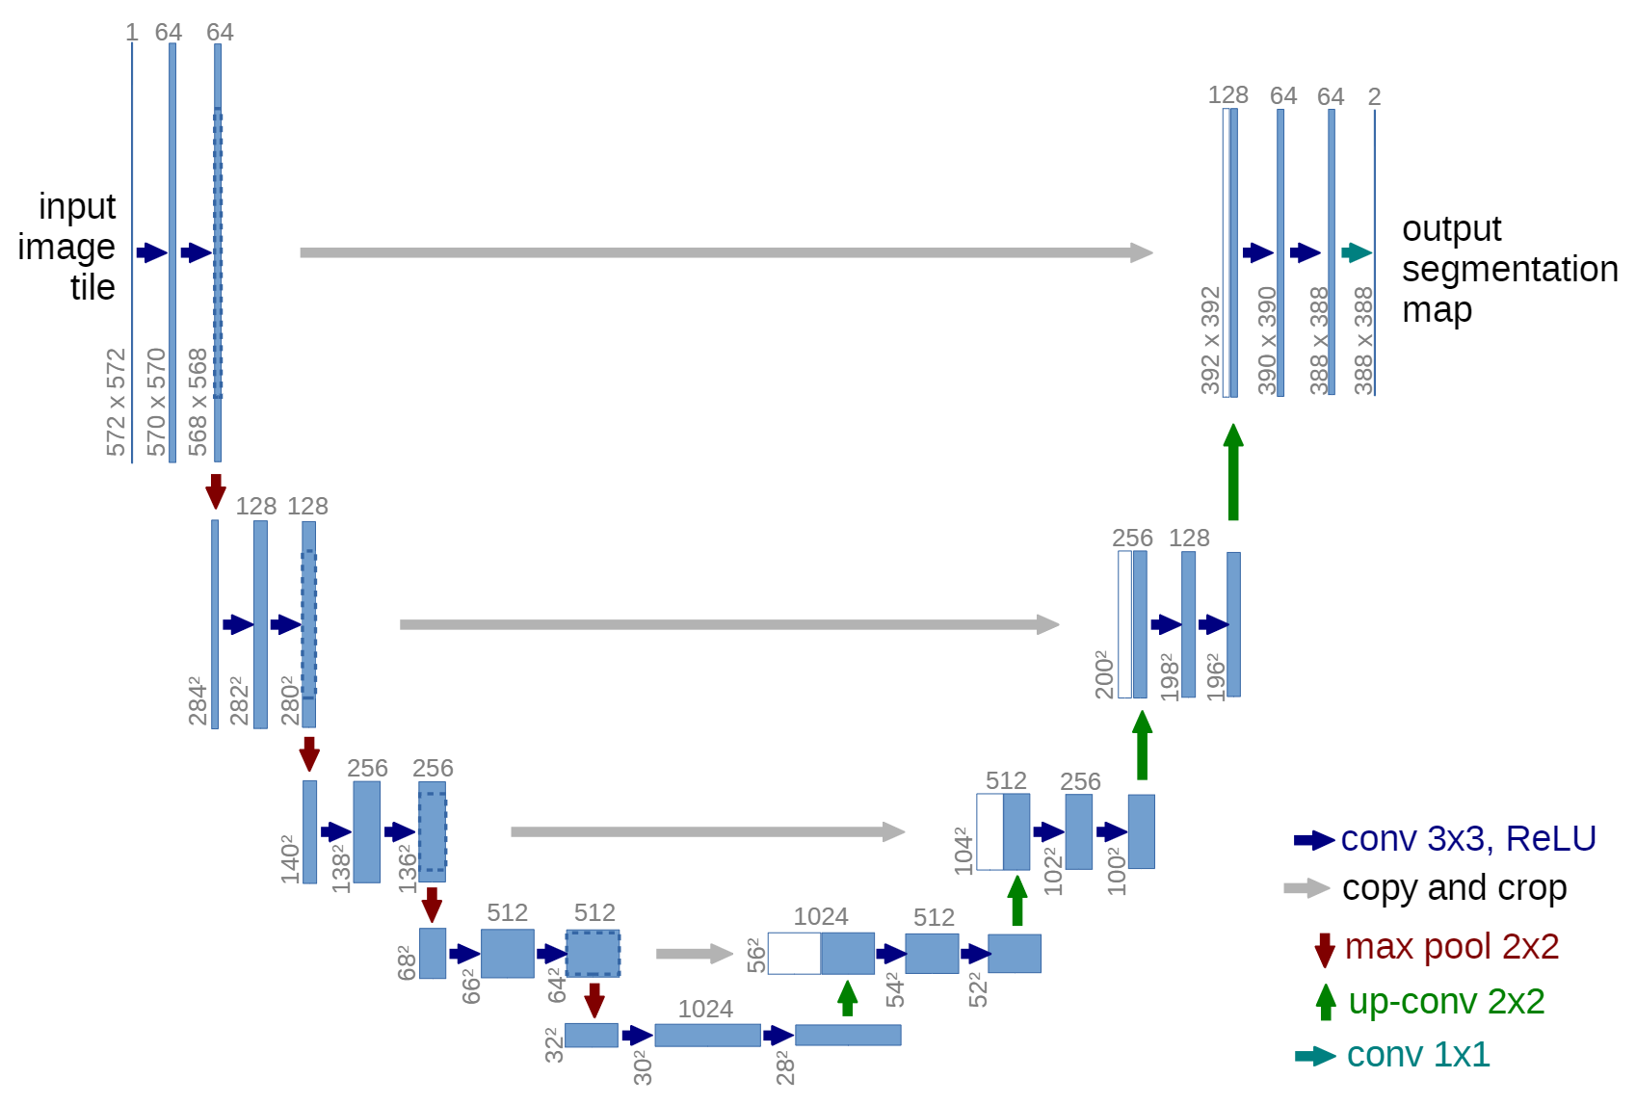
Test
Dataset
Original
Pages
3-channel
tensor
Train&Val
Dataset
UNet
Evaluate
Dataloader
Preprocessing
IoU
 | Class 1 | ...... | Class 6 | Total
IoU | 0.96 | ...... | 0.87 | 0.92
F1 Score | 0.95 | ...... | 0.84 | 0.91
Error Rate | 0.04 | ...... | 0.16 | 0.08
Training Process
Training Step
Output
F1 Score
Evaluate
Preprocessing
Dataloader
Ground
Truth
One-hot
label image
Train&Val
Dataset
Loss
Function
Update
Weights
FN + FP
Test
Dataset

