Slide 1
PROJECT TITLE
KEYLOGGER PROJECT
Presented By:
S Suganthan
Rajiv Gandhi College of Engineering
BE CSE

Slide 2
OUTLINE
Problem Statement
Proposed System/Solution
System Development Approach (Technology Used)
Algorithm & Deployment
Result (Output Image)
Conclusion
Future Scope
References

Slide 3
Problem Statement
The Key Loggers where initially introduced for tracing the software development process by knowing the minor details of the code.
But later due to the ability of the keylogger to maintain the entire log of the user activity the attackers started using it for malicious purposes.

Slide 4
Proposed Solution
Antivirus/Anti-Malware Software: Regularly update and use reputable antivirus or anti-malware software that includes features to detect and block keyloggers.
Firewalls: Utilize firewalls to monitor and control incoming and outgoing traffic on your computer. Configure your firewall settings to block suspicious connections.
Regular System Scans: Perform regular system scans using antivirus software to detect and remove any malicious software, including keyloggers, that may be present on your system.

Slide 5
System Approach
The "System Approach" section outlines the overall strategy and methodology for developing and implementing the rental bike prediction system. Here's a suggested structure for this section:
System requirements:
- A Computer with Python
Library required to build the model
- Python 3.0 or higher
- Tkinter
- pynput

Slide 6
Algorithm & Deployment
Import the necessary libraries: `tkinter`, `keyboard` from `pynput`, and `json`.
Declare global variables such as `keys_used`, `flag`, and `keys`.
Define functions to log key events to both a text file and a JSON file, handle key press and release events, start and stop the keylogger, and manage the graphical user interface.
Create a Tkinter window (`root`) with a title "Keylogger", including a status label and "Start" and "Stop" buttons to control the keylogger, configuring their commands and initial states.
Start the Tkinter main event loop (`root.mainloop()`).
Handle key events using the `pynput` library, updating the keylogger's status and log files accordingly.

Slide 7
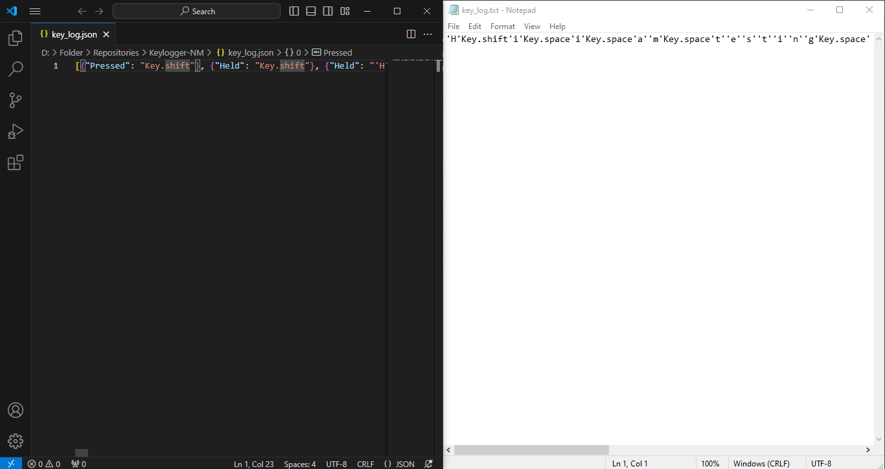
Result

Slide 8
Conclusion
In this presentation, we delved into crafting a keylogger with Python, Tkinter, and the pynput library. Covering keystroke capture, logging to text and JSON, and a user-friendly Tkinter interface, it provides a solid foundation for Python enthusiasts. It's crucial to grasp the ethical and legal considerations of such tools, making this a comprehensive guide to responsible keylogger development.

Slide 9
Future scope
Enhanced Logging: Implement features to log additional information such as timestamps, window titles, or application context alongside keystrokes to provide more context for captured data.
Remote Monitoring: Extend the keylogger to transmit logged data to a remote server for monitoring, enabling users to access keylogs remotely and receive real-time notifications.
Encryption and Security: Integrate encryption techniques to secure logged data, ensuring that sensitive information remains protected from unauthorized access or interception.

Slide 10
References
NM Videos
Chat GPT
Google Web Search
William Stallings, "Cryptography and Network Security - Principles and Practice", Seventh Edition, Pearson Education, 2017

Slide 11
THANK YOU

