Slide 1
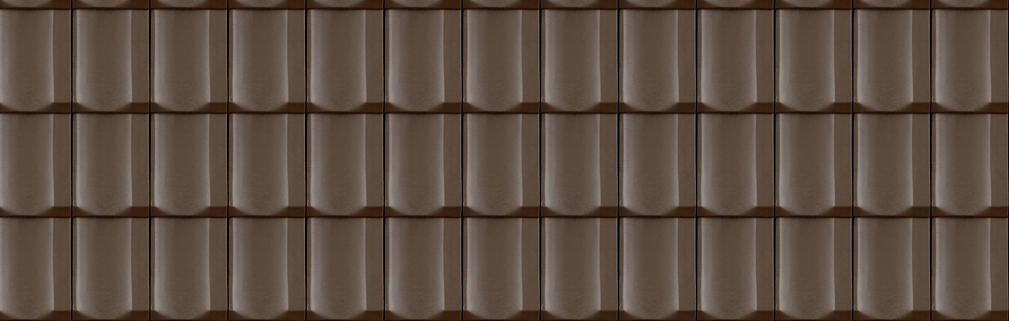




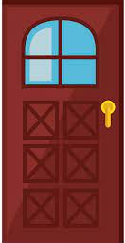
BUILD YOUR HOUSE
One stair
CHANRY
RED WALL
WHITE WALL
ROOF
DOOR
WINDOWS
OWNER BOARD
TREE

Slide 2
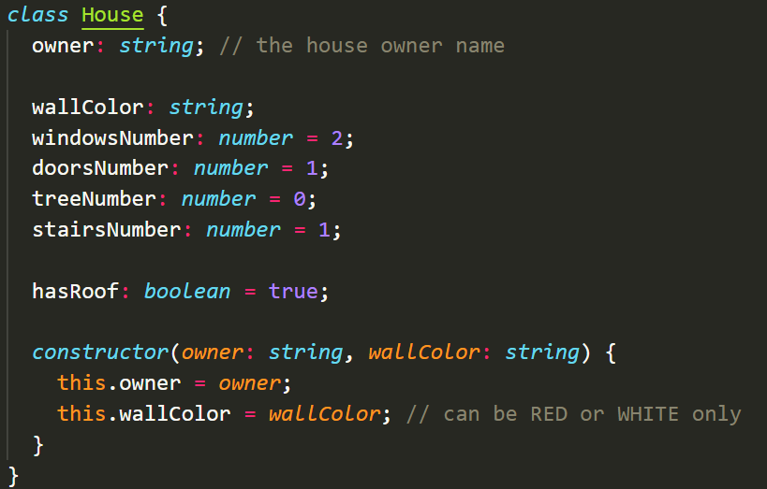
THE CLASS MODEL

Slide 3
THE OBJECT
let houseRonan = new House("ronan", "RED");
houseRonan.windowsNumber = 1;
THE RESULT
hasRoof is true
The owner is RONAN
Only 1 stair
1 DOOR by default
RONAN
1 window

Slide 4
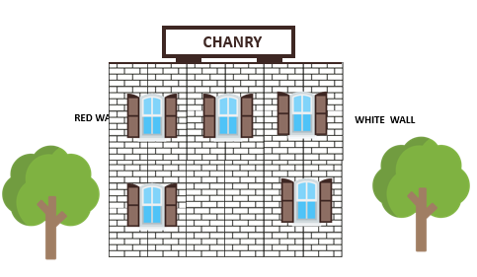
THE OBJECT
let houseChanry = new House(“CHANRY", “WHITE");
houseChanry.stairNumber = 2;
houseChanry.windowsNumber = 5;
houseChanry. treeNumber = 2;
houseChanry.hasRoof = false;
THE RESULT

Slide 5


THE OBJECT
let houseKunthy = new House(“KUNTHY", “RED");
houseKunthy.stairsNumber = 2;
houseKunthy.windowsNumber = 3;
houseKunthy.doorsNumber = 2;
houseKunthy.treesNumber = 3;
houseKunthy.hasRoof = true;
THE RESULT
Kunthy

Slide 6
THE OBJECT
<WRITE THE CODE TO BUILD THIS HOUSE>
Let houseChanthea = new House(“Chanthea”, “white”);
houseChanthea.treeNumber = 5;
houseChanthea.hasRoof = true;
houseChanthea.doorNumber = 2;
houseChanthea.windowNumber = 0;
houseChanthea.stairNumber =1;
THE RESULT
CHANTHEA

