Slide 1
DevOps - Deploy Secure Cloud Native Apps FAST Aqua Security
Raj Seshadri – Solutions Architect raj@aquasec.com
@texanraj

Slide 2
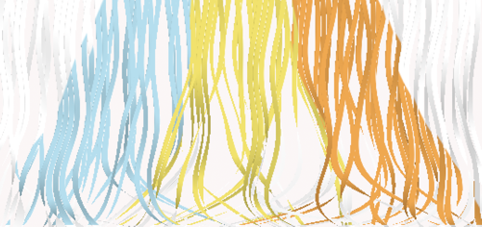

Cloud native technology brings a dramatic shift in speed, scale and networking
Attack surface
CONTAINER
Dev cycles
VM
Continuous deployment
Infrequent, major releases
Scale
10x per host, weeks/months
1000x per host, hours/days
Few apps, few nodes
Connectivity
Dozens of interconnected micro services

Slide 3
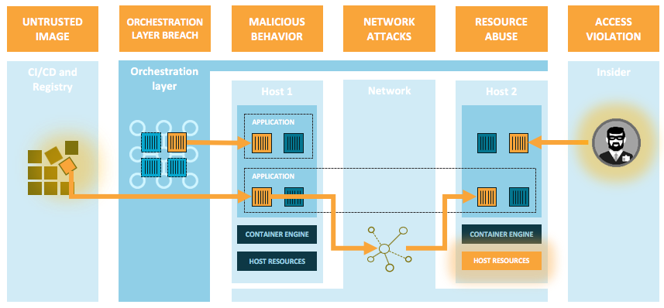
The Threat Landscape

Slide 4
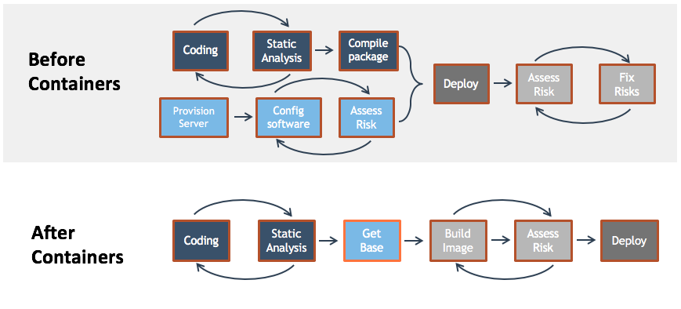
Where Security Fits

Slide 5



Aqua Security: Our Approach
Make Cloud-Native the most secure, predictable and controlled platform for running critical applications
Security as a shared responsibility |  | Protect workloads with focus on prevention |  | Secure Once, Run Anywhere
“Shift left” security, fix issues early and fast |  | Whitelist good behavior, preventing anomalies |  | Secure the application uniformly across clouds and platforms

Slide 6
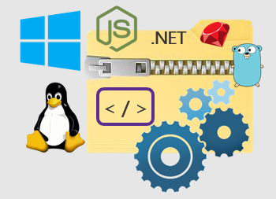
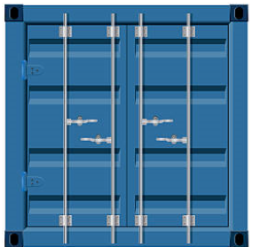
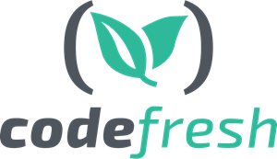
The Container Lifecycle
What is the risk of running an image? What can a running container do?
Cryptographic digest of image
Track image and ensure integrity
Malware
Build
Ship
Run
Unapproved Base Images
Hard-Coded Secrets
OSS Licenses
Known CVEs
Scan for vulnerabilities, malware, OSS, secrets
Base-image policy
Check configuration
Block unapproved images
Enforce image risk policy
Changes move in one direction

Slide 7








Shift Left: Baked-In vs Bolt-On Security
Build
Ship
Run
✓
✗
1
2
3
Unique digest
Continuous scan for CVEs
CVE blacklist & whitelist
Risk Score
Feedback to developers
Aqua Cyber Intelligence

Slide 8
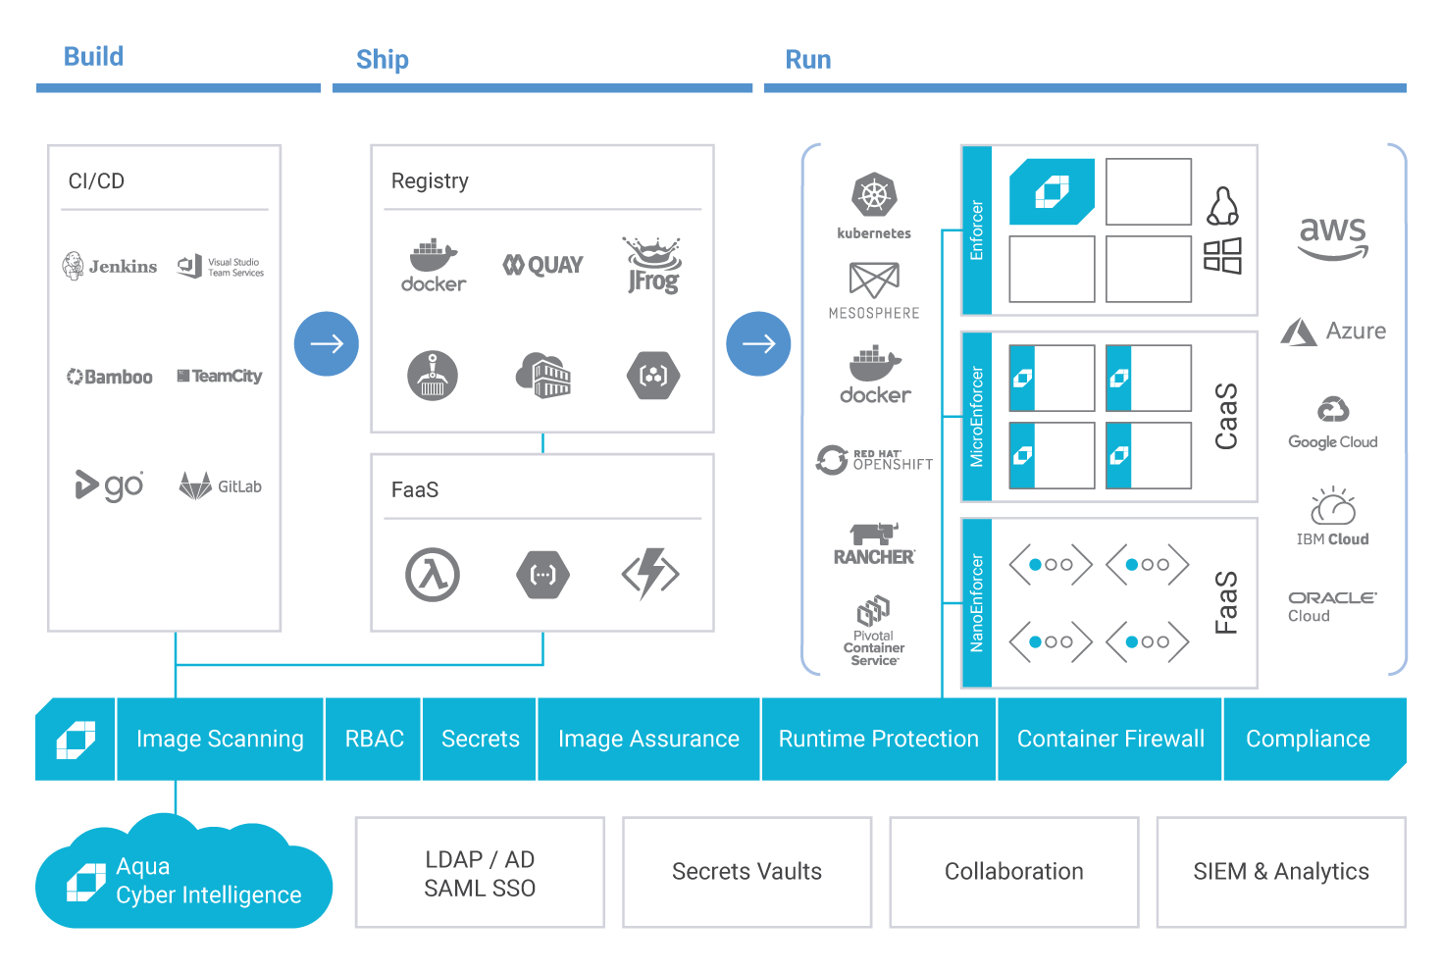
Secure Once, Run Anywhere

Slide 9
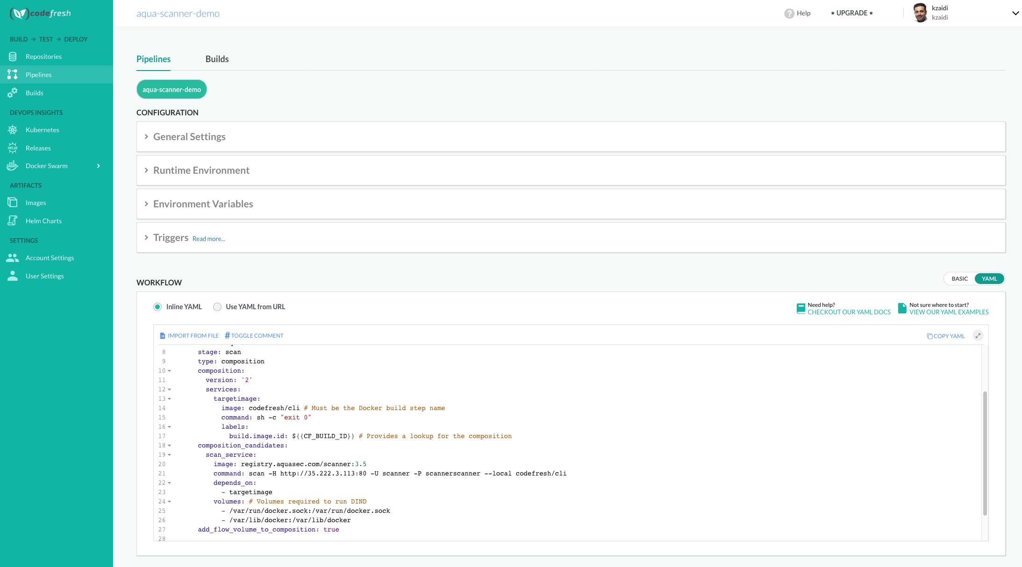
Integration into Codefresh CI

Slide 10
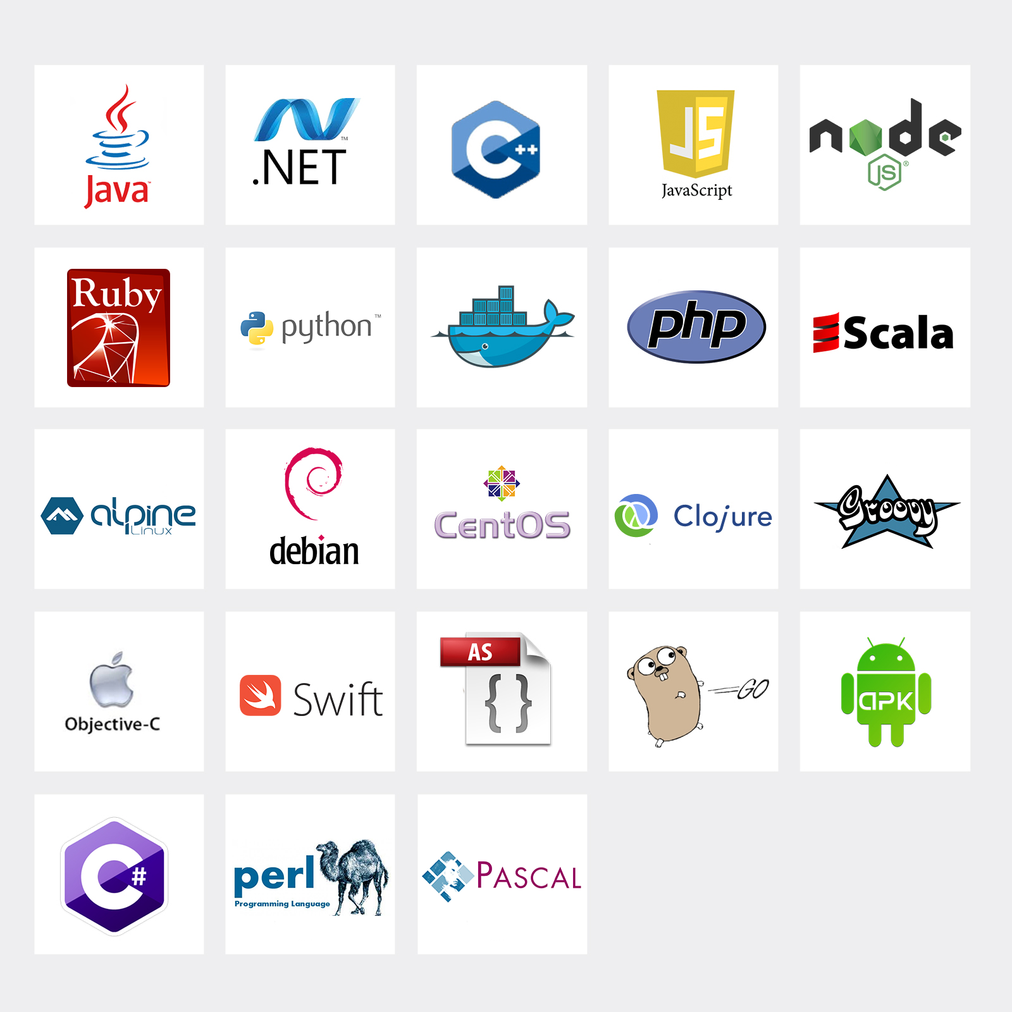


Aqua Image Scanning
Key Features
CVE scanning based on multiple sources (NVD, vendor advisories, proprietary research) - updated continuously
Scans for hard-coded secretes in images (tokens, private keys, certificates)
Scans for malware
Checks best practice configuration issues
Supports all Docker registries
Native plug-ins for CI/CD including Codefresh, Jenkins, VSTS, Bamboo and others
Languages
National Vulnerabilities Database

Slide 11
Aqua Runtime: Focus on Prevention
Immutable applications are easier to protect:
Updates should only be done via a monitored build process
Any change made to a running application is therefore suspicious
Aqua checks application contents against its originating build artifact
If a change is detected – generates alert, can block the specific change attempt
Original Application
Observed Behavior
Protected Application
✗
✗
✗
✗
✗
✗
✗
✗
✗
✗
✗
✗
✗
✗
✗
✗
✗
✗
✗
✗
✗
✗
✗
✗
✗
✗
✗
✗

Slide 12
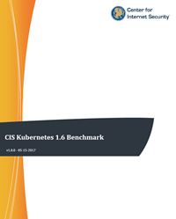
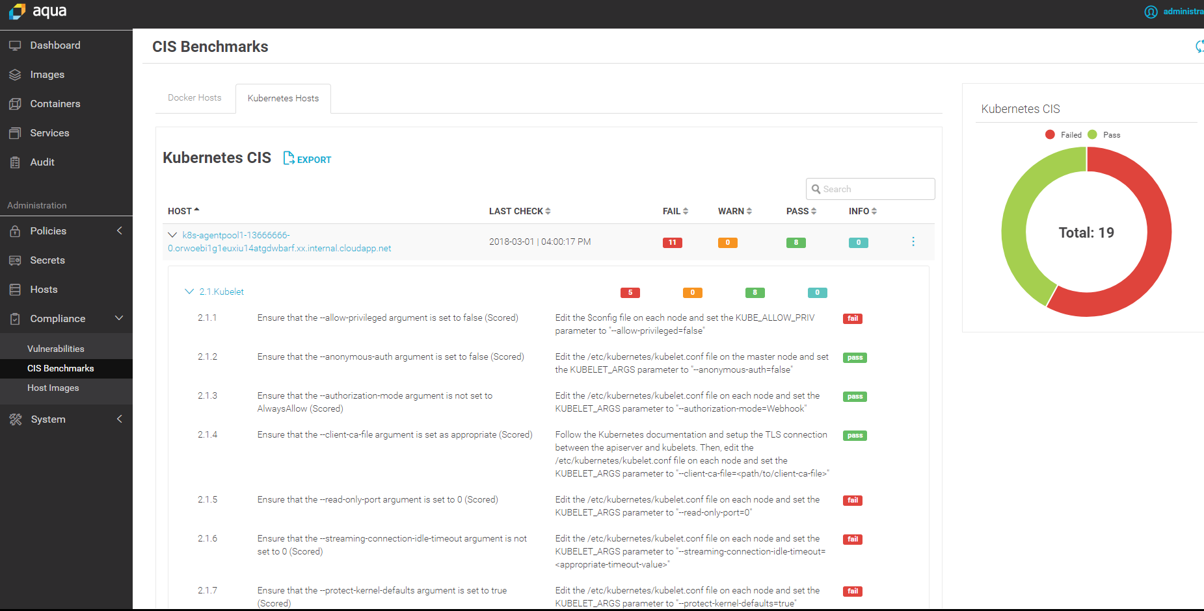

Kubernetes & Docker CIS Benchmarks
Runs checks against all 200+ CIS tests
Provides a scored report of the results
Can be scheduled to run daily
Aqua is a CIS SecureSuite member

Slide 13
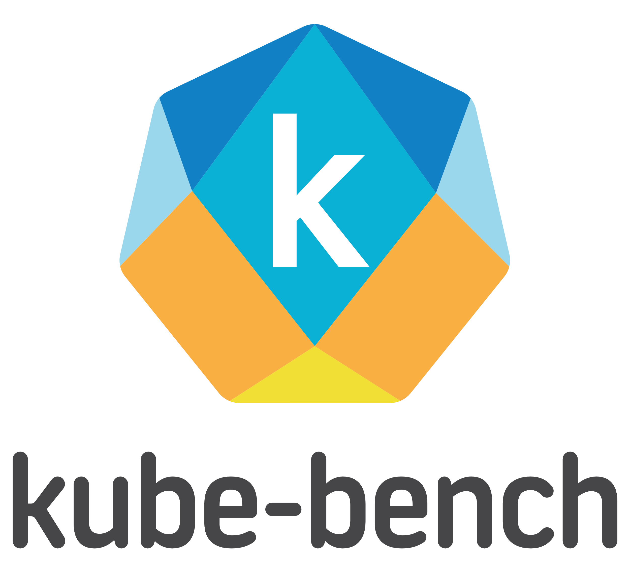
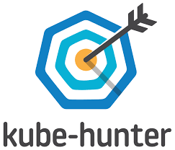
Kubernetes Open Source Security Tools
Open-source project automates CIS Benchmark testing
Get it at https://github.com/aquasecurity/kube-bench
Open-source project for pen-testing Kubernetes deployments
Get it at https://kube-hunter.aquasec.com/

Slide 14
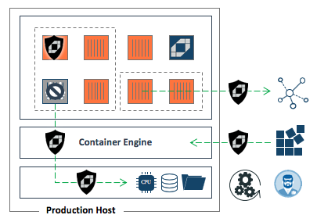
Containers Present an Opportunity for Better Security
Prevent unknown images
Stop image by CVEs and score
Stop user privilege escalation
Stop suspicious processes
Control capabilities
Enforce network isolation
Protect the host resources
Encrypt sensitive variables
Enforce use of automation tools
Visibility across the environment

Slide 15



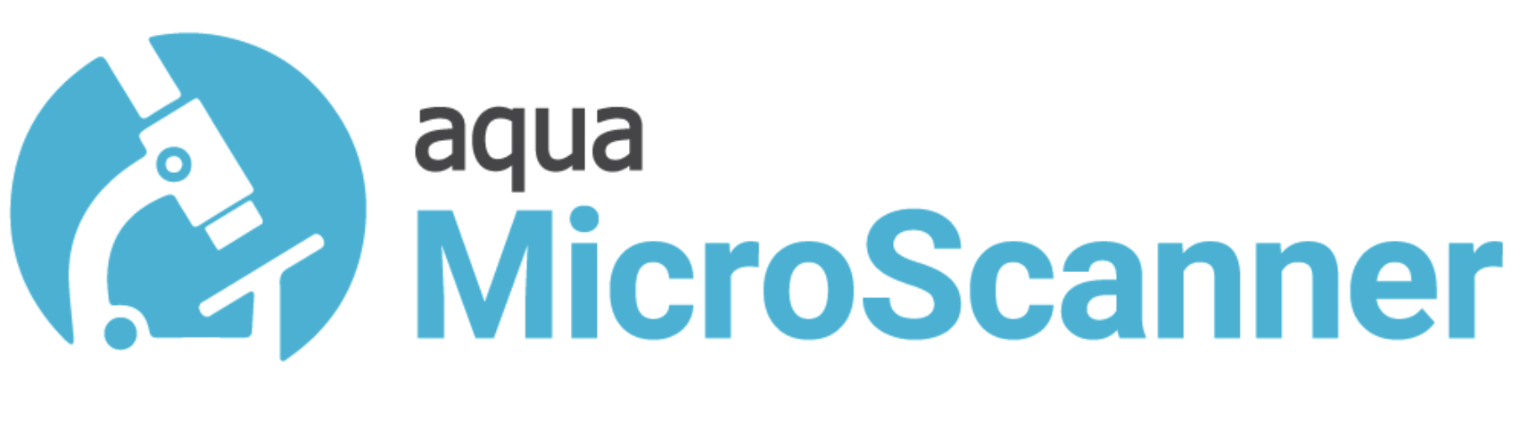
Try Aqua and Secure Your Cloud Native Workloads Today
Try Aqua on a Cloud Marketplace
Secure your workloads
Prepare a plan
Involve your teams
Use the tools at hand

Slide 16
Thank You @texanraj

