Slide 1

Embedded System for Photographic FLASH Triggering
Sotiris Kordas
School of Electrical and Computer Engineering
Committee:
Prof. A.Dollas
Assoc.Prof. E. Koutroulis
Assoc.Prof. I. Papaefstathiou (AUTH)

Slide 2
Aims
Design of photographic flash triggering system
Wireless sensor triggers
Low cost (< 60$)
Open Source
Readily available components
Easy construction

Slide 3


High Speed Photography
Multiple consecutive shots at high frequency
Single image capturing a specific moment in time
E. Muybridge, Descriptive Zoopraxography
http://www.cameraaxe.com/wp/
SMPTE, “Society of Motion Picture and Television Engineers”, www.smpte.org/home, 2007. [Online]. Available: http://www.smpte.org/home
J. E. Field, “High-speed photography,” Contemporary Physics, 1983. [Online]. Available: https://en.wikipedia.org/wiki/High-speed_photography#Notes

Slide 4

Triggering Systems
Common Principles and Similar Architectures
Microcontrollers → computing units
Sensor Measurements → Τriggers
http://www.universaltimer.com/info1.html

Slide 5
Human Reaction Time
Slow (mean 250 ms)
Reaction Time (Tr) = Stimulus Time to Brain (Ts) + Brain to Body Command Time (Tb)
Age, Health State, Gender and Type of Stimulus as Factors for Reaction Times
A. Jain, R. Bansal, A. Kumar, and K. D. Singh, “A comparative study of visual and auditory
reaction times on the basis of gender and physical activity levels of medical first year
students.,” Int. J. Appl. basic Med. Res., vol. 5, no. 2, pp. 124–7, 2015.
A. T. Welford, “Speed-accuracy trade-off and information processing dynamics,” Academic Press, 1934.
F. Mawase, D. Lopez, P. A. Celnik, and A. M. Haith, “Movement Repetition Facilitates Response Preparation,” 2018.
R. J. Kosinski, “A Literature Review on Reaction Time.”

Slide 6
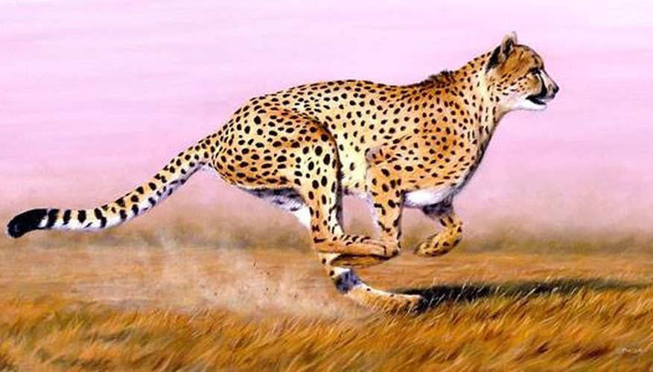
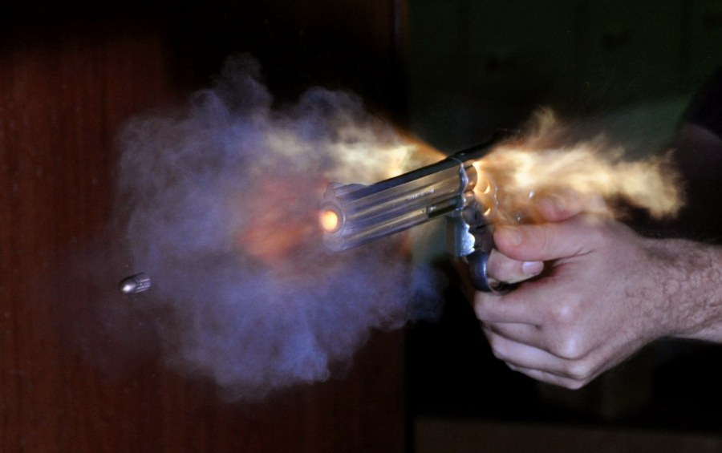


Duration of Interesting Phenomena
Animals (98 – 389 km/h)
Popping balloons (5-10 ms)
Bullets (120 – 1700 m/s)
Lightning (100 – 200 ms)
Objects Breaking (no specific value)
N. C. C. Sharp, “Timed running speed of a cheetah (Acinonyx jubatus),” J. Zool., vol. 241, no. 3, pp. 493–494, Mar. 1997.
High-Velocity Falcon | National Geographic, National Geographic , 2007.
B. Wilburn, N. Joshi, V. Vaish, M. Levoy, and M. Horowitz, “High-speed videography using a dense camera array,” Proc. 2004 IEEE Comput. Soc. Conf. Comput. Vis. Pattern Recognition, 2004. CVPR 2004., vol. 2, pp. 294–301, 2004

Slide 7
Features and Specifications
Main Features
2 sensors with changeable threshold
Triggering of one flash/camera
Wireless Sensor Connection
Two trigger functions
Selectable Trigger Delay
Specifications
System Latency : < 5 ms
Hardware:
  3 computing units
  3 wireless nodes
  1 OLED screen
  1 button
Total Cost : < $60
Computing Units’ I/O :
> 9 I/O Pins

Slide 8
Technology Mapping : Criteria
Performance
Cost and Availability
Power Consumption
Latency (for Wireless Communication)

Slide 9
Technology Mapping : Computing Units
Technology | Frequency | Cost | Power Consumption
CPU | > 1 GHz | > $40 | > 25 W (min 5 W)
FPGA | > 100 MHz | > $80 | > W
MCU | > 10 MHz | > $1-5 | < 500 mW
Goal | > 1 MHz | < $60 | < W

Slide 10
Technology Mapping : Wireless Communication
Technology | Estimation of Maximum Latency | Mandatory Optical Contact | Cost | Versatile | Typical Latency Value
Optical | Yes | Yes | > $3 | No | < 100 us
WiFi | No | No | > $3.6 | No | > 25 ms
Bluetooth | No | No | > $6.3 | No | > 25 ms
Zigbee | No | No | > $45 | No | > 25 ms
RF | Yes | No | > $2.4 | Yes | < 1 ms

Slide 11
General System Model
Flash/Camera
PC Sync/Mini Jack
Base System
Sensor System 0
RF Custom Protocol
RF Custom Protocol
Sensor System 1
System Model Diagram

Slide 12
Base Subsystem Model
Base MCU
Flash/Camera
PC Sync/Mini Jack
I2C
SPI
Push Button
OLED Screen
RF Transceiver
Base Subsystem Model Diagram

Slide 13
Sensor Subsystem Model
Sensor MCU
SPI
Analog Sensor
RF Transceiver
Sensor Subsystem Model Diagram

Slide 14
Comparison with Other Systems
Similarities
Use of sensors for triggers
Base responsible for:
  user interface
  checking trigger function
  triggering
Differences
Less centralized system
Dedicated MCU for each sensor
Wireless communication

Slide 15
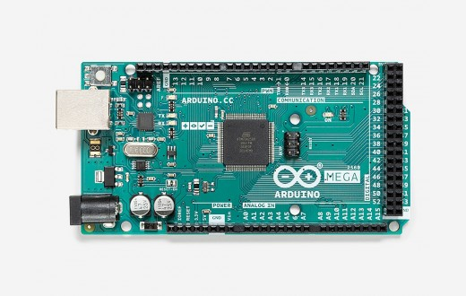
Base Subsystem MCU
Arduino Mega 2560
16 MHz
16 Analog Inputs, 54 Digital I/O
I2C, SPI, Serial support
Four 16-bit timers and two 8-bit timers
256 kbyte Flash/8 kbyte SRAM
Open platform → Well supported libraries
Low price (< 8$)
https://www.microchip.com/wwwproducts/en/ATmega2560
Arduino, “Arduino Mega 2560 Rev3 | Arduino Official Store,” Arduino. [Online]. Available: https://store.arduino.cc/arduino-mega-2560-rev3
Microchip Technology Inc., “ATmega640/V-1280/V-1281/V-2560/V-2561/V.” Microchip Technology Inc., p. 436.

Slide 16
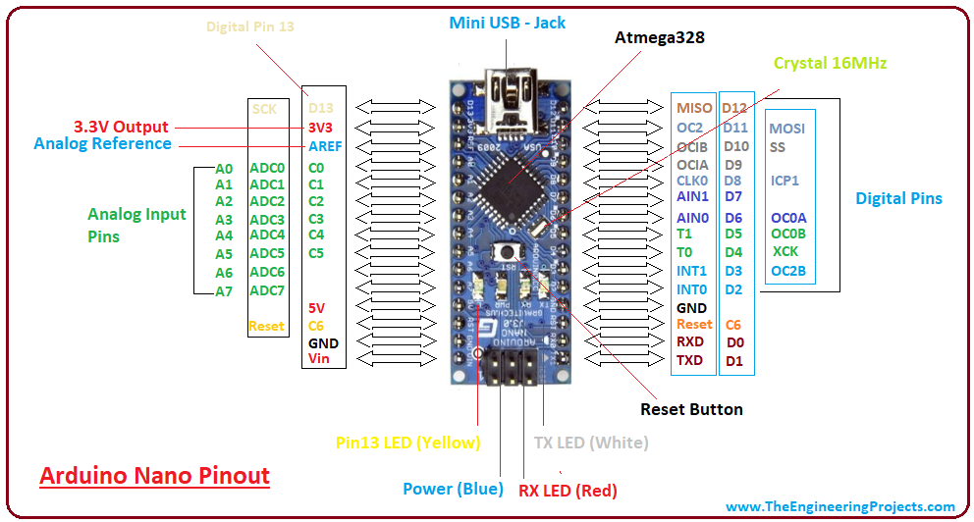
Sensor Subsystem MCU
Arduino Nano V3
Same architecture with Arduino Mega 2560
16 MHz
8 Analog Inputs, 22 Digital I/O pins
32 kbyte Flash/2 kbyte SRAM
Low price ( < 3$)
https://www.theengineeringprojects.com/2018/06/introduction-to-arduino-nano.html
Arduino, “Arduino Nano.” [Online]. Available: https://store.arduino.cc/arduino-nano
Microchip Technology Inc., “ATmega328P 8-bit AVR.” Microchip Technology Inc., p. 294.

Slide 17

RF Transceiver Module
nRF24L01+ by Nordic Semiconductors
RF Transceiver
SPI Interface
2.4 GHz band, 126 channels, 2 Mbps
Low Power Consumption (max 13.5 mA)
RX→TX or TX→RX in 130 us, total time < 230 us
http://robotechshop.com/shop/module/nrf24l01/?v=f214a7d42e0d
Nordic, “nRF24L01+ Single Chip 2.4GHz Transceiver Product Specification v1.0,” Build. Res., no. 1, p. 78, 2008

Slide 18
Other Hardware
Generic 0.92 inch I2C OLED Screen
OLED → Low Power Consumption
High contrast
Easily available
Low cost (< 3$)
Sensors
Analog
3-pin
Support for 2-pin simple components
0-5 V Voltage Range
Draw current < 40 mA

Slide 19
Bypassing Enhanced ShockBurst
Automatic ACKs → Less Determenistic
Need for ACKs only during:
  Sensor Recognition
  Change of system state
Fewer packet transmissions
Reduced power consumption

Slide 20
Custom Protocol
Low latency communication
Event based changes
Event representation → Predetermined value
Same state for every subsystem

Slide 21
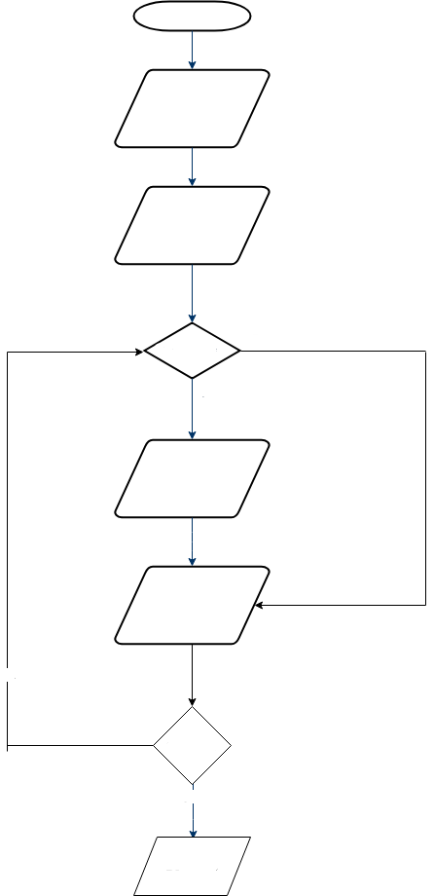
Sensor Recognition : Sensor Subsystem
Power ON
RF Parameter Setup
Initial Delay
no
Rec Timer = 1
yes
Send Init Value
Start Listening
no
Got Reply
yes
Delay 20s
Sensor recognition state flowchart for sensor subsystem

Slide 22
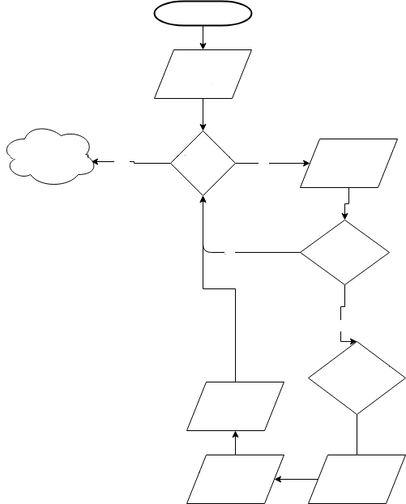
Sensor Recognition : Base Subsystem
Power ON
RF Parameter Setup
User Config Stage
yes
15 sec Timer = 1
no
RF start Listening
no
Init message
Available ?
yes
Sensor counter < MAX
&&
Message is Valid
Sensor Counter ++
Send ACK
to correct Sensor
RF Stop Listening
Sensor recognition state flowchart for base subsystem

Slide 23
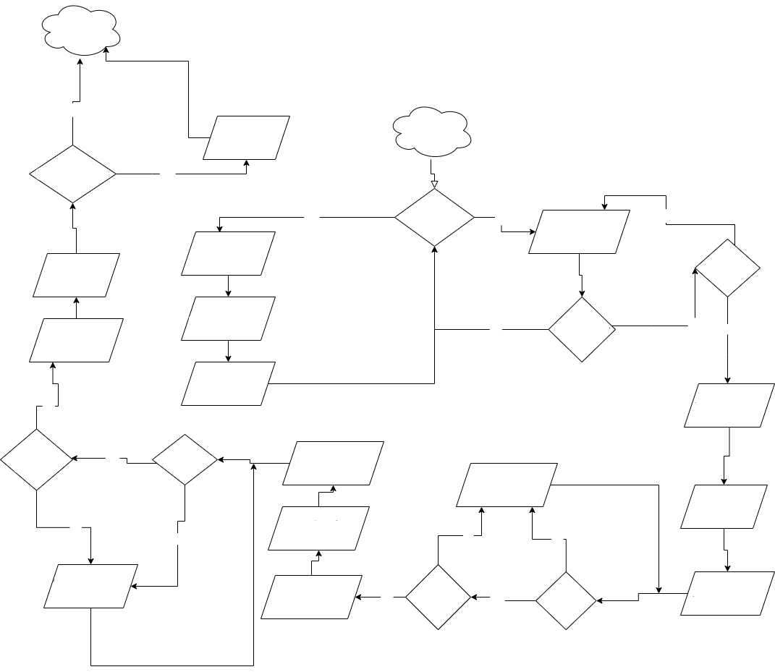
Configuration : Sensor Subsystem
Trigger Stage
No
Wait for x ms
Init Stage
Sensor Number > 1
Yes
Yes
Data Timer
clicked?
No
Check for Incoming
Packets
No
Send Sensor
Number
ACK 6 times
RF Stop Listening
Threshold
Message?
Send Current Value
No
Got Message?
Yes
Yes
RF Stop Listening
RF Start Listening
Yes
RF Stop Listening
Sensor
Number
Message?
Yes
Got Message?
RF Start Listening
Check for Incoming
Packets
Send Threshold
ACK 6 times
No
No
Send Operator
ACK 6 times
No
No
Check for Incoming
Packets
Operator
Message?
RF Stop Listening
Yes
Yes
Got Message?
RF Start Listening
Configuration state flowchart for sensor subsystem

Slide 24
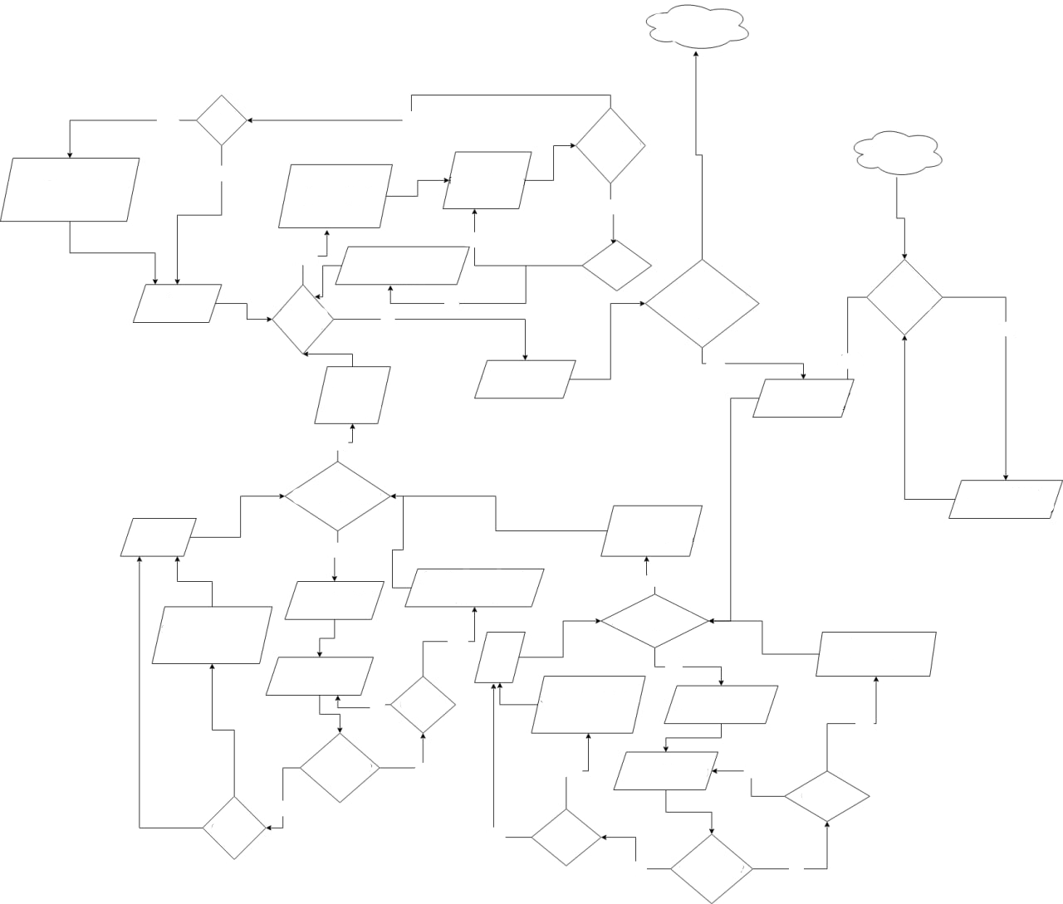
Configuration State : Base Subsystem
Trigger Stage
yes
Got ACK?
yes
1 sec passed?
1 sec passed?
Init Stage
SensorRCSensorNumber = 1
Wait 2ms
No
RF Start Listening
Send Sensor Number
No
yes
SensorRCSensorNumber = 1
i++
Wait 2ms
No
Got ACK?
i++
yes
Sensor Counter =
RC Counter
User Settings
Complete?
i < Sensor
Number ?
No
No
i = 0,
RF Stop
Listening
Check All RC Tables
No
yes
i = 0,
RF Stop Listening
No
i < Sensor Number ?
Update Menu
Check User Setting
i++
yes
i = 0,
RF Stop Listening
SensorRCOperator = 1
i++
Wait 2ms
No
Send Operator
i < Sensor Number ?
SensorRCOperator = 1
Wait 2ms
yes
SensorRCThresh = 1
i++
Wait 2ms
RF Start Listening
i++
yes
No
Got ACK?
SensorRCThresh = 1
Wait 2ms
Send Threshold
yes
1 sec passed?
No
yes
RF Start Listening
No
yes
Got ACK?
Got ACK?
No
Got ACK?
yes
1 sec passed?
No
Configuration state flowchart for base subsystem

Slide 25
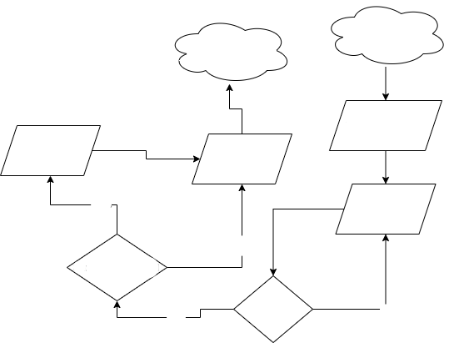
Triggering : Sensor Subsystem
User Config Stage
After Trigger Stage
RF Stop Listening
Wait for x μs
Send Trigger
to base
yes
Get Sensor Data
no
Sensor Number > 1
Sensor
Triggered?
no
yes
Triggering stage flowchart for sensor subsystem

Slide 26
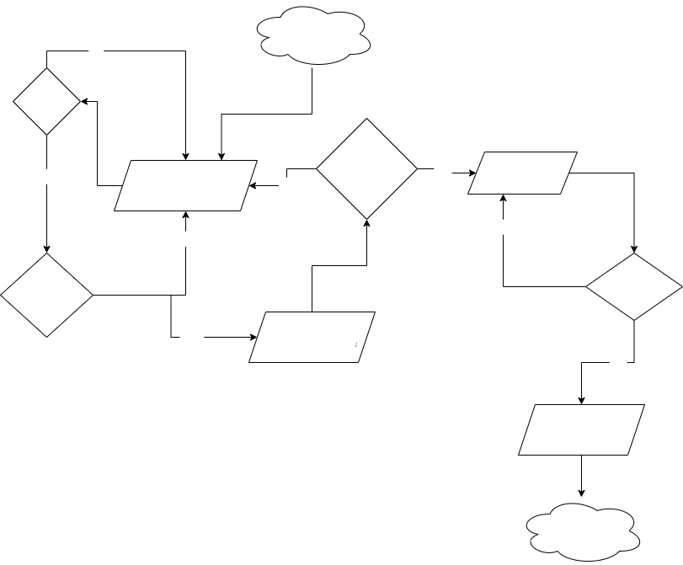
Triggering : Base Subsystem
no
User Config Stage
Got Trigger?
yes
no
TriggerCounter =
Sensor Number?
yes
Check User Delay
RF Start Listening
yes
no
Sensor Already
Triggered?
Trigger Delay
Passed?
no
TriggerCounter ++
Update Trigger Table
yes
Trigger Flash/Camera
After Trigger Stage
Triggering stage flowchart for base subsystem

Slide 27
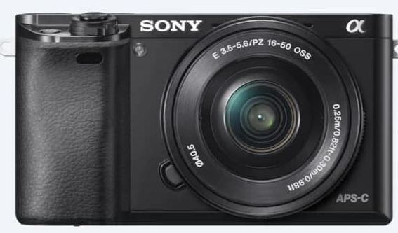

Photographic Equipment
Camera
Sony a6000
Canon EOS 300D
Flash
Fotomatic 140
Yongnuo Speedlite YN560 IV
Vivitar Auto 2600
https://www.sony.com/electronics/interchangeable-lens-cameras/ilce-6000-body-kit
https://www.pinterest.co.uk/pin/299630181460781731/

Slide 28
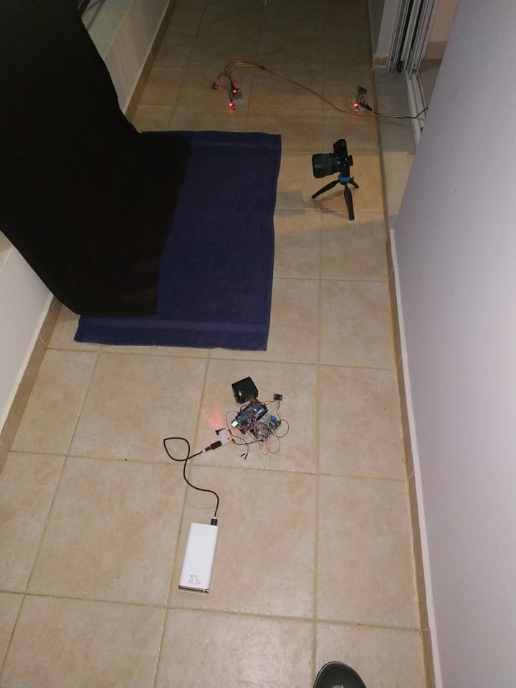
Experimentation Site And Tested Cases
Sensor 0
Sensor 1
Tested Cases
Popping balloons
Breaking of objects
Falling objects on liquid surface
Inability to test
Lightning
Projectiles/Bullets
Wild animals
Camera
Flash
Base
System Setup

Slide 29
Testing Parameters
Sound Sensors only
Variable distances from objects → Change in total response time
Slow response time → Correct operation on worst cases
Example with selected delay
Better visual effect
Test for the selected delay functionality

Slide 30
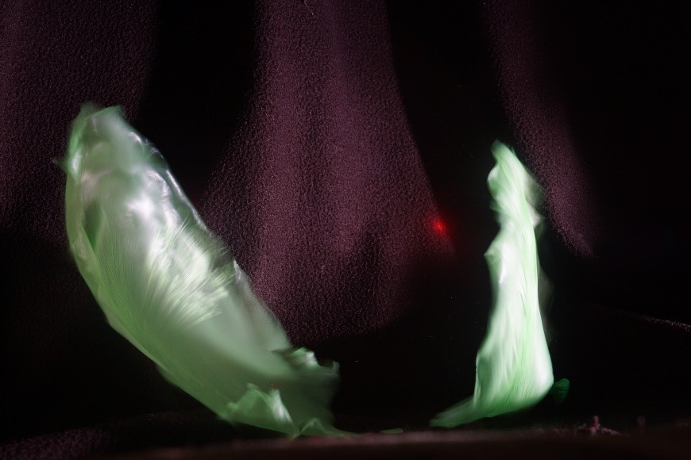
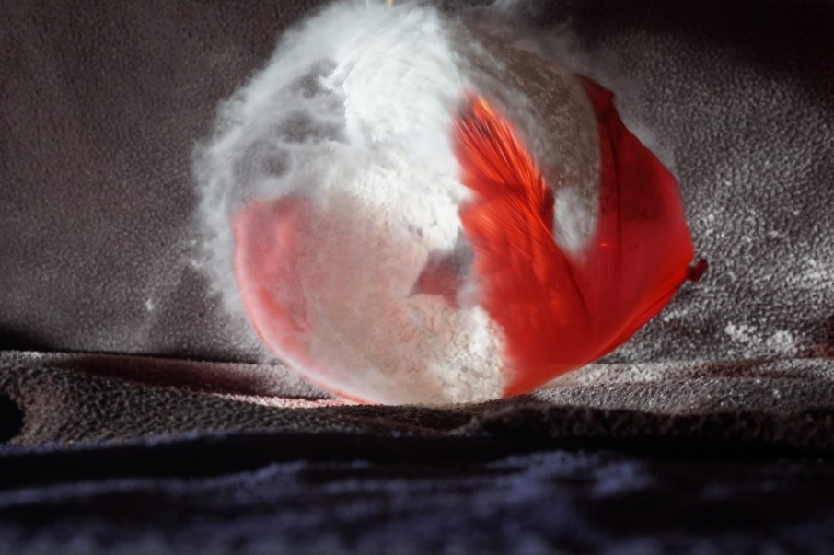
Images From Our System
Popping balloon
Popping balloon (filled with flour)
Phenomenon | Sensors | Distance | Selected delay
Popping balloon | 1 | 5 cm | 0 ms
Popping balloon (flour) | 1 | 25 cm | 0 ms

Slide 31
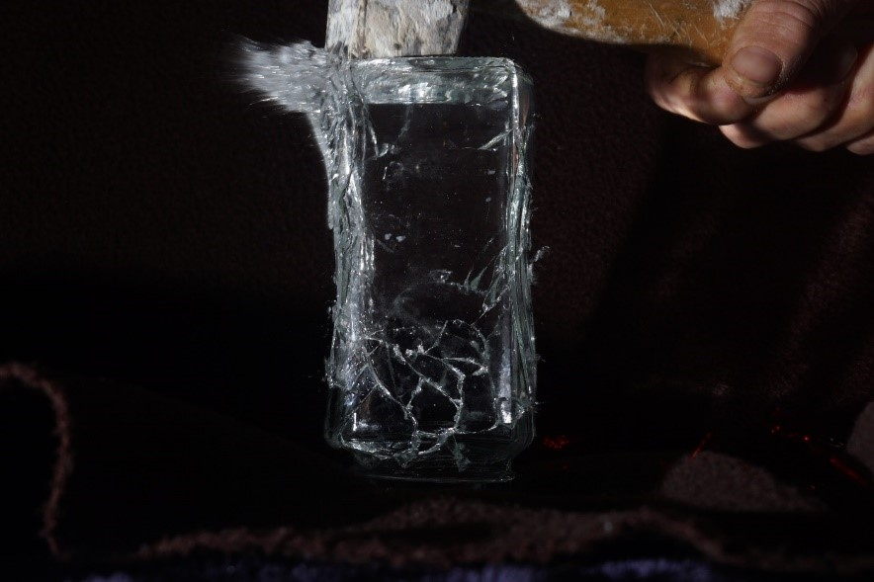
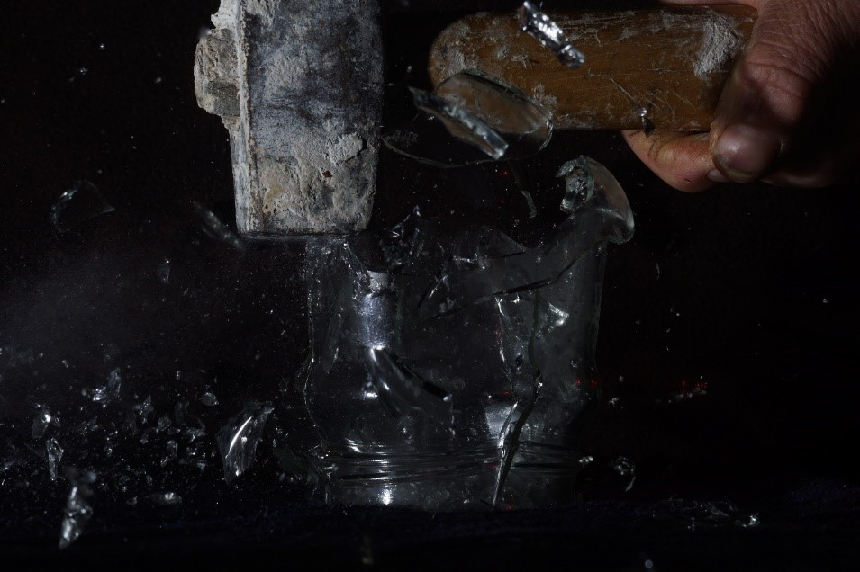
Images From Our System
Breaking vase
Breaking vase (with delay)
Phenomenon | Sensors | Distance | Selected delay
Breaking vase | 1 | 15 cm | 0 ms
Breaking vase (with delay) | 1 | 15 cm | 50 ms

Slide 32

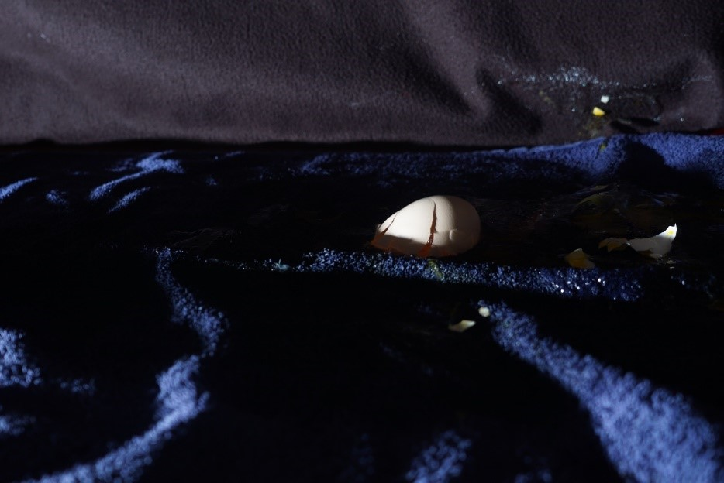
Images From Our System
Falling object on liquid surface
Breaking egg
Phenomenon | Sensors | Distance | Selected delay
Falling object on liquid surface | 2 | 30 cm/45 cm | 0 ms
Breaking egg | 1 | 30 cm | 0 ms

Slide 33
Latency Measurement Method
Estimation :
Sensor data collection (~ 100 us)
SPI communication with transmitter MCU (~ 16-32 us)
RF Transceiver settling (~ 230 us)
RF transmission (~ 90 us)
SPI communication with receiver MCU (~ 32 us)
Electrical Isolation Circuits and Triggering (~ 50 us)
Total : ~ 530 us
Measurements from oscilloscope waveforms
Use of LED instead of flash

Slide 34




System Latency
Sensor Output
System Output
Voltage
Voltage
System Output
Sensor Output
Time
Time
Example 1: Photodiode, Delay 0.56 ms
Example 2: Photodiode, Delay 0.8 ms
Sensor Output
Voltage
System Output
Voltage
System Output
Sensor Output
Time
Time
Example 3: Microphone, Delay 0.56 ms
Example 4: Photodiode, Delay 3.12 ms (sensor response)

Slide 35
Challenges
Resolved
Constraining the program memory footprint to the available SRAM
Support wide variety of flash voltages → Use of Opto TRIAC and SCR
Unresolved
Maintain system consistency at all times
Define a recovery procedure in case of system crash
Changing trigger parameters after entering Triggering state

Slide 36
Conclusion
 | Sensor Connection | Supported Sensors | System Latency | Voltage | Cost
Goal | Wireless | 2 | < 5 ms | 3.3-5 V | < $60
Achievement | Wireless | 2 | < 1 ms | 5 V | < $30
Other Achieved Goals
Open source system
Availability of used components
Support for any flash up to 300 V
Concerns
Higher latency compared to a wired system
Risk of lost messages
Need for more components

Slide 37
Outlook
Perspectives
Recovery from system crash
Parameters change after Configuration state
Addition of more sensors
Combination of wireless and wired sensors
Fine tuning of libraries for even lower latency
Design of custom PCB
Improvement of user interface

Slide 38
Acknowledgments
Prof. A. Dollas
Assoc.Prof. E. Koutroulis
Assoc.Prof. I. Papaefstathiou (AUTH)
I. Galanommatis
M. Kimionis
A. Brokalakis
V. Oikonomopoulos
Ch. Tsiligianni
P. Barouni

Slide 39
Thank you!

