Slide 1

Sales Insights
File created on: 14-01-2021 12:41:57

Slide 2
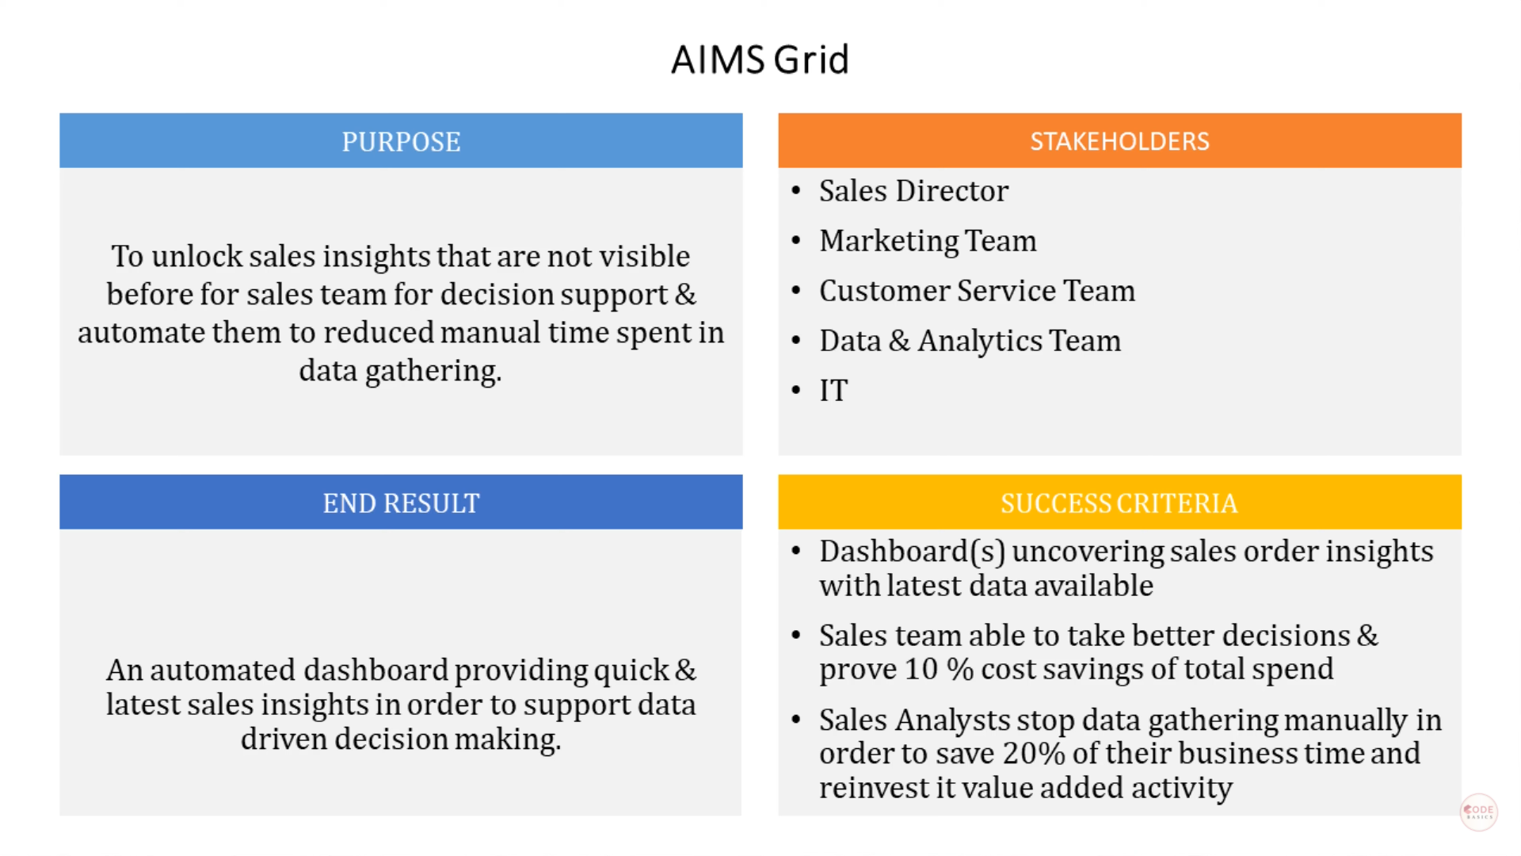

Slide 3
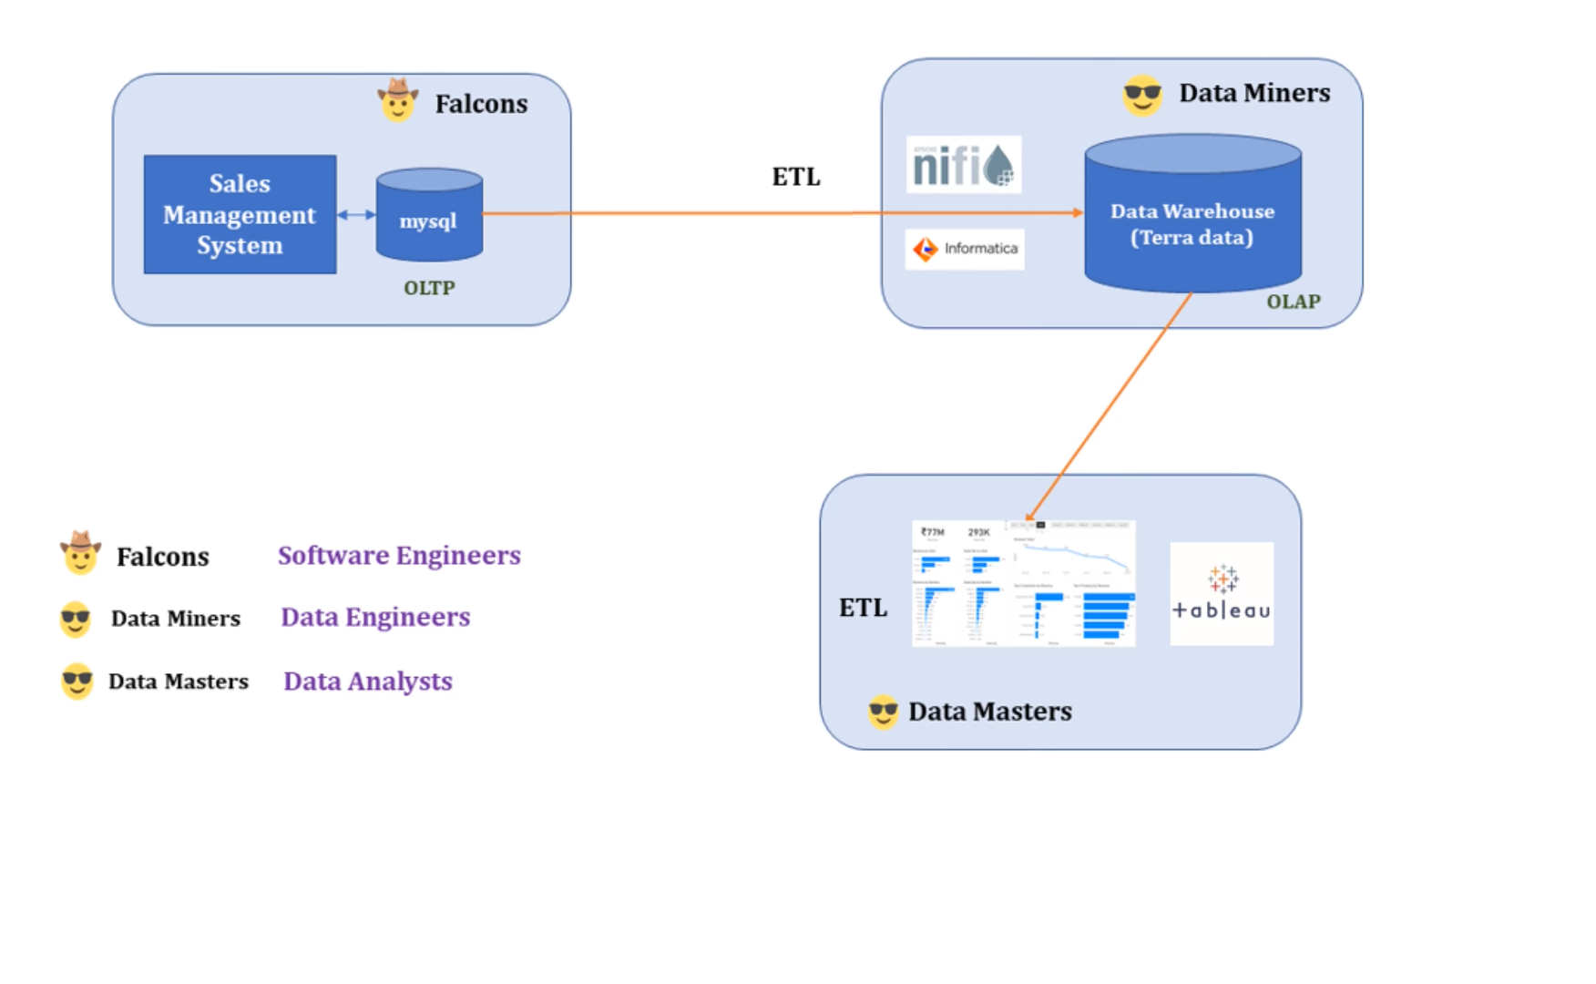

Slide 4
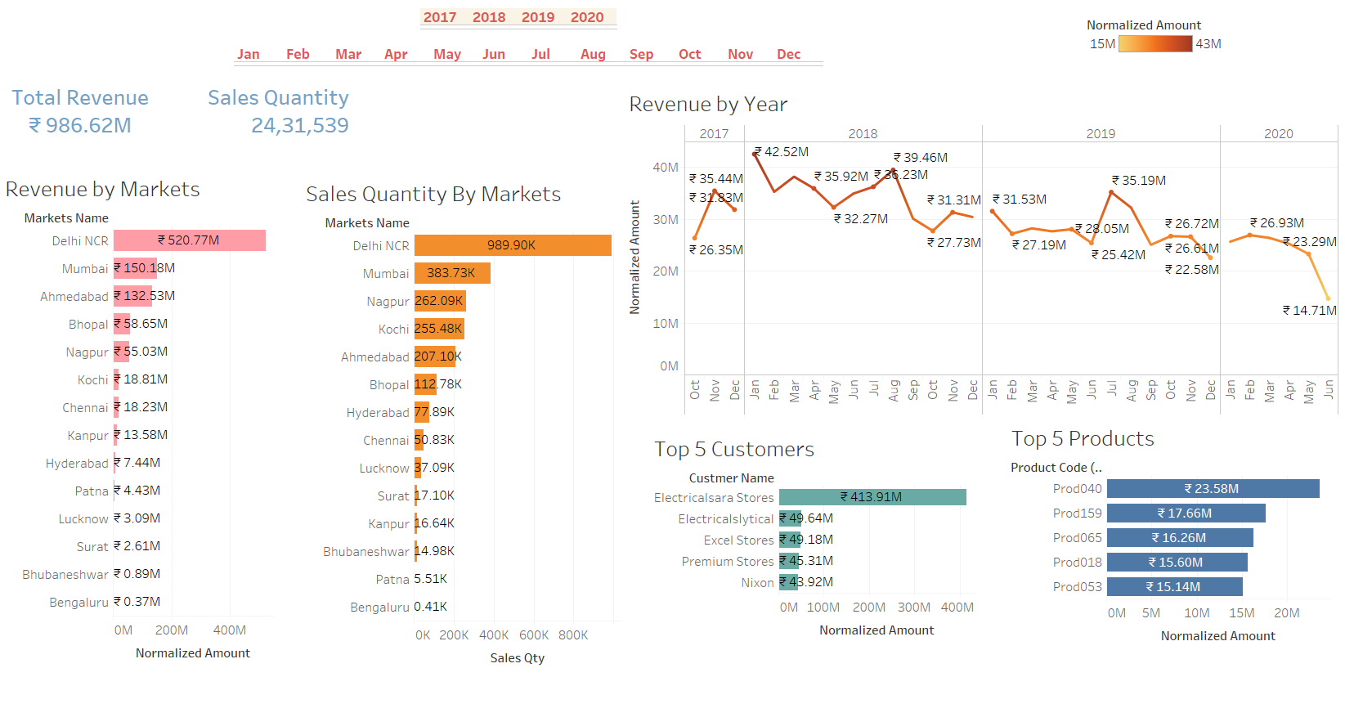

Slide 5
Sales are declining. For increase profit
* Increase product Quality.
* Effective Promotion/Ads.
* Discounts.
* Healthy Communication Between Management & Suppliers.
* Product Attraction (Packing).
* Segmentation , Targeting, Positioning.

