Slide 1


Slide 2
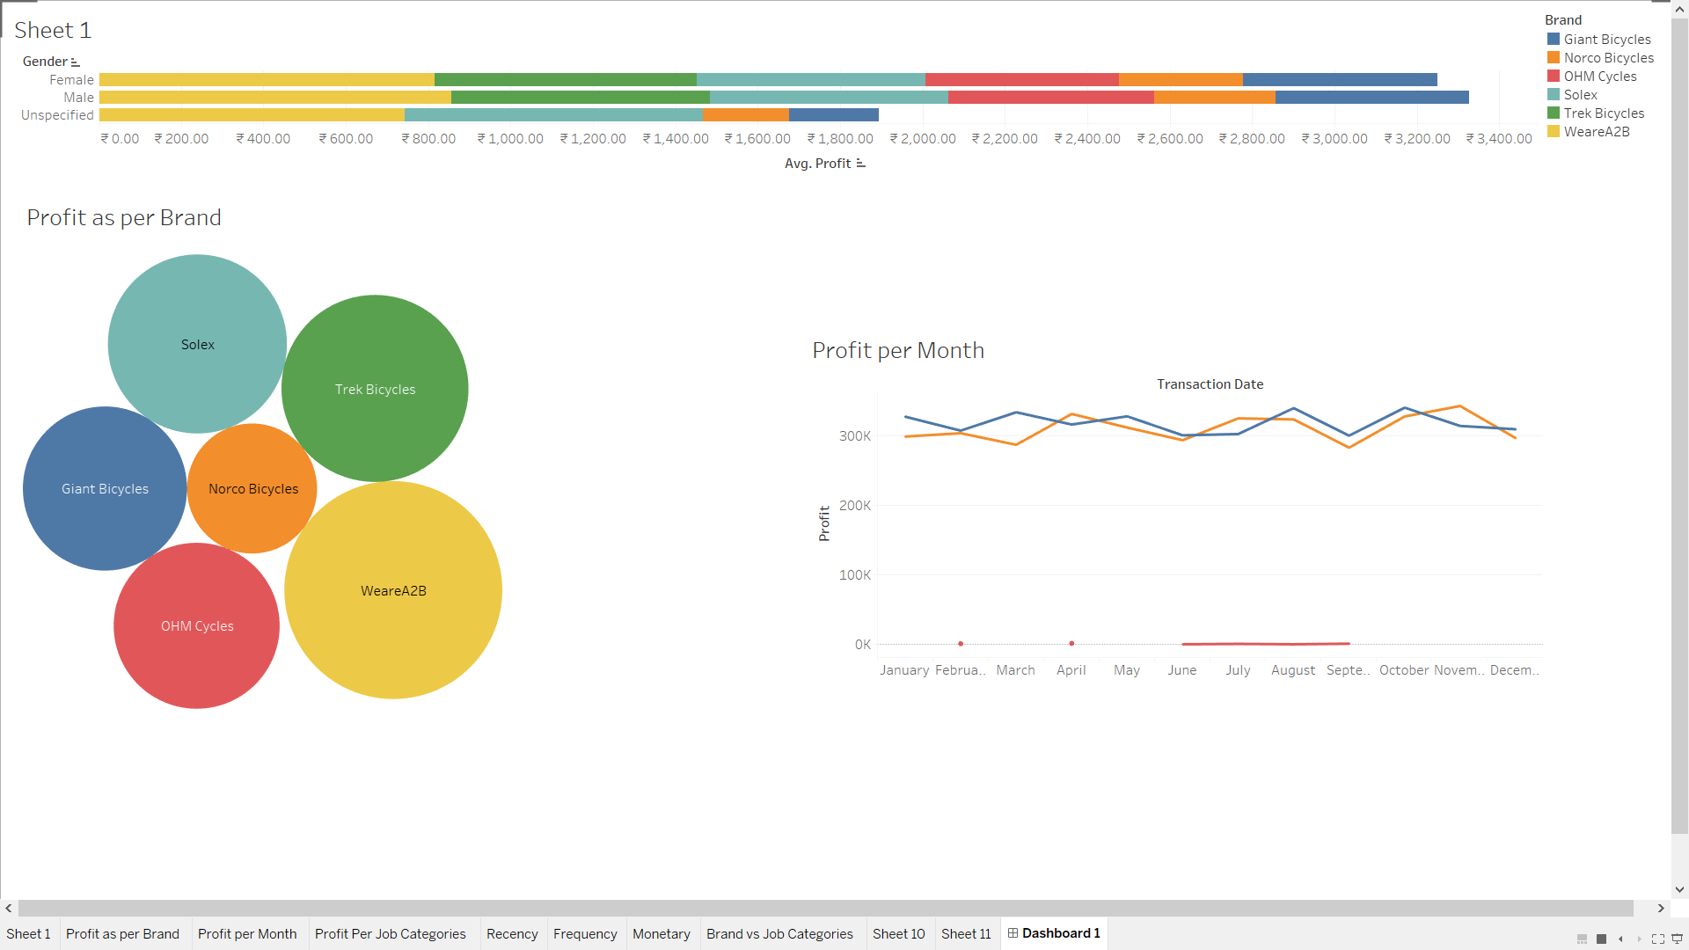

Slide 3
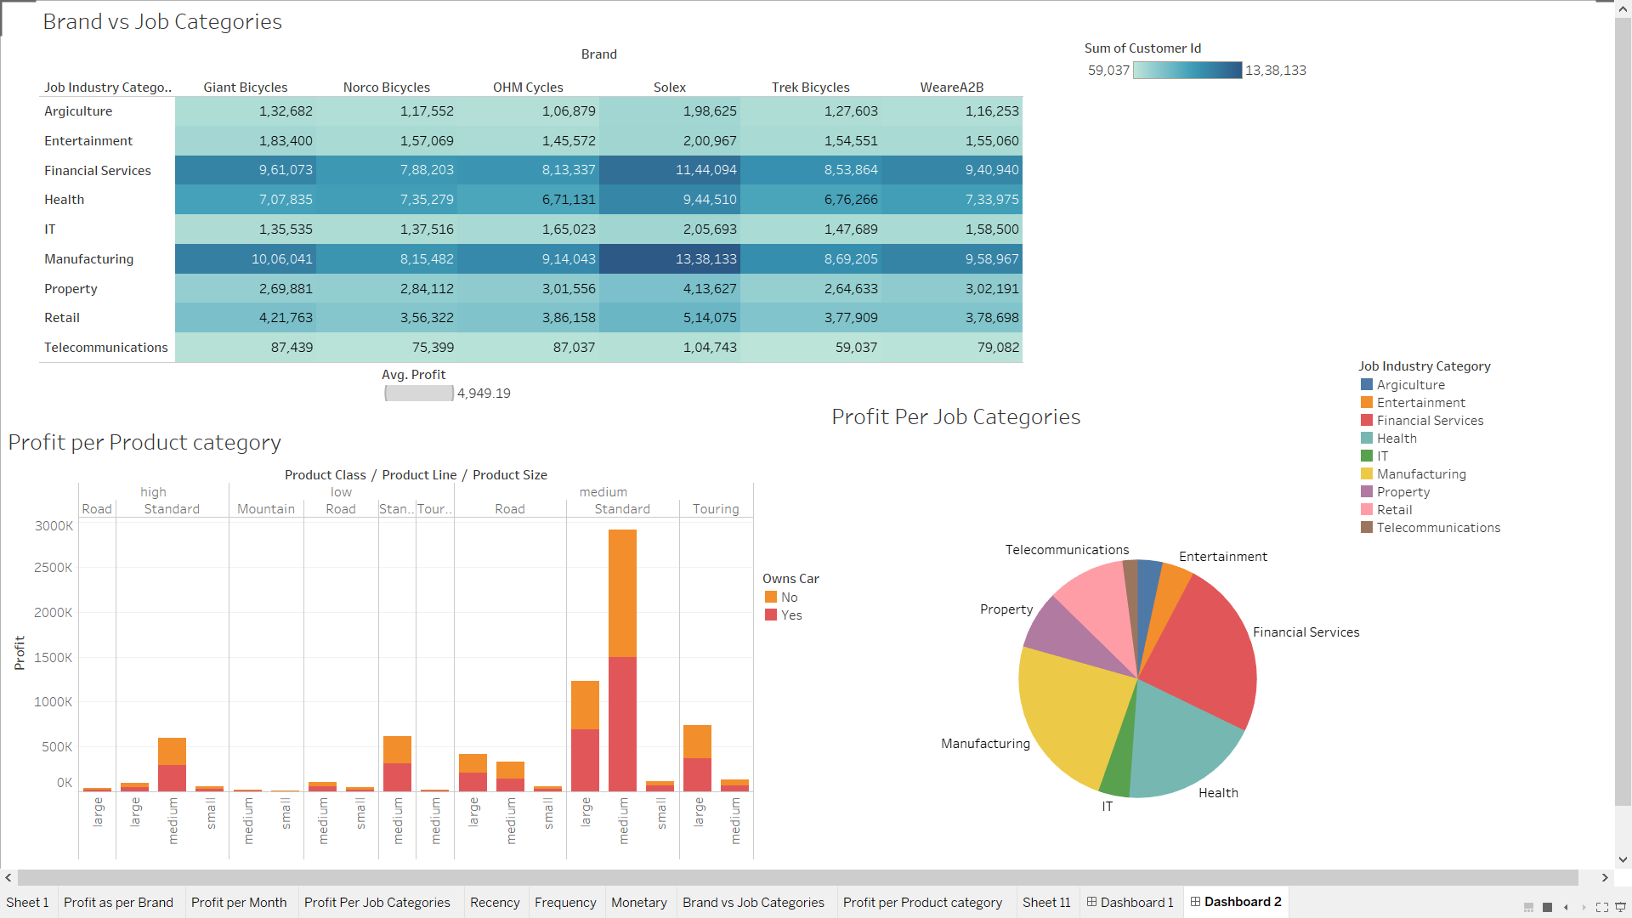

Slide 4
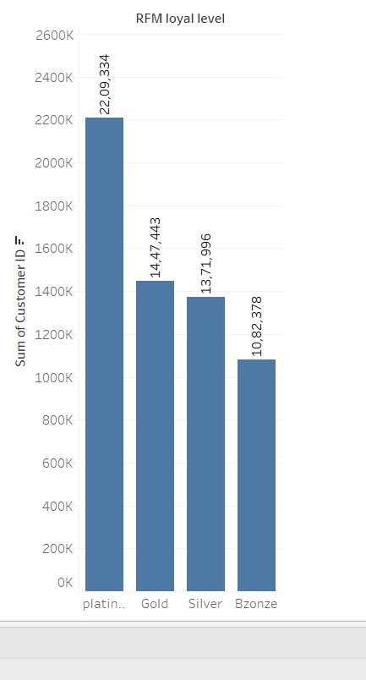
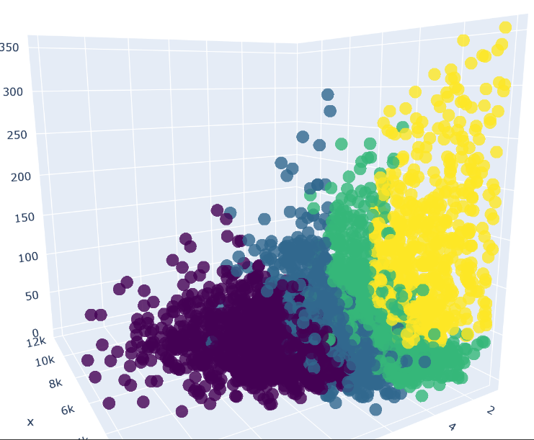
RFM score

Slide 5
RFM Score
4 Loyalty Level - Platinum, Gold, Silver, Bronze .
Platinum has More Customers .
THANK YOU
KPMG Analytics Team

