Slide 1
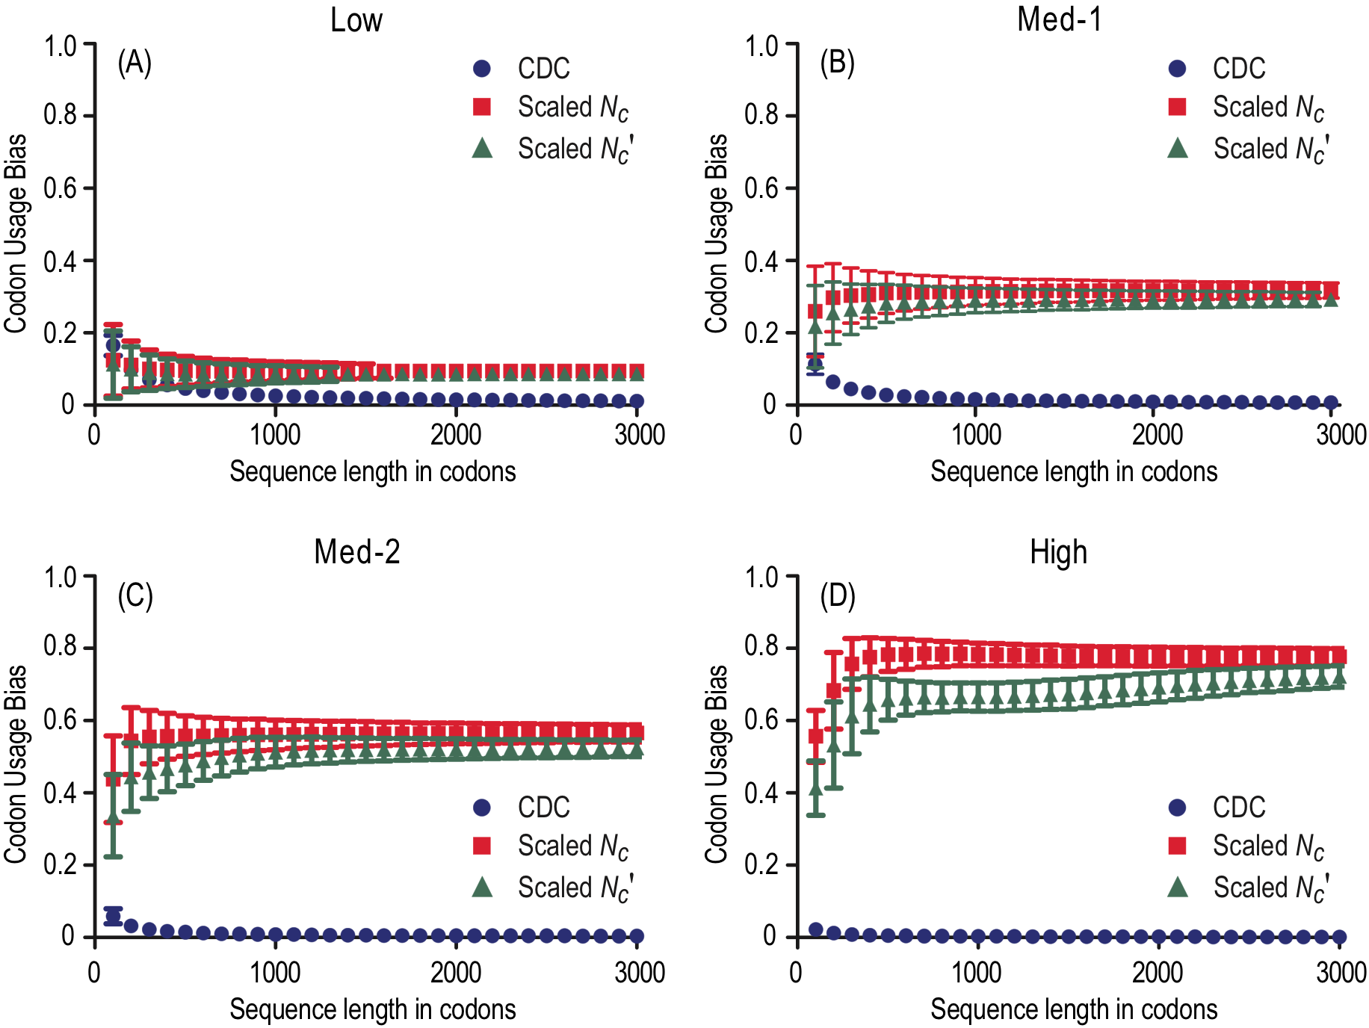
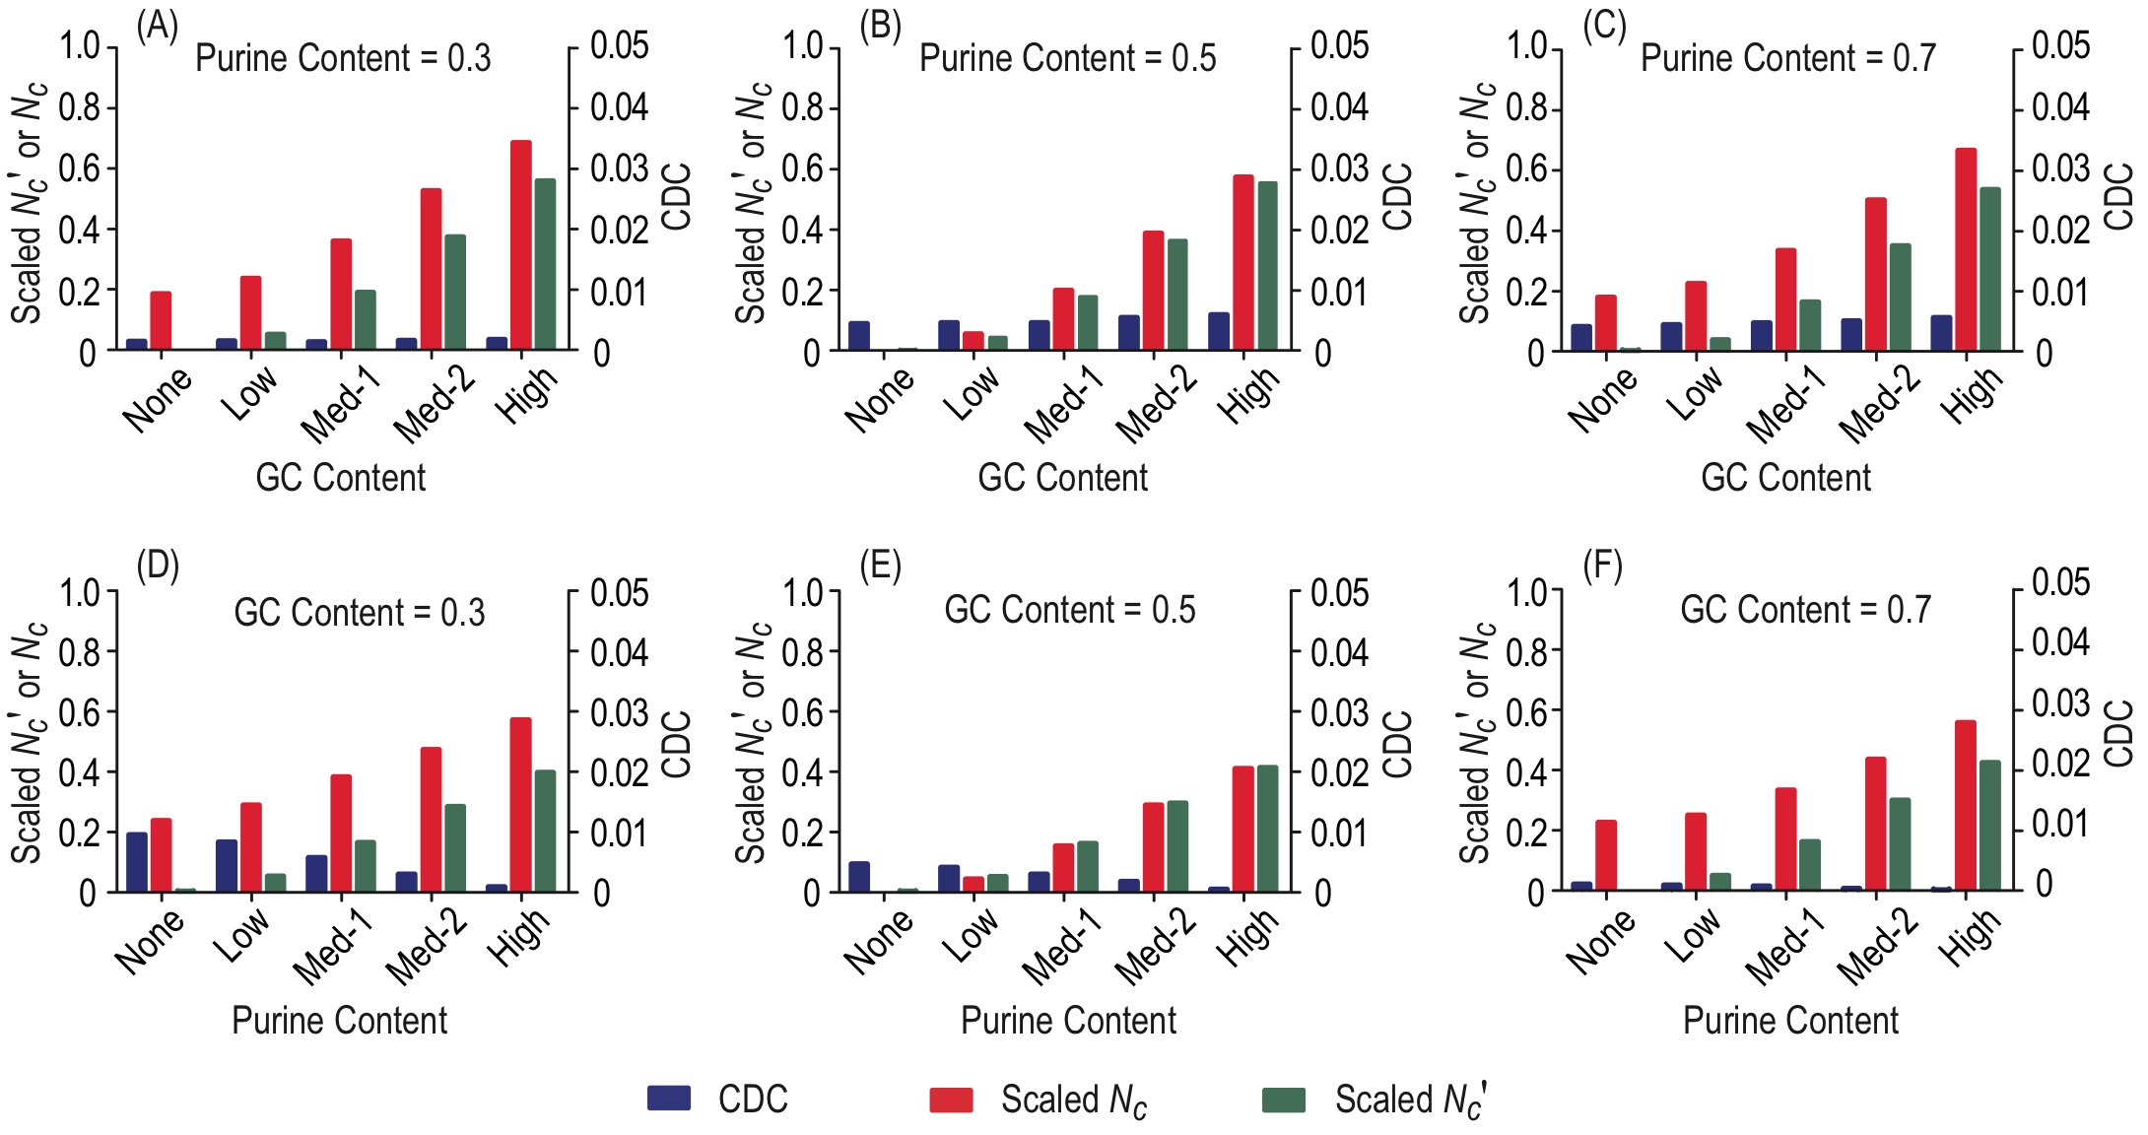
A novel method for measuring codon usage bias and estimating its statistical significance
Zhang Zhang CAS Key Laboratory of Genome Sciences and Information, Beijing Institute of Genomics, Chinese Academy of Sciences
Introduction
Therefore, when both expected ( ) and observed ( ) codon usage vectors are available for any given sequence, CDC renders a distance coefficient ranging from 0 (no bias) to 1 (maximum bias), to represent CUB, expressed by the deviation of from .
Codon usage bias or CUB, a phenomenon in which synonymous codons are used at different frequencies, is generally believed to be a combined outcome of mutation pressure, natural selection, and genetic drift.
Why should we care
Genes often exhibit variable CUBs, which are closely related with gene expression for translational efficiency and/or accuracy.
The ability to accurately quantify CUBs for protein-coding sequences is of fundamental importance in revealing the underlying mechanisms behind codon usage and understanding gene evolution and function in general.
What is the question
Extant measures for estimating CUB have limitations.
They are not supplied with straightforward procedures for assessing the statistical significance of the bias in codon usages for any given gene.
They are not fully effective at incorporating background nucleotide composition into CUB estimation.
How we can do it
Here we present a novel measure, Codon Deviation Coefficient (CDC), using it to characterize CUB and to ascertain its statistical significance.
Statistical significance of codon usage bias
To evaluate the statistical significance of codon usage bias, we implement a bootstrap resampling of N=10000 replicates for any given sequence.
Each replicate is randomly generated according to the sequence background nucleotide composition (S_{i} and R_{i}, i = 1, 2, 3) and the sequence length.
When CUB is derived from each replicate, a bootstrap distribution of N estimates of CUB is obtained.
A two-sided bootstrap P-value is calculated as twice the smaller of the two one-sided P-values. P ranges from 0 to 1.
By convention, a statistically significant CUB is identified by P < 0.05. CDC features its first application of the bootstrap resampling in estimating the statistical significance of CUB.
Implementation and availability
CDC is written in standard C++ programming language and implemented into Composition Analysis Toolkit (CAT). Its software package, including compiled executables on Linux/Mac/Windows, example data, documentation, and source codes, is freely available at http://cbb.big.ac.cn/software.
Figure 2 Codon usage bias across a range of sequence lengths. Sequences were simulated with the four non-uniform positional composition sets: Low (panel A), Med-1 (panel B), Med-2 (panel C) and High (panel D). The expected values of codon usage bias are zero for all examined cases.
Taken together, our simulation results demonstrate that CDC is superior to N_{c}′ and N_{c}.
Application to empirical data
To empirically test CDC and compare it to three popular measures, N_{c}′, N_{c} and CAI, we collected multiple expression data sets from different species and correlated their CUBs with gene expression levels. Overall, CDC correlates positively with gene expression level, much better than scaled N_{c}', scaled N_{c}, and CAI (Table 1).
Materials and methods
Table 1 Correlation coefficients of CUB with gene expression level
Measure | E. coli¹ |  | S. cerevisiae² | D. melanogaster³ | C. elegans⁴ | A. thaliana⁵
 | LB | M9
CDC | 0.433 | 0.367 | 0.654 | 0.460 | 0.374 | 0.228
Scaled N_{c}′ | 0.315 | 0.187 | 0.664 | 0.302 | 0.328 | 0.130
Scaled N_{c} | 0.257 | 0.125 | 0.600 | 0.321 | 0.192 | 0.063
CAI | 0.443 | 0.288 | 0.675 | 0.386 | -0.118 | 0.034
Note: Expression data were obtained from ¹Bernstein et al, ²Holstege et al, ³Zhang et al, ⁴Roy et al, and ⁵Wuest et al. P < 0.0001 for all values.
Expected codon usage
CDC considers both GC and purine contents as background nucleotide composition and derives expected codon usage from observed positional GC and purine contents. We denote the content of the four nucleotides (adenine, thymine, guanine, and cytosine), GC content, and purine content as A, T, G, C, S and R, respectively. The expected position-dependent nucleotide contents are formulated:
Results and discussion
Comparative analysis on simulated data
To evaluate the performance of CDC and compare it against N_{c} (Effective Number of Codons) and the most powerful extant measure, N_{c}′ (N_{c}’s variant), We simulated sequences by specifying different heterogeneities in positional background nucleotide compositions (Figure 1) and varying sequence lengths (Figure 2).
where S_{i} and R_{i} are their corresponding observed contents at codon position i and A_{i}, T_{i}, G_{i}, C_{i} are expected nucleotide contents at codon position i (i = 1, 2, 3).
For any sense codon xyz, the expected usage π_{xyz} is defined as the product of its constituent expected nucleotide contents x₁y₂z₃, normalized by the sum over all sense codons, viz.,
We proceeded to calculate CDC values for all E. coli genes.
The gene with the highest CDC value and statistical significance in CUB is rpmI (CDC=0.481, P<0.05), which encodes ribosomal protein L35.
CDC values for 54 ribosomal protein (RP) genes in E. coli, are larger than the mean and median values of all genes.
Nearly all RP genes have statistically significant CUBs, with three exceptions (Table 2).
It should be noted that CDC ranges from 0 (no bias) to 1 (maximum bias), whereas N_{c}′ and N_{c} range from 20 (maximum bias) to 61 (no bias). To facilitate comparisons of CDC with N_{c}′ and N_{c}, we use the formula (61- N_{c}′) / 41 and (61- N_{c}) / 41 to rescale their ranges, denoted as scaled N_{c}′ and scaled N_{c}, respectively, from 0 (no bias) to 1 (maximum bias).
Table 2 Three exceptions of RP genes having insignificant CUBs
RP Gene | CDC | P | Description
rpmE | 0.267 | 0.1136 | encoding RP L31, which is loosely associated with ribosome
rmpF | 0.329 | 0.1096 | encoding RP L32, which locates near the peptidyltransferase center
rpmJ | 0.422 | 0.0564 | encoding RP L36, which is non-essential for protein synthesis
where and
.
Codon usage bias
Any coding sequence can be represented as a vector of n dimensions, whose entries correspond to n sense codon usages in the sequence.
The dimension n equals 61 for the canonical code; although codons ATG and TGG could be set aside due to the absence of synonymous codons, calculation based on a vector of 61 dimensions instead of 59 dimensions makes little substantial difference.
To calculate CUB for any given sequence, we employ the cosine distance metric based on the cosine of the angle between the two vectors of n dimensions.
These results suggest that CDC has the potential to illuminate the evolutionary process that has operated on each gene.
Conclusions
Figure 1 Codon usage bias across a variety of positional background nucleotide compositions. Heterogeneous positional background compositions were considered for GC content (panels A to C) and purine content (panels D to E), respectively. The expected values of codon usage bias are zero for all examined cases.
CDC accounts for background nucleotide composition to estimate codon usage bias and utilizes a bootstrap assessment to evaluate the statistical significance of codon usage bias.
As validated by simulated sequences and empirical data, CDC outperforms extant measures by providing informative estimates of codon usage bias and its statistical significance.
Literature cited
Sharp, PM, WH Li. 1987. The codon Adaptation Index--a measure of directional synonymous codon usage bias, and its potential applications. Nucleic Acids Res 15:1281-1295.
Wright, F. 1990. The 'effective number of codons' used in a gene. Gene 87:23-29.
Zhang, Z, J Yu. 2010. Modeling compositional dynamics based on GC and purine contents of protein-coding sequences. Biol Direct 5:63.
Zhang, Z, J Yu. 2011. On the organizational dynamics of the genetic code. Genomics Proteomics Bioinformatics 9:21-29.
Further information
Bulmer, M. 1991. The selection-mutation-drift theory of synonymous codon usage. Genetics 129:897-907.
Hershberg, R, DA Petrov. 2008. Selection on codon bias. Annu Rev Genet 42:287-299.
Novembre, JA. 2002. Accounting for background nucleotide composition when measuring codon usage bias. Mol Biol Evol 19:1390-1394.
Plotkin, JB, G Kudla. 2011. Synonymous but not the same: the causes and consequences of codon bias. Nature Reviews Genetics 12:32-42.
The proposed measure (CDC) has been published as a journal article.
Reference: Zhang, Z. et al 2012. Codon Deviation Coefficient: a novel measure for estimating codon usage bias and its statistical significance. BMC Bioinformatics 13:43.
Contact: zhangzhang@big.ac.cn
Lab website: http://cbb.big.ac.cn

