Slide 1

MergeCallibr-Jev
Intelligent Pull Request Triage — powered by probabilistic AI risk evaluation.

Slide 2


The Problem: AI Accelerates Code Faster Than We Can Review It
More PRs, More Complexity
AI-generated code floods repositories with more PRs than review pipelines were designed to handle.
Reviewer Fatigue
Large, complex PRs demand substantial cognitive effort — burning out the engineers who matter most.
Wasted Scrutiny
Low-risk changes receive the same rigorous attention as high-risk ones. Every PR is treated as a potential threat.

Slide 3

The Bottleneck
Human attention is the scarcest resource in software delivery — and today it's spread too thin.
High review effort: developers spend significant time understanding changes before they can even assess safety.
Velocity blocked: the verification burden slows every merge cycle, regardless of actual risk.
No differentiation: human attention is spread equally across all PRs — a trivial typo fix and a security-critical refactor get identical treatment.

Slide 4
Our Solution: Probabilistic PR Triage
Route pull requests by actual threat level — not blanket review.
Understand Automatically
Evaluate Risk
Route Intelligently
Reads repository context and code changes to build a full picture of what each PR actually does.
Scores security, regression, breaking change, complexity, and subsystem impact — with typed, probabilistic outputs.
Deterministic verdict: no review needed, needs review, or high risk. Human attention goes exactly where it matters.

Slide 5

How MergeCallibr-Jev Works
DeepSeek Read
Jev Evaluate
Verdict Route
Each stage is purpose-built: DeepSeek provides deep code comprehension, Jev enforces typed decision primitives with probabilistic confidence scores, and the verdict is always deterministic and actionable.

Slide 6
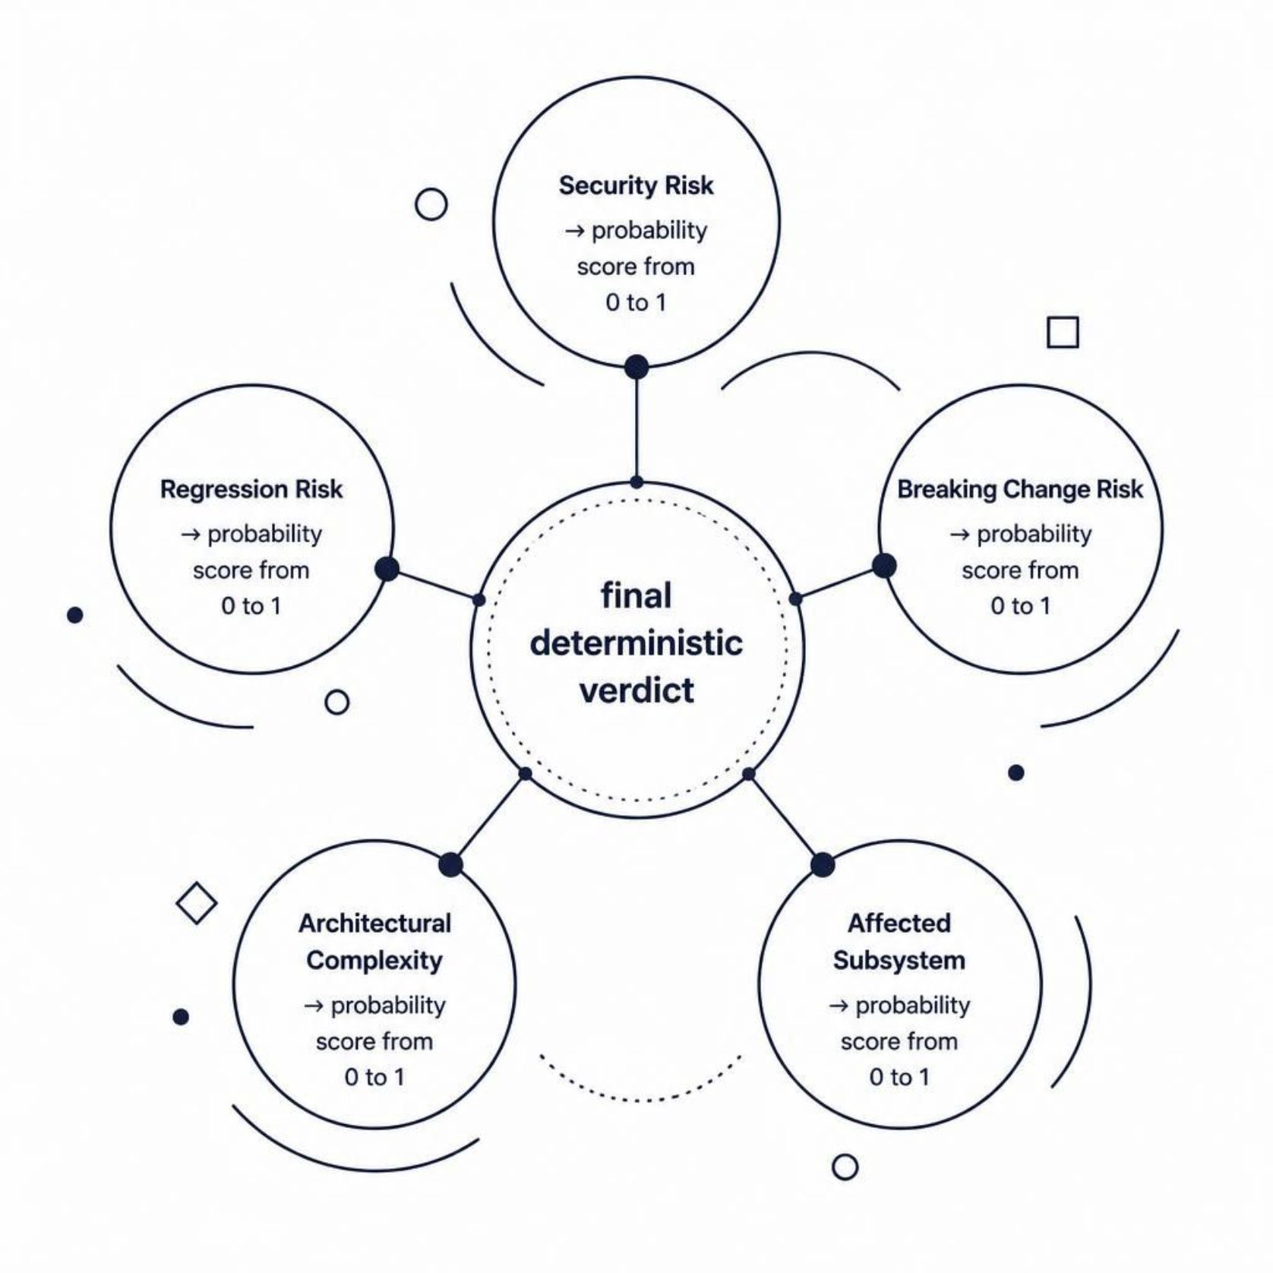
The Decision Engine
Jev returns typed decisions and probabilities — not free-form explanations. Every verdict is structured, auditable, and consistent.
✅ No Review Required
🔴 Human Review Required
Security Risk: 0.12 | Regression Risk: 0.18 | Confidence: 0.93
Low scores across all dimensions — safe to merge automatically.
Security Risk: 0.88 | Confidence: 0.94
Elevated security signal with high confidence — routed immediately to a human reviewer.

Slide 7





Before: Every PR Gets Full Scrutiny
Without triage, the review pipeline is a single-speed machine — every PR processed the same way, regardless of risk.
PR Opened
Any change, any size, any risk level
Human Reviewer
Manually reads, understands, assesses
Decision
Approve or request changes — after full effort
Result: reviewer fatigue, slow triage, and inconsistent risk assessment across the team.

Slide 8
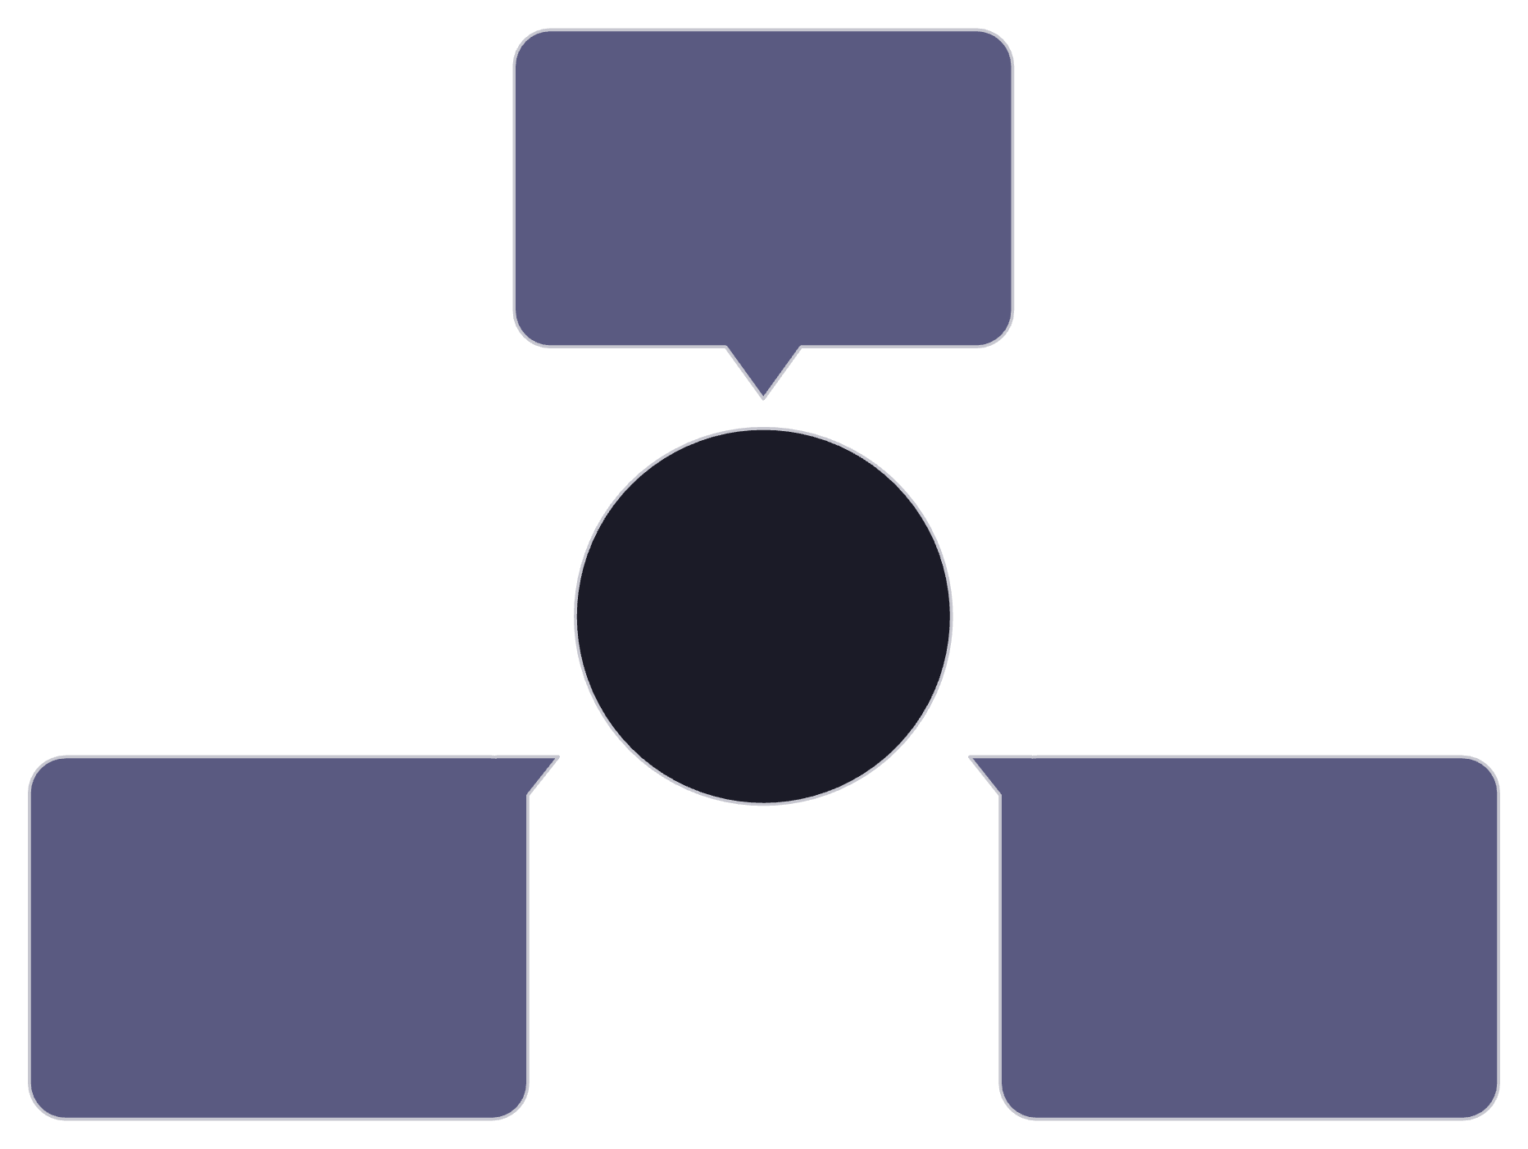

After: Smart Triage Routes Attention
The New Workflow
Low Risk
Every PR flows through DeepSeek + Jev first — then gets routed automatically based on its real risk profile.
Auto-merge with minimal attention
Low risk → minimal attention, fast merge
Uncertain → targeted human review
High risk → priority escalation
Smart Triage Flow
High Risk
Uncertain
Result: faster triage, consistent risk signals, developers focused on what actually matters.
Priority human review
Focused human review

Slide 9




Tech Stack
GitHub API
DeepSeek V4.1 Flash
PR ingestion, webhook integration, and merge routing directly through the GitHub platform.
Reads full repository context and code diffs to build semantic understanding of each change.
TypeSafe Jev
TypeScript
Typed decision primitives and probabilistic outputs — structured, auditable, consistent verdicts every time.
End-to-end type safety from code ingestion through risk scoring to routing logic.

Slide 10




The Impact
Less Unnecessary Review
Faster Triage & Merge Cycles
Low-risk PRs stop consuming senior engineering time. Cognitive load is reserved for decisions that actually require human judgment.
Automated routing eliminates the queue. PRs move at the speed their risk profile warrants — not the speed of the slowest reviewer.
Consistent, Explainable Risk
Every verdict is typed, scored, and traceable. No more gut-feel reviews — just structured signals teams can trust and act on.

