Slide 1

SPOTIFY DATA ANALYSIS

Slide 2
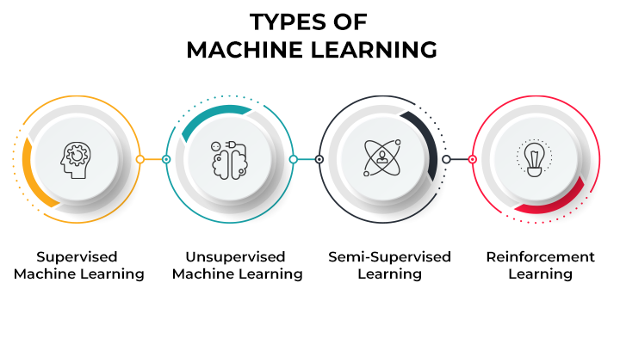
MACHINE LEARNING
Machine learning (ML) is a type of artificial intelligence (AI) that allows software applications to become more accurate at predicting outcomes without being explicitly programmed to do so. Machine learning algorithms use historical data as input to predict new output values.
Machine learning is important because it gives enterprises a view of trends in customer behavior and business operational patterns, as well as supports the development of new products. Many of today's leading companies, such as Facebook, Google and Uber, make machine learning a central part of their operations. Machine learning has become a significant competitive differentiator for many companies.

Slide 3

INTRODUCTION
Spotify is a digital music, podcast, and video service that gives you access to millions of songs and other content from creators all over the world.

Slide 4


PROBLEM STATEMENT
Spotify is a proprietary Swedish audio streaming and media services provider founded on 23 April 2006 by Daniel Ek and Martin Lorentzon. It is one of the largest music streaming service providers, with over 489 million monthly active users, including 205 million paying subscribers, as of December 2022.
How does Spotify work?
what are the top genres ?
Which songs are the most played ?
What is the number of songs uploded yearly ?

Slide 5

CHALLENGES
Finding the best regression algorithm, among Linear Regression for our problem was a challenge.
Collecting meaningful data.
With the high volume of data available for businesses, collecting meaningful data is a big challenge.
Selecting the right analytics tool.

Slide 6
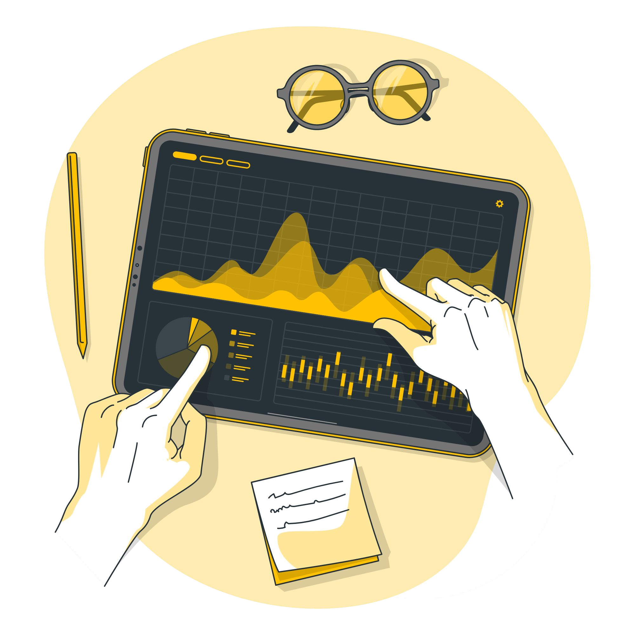
SOLUTION APPROACH
"tracks_Data.csv" dataset was taken from spotify.com and was reconﬁgured to reﬂect the important features.
Categorical features were then converted to numerical values.
We have deleted null or duplicate values from data set.
We created a scatter ,surface plot and different types of bar plots to analysis the data.

Slide 7
LIBRARIES USED
import NumPy
NumPy is a Python library used for working with arrays. It also has functions for working in domain of linear algebra, Fourier transform, and matrices.
import pandas
Pandas is a game changer, and it is one of the most popular and commonly used tools in data analytics. Pandas is that it takes data from a CSV or TSV file or a SQL database and generates a Python object with rows and columns called a data frame, which looks remarkably similar to a table in statistics tools like Excel. Working with this is far more convenient than dealing with lists and/or dictionaries.
import matplotlib
Matplotlib is a python library used to create 2D graphs and plots by using python scripts. It has a module named pyplot which makes things easy for plotting by providing feature to control line styles, font properties, formatting axes etc.
import tensorflow
TensorFlow is an open-source library developed by Google primarily for deep learning applications. It also supports traditional machine learning. TensorFlow was originally developed for large numerical computations without keeping deep learning in mind.
import seaborn
Seaborn is a Python data visualization library based on matplotlib. It provides a high-level interface for drawing attractive and informative statistical graphics.

Slide 8
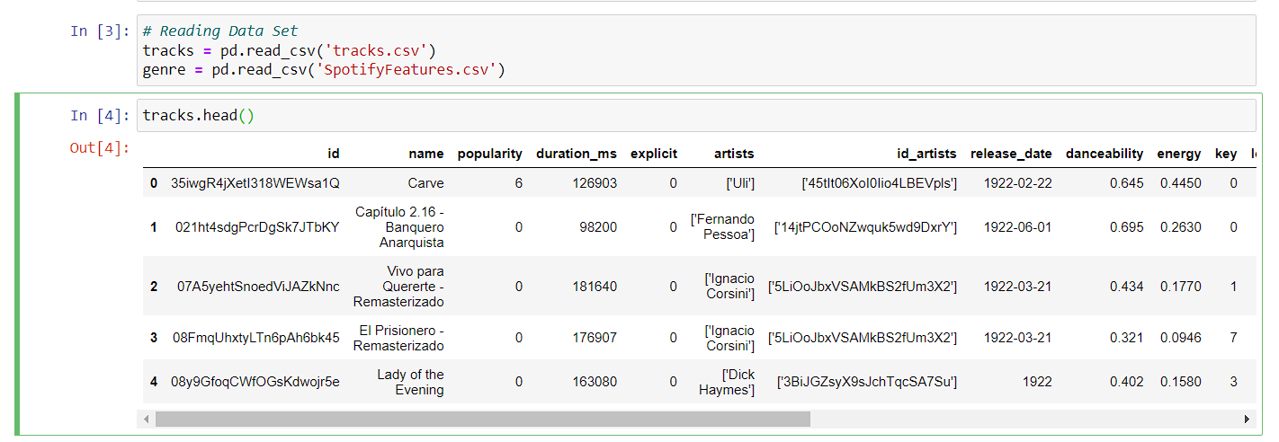
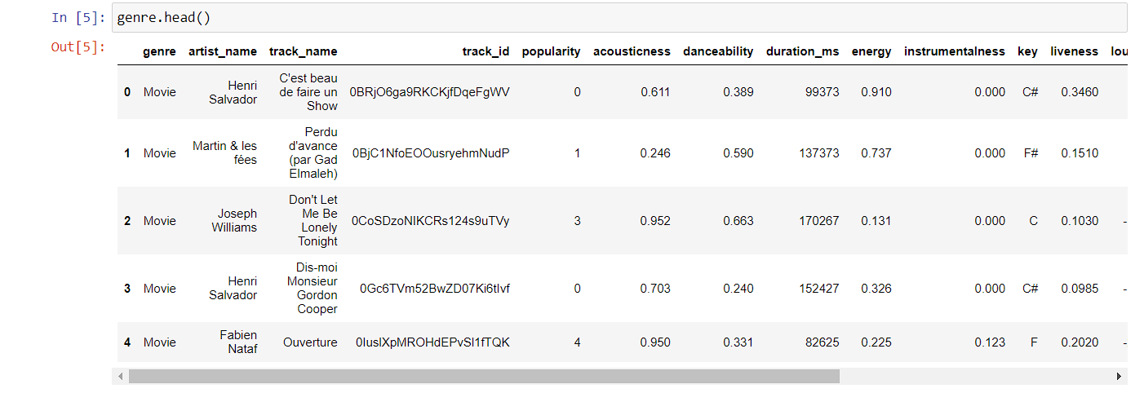
DATA READING
It is the data that we need to load for starting any of the ML project. With respect to data, the most common format of data for ML projects is CSV (comma-separated values). Basically, CSV is a simple file format which is used to store tabular data (number and text) such as a spreadsheet in plain text.

Slide 9
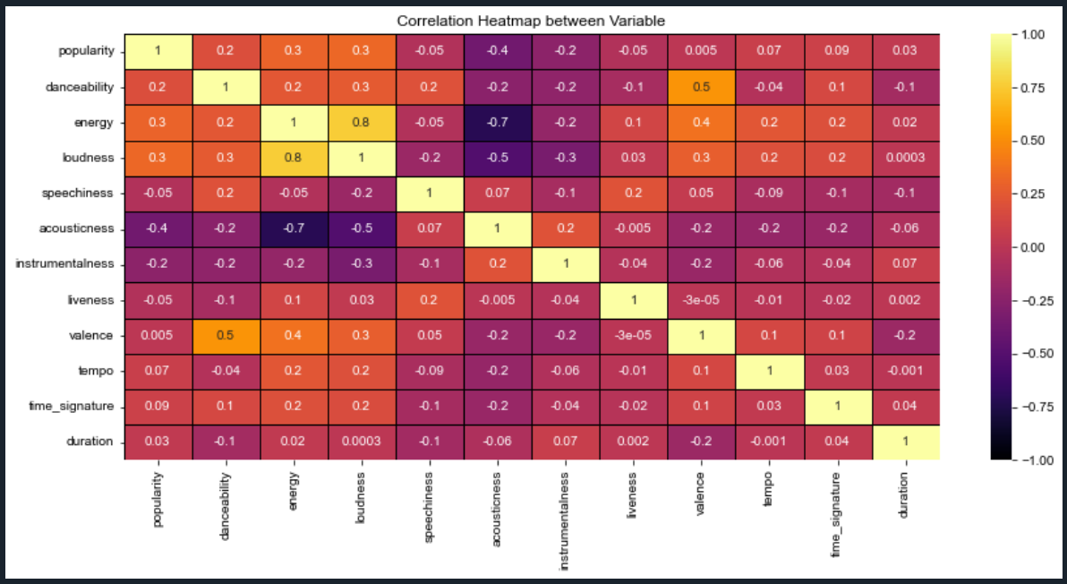
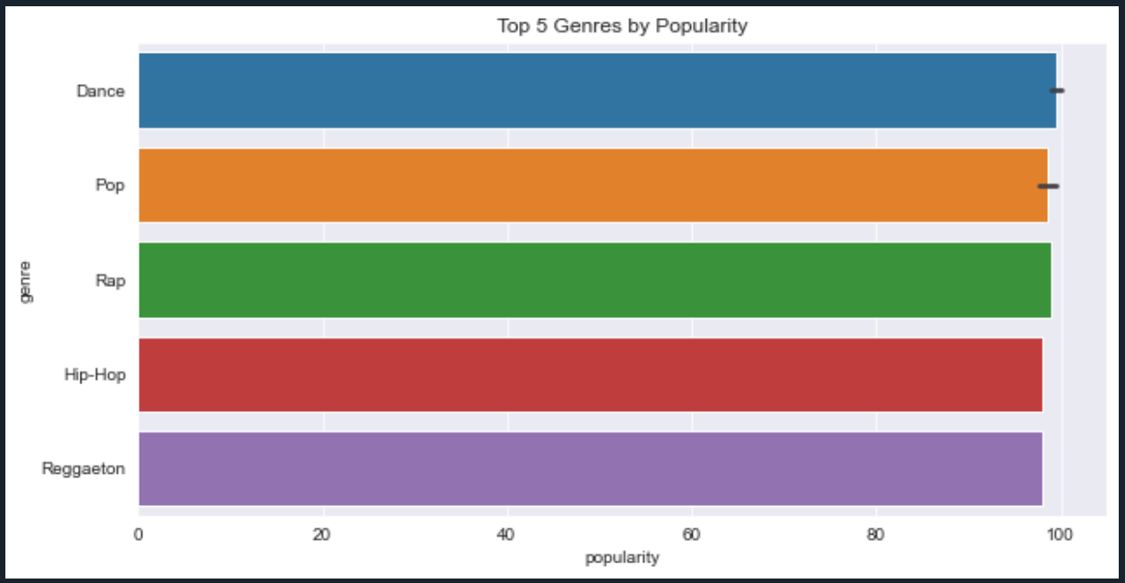
DATA VISUALIZATION
Data visualization is a graphical representation of quantitative information and data by using visual elements like graphs, charts, and maps.

Slide 10
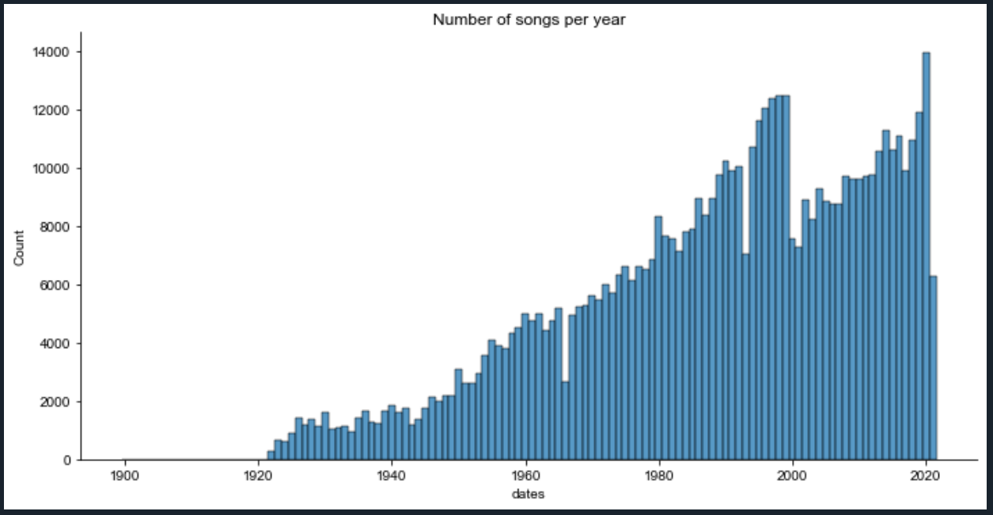
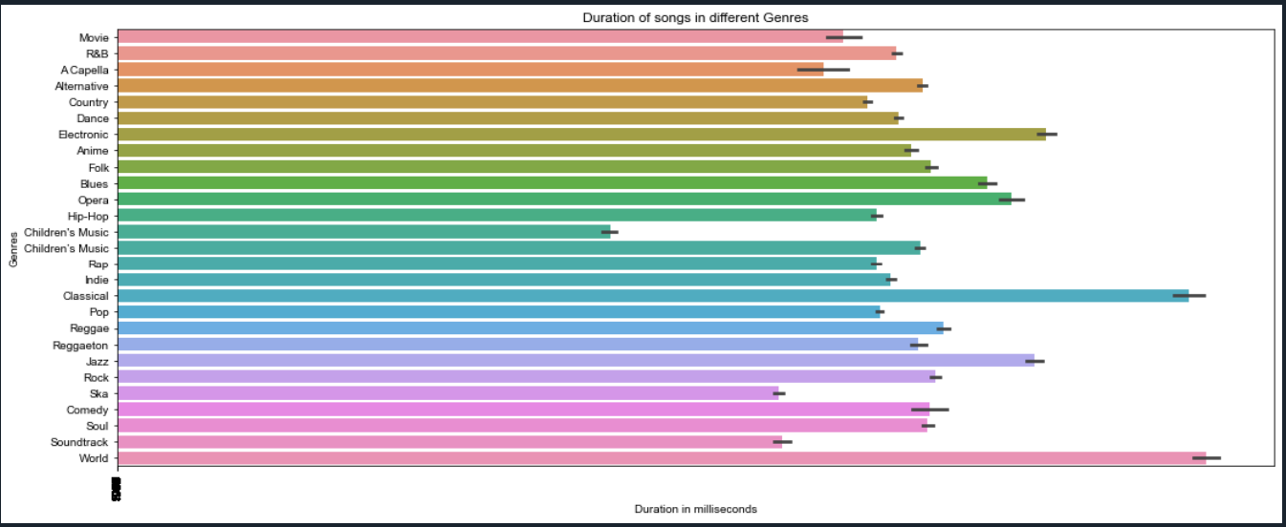
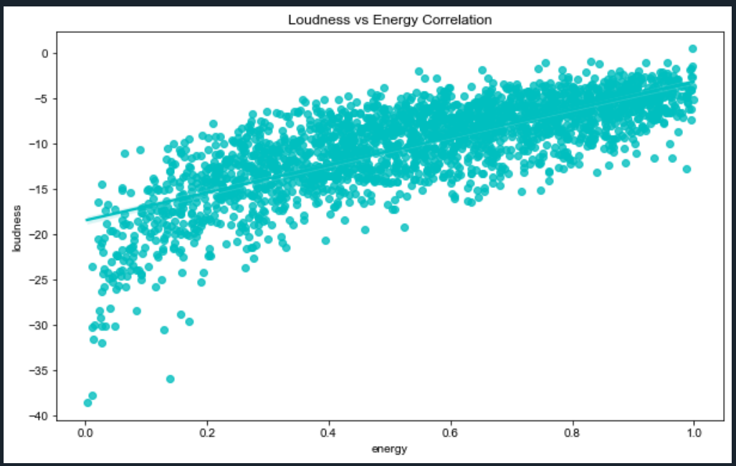
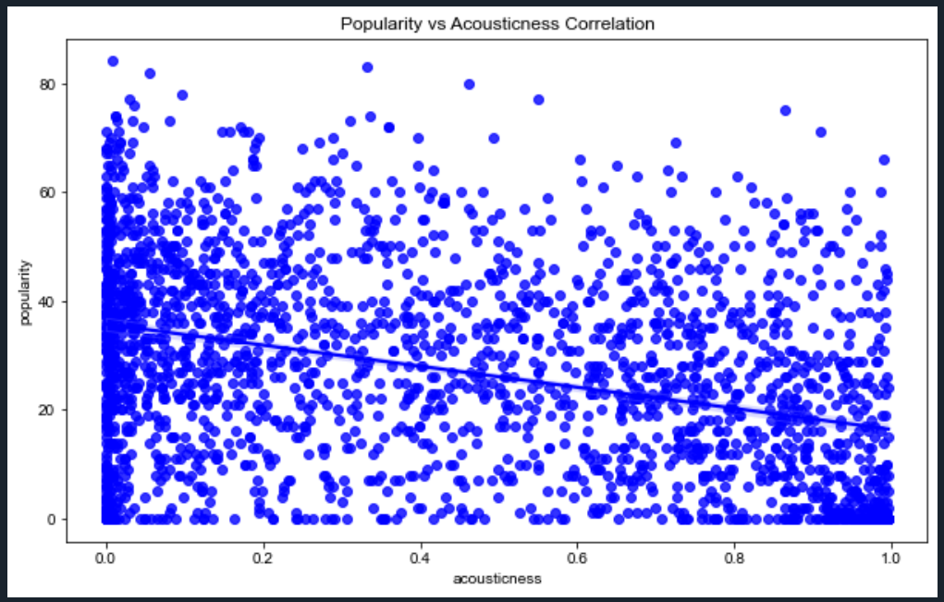

Slide 11
OBSERVATION
In this project,
First we have imported different type of python module and dataset.
Then after getting the output of dataset ,we have cleaned the dataset that whether the dataset has any null value or duplicate value or not.
Data visualization ,we have done it through different kind of data plotting.
Thus by this following steps we observe different kind of plotting and by comparing different kind of labelled data and we have plotted it.

Slide 12
RESULTS
Project name : SPOTIFY DATA ANALYSIS
CONTRIBUTION :
1.GOURAV SARKAR
2.NILADRI KARMAKAR
3.AYUSH MALLICK
4.SNEHASISH BISWAS
5.SUBIR BALA
6.SOUBHIK SARKAR
github link : https://github.com/Soubhik13/Spotify-Data-Analysis

Slide 13
CONCLUSION
There is a significant evidence to conclude that there is a significant difference in records released over the decades.
It is quite obvious given that 100 years ago the technology needed to record and publish music would have been rare and exotic compared to today!

Slide 14


CREDITS: This presentation template was created by Slidesgo, including icons by Flaticon, and infographics & images by Freepik and illustrations by Stories

