Slide 1

CI/CD PIPELINE
Maksym Obukhovskyi
EPAM DevOps Winter 2022 External Course

Slide 2
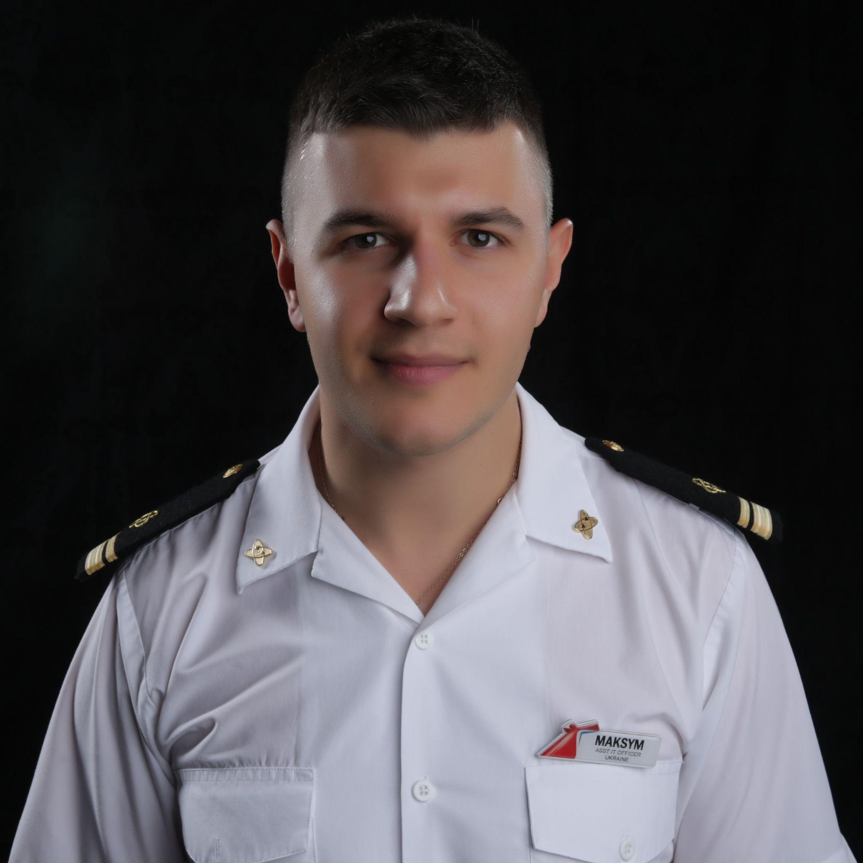
About me
IT Specialist with over 5 years of experience in operation support on the cruise vessels
Eager to learn DevOps practices and tools to become a systems engineer

Slide 3
PROJECT
OBJECTIVES
Motivation
The importance of diving deep into technologies, systems and tools that I learnt throughout the course. Ability to apply theoretical knowledge on practice to achieve the goal
Goal
To build a successful CI/CD pipeline by adhering to the DevOps practices
Relevance
Project provides an environment that solves the widespread problem of manual interaction and automates the processes in application life cycle, from development and test through deployment to operations

Slide 4
TECHNOLOGY
STACK
Github
Jenkins
Docker
AWS (EC2)
Terraform
Ansible

Slide 5
PROJECT
TASKS
Choose front and backend applications
Provision the necessary environments
Use all tools from technology stack and knowledge to achieve the goal
Minimize human interaction by automating tasks
Make a successful CI/CD pipeline

Slide 6
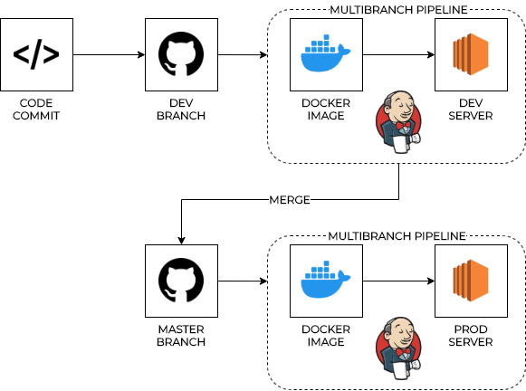
HIGH-LEVEL
DIAGRAM

Slide 7
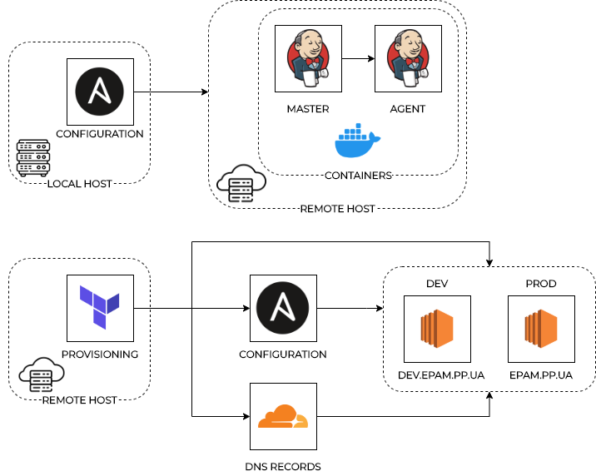
ENVIRONMENT
SETUP

Slide 8
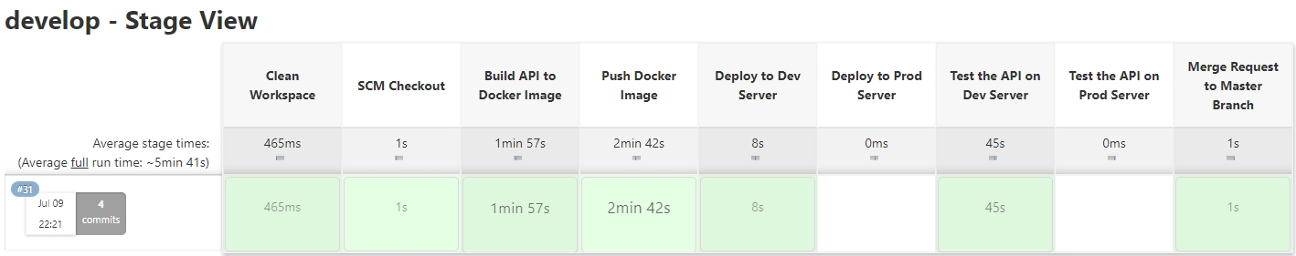
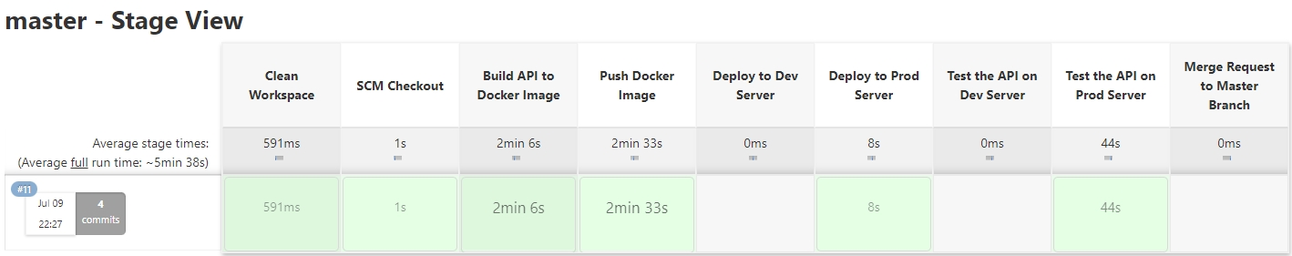
PIPELINE
JAVA API
Notes:
SAY HI AT THIS SLIDE

Slide 9
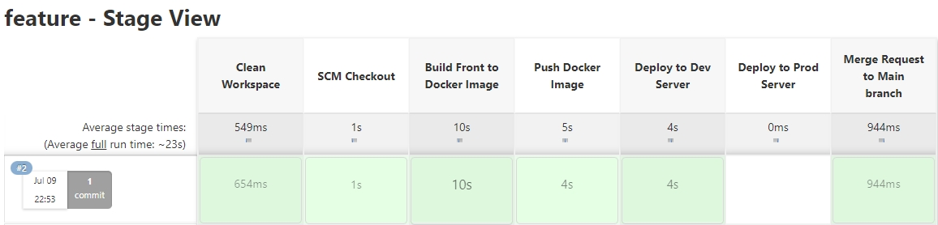
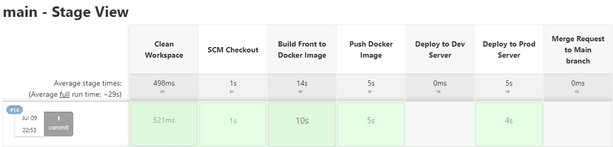
PIPELINE
SOLIDJS FRONT

Slide 10
LIVE DEMO

Slide 11
THINGS
TO IMPROVE
Create an Ansible playbook which will build the portable environment from end to end
Limit manual steps by automation
Rectify poor practices

Slide 12

THANK YOU
Q&A

