Slide 1





Intelligent Leave
Management Solution
Developed by :
Soufiane Moussaoui
Supervised By :
Mme.Amnay Meriem
Jury Members :
Mme.AIT OULHAYANE Hafsa
Mme.SOUBA Yasmine

Slide 2


SUMMARY
1
4
Introduction
Implementation
2
5
Nedds Analysis
User Exeperience
3
6
System Architecture Overview
Conclusion & Future Development
1

Slide 3

Introduction
Manual leave handling wastes time, hides real-time availability and creates avoidable scheduling conflicts.
SmartLeave restores visibility and speeds decisions, turning leave management from an administrative burden into a productivity enabler.
2

Slide 4


Needs Analysis
Problem
Solution
> Paper and email-based requests cause delays, mistakes and staffing gaps.
> SmartLeave centralizes requests and automates approval workflows and notifications.
It provides a role-based access for clear responsibility.
Built-in reporting and export (PDF/CSV) support audits and staffing forecasts.
> Benefit: faster approvals, fewer conflicts and less admin overhead.
3

Slide 5

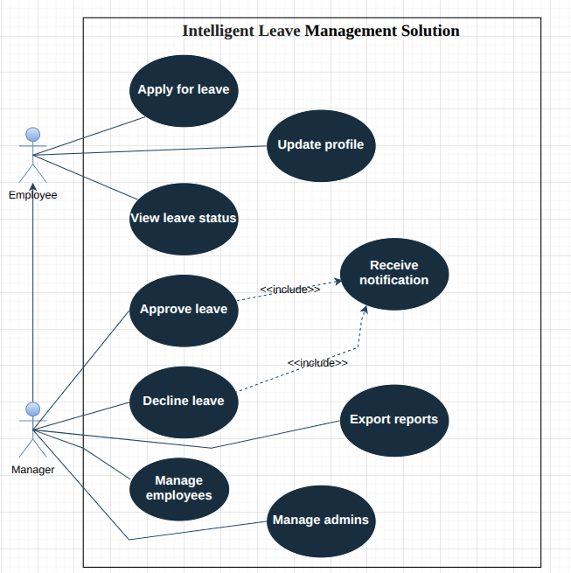
System Architecture Overview
Use Case Diagram

Slide 6
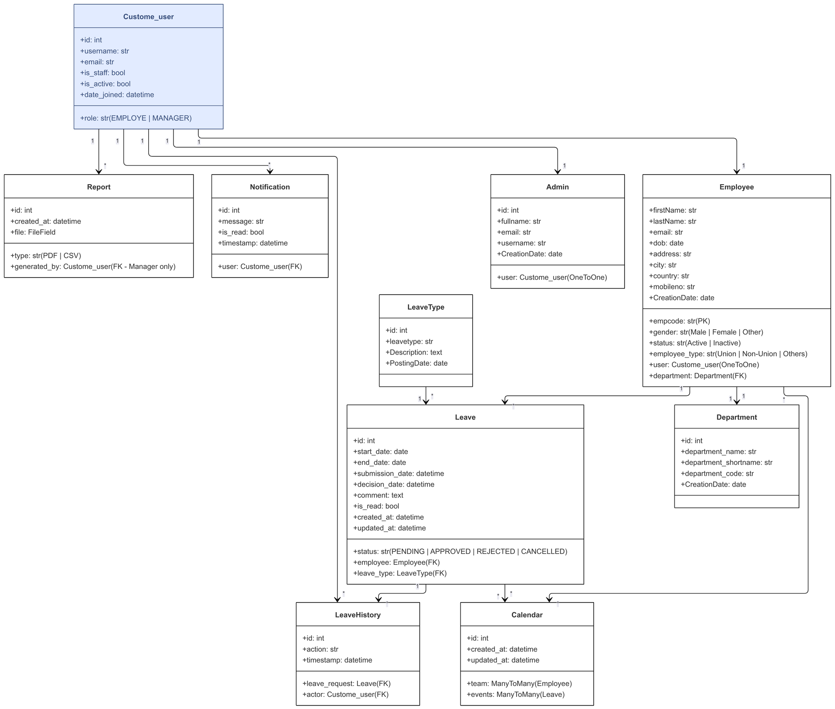
Class
Diagram

Slide 7
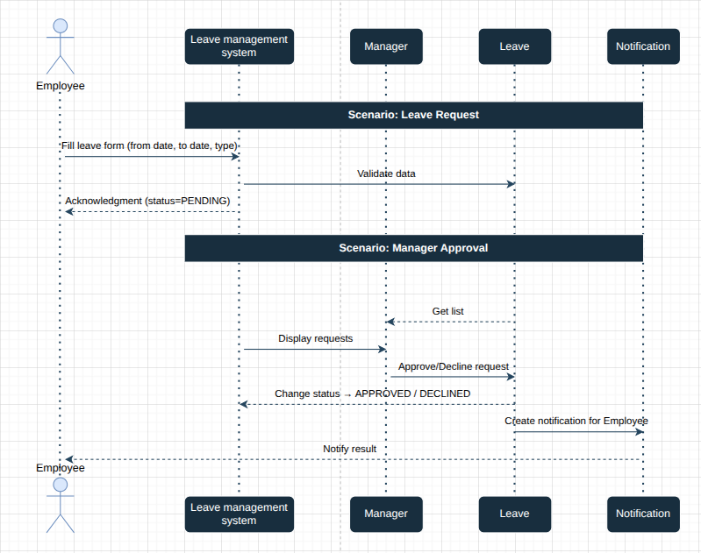
System Architecture Overview
Sequence
Diagram

Slide 8

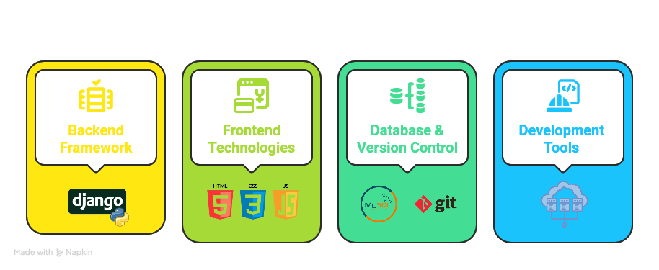
Implementation
Technology Stack
7

Slide 9

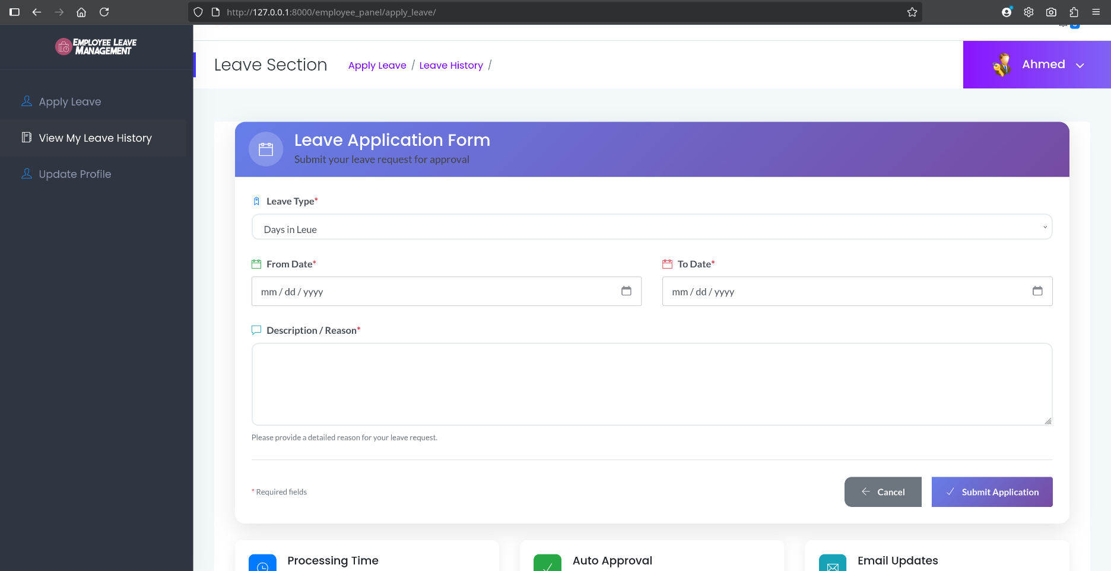
User Exeperience

Slide 10
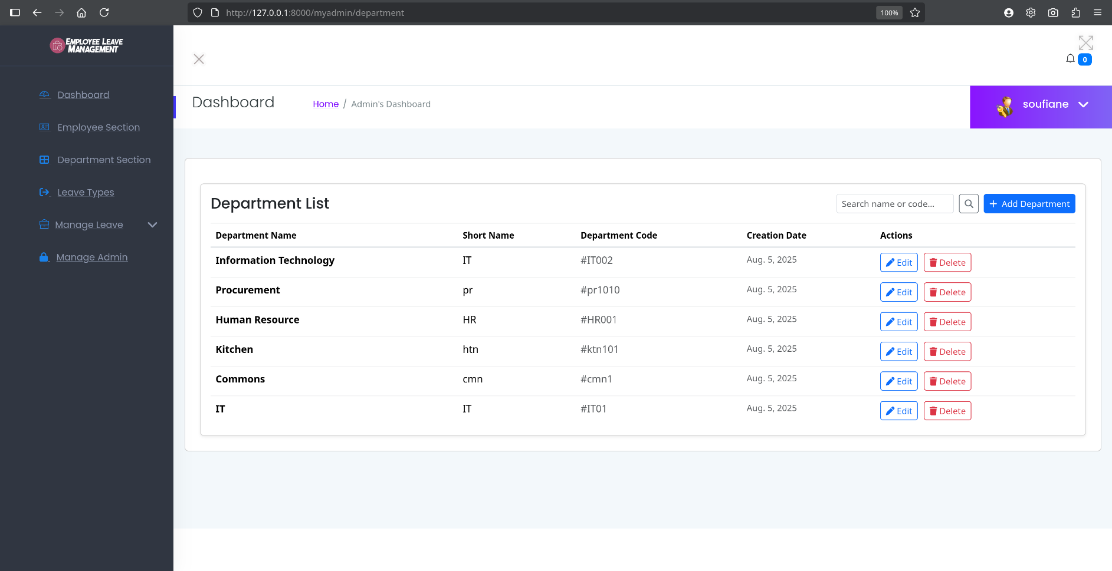
User Exeperience

Slide 11
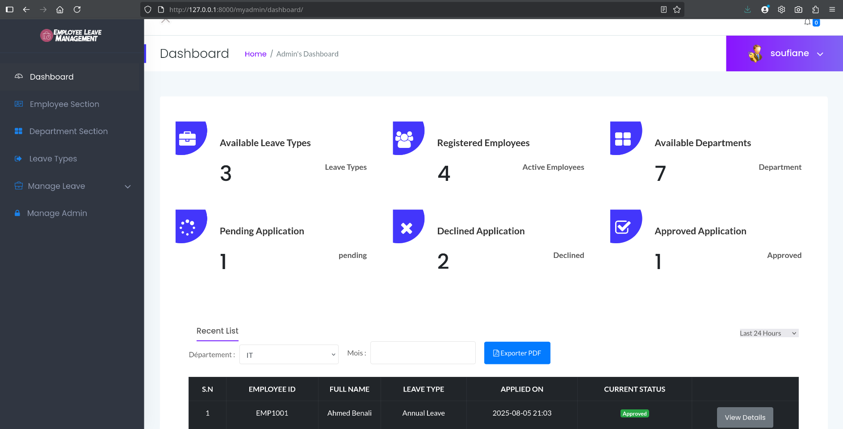
User Exeperience

Slide 12
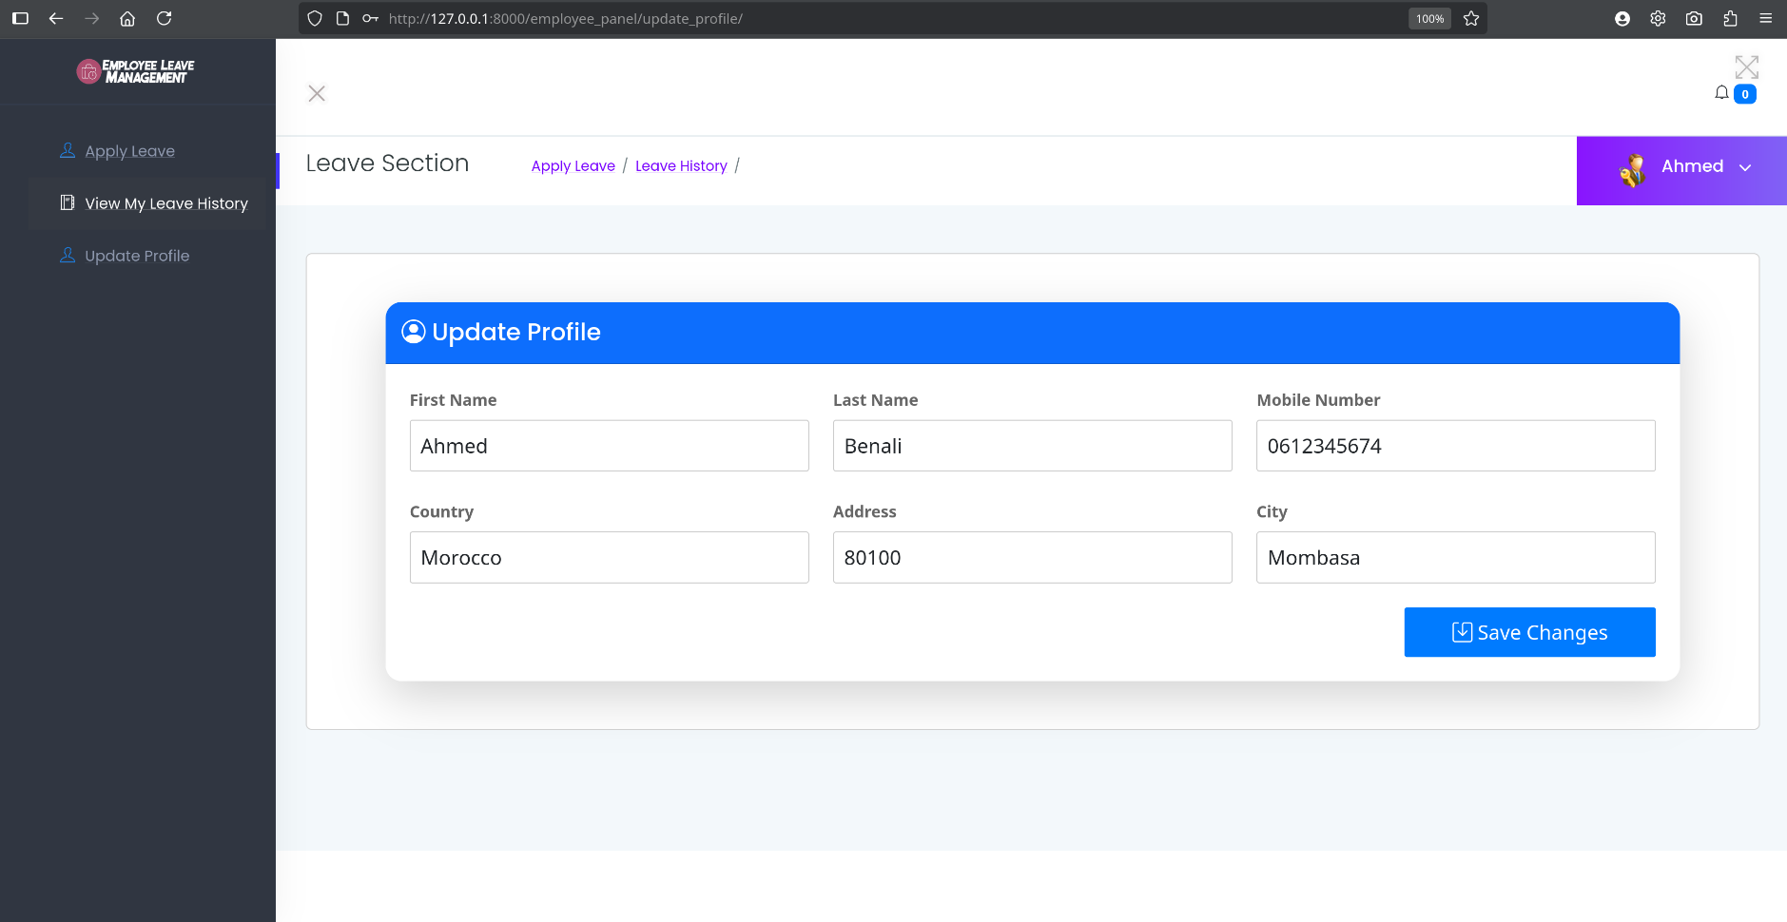
User Exeperience

Slide 13

Conclusion
The project delivers a fully developed technical design, on-going testing and documentation to support implementation success with the possibility of adding optionality later, such as AI-based analytics for resource planning and interfacing with enterprise systems.
8

Slide 14

Thank
You
9

