Slide 1


G M University
Davanagere
Department of Computer Science and Engineering
Project Work - I
Review 1
Agentic AI-Driven Workforce Capacity Forecasting and Resource Optimization System
Student Names & USN
Sl .No | Name | USN
1 | Soujanya Jain Brahmaraj | U23E01CS071
2 | Sujan N M | U23E01CS075
3 | Tejaswini K S | U23E01CS078
4 | U M Vinay | U23E01CS080
5 | Vinay Kumar B M | U23E01CS082
Guide Name
Mr.Babu Sab
Assistant Professor
Faculty of Engineering and
Technology

Slide 2
1. Introduction
Effective workload and workforce management is essential for timely project completion and efficient resource utilization.
Traditional planning relies heavily on spreadsheets, historical records, and manual estimation.
These approaches provide limited support for predicting future workload and identifying capacity problems in advance.
The proposed system uses AI-based workload forecasting and workforce capacity analysis to support future planning.
It provides workload insights, risk identification, and resource planning recommendations through an interactive dashboard.

Slide 3
2. Problem Statement
Workload and employee assignments change continuously across projects.
Managers must consider:
  Task workload and duration
  Deadlines and priorities
  Employee availability
  Working capacity
  Current and historical workload
Manual analysis makes it difficult to predict future workload accurately.
Potential employee overload, underutilization, and capacity gaps may be identified only after they occur.
There is a need for an intelligent system that can predict workload and support workforce planning decisions.
Affected Stakeholders
Project Managers | Team Leaders | Workforce Planners | Organizations

Slide 4
3. Motivation
Increasing number of projects and tasks makes manual workload planning difficult.
Future workload needs to be estimated before resource shortages occur.
Managers need better visibility into employee capacity and workload distribution
Early identification of overload can help reduce project delays and workload imbalance.
AI can transform historical workload data into predictive insights for workforce planning

Slide 5
4. Objectives
Analyze historical and current workload data to identify workload patterns.
Develop an AI-based model to forecast future workload.
Analyze workforce capacity and identify overload, underutilization, and capacity gaps.
Generate resource planning recommendations such as task redistribution and rescheduling.
Develop an interactive dashboard for workload forecasting, risk analysis, and workforce planning.

Slide 6
5. Existing System / Literature Survey
Study | Approach | Key Contribution
Kumar et al. (2021) | ML-based workload forecasting | Forecasting workload for resource management
Bi et al. (2021) | Deep learning | Joint workload and resource prediction
Mizan & Taghipour (2022) | ML + optimization | Prediction combined with resource allocation
Ogungbire & Mitra (2025) | ML-based workforce forecasting | Estimation of future workforce requirements
Existing Limitations
Most approaches focus on specific domains or individual aspects.
Workload forecasting and workforce planning are often treated separately.
Limited integration of forecasting + capacity analysis + actionable planning recommendations.

Slide 7
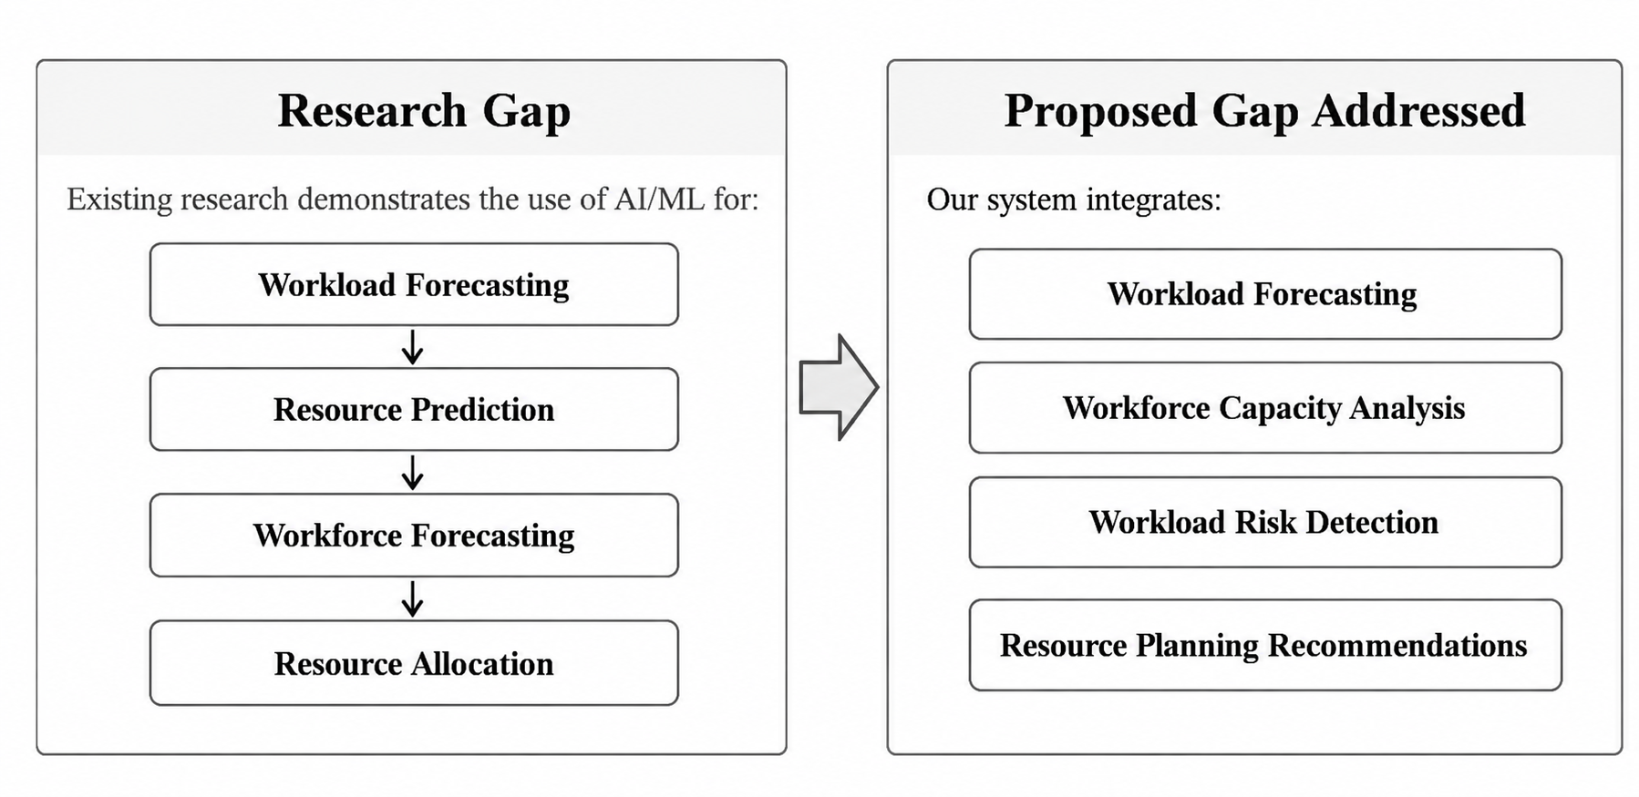
6. Research Gap / Limitations
Key Difference
The proposed system moves from predicting workload to supporting workforce planning decisions

Slide 8
7. Proposed System
The proposed system is an AI-driven decision-support platform that analyzes historical and current workload information to forecast future workload and assist workforce planning.
Key Features
Historical and current workload analysis
AI-based workload forecasting
Employee and team capacity analysis
Overload and underutilization detection
Capacity-gap identification
Task redistribution recommendations
Task rescheduling recommendations
Additional workforce requirement identification
Interactive analytics dashboard
Data
Forecast
Capacity
Risk
Recommendation
Dashboard

Slide 9
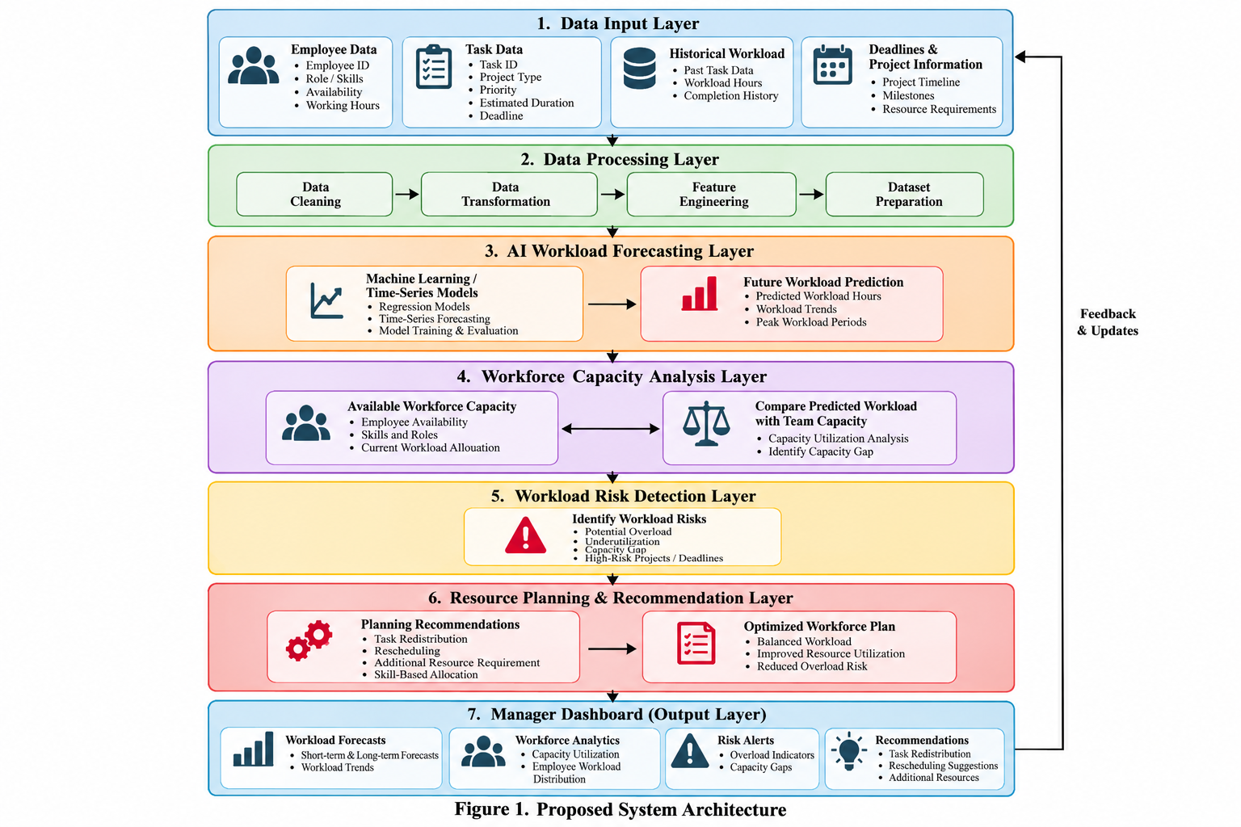
8. Proposed Architecture / Workflow

Slide 10
9. Proposed Modules
Module 1 — Workforce & Task Management
Employee information
Task details
Deadlines
Availability
Workload records
Module 2 — Data Processing & AI Forecasting
Data preprocessing
Feature engineering
Workload pattern analysis
AI/ML forecasting
Module 3 — Capacity & Risk Analysis
Employee/team capacity calculation
Workload-capacity comparison
Overload detection
Underutilization and capacity-gap detection
Module 4 — Resource Planning & Dashboard
Task redistribution
Rescheduling recommendations
Additional resource requirements
Analytics and visualization dashboard

Slide 11
10. Tools & Technologies
Category | Technology
Programming Language | Python
Frontend | React.js
Backend | Flask
Machine Learning | Scikit-learn
Data Processing | Pandas, NumPy
Visualization | Plotly / Recharts
Database | PostgreSQL
Development | VS Code, Jupyter Notebook
Version Control | Git & GitHub
Dataset | Realistic / Simulated Workload Dataset

Slide 12
11. Expected Outcome – Project Work–I
By the end of Project Work–I, the following are expected:
Completed data preprocessing and exploratory analysis
Identified important workload-related features
Developed and evaluated initial AI workload forecasting model
Implemented workforce capacity calculation
Performed workload-capacity comparison
Identified potential workload risks
Developed initial resource planning recommendations
Developed a basic interactive dashboard
Integrated major prototype components for demonstration
Prototype Outcome
A working prototype demonstrating AI-based workload forecasting and workforce capacity analysis for data-driven workforce planning.

Slide 13
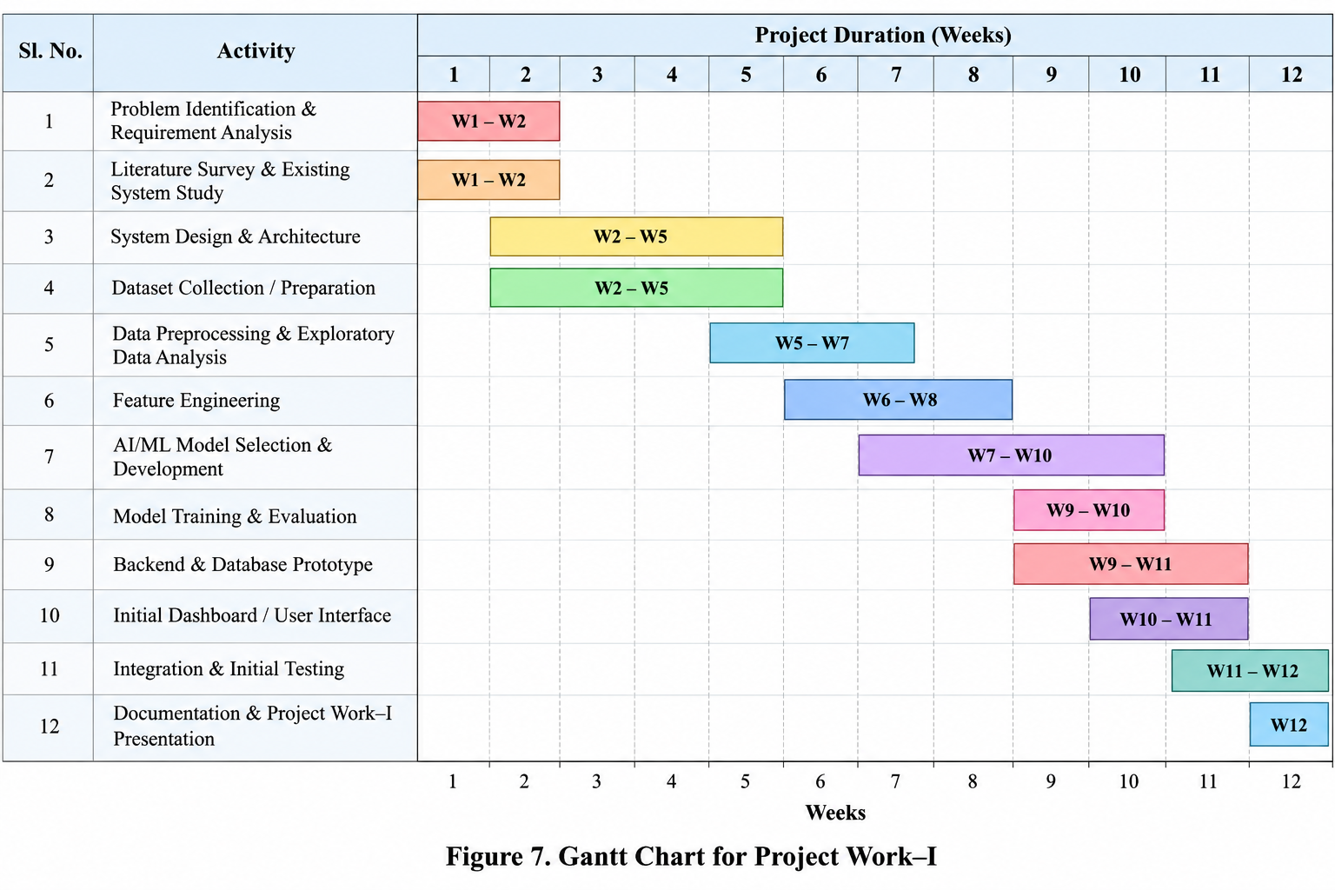
12. Project Work–I Timeline

Slide 14
13. References
[1] J. Kumar, A. K. Singh, and R. Buyya, “Self Directed Learning Based Workload Forecasting Model for Cloud Resource Management,” Information Sciences, 2021.
[2] J. Bi, S. Li, H. Yuan, and M. C. Zhou, “Integrated Deep Learning Method for Workload and Resource Prediction in Cloud Systems,” Neurocomputing, 2021.
[3] T. Mizan and S. Taghipour, “Medical Resource Allocation Planning by Integrating Machine Learning and Optimization Models,” Artificial Intelligence in Medicine, 2022.
[4] A. Ogungbire and S. K. Mitra, “Workforce Forecasting for State Transportation Agencies: A Machine Learning Approach,” International Journal of Transportation Science and Technology, 2025.
[5] A. Nabot et al., “AI for Software Project Management: Predicting Delivery Times & Resource Allocation,” IEEE ICIT, 2025.
[6] R. J. Hyndman and G. Athanasopoulos, Forecasting: Principles and Practice, 3rd ed., OTexts, 2021.

Slide 15
Review–1 Presentation Flow
Problem
Motivation
Objectives
Existing Work/Literature Survey
Research Gap
Proposed Solution
Architecture and Workflow
Modules
Technologies
Timeline
References

