Slide 1

Materia Medica 2050
EthnoHack 2026 · Track 3: Biodiversity & Sustainability
The plants that founded Western pharmacy, mapped then and now: what we stand to lose, and where to save it
De Materia Medica · 1st century CE
Soujanya Chatti
Notes:
Hook: Dioscorides' De Materia Medica guided European pharmacy for over 1,500 years, and many of its plants still grow wild in Greece. Question: which could we lose by 2050, and where could we grow them instead?

Slide 2



Greek medicinal plants face three pressures at once
Climate change
~1,140
The Mediterranean is a recognised climate and biodiversity hotspot; ranges shift or shrink
Wild harvesting
medicinal and aromatic plant taxa in Greece's flora
Plants such as Cretan dittany and mountain tea are still collected from the wild
Land-use change
Habitat loss compounds climate and harvest pressure
Solomou et al. 2026, Diversity 18:56 · doi:10.3390/d18010056
Our question Which Dioscoridean plants face the greatest combined risk by 2050, and where could they be cultivated instead?
Notes:
Pressures on Greek medicinal plants are documented in Solomou et al. 2026. Nobody has assessed Dioscorides' plants as a group, linked to their historical identity.

Slide 3





Built on open, cited data and on prior Greek modelling
Dioscorides
Occurrences
Climate
Terrain
Wellmann Greek edition + published identifications
GBIF · DOI 10.15468/dl.4u6k8n
WorldClim 2.1, 2.5′; 2041–2060, 3 CMIP6 models
Copernicus elevation and slope
Protection
Land cover
Accessibility
Modern use
Natura 2000 sites
CORINE Land Cover 2018
OpenStreetMap roads and settlements
EMA herbal monographs
Builds on climate niche models for 10 medicinal plants in Crete (Biology 2023, doi:10.3390/biology12101327). We extend to Dioscorides' plants, all of Greece, harvest pressure and visible uncertainty.
Notes:
Every dataset is open, with licences in DATA_LICENSES.md and the GBIF download cited by DOI. Credit the Crete study openly; we extend it in four ways.

Slide 4





Six reproducible steps from ancient text to risk ranking
01
02
03
04
05
06
Species
Occurrences
Climate
Models
Risk score
Cultivation
32 Dioscoridean plants native to Greece
Clean, de-duplicate and spatially thin GBIF records
2.5′ (~4.6 km) variables, now and 2041–2060
MaxEnt + random forest
Range loss, endemism, status, harvest
Suitable in 2050; cells within 5 km of wild populations excluded
Open and reproducible github.com/SoujanyaChatti/Materia-Medica-2050 · data licences documented
Notes:
Walk the pipeline left to right. Climate data is at 2.5 arc-minutes, about 4.6 km. State the thinning distance the pipeline actually used.

Slide 5
The top 10 is robust to weights, sensitive to disputed names
6
3 models (MPI-ESM1-2-HR, MRI-ESM2-0, IPSL-CM6A-LR) × 2 scenarios (SSP2-4.5, SSP5-8.5); we report the median and the range
84%
Average across 1,000 random risk weightings. Dittany stays in the top 10 in 82% of them, but its rank ranges from 1 to 23
climate futures
top-10 stability
12 / 32
Fewer than 30 records or cross-validated AUC below 0.75; flagged in results, not dropped
50%
Without the 9 disputed identifications, only half the top 10 stays the same. We report this as a finding
low-confidence models
of the top 10 unchanged
Notes:
Lead with the honest finding: rankings are robust to how we weight risk, but dropping the 9 disputed identifications changes half the top 10. Historical name uncertainty is itself a result.

Slide 6
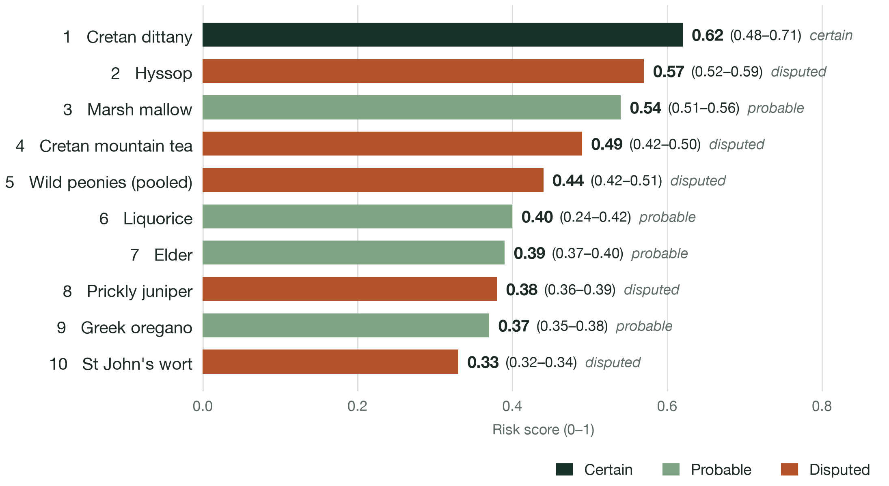
Cretan dittany could lose over half its climate range by 2050
Top-10 risk score, by identification confidence
32
plants modelled
12 low-confidence, 9 disputed names
−49%
median range change, top 10
SSP2-4.5; plants range −9% to −69%
84%
top-10 stability
Brackets: score range across 3 climate models (SSP2-4.5)
across 1,000 random weightings
Notes:
Dittany ranks first: under SSP2-4.5 its median range change is −58% (−24 to −81% across 3 climate models), and −65% under SSP5-8.5. Its identification is certain. Point out that 5 of the top 10 have disputed names. The brackets give the score range across the 3 climate models.

Slide 7

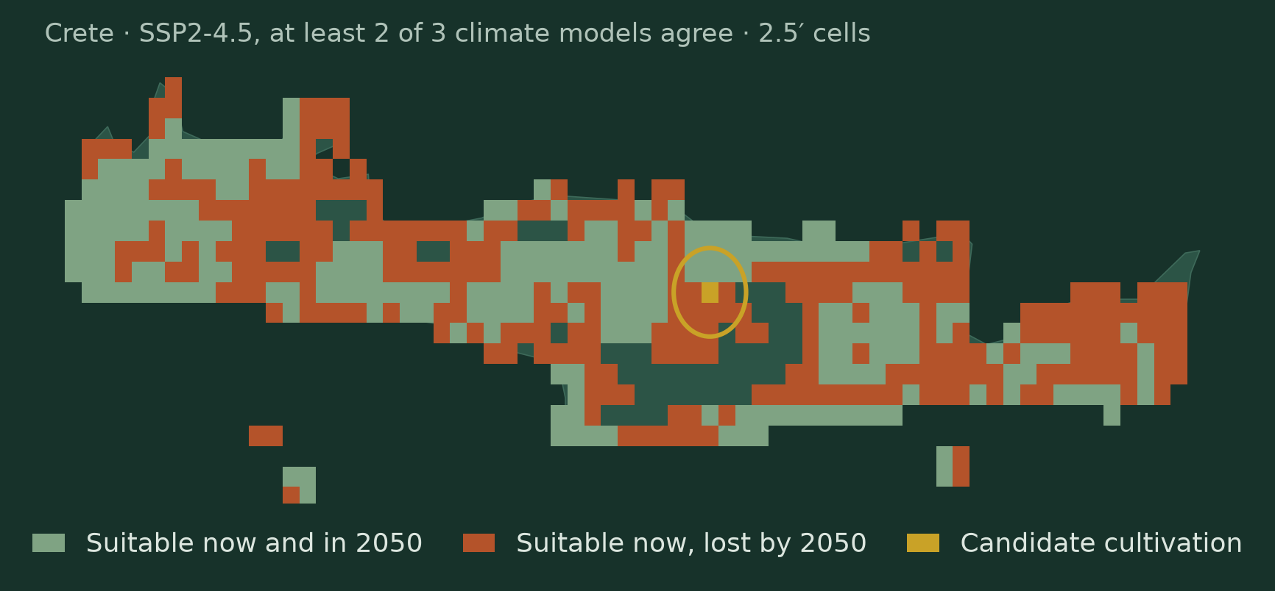
Dittany has almost nowhere to be cultivated instead
Cretan dittany
Cretan mountain tea
Origanum dictamnus
Sideritis syriaca
Identification certain
Identification disputed
Range change by 2050, SSP2-4.5
Range change by 2050, SSP2-4.5
−58% (−24 to −81%)
−50% (−32 to −52%)
Cultivation area, SSP2-4.5
Cultivation area, SSP2-4.5
~17 km² (0–210)
~272 km² (118–784)
Dittany: one ~17 km² cell suitable for cultivation (0–210)
Notes:
Both figures are SSP2-4.5: the median of 3 climate models with the range across them. The map shows dittany at the model resolution (2.5′): 324 of 558 currently suitable cells are lost and one cell qualifies for cultivation. 16 of 32 plants have no cultivation area at all, because cells within 5 km of wild populations are excluded.

Slide 8
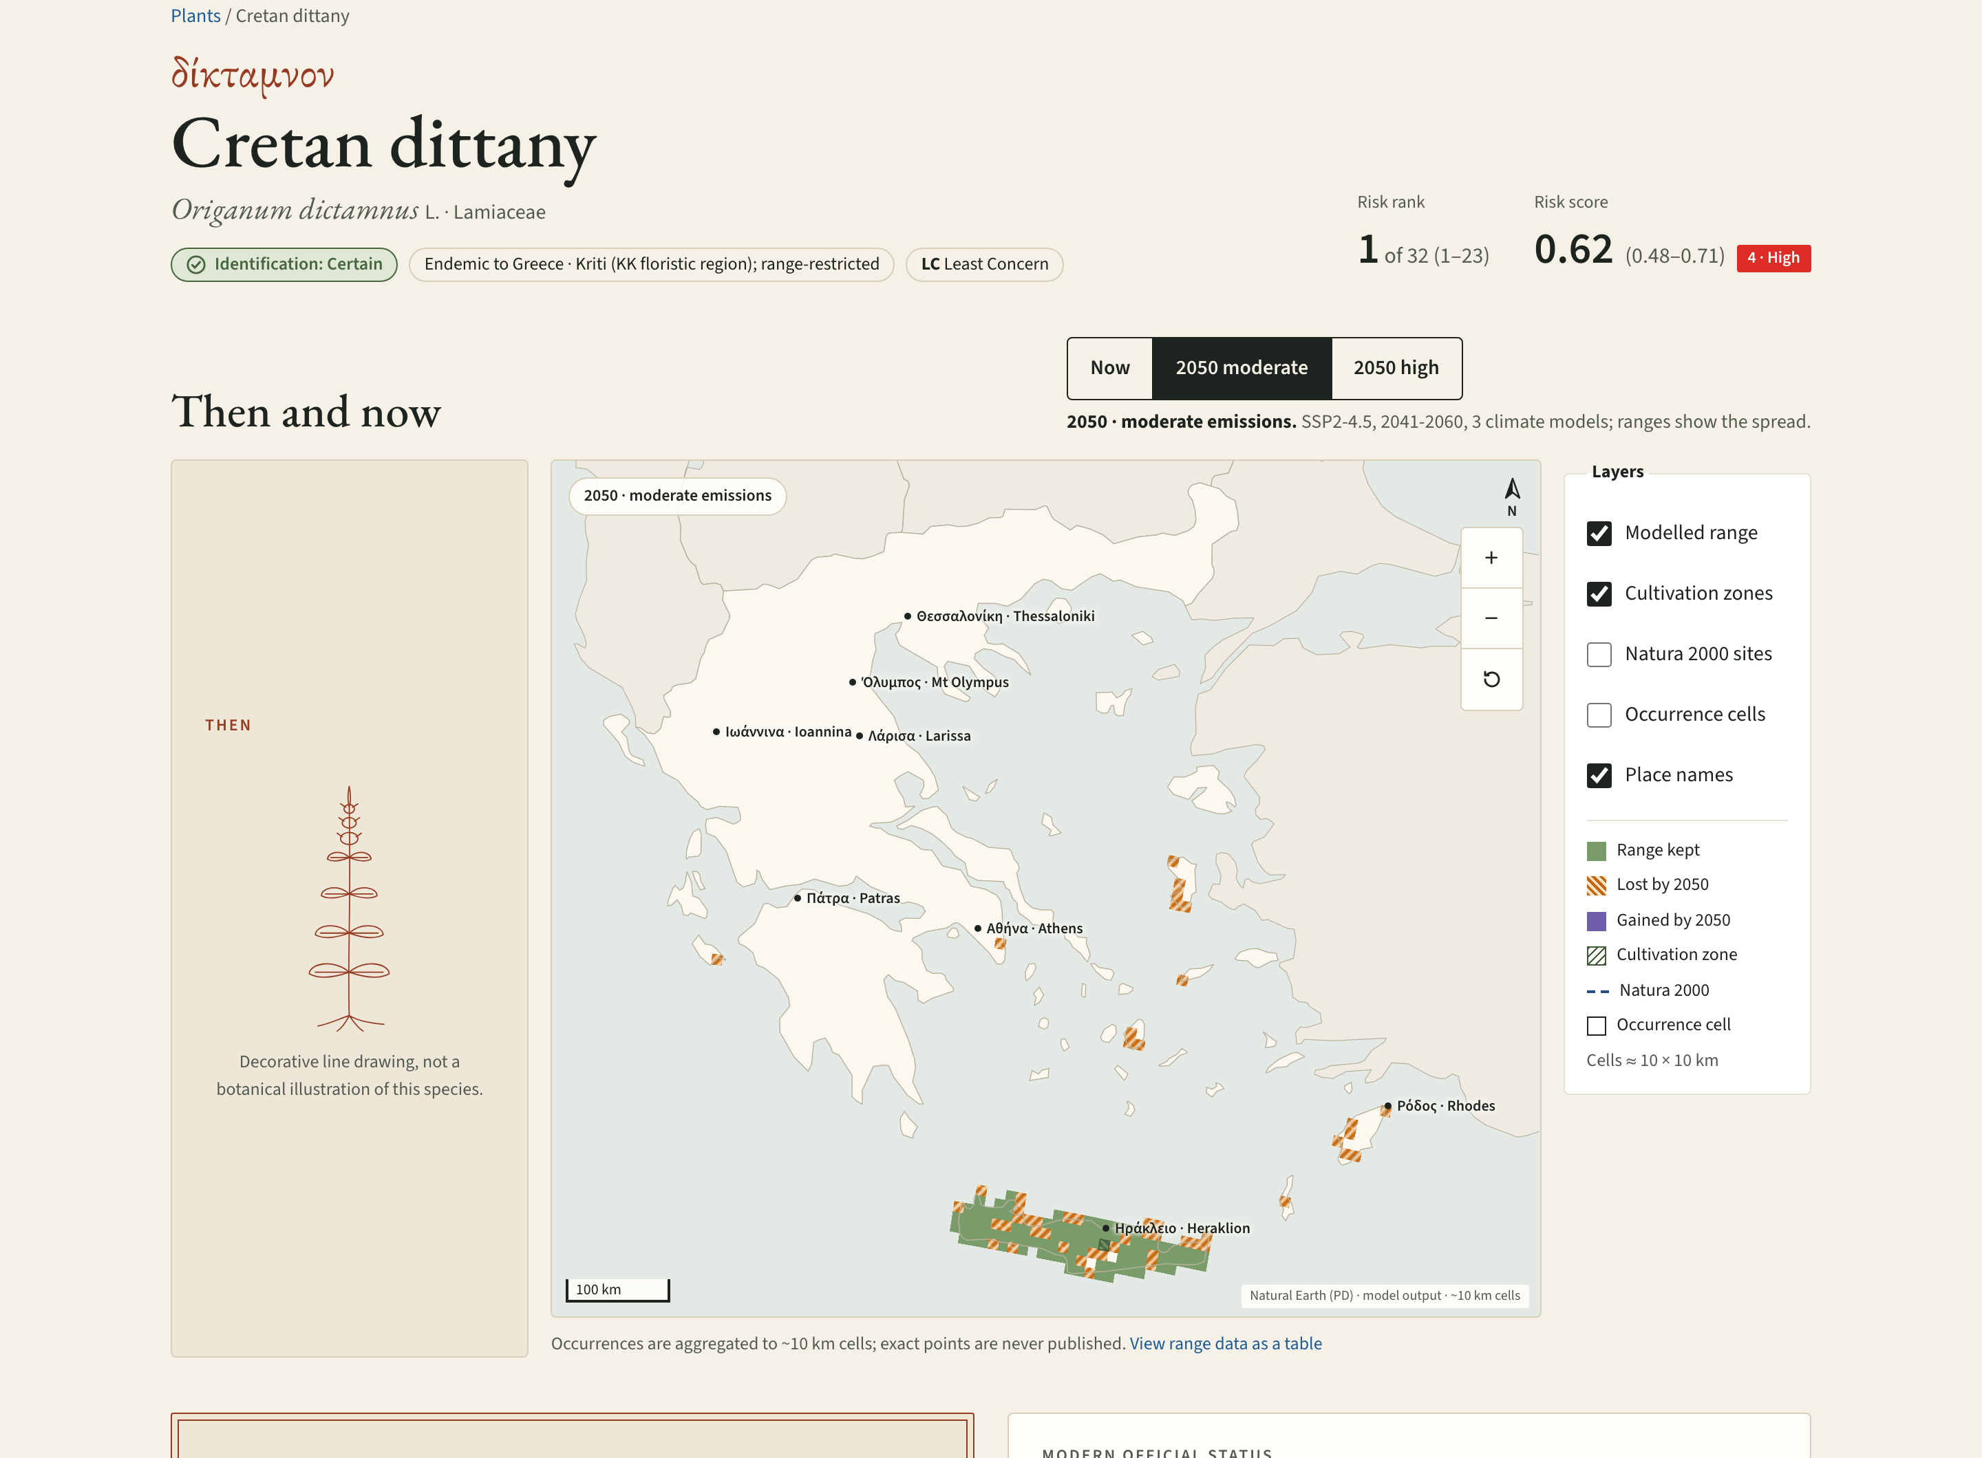
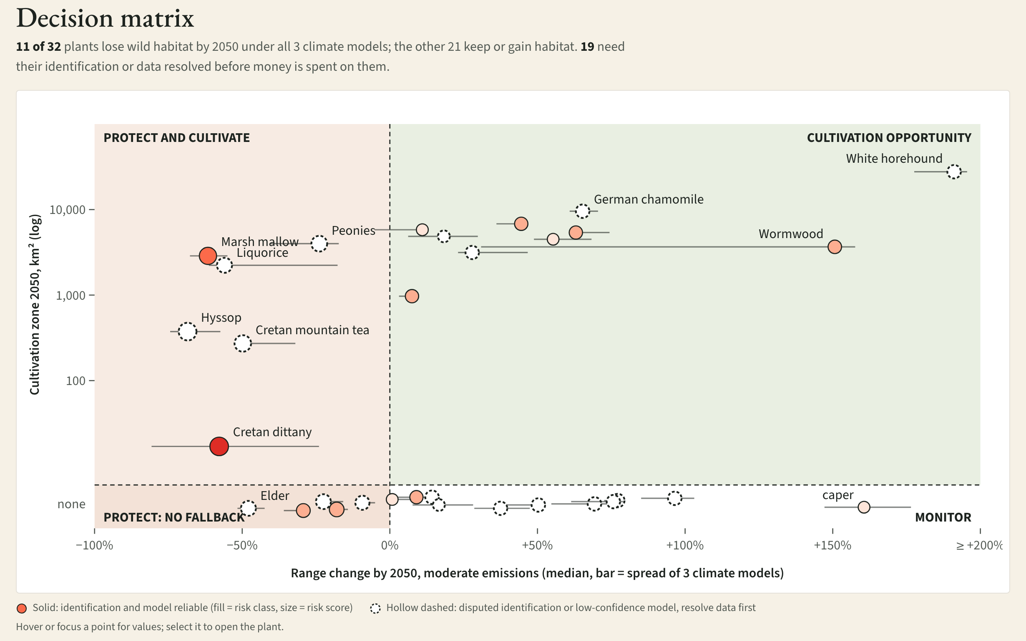
Every plant, its uncertainty and a suggested action, online
Plant page
2050 ranges, risk breakdown, suggested action, names timeline
Action plan
All 32 plants sorted into four actions; grower finder per ~10 km cell
Notes:
Show the live site: open Cretan dittany, toggle between now and 2050, and scroll to its suggested action and the identification timeline (1530 to today). Then open the Action plan: the decision matrix puts every plant in one of four actions, and the grower finder lists what a chosen ~10 km cell or farming region could grow by 2050. The risk weight lab on /plants re-ranks live.

Slide 9





Our results are hypotheses with eight known limits
Sampling bias
Harvest is a proxy
GBIF records cluster where botanists walk
Road access saturates (0.86–0.99), so it barely moves ranks
Dispersal assumed
2.5′ climate
Correlative models; range gains assume unlimited dispersal
About 4.6 km cells, coarse for small habitats
Ancient names
Pooled taxa
9 identifications disputed; they reshape half the top 10
Peonies, capers, juniper and mandrake modelled as groups
Global IUCN status
5 km rule
IUCN categories are global, not Greece-specific
Leaves 16 of 32 plants with no cultivation area
Hypotheses for conservation planning, not prescriptions. Not medical advice.
Notes:
Say these limits out loud. The 5 km exclusion protects wild populations, but it is why half the plants have no cultivation area.

Slide 10

From an ancient text to an action plan
Conservation
Communities
Researchers
6 plants to protect and cultivate; 5 to protect with no farmland fallback
A grower finder: what each ~10 km cell could grow by 2050, to test with collectors
Open pipeline, data and five centuries of identifications, reusable elsewhere
Next: expert review of identifications · resolve pooled taxa · field-test cultivation zones
Live site soujanyachatti.github.io/Materia-Medica-2050 Code https://github.com/SoujanyaChatti/Materia-Medica-2050
Notes:
Close on three audiences. The decision matrix: 11 of 32 plants lose habitat under all 3 climate models; 6 of them have a 2050 cultivation zone, 5 do not. 19 plants need their identification or data resolved before money is spent. Invite judges to open the Action plan and pick a region.

