Slide 1




Creating Value Leveraging Knowledge
Dr. M. S. Sheshgiri Campus, Belagavi
MilletVision :
Smart Millet Detection System
1

Slide 2



Creating Value Leveraging Knowledge
Dr. M. S. Sheshgiri Campus, Belagavi
Team Details
Team : B-15
Sr No | Name | SRN
1 | Omkar Bhandare | 02FE22BCS062
2 | Siddharth Sutar | 02FE22BCS134
3 | Sonali Jadhav | 02FE22BCS146
4 | Soujanya Mirajkar | 02FE22BCS147
Under the guidance of
Dr. Prema T. Akkasaligar
2

Slide 3

MOTIVATION
In recent years, millets have been recognized as nutrient grains they require less water, grow well in dry regions, and are rich in nutrients.
However, one major challenge faced by farmers, traders, and even consumers is the difficulty in visually identifying different millet varieties, as they often look very similar to each other.
Manual identification is time-consuming, prone to errors, and sometimes requires expert knowledge.
Automated millet classification helps farmers, seed companies, and industries in sorting, certification, and traceability — enabling a modern data-driven agri-ecosystem.
3

Slide 4

PROBLEM STATEMENT
Manual identification of millet types is often inaccurate and inefficient, especially for farmers, food industries, and consumers who lack technical expertise. There is also limited awareness about the nutritional benefits, health impacts, and uses of different millets. Hence, there is a need for a system that can classify millet types from images and provide detailed information, promoting better utilization and awareness of these nutritious grains.
4

Slide 5
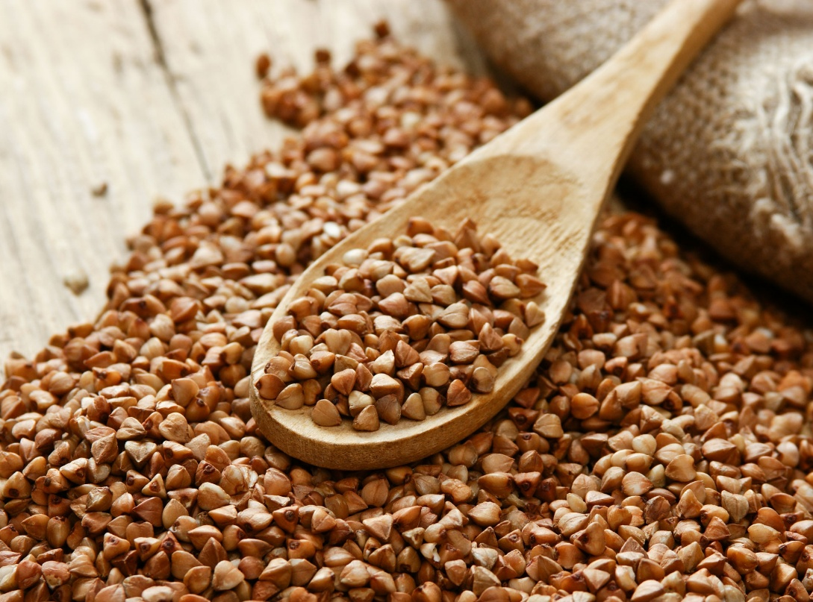
OBJECTIVE
To develop a millet classification system using Vision Transformers.
To provide detailed information on nutritional facts, health benefits, uses, and recipes for each millet.
To promote millet awareness and healthy food choices through an easy-to-use interactive web application.
Buck-wheat Millet
5

Slide 6
COURSE CONNECT
Feature Extraction & Model Training → AI, Machine Learning, Pattern Recognition.
Vision Transformer (ViT) Implementation → Deep Learning, Computer Vision.
Model Optimization & Regularization → Linear Algebra, Calculus.
Evaluation Metrics & Performance Analysis → Statistics & Data Analytics
Deployment & User Interface → Software Engineering, Web Development
6

Slide 7
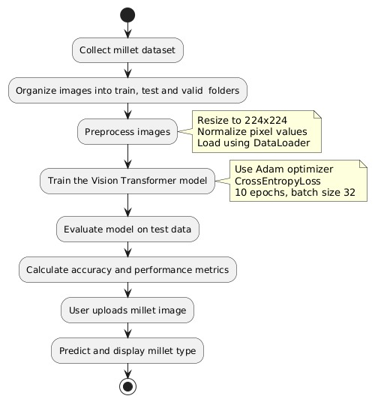
METHODOLGY
Dataset Description:
Millet images of five categories: buck-wheat-millet, little-millet, pearl-millet, ragi-millet, and sorghum-millet.
The dataset was organized into train and test folders for supervised learning.
Data Preprocessing:
All images were resized to 224×224 pixels for uniform input dimensions.
Applied normalization to scale pixel values for stable model convergence.
Model Architecture:
Implemented a Vision Transformer (ViT) model from the timm library.
The pre-trained ViT-Base-Patch16-224 model was fine-tuned for millet image classification.
Modified the final classification layer to output 5 classes corresponding to the millet types.
7
7

Slide 8
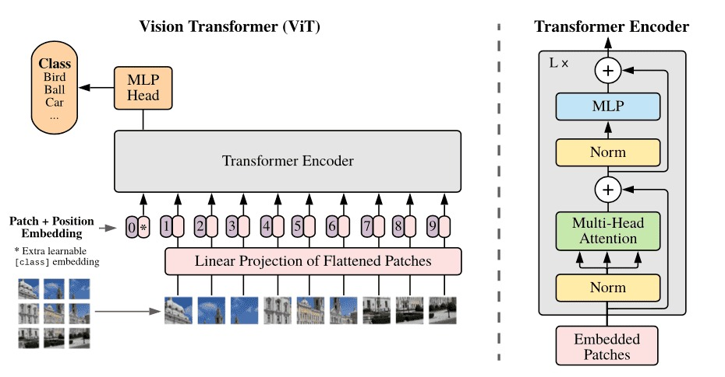
VISION TRANSFORMER ARCHITECTURE
8

Slide 9

METHODOLOGY
Training Phase:
The model was trained using the Adam optimizer and Cross Entropy Loss function.
Training was performed for 10 epochs with a batch size of 32.
Evaluation:
The trained model was evaluated on the test dataset.
Computed accuracy score to measure overall performance.
Output:
The system accurately identifies the given millet image as one of the five categories.
Provides an easy-to-use web interface for demonstration
Buck-wheat Millet
9

Slide 10
LITERATURE SURVEY
Paper Title | Authors and Year | Methodology /Implementation | Limitations/Disadvtanges | Gaps Identified
1. Classification of Millet Cultivars Using Image Processing and Machine Learning Techniques | Dewendra Bharambe, Pushpalata Aher (2023) | Used color feature extraction and ML classifiers (SVM, KNN, XGBoost) for eight millet cultivars. | Limited dataset; single seed images used mostly. | Need for large bulk-grain datasets and inclusion of multi-feature learning.
2. Smart Millet Detection and Advisory System for Farmers | Nagarjuna G.R. et al. (2025) | AI-based system integrating ML models for millet disease detection and farming advice. | System not field-tested on real-time data. | Lack of real-time integration with IoT for advisory.
3. A Deep Learning-Based System for Classification and Quality Evaluation of Seeds (Pearl Millet & Maize) | Balaji Tedla et al. (2023) | Mixed Cropping Seed Classifier and Quality Tester (MCSCQT) using CNN and ImageNet data. | Limited to maize and pearl millet. | Extend to more crop varieties and real-field conditions.
10

Slide 11
Paper Title | Authors and Year | Methodology /Implementation | Limitations/Disadvtanges | Gaps Identified
4. Folk Biological Classification of Minor Millet Species in Kolli Hills, India | R. Rengalakshmi (2005) | Ethnographic study of tribal millet classification based on morphology and cultural traits. | No digital or automated classification used. | Integration of indigenous taxonomy with modern AI methods.
5. A Hybrid Deep Learning Framework for Detection of Different Varieties of Grain Types | Rahul Nijhawan et al. (2021) | Hybrid CNN + Random Forest model for 13 grain types (including millets). | Limited generalization on unseen grain images. | Model scalability to real-world, mixed-grain samples.
6. Identification of Millet Varieties Using Hyperspectral Imaging Technology | X. Wang, Z. Li, D. Zheng, W. Wang (2020) | Hyperspectral imaging (VIS–NIR) + SVM and attention-CRNN models. | Small dataset (480 samples). | Expand dataset and integrate real-time hyperspectral sensors.
7. Detection of Fungal Contamination in Millet Grain Using Near-Infrared Spectroscopy | (From file 00387010.2019.1639762) | NIR spectroscopy with PLS-DA, KNN, and SVM models. | Sensitive to noise and spectral variation. | Improve noise filtering and apply deep learning on NIR data.
11

Slide 12
Paper Title | Authors and Year | Methodology /Implementation | Limitations/Disadvtanges | Gaps Identified
8. Wheat Kernel Variety Identification Using Deep Learning-Based Feature Selection | Lei Zhou et al. (2020) | CNN-based feature selector (CNN-FS) with CNN-ATT classifier on large NIR dataset. | Focused on wheat, not small grains. | Extend deep spectral models to millet datasets.
9. Classification of Pepper Seeds by Machine Learning Using CFA Images | Kani Djoulde et al. (2024) | Color Filter Array image features with SVM and ML models. | Limited to pepper seeds. | Apply CFA-based imaging to millet and other cereals.
10. Comparative Study Between Traditional ML and DL Models to Classify Rice Types | Zainab M.G.H.M. Ali (2022) | Compared SVM, Random Forest, Decision Tree, and CNN on 75k rice images. | CNN underperformed due to small tuning. | Hybrid deep models needed for better generalization to millet.
12

Slide 13

THANK YOU
15
13

