Slide 1

A Systematic Approach to Scalably Saturate PM Bandwidth
Soujanya Ponnapalli, Sekwon Lee, Rohan Kadekodi, Vijay Chidambaram
soujanya.ponnapalli@utexas.edu
Task/Theme: 3135.003
Notes:
Hi everyone,
Thanks a lot for attending this talk. I am Soujanya Ponnapalli!
I am a PhD candidate at UT Austin, I am graduating this October and will be joining UC Berkeley as a postdoc.
Broadly, my research interests are in Storage and Distributed systems and I am open to collaborating on projects in this space.
Today, I will be presenting a systematic approach to scale-ably saturate Persistent Memory bandwidth.

Slide 2
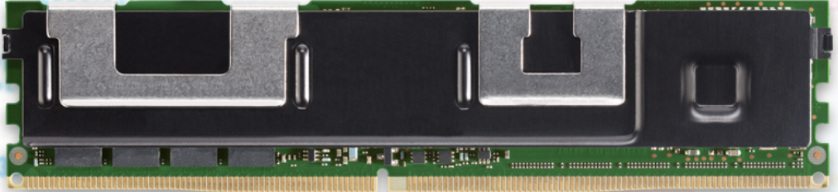
Persistent Memory
 |  | Persistent Memory (PM)
Notes:
Lets begin with a brief overview on Persistent Memory.
Persistent Memory is a new storage-class memory technology.

Slide 3



Persistent Memory
 |  | Persistent Memory (PM)
Non-volatile
Byte-addressable
Notes:
PM is non-volatile: It durably stores data across power cycles.

Slide 4
Persistent Memory
 |  | Persistent Memory (PM)
Non-volatile
Byte-addressable
Notes:
PM is also byte-addressable: it allows applications to directly load and store data at cacheline granularity

Slide 5
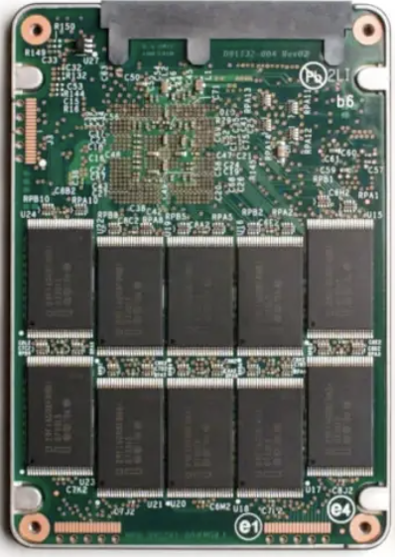
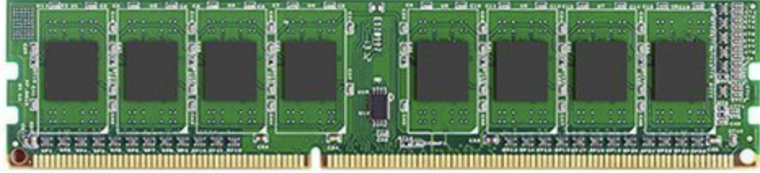

Persistent Memory
 | DRAM | Persistent Memory (PM) | Solid-state Drive (SSD)
Non-volatile
Byte-addressable
Notes:
This way, PM fills the gap between DRAM and SSDs:
It provides durable writes unlike DRAM and
supports direct loads and stores instead of supporting only (4kB or) block-sized I/O operations like SSDs

Slide 6
Persistent Memory
 | DRAM | Persistent Memory (PM) | Solid-state Drive (SSD)
Latency | < 100ns (1x) | 2—3x | 1000x
Non-volatile
Byte-addressable
Notes:
Intel’s Optane DC Persistent Memory is the first PM media that was commercially-available and
it has 2-3x higher latency than DRAM.
Thus, PM supports low, DRAM-comparable latencies!

Slide 7
Persistent Memory
 | DRAM | Persistent Memory (PM) | Solid-state Drive (SSD)
Latency | < 100ns (1x) | 2—3x | 1000x
Non-volatile
Byte-addressable
PM offers durability and byte-addressability at low latency
Notes:
Overall, PM offers durability and byte-addressability at low latencies.

Slide 8
Persistent Memory
Durable writes
Byte-addressable
High capacity and density
PM is a promising building block for large-scale kv-stores
Notes:
Besides, PM also has high density and is available in large capacities in a server.
A single server can support up to 12 TB of PM across (Non-Uniform Memory Access or ) NUMA nodes.
Thus, PM is a promising technology for building large-scale key-value stores

Slide 9
Persistent Memory
Durable writes | Higher cost relative to SSD
Byte-addressable | Lower bandwidth relative to DRAM
High capacity and density | Nuanced Performance Characteristics [1,2,3]*
[1] Yang, Jian, et al. "An empirical guide to the behavior and use of scalable persistent memory." 18th USENIX Conference on File and Storage Technologies (FAST 20). 2020.
[2] Daase, Björn, et al. "Maximizing persistent memory bandwidth utilization for OLAP workloads." Proceedings of the 2021 International Conference on Management of Data. 2021.
[3] Izraelevitz, Joseph, et al. "Basic performance measurements of the intel optane DC persistent memory module." arXiv preprint arXiv:1903.05714 (2019).
Notes:
On the other hand,
PM has higher cost / GB relative to SSDs, AND
Has lower bandwidth relative to DRAM – making it important to achieve high PM bandwidth utilization.
However, PM has nuanced performance characteristics, AND
Prior research shows that achieving high PM utilization is challenging;
primarily because its peak achievable bandwidth is dependent to a lot of factors.

Slide 10
PM Key-Value Stores
State-of-the-art PM key-value stores
FlatStore
Viper
ChameleonDB
Underutilize available PM bandwidth
Low throughput
Poor scalability
Notes:
We show that state-of-the-art PM kv-stores like FlatStore, Viper, and ChameleonDB
Underutilize available PM bandwidth
And suffer from low throughout and scalability

Slide 11
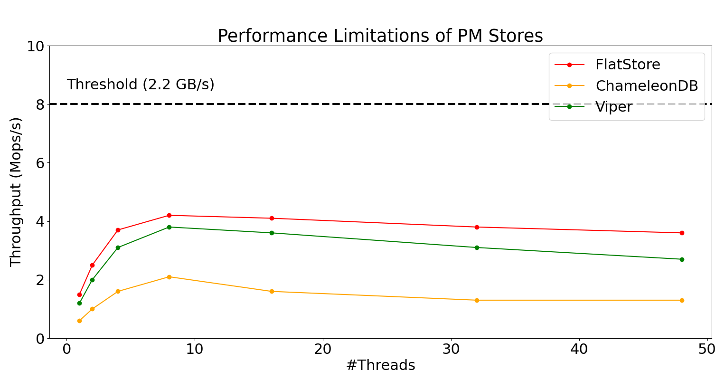
PM Key-Value Stores
Notes:
We use YCSB LoadA workload to measure the write throughput of the three PM stores with increasing number of application threads.
We report the throughput of these PM stores (shows in Mops/s on the Y-axis) and
Report the number of application threads (on the x-axis)
The maximum PM write bandwidth of a single NVDIMM is 2.2 GB/s

Slide 12
PM Key-Value Stores
45% of PM bandwidth
Notes:
We observe that all PM stores utilize <45% of available PM bandwidth
Further, their throughput drops on increasing number of application threads beyond 8
In addition, we also observe that, their throughput does not scale with the available PM capacity!

Slide 13
PM Key-Value Stores
PM stores suffer from low throughput and poor scalability
Notes:
Thus, PM stores suffer from low throughput and have poor scalability

Slide 14
Motivation: Efficient PM Stores
Write-optimized key-value stores are popular storage engines for distributed systems
Compute Express Link (CXL) and PM expansion: Scalable PM stores
Disaggregated PM: Improving the utilization of resources is crucial for cost efficient datacenters
High bandwidth utilization is crucial for efficient PM stores
Notes:
In this work, we motivate the need for efficient PM stores in the context of three emerging trends.
(a) Write-optimized key-value stores are widely used as storage backends for distributed systems like Flink, CockroachDB, and others
(b) Next, the emerging Compute Express Link, a cache coherent interconnect for processors and memory devices, makes PM expansion possible.
Thus, we need scalable Pm stores
(c) Finally, increasingly, datacenters are moving towards fully disaggregated architectures where improving the utilization is crucial for keeping the costs low
Overall, we need PM stores that can obtain high bandwidth utilization and can achieve scalable throughput.

Slide 15
Scalably Saturating PM Bandwidth
TyrantKV improves PM bandwidth utilization by retaining fine-grained control over all PM accesses
In-Direct access for applications
Manages PM as individual NVDIMMs
Leverages multiple media to avoid overloading PM
Obtains 2.5 – 5x higher throughput than state-of-the-art PM stores on standard YCSB workloads
Notes:
With our work, we discuss a systematic approach to scalably utilize PM bandwidth and present a novel PM store called TyrantKV
TyrantKV achieves high and scalable PM bandwidth utilization by retaining fine-grained control over all PM accesses.
TyrantKV is designed around three central ideas:
TyrantKV provides indirect-access for applications and
Manages PM as multiple, individual NVDIMMs instead of as a single PM device
and leverage DRAM and SSD to obtain high throughput
We show that TyrantKV obtains 2-5x higher throughput than existing PM stores on standard YCSB workloads

Slide 16
Outline
I/O bottlenecks in PM stores
Strawman solution and drawbacks
Design and architecture of TyrantKV
Performance and Scalability of TyrantKV
Notes:
In the rest of today's talk,
we first discuss the I/O bottlenecks in PM stores
- we also review a strawman solution and its drawbacks
Next, we outline the Design and architecture of TyrantKV
Finally, we describe the Performance and Scalability of TyrantKV

Slide 17
PM Stores: Design for Low Latency
Notes:
Let's take a step back and review the design of existing PM stores.
These PM stores design for low latency.

Slide 18
PM Stores: Design for Low Latency
Direct-access for applications
Application threads directly perform I/O on NVDIMMs
PM stores do not control the #threads concurrent threads reading or writing to NVDIMMs
Notes:
PM stores provide Direct-access for applications
With direct access, Application threads directly read and write to NVDIMMs
Thus, PM stores no longer control the number of concurrent threads performing I/O on NVDIMMs

Slide 19
PM Stores: Design for Low Latency
Direct-access for applications
Application threads directly perform I/O on NVDIMMs
PM stores do not control the #threads concurrent threads reading or writing to NVDIMMs
Hardware manages individual NVDIMMs
A large file round-robins at 4kB granularity across available NVDIMMs per NUMA node
Memory controllers place data on NVDIMMs
Notes:
PM stores also rely on hardware to manage multiple NVDIMMs
They configure NVDIMMs with interleaving where its memory controllers control how data is placed on NVDIMMs
A large file round-robins at 4kB granularity across available NVDIMMs per NUMA node
Thus PM stores no longer control how data is placed acros NVDIMMs

Slide 20
PM Stores: Design for Low Latency
Direct-access for applications
Application threads directly perform I/O on NVDIMMs
PM stores do not control the #threads concurrent threads reading or writing to NVDIMMs
Hardware manages individual NVDIMMs
A large file round-robins at 4kB granularity across available NVDIMMs per NUMA node
Memory controllers place data on NVDIMMs
PM stores let go off fine-grained control over PM accesses
Notes:
Overall, we observe that, PM stores offload fine-grained control over PM accesses to applications and hardware
and they suffer from low throughput and poor scalability

Slide 21
PM Analysis: Insights
Bounded thread scaling
Non-interleaved NVDIMMs
Concurrent reads and writes to NVDIMMs
Notes:
However, our analysis on PM showcases that obtaining high PM bandwidth requires the following:
bounded thread scaling
managing NVDIMMs individually, and
performing concurrent reads and writes to NVDIMMs

Slide 22
PM Analysis: Insights
Bounded thread scaling
Scaling threads beyond a threshold hurts PM bandwidth
Non-interleaved NVDIMMs
To balance the load across NVDIMMs and avoid overwhelming PM controllers
Concurrent reads and writes to NVDIMMs
Provides peak throughput with lower #threads *([3])
PM requires fine-grained control to achieve high utilization
Notes:
Our analysis highlights that the peak bandwidth of PM infact suffers on increasing the number of threads beyond a certain threshold
Next, it shows that configuring NVDIMMs without interleaving, and managing each individual NVDIMM,
Is crucial for balancing the load across NVDIMMs AND for
achieving peak bandwidth utilization without overwhelming PM controllers
Finally, in contrast to prior research, our analysis highlights that performing concurrent reads and writes allows obtaining peak throughput with fewer number of threads relative to serializing reads and writes to NVDIMMs
(Please find the detailed empirical evaluation in the full paper)
Overall, our analysis shows that PM stores need to retain fine-grained control over how data is placed across NVDIMMs and how threads perform I/O for achieving high bandwidth utilization

Slide 23
I/O Bottlenecks: PM-agnostic Design
Direct-access for applications
Applications determine the #threads per NVDIMM
Hardware-managed NVDIMMs
Memory-controllers determine data placement
Overheads from PM agnostic design choices
Strawman solution: PM-aware FS
Overheads from system calls
Notes:
With our insights from our analysis on PM stores and PM behavior,
we underline that PM stores incur I/O bottlenecks
that are inherent to their PM-agnostic design choices, like
Allowing applications to control the number of concurrent threads
and allowing hardware to place data across NVDIMMs
Before introducing our solution, we also
evaluate if existing PM stores can achieve higher throughput by running on a PM-aware file system like OdinFS.
However, we observe that PM File systems add orders of magnitude higher overheads for system calls
And memory-mapping PM stores that perform direct loads and stores on PM do not benefit from PM file systems.

Slide 24
TyrantKV
…
NVDIMM
NVDIMM
NUMA Node-0
Node-N
Notes:
Therefore, we introduce TyrantKV: a novel PM store
that is designed from the ground-up to avoid I/O bottlenecks from PM.
TyrantKV is designed for multi-socket servers with multiple NVDIMMS per NUMA node.

Slide 25
TyrantKV: nvLOG interface
…
nvLOG
interface
NVDIMM
NVDIMM
NUMA Node-0
Node-N
Notes:
It proposes using a novel nvLOG interface to maintain data and metadata logs on NVDIMMs.
nvLOG supports log appends with flexible-sized writes, and under the hood
handles batching small writes, and avoids I/O bottlenecks from inefficient I/O

Slide 26
TyrantKV: Indirect Access
Request pending
queues
Indirect access
…
…
…
nvLOG
interface
NVDIMM
NVDIMM
NUMA Node-0
Node-N
Notes:
Next, TyrantKV diverges from current PM stores,
And provides indirect-access for applications.
It manages multiple request pending queues that bridge applications and TyrantKV.
With request pending queues, TyrantKV claims back its control over how I/O is performed on NVDIMMs.

Slide 27
TyrantKV: Indirect Access
Application Threads
Request pending
queues
Indirect access
…
…
…
nvLOG
interface
NVDIMM
NVDIMM
NUMA Node-0
Node-N
Notes:
Application threads insert requests into pending queues

Slide 28
TyrantKV: Indirect Access
Application Threads
Request pending
queues
Indirect access
…
…
…
Workers
nvLOG
interface
NVDIMM
NVDIMM
NUMA Node-0
Node-N
Notes:
And TyrantKV uses dedicated worker threads to perform I/O on NVDIMMs.
This way, TyrantKV limits the maximum number of concurrent operations on NVDIMMs and
obtains scalable PM bandwidth utilization.

Slide 29
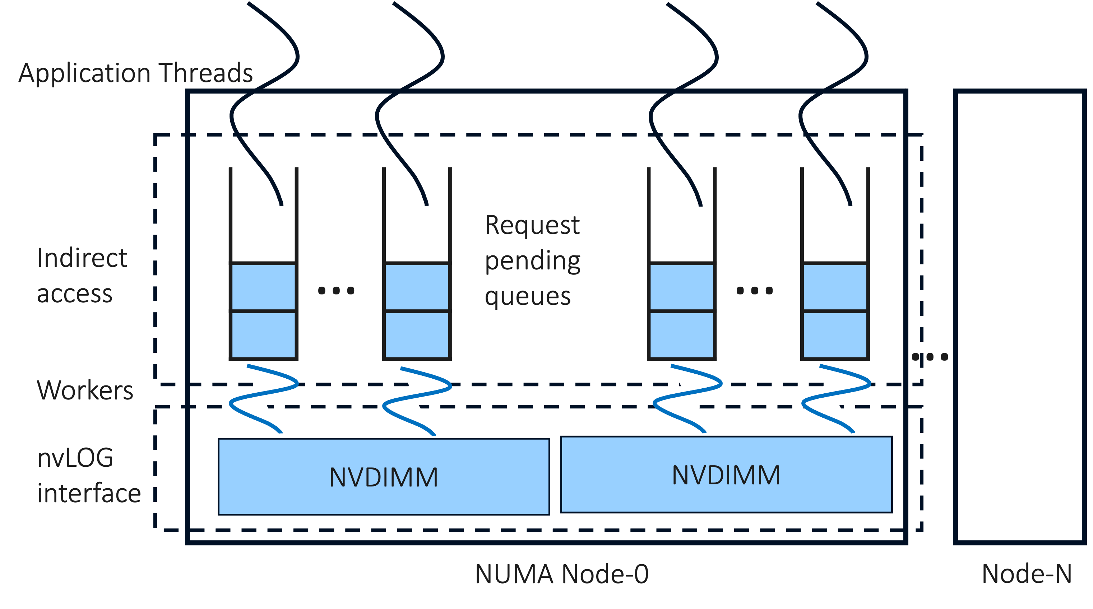
TyrantKV: Multiple Media
NUMA-Aware Request Router
Notes:
Finally, TyrantKV has a sharded architecture and leverages multiple media to avoid overwhelming PM controllers.
It employs an in-memory request router to distribute load across NUMA nodes;

Slide 30

TyrantKV: Multiple Media
In-memory metadata indexes
NUMA-Aware Request Router
Notes:
Further, it uses DRAM to employ in-memory indexes for storing metadata

Slide 31
TyrantKV: Multiple Media
In-memory metadata indexes
NUMA-Aware Request Router
Checkpoints
Solid-State Drive (SSD)
Notes:
And it leverages available solid state drives to periodically checkpoint metadata indexes to disks.

Slide 32
TyrantKV: Fine-Grained Control
Avoids I/O overheads from PM
nvLOGs: DIMM-aware data placement
Indirect-access: Bounded thread scaling
Multi-media design: Avoids overloading PM
Notes:
Thus, TyrantKV obtains a novel NUMA-aware and DIMM-aware design to avoid I/O bottlenecks from PM.
In summary, TyrantKV retains fine-grained control over ALL pm accesses:
By using nvLOG to manage individual NVDIMMs,
with dedicated worker threads to provide indirect-access to applications,
and leveraging multiple media to avoid overwhelming PM controllers.

Slide 33
Evaluation: Setup
Experimental Setup
compute_nvdimm server: Chameleon cloud
4-socket NUMA server
56 cores per CPU
3 TB PM
Yahoo-Cloud Serving Benchmark (YCSB)
12GB Load-A workload
8B keys, 256B values
Notes:
We implement TyrantKV in 10K lines of code
In this talk, we describe the performance and scalability of TyrantKV relative to state-of-the-art PM stores
We use a single 4-socket NUMA server, with 56 cores per CPU, and 3 TB PM
We use YCSB load-A workload with 8B and 256B values

Slide 34
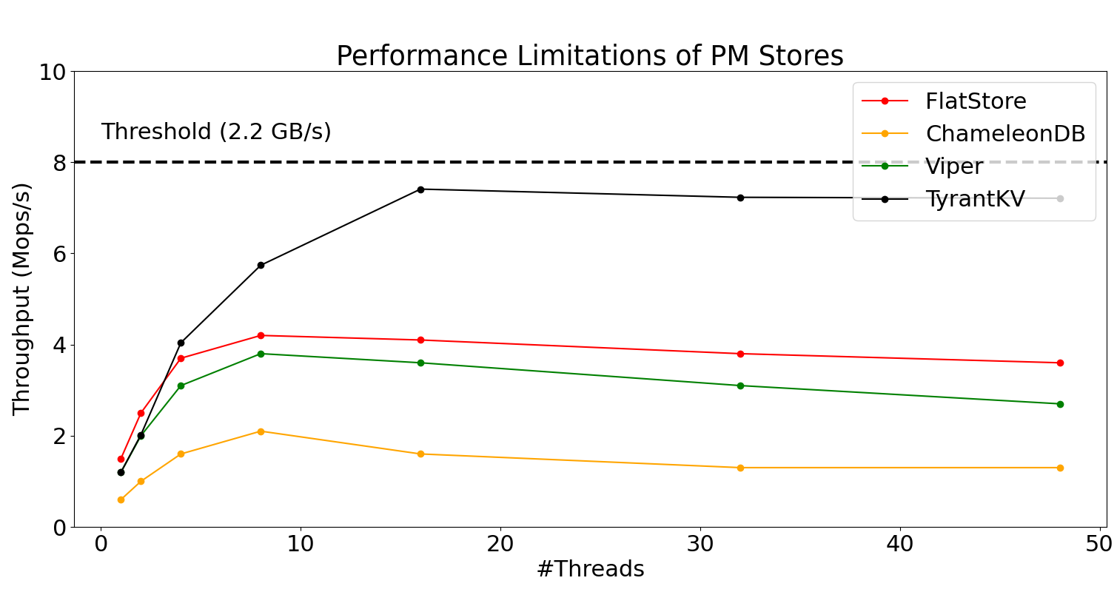
High Throughput
Notes:
We show that TyrantKV outperform the rest of the PM stores,
And scalably obtains close to 88% of PM write bandwidth

Slide 35
Scalability
State-of-the-art PM key-value stores
FlatStore, Viper, and ChameleonDB
Achieves up to 88% write bandwidth utilization
Increasing the number of NVDIMMs from 1 to 4,
TyrantKV’s throughput scales by 3.9x
Notes:
We also show that on increasing the available PM capacity by 4x,
We observe that the throughput of TyrantKV scales by 3.9x

Slide 36
Evaluation: Summary
State-of-the-art PM key-value stores
FlatStore, Viper, and ChameleonDB
Achieves up to 88% write bandwidth utilization
Increasing the number of NVDIMMs from 1 to 4,
TyrantKV’s throughput scales by 3.9x
On YCSB workloads, TyrantKV achieves higher throughput and outperforms PM stores by 2.5 – 5x
Notes:
We also evaluate the performance and scalability of TyrantKV for all YCSB workloads.
Across all YCSB workloads, TyrantKV achieves outperforms PM stores by 2.5 – 5x
We also evaluate the effect of batching and discuss the latency of TyrantKV in detail in the paper.
Please find the full paper for these details.

Slide 37
Future work
Disaggregated PM stores
CXL PM expansion
PM bandwidth utilization
Notes:
In the future, we plan to improve PM bandwidth utilization for CXL-enabled disaggregated PM.
The primary challenge with this work is that the performance of CXL is also sensitive to I/O types, sizes, and its rate.

Slide 38
Summary
cs.utexas.edu/~soujanya
soujanya.ponnapalli@utexas.edu
Achieving high, scalable PM bandwidth utilization is crucial for cost efficiency and practical adoption of PM
Fine-grained control over all accesses is fundamental for obtaining high, scalable PM bandwidth utilization
TyrantKV retains fine-grained control over all PM accesses and saturates 86% of PM write bandwidth
TyrantKV has 2—5x higher throughput to PM stores on YCSB and scales to NVDIMMs across NUMA nodes
Notes:
To summarize today’s talk,
We first motivate the need for Achieving high, scalable PM bandwidth utilization is crucial for cost efficiency and practical adoption of PM
Fine-grained control over all accesses is fundamental for obtaining high, scalable PM bandwidth utilization
TyrantKV retains fine-grained control over all PM accesses and saturates 86% of PM write bandwidth
TyrantKV has 2—5x higher throughput to PM stores on YCSB and scales to NVDIMMs across NUMA nodes

Slide 39
Backup Slides
Outline
Background on PM stores
I/O bottlenecks and PM analysis
Evaluation

Slide 40
TyrantKV: Indirect Access
NUMA-Aware Request Router
Application Threads
Request pending
queues
Indirect access
…
…
…
Workers
nvLOG
interface
NVDIMM
NVDIMM
NUMA Node-0
Node-N

Slide 41
Request Life Path in TyrantKV

Slide 42
Compute Express Link and PM

Slide 43
TyrantKV
Fine-grained control over all PM accesses

