Slide 1



Recovery can be Simple: Asynchronous Logging for Distributed Transactions
Sky Summer Retreat – 2024
Soujanya Ponnapalli Mentor: Jonathan Goldstein
Notes:
Hellow everyone, I’m Soujanya – a postdoc in the distributed systems group at Sky lab.
Today: I’ll be presenting Cascades – this IS A project that my mentors and I had started while I was interning at MSR
The main contribution of this work is to show that --
high-throughput distributed txs (with asynchronous logging)
are achieve-able while ALSO
keeping recovery simple!

Slide 2


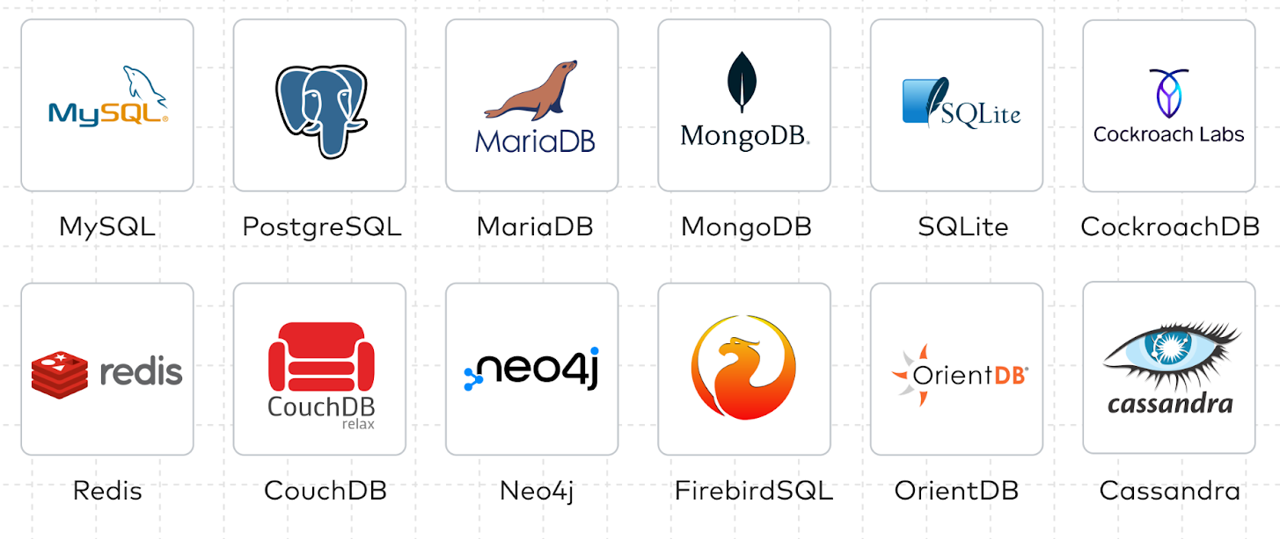










Applications and Distributed Transactions
Notes:
Distributed transactions are fundamental building blocks for many applications.
Consider this sample of applications:
Banks
payment wallets
decentralized applications,
Databases
Operating systems -- all of them use distributed transactions.
I’d say a simple file rename operation is also a distributed transaction as it requires updating
multiple kernel data structures simultaneously

Slide 3
Distributed Transactions have low throughput and poor scalability!
Notes:
However, fundamentally Distributed Transactions have low throughput and poor scalability!

Slide 4

Back to Fundamentals: Distributed Transactions
In the context of databases
Transaction
Notes:
To review this in the context of distributed databases,
Say with servers handling three unique data partitions,
where each server has backup replicas to tolerate crashes,
and say a client requests a transaction on her data
that spans across the three data partitions;
Then her transaction MUST

Slide 5
Back to Fundamentals: Distributed Transactions
In the context of databases
Transaction
Commit
Abort
For atomicity, databases rely on distributed commit protocols
Notes:
Either commit in all three partitions
Or be aborted at each of them…
To achieve atomic execution, databases use distributed commit protocols

Slide 6

Back to Fundamentals: Distributed Transactions
Two Phase Commit
Transaction
Notes:
To convince you of the problem that I’ll be discussing today – ill give a brief overview of such an atomic commit protocol – two phase commit!
In 2PC, one of the participating primary server acts as the coordinator
And like the name suggests, the coordinator commits the transactions in two phases,

Slide 7


Back to Fundamentals: Distributed Transactions
Two Phase Commit – Phase I (PREPARE)
Transaction
Notes:
In the first phase,
Coordinator sends out prepare messages
And in response,
all participating servers acquire locks and modify the data
At this point, these modifications are hidden from the clients and concurrent transactions
In the second phase,

Slide 8
Back to Fundamentals: Distributed Transactions
Two Phase Commit – Phase II (COMMIT)
Transaction
Done
To provide fault-tolerant ACID transactions, databases use logs!
Notes:
Coordinator sends out commit messages
And in response these participating servers release locks and make these modifications visible to other transactions.
At this point, coordinator notifies the client that the transaction has committed…
Now to achieve similar effects despite power failures, servers maintain logs

Slide 9
Back to Fundamentals: Distributed Transactions
Two Phase Commit – Phase II (COMMIT)
Transaction
Commit T1
Notes:
For example,
the coordinator first logs a Tx commit record in their log
then sends commit msgs
before responding to the commit msgs,
servers log commit record in their own logs!
Servers use these logs to recover to consistent states and commit the transaction despite power failures!

Slide 10
Back to Fundamentals: Distributed Transactions
Two Phase Commit – Phase II (COMMIT)
Transaction
Done
Commit T1
Commit T1
Commit T1
Notes:
For example,
the coordinator first logs a Tx commit record in their log
then sends commit msgs
before responding to the commit msgs,
servers log commit record in their own logs!
Servers use these logs to recover to consistent states and commit the transaction despite power failures!

Slide 11
Updating Recovery Logs in the Critical Path!
Transaction Commit Path:
Coordinator writes to its Recovery Log before sending commit msgs
Servers write to their Recovery Logs before acknowledging commit msgs
Primary notifies the client
Transaction throughput is limited by the I/O throughput at the servers!
Highly-contented transactions stall for I/O to complete and scale poorly!
Notes:
Note that by design, databases update recovery logs in the critical path of distributed transactions…
First, Coordinator writes to its Recovery Log before sending commit msgs
In response, servers write to their own Recovery Logs before acknowledging the commit msgs
Finally, primary notifies the client
Note that:
The network messages are sent AFTER a server updates its recovery logs
This results in low throughput and poor scalability:
Low throughput: Transaction throughput is limited by the I/O throughput of the servers
Poor scalability: Conflicting transactions stall until I/O completes to make progress

Slide 12
Logging Limits Performance – Why Bother? ☹
Two-orders of performance difference between storage and network
Networks got faster!
Accelerated networking with low-latency NICs
General-purpose datacenter networks like eRPC
~100x higher throughput than gRPC
For two servers in the same datacenter at Azure
eRPC could handle about 2.6 Mops/s
Whereas network-replicated disks could support 30 Kops/s
Notes:
Although logs need to be updated before committing distributed transactions,
We need to do better -- because the performance gap between storage and network is increasing!
For instance, there is about two-orders of performance difference between
Datacenter networks like eRPC that bypass the kernel and offer us-scale round-trip latencies
And writing to a high-speed network-replicated disk in Azure

Slide 13
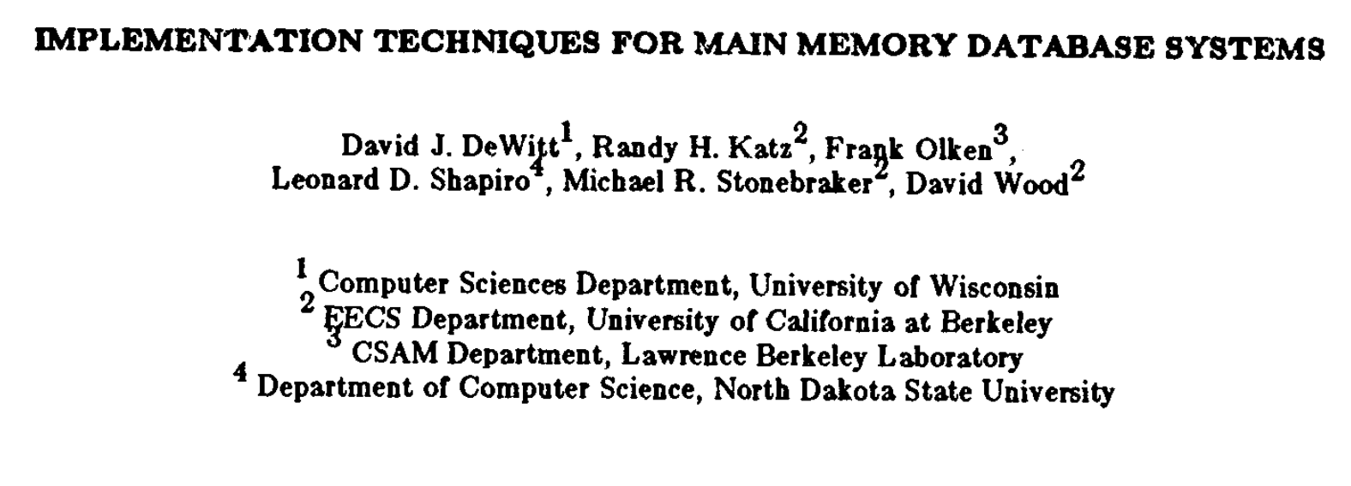
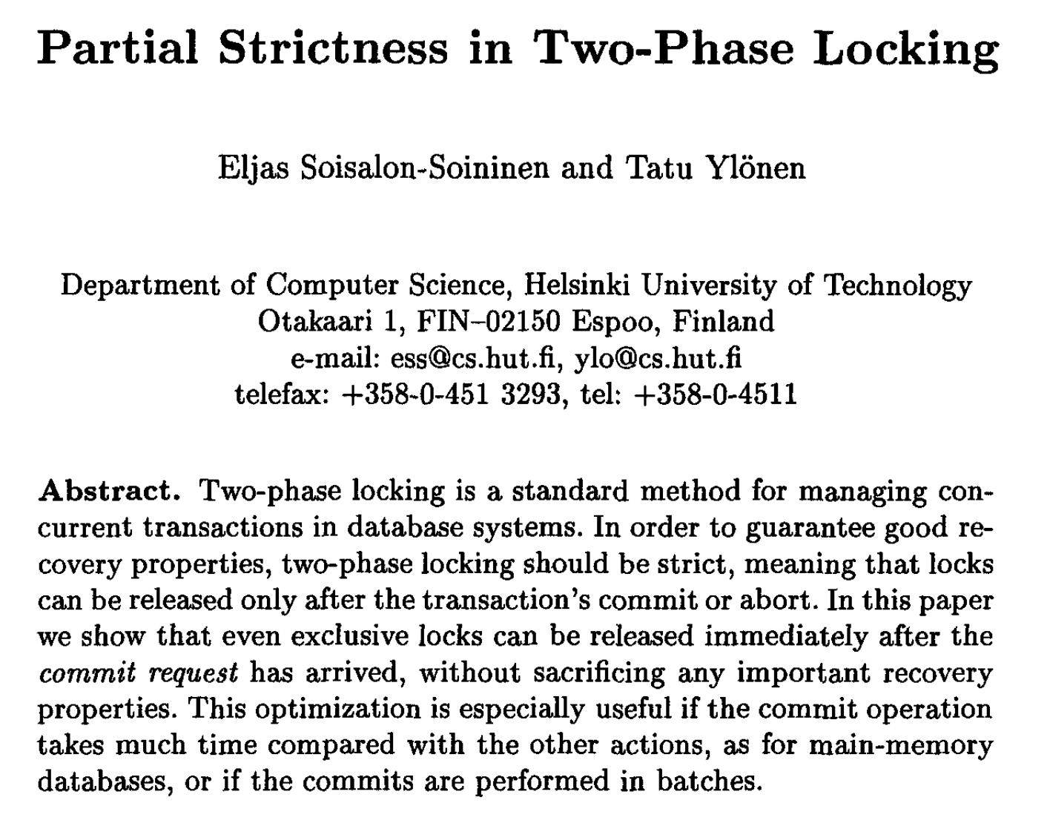
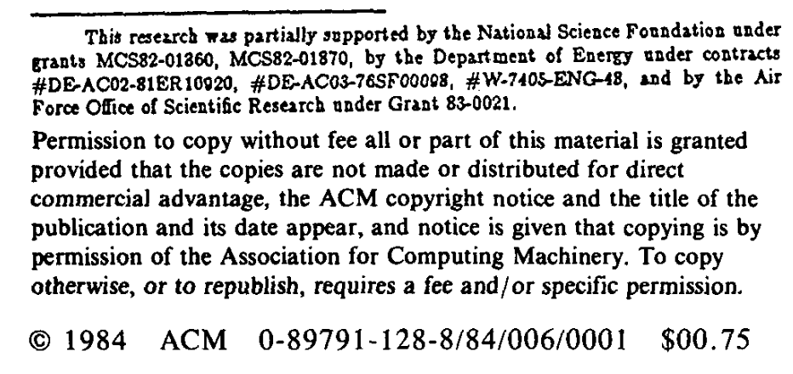
Mitigating I/O Bottlenecks: Early Lock Release
Notes:
There is prior work on mitigating I/O Bottlenecks in distributed transactions…
There is this paper published in 1984
That introduced Early Lock Release to use asynchronous logging to scale distributed transactions in databases
A paper that was published a decade later in 1995 proved that the recovery properties hold
even when using early lock release and asynchronous logging

Slide 14
Mitigating I/O Bottlenecks: Early Lock Release
Limited wide-adoption of ELR and asynchronous logging
In-consistent in-memory state
Crash recovery and consistency
Notes:
However, these techniques have little adoption in real databases even today
And this is primarily because of the increased complexity of recovery protocols and the difficulty to ensure the consistency of in-memory state

Slide 15
An active tradeoff between achieving high performance and keeping recovery simple!
Notes:
So this is core problem that our work will address:
Today there is an active tradeoff between achieving high performance and keeping recovery simple!

Slide 16
Simple Idea: Asynchronous Logging
Transaction
Notes:
Actually, asynchronous logging is a simple idea:
In the commit path,

Slide 17

Simple Idea: Asynchronous Logging
Transaction
Done
Commit T1
Commit T1
Commit T1
Commit T1
Commit T1
Commit T1
Notes:
The coordinator broadcasts the commit message,
IN response, the servers release the locks and make these updates visible to following transactions
however they do not wait for the commit records to be flushed to disk...
and, they delay the notifications to the clients
until after all the commit records are flushed to disk

Slide 18
Simple Recovery: Fundamental Challenge
Transaction
Commit T1
Commit T1
Commit T1
Notes:
Note that these commit records are not all equal
The commit record at the coordinator should persist before the commit records at the participating servers

Slide 19
Simple Recovery: Fundamental Challenge
Transaction
Commit T1
Commit T1
Commit T1
Notes:
Therefore, in the traditional case there wouldn't be a recovery state where the commit record at the coordinator is missing while the commit records at the participating servers are still present

Slide 20
Simple Recovery: Fundamental Challenge
Transaction
Commit T1
Commit T1
Notes:
However, with asynchronous logging, this possible state needs to be handled in the recovery protocol

Slide 21
Recovery Becomes Complicated!
Needs tracking distributed dependencies across Recovery Logs
Too many possible states to potentially recover from
Notes:
And handling this requires tracking dependencies across commit records
and handling too many potential states to recover consistently from
making the recovery protocol complex!

Slide 22

Cascades: Recovery Can Be Simple!
Persistence vs Durability
Persistence
Commit record is flushed to disk
Durability
Commit record and all its dependencies are persisted
Commit T1
Commit T1
Commit T1
Commit record is durable when it and its dependencies are persisted
Notes:
We propose cascades to achieve high performance while keeping recovery simple
Cascades differentiate between persistency and durability
A commit record is persisted once it is flushed to disk
However, it is durable only after it and all its dependencies are persisted to disk
For example, in the earlier example, these commit records are persisted
and become durable only after the coordinators commit record also is persisted

Slide 23
Insight: Speculate on Durability of Commit Records
Transaction
Notes:
In the interest of time, I will present the three main insights that cascades builds on:
(a) Cascades allows transactions to speculate on the durability of commit records
For instance,

Slide 24
Insight: Speculate on Durability of Commit Records
Transaction
New-Txn
Commit T1
Commit T1
Commit T1
Commit T1
Commit T1
Commit T1
Notes:
In response to commit messages,
servers release locks and make the updates available to other
transactions
and, the commit records will eventually become durable

Slide 25
Insight: Replicate Durable Records Asynchronously
Transaction
Notes:
The second insight is to replicate only durable records to backup replicas
for instance, lets look at one of the partitions:

Slide 26
Insight: Replicate Durable Records Asynchronously
Transaction
Commit T1
Commit T1
Commit T2
Commit T2
Notes:
Instead of synchronously replicating all persisted and durable records

Slide 27

Insight: Replicate Durable Records Asynchronously
Transaction
Commit T1
Commit T2
Commit T2
Notes:
Cascades only replicates durables records to its backup replicas

Slide 28
Insight: Replicate Durable Records Asynchronously
Transaction
Commit T1
Commit T1
Commit T2
Commit T2
Notes:
Once the commit record at the primary becomes durable, it is replicated to its backups

Slide 29
Insight: Use Cascade’s Replicas for Simplifying Recovery
Transaction
Commit T1
Commit T1
Commit T1
Commit T2
Commit T2
Commit T2
Commit T2
Commit T2
Commit T2
Notes:
Finally, Cascades uses these replicas to simplify recovery
Now if one of the primaries crashes,

Slide 30
Insight: Use Cascade’s Replicas for Simplifying Recovery
Transaction
Commit T1
Commit T1
Commit T1
Commit T2
Commit T2
Commit T2
Commit T2
Commit T2
Commit T2
Notes:
Then cascades allows other primaries that depend on the persisted but not-yet durable records to crash too

Slide 31
Insight: Use Cascade’s Replicas for Simplifying Recovery
Transaction
Commit T1
Commit T1
Commit T2
Commit T2
Commit T2
Commit T2
Commit T2
Notes:
And ends up falling back to replicas that store only durable records
And this way starts operating from a recent, consistent checkpoint

Slide 32
Cascades: High Throughput and Simple Recovery
Provides the same consistency guarantees to the client
Delays notification until durability
Cascades simultaneously achieves
High-throughput
With asynchronous logging
Without trading off simplicity of recovery
Notes:
Note that,
Cascades also delays notifications to the client until records are durable to ensure that the consistency guarantees provided to the clients remain unmodified
In summary,
Cascades achieves
High-throughput
With asynchronous logging and early lock release
Without trading off the simplicity of recovery

Slide 33
Cascades: Performance Preview
Builds atop Lattice*, an asynchronous logging framework from MSR *Jose Faleiro, Jonathan Goldstein, Phil Bernstein from MSR Redmond
For highly-conflicted transactions and relative to synchronous logging on network-replicated premium-SSDs for logging, Cascades provides 160x higher throughput
Instead with high-speed ultra-SSDs (4x faster than premium-SSDs), Cascades provides 35x higher throughput
Find me at the poster session! soujanya@berkeley.edu
Notes:
We observe really promising results.
For our best-case workloads which have highly-conflicting transactions,
We observe about two-orders of higher transaction throughput.
Even with the fastest most-expensive SSDs, we observe 35 times higher throughput.
So if you find this work interesting and want to know more about it,
Find me at the poster session today or email me!
With that, thanks for attending this talk and Im happy to answer any of your questions!

