Slide 1

Rethinking Fault Tolerance
Abstractions, Guarantees and Performance
Soujanya Ponnapalli
Notes:
Thanks for the introduction!
Hi everyone,
I’m REALLY excited to be here today!
I will be talking about the fault-tolerance work that I’ve led as a postdoc at Berkeley:
this work is done in collaboration with some of Natacha’s amazing PhD students
[Btw, feel free to interrupt me at any time with questions… there’s no reason for this to be a lecture… I’d actually enjoy hearing your thoughts as we go!]

Slide 2

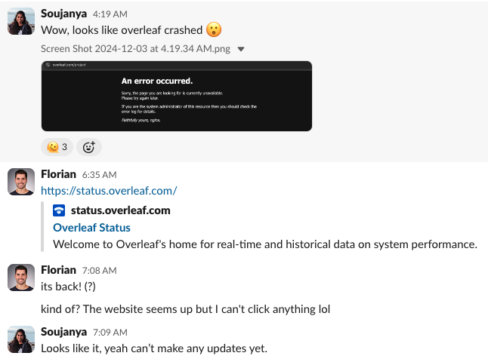

We Assume Fault Tolerance
SOSP’25 Deadline
Hugging Face
Hugging Face (90 days) | % Uptime | # Failures
Git Hosting and Serving | 99.928 | 2
HF Inference | 99.263 | 7
https://status.huggingface.co/
Notes:
So everyday, you me, everyone, implicitly assume fault tolerance from the applications we use:
And when things do not go as expected and start to notice application downtime – we wonder how are these applications fault-tolerant in the first place?
<>
take overleaf: the popular collaborative latex editing tool that we all are very familiar with
and I can NOT live without
Around the most popular conference deadlines this year: SOSP and Neurips <>
was down for several minutes
<>
... making some of the self-proclaimed optimists (whom we clearly cannot identify from this image) QUESTION if we'd even make these deadlines :p
And if we consider the popular hugging face ML platform that hosts datasets and models....
and enables users to test, train and deploy these models…
In two of its services, in the last 3 months, <>
there were almost 10 instances of the service being unavailable <>

Slide 3
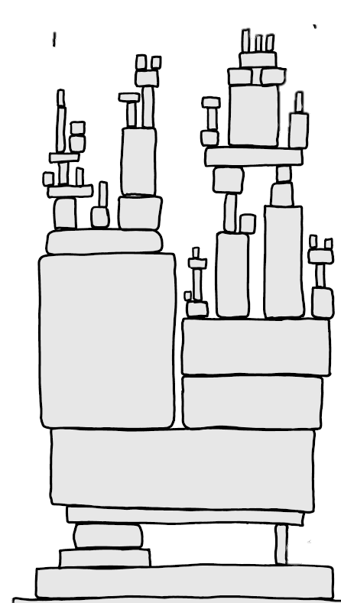

Applications Expect Fault-Tolerance
Applications
Applications are built on top of fault-tolerant distributed systems
Root of Trust
Fault-Tolerant Core
The state of
distributed systems
Notes:
So naturally, just like we do, applications expect fault-tolerance from the systems underneath
I’ll make the claim that, fundamentally, every large-scale application implicitly trusts a specific component of the system <>
whether in software or hardware, for the reliability of the
data it stores and the compute it performs.
This fault-tolerant core <> provides the abstraction of a single failure-free component. And it’s on top of that failure-free <> component that application logic gets implemented.
<> Effectively applications use this fault-tolerant core really as the root of trust to bootstrap application correctness.

Slide 4


The Fault-Tolerant Core
Web Applications
Web Frontend
Tex Editing Logic
Account Management
File Store
Notes:
Take Overleaf for example,
It layers a web frontend that we use to edit and collaborate on text <CLICK> , with the actual tex editor logic <CLICK>, that again sits on top of a filestore that handles compression and serialization, before reliably storing all the data to a
Persistent object store like MongoDB often externally hosted on top of Amazon S3
MongoDB on top of Amazon S3 <CLICK> is Overleaf’s fault-tolerant core.

Slide 5



The Fault-Tolerant Core
ML Infrastructure
ML Models
Training Datasets
Inference Hosting Platform
Controllers
Notes:
And it’s the same for machine learning systems, take Hugging face from our previous example, <CLICK>
To store and host models, Hugging Face uses containers to quickly spawn and destroy machines. Containers are managed using a cluster management service, Kubernetes <CLICK>.
Internally, Kubernetes uses a reliable controller to manage the control plane. And that controller’s state is reliably stored in the key-value store Etcd.
etcd, it is the ML platform’s fault tolerant core. And there’s many more similar examples.

Slide 6
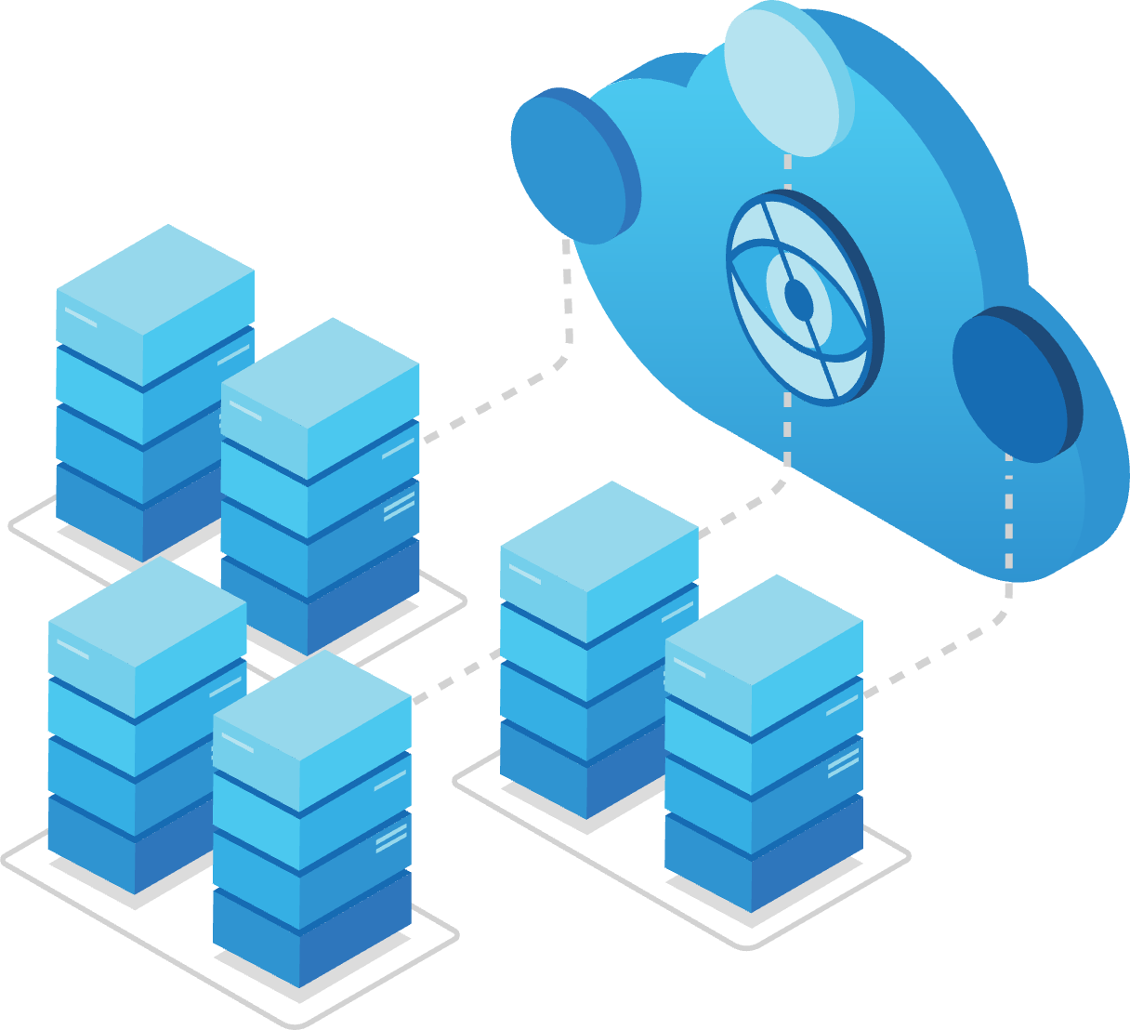



The Fault-Tolerant Core
Decentralized Apps
Accounts
Data Management
Transactions and Contracts
Notes:
But to wrap up with one last example, take decentralized systems that distribute trust:
Consider Azure Confidential Ledger, Microsoft’s distributed trust offering – which Signal uses for key recovery
Or of course the infamous, blockchain ledgers, that enable peer-to-peer transactions without a trusted centralized entity
These systems rely on software (using data authenticating structures like Merkle trees) (or the privacy-preserving data encryption) and hardware (like trusted execution engines)
To build data stores that distribute trust
These data stores form the fault-tolerant core of these decentralized applications
---
Signal for its key recovery, uses the Azure confidential ledger,which is Microsoft’s distributed trust offering, and is also used for key transparency, code transparency, to secure model weights etc.
(when you lose your phone while skiing and need to restore your account, and this may be a true story, ACL)
And finally, of course, the infamous blockchains, that enable us to make a peer-to-peer transactions, without having to trust a centralized entity.

Slide 7
The Fault-Tolerant Core
The Fault-Tolerant Core | Simple Recipe
Persistent Data Stores
Replication aka Consensus
Provide an abstraction of a
fault-tolerant data store
Tolerate a few server failures [*]
Applications store some state
(often a small amount of data)
Internally, these stores replicate the data to multiple servers
Notes:
Fundamentally, the recipe is the same for all large-scale applications.
Somewhere, potentially pretty far down the stack, there exists a persistent data store which internally uses replication.
<>
<>
These data stores provide the abstraction of a failure-free service
<>
Internally, the way in which this datastore remains robust to failures is through replicating data using something called consensus, or you might have also heard it under the name of Paxos.
Usually, the small amount state in this stores
state is either key tolerating failures for the whole application,
or to provide you just enough information that applications can use to recover and reboot correctly.

Slide 8
Persistent Data Stores
File systems *
Key-value stores
Transactional
stores
Decentralized stores
  Crash consistency of file systems
  OSDI'18
  Dinomo: Key-value store for Disaggregated Persistent Memory
  VLDB’22
  Software-Defined Data Protection
  VLDB’21
  mLSM: Authenticated data structure
  HotStorage’18
  WineFS: PM file system that ages gracefully
  SOSP’21
  SkyStore: Object store across multiple clouds
  VLDB’25
  Metronome: IO efficient replicated systems
  (under submission)
  RainBlock: Architecture for public blockchains
  ATC’21
  FairDB: Delayed fair sharing for multi-tenant LSM stores
  (under submission)
  Recoverable processes for transactional stores
  (ongoing)
  Rollbaccine: Immunity against rollback attacks
  (under submission)
Notes:
In the last few years, I’ve worked on persistent data stores:
From file systems, key-value stores, to databases and decentralized stores:
I worked on testing the crash consistency of file systems, and file systems that age gracefully
I also worked on key-value stores…
for disaggregated PM
to optimize for cost while storing data across multiple clouds
and to fairly distribute storage resources across multiple tenants on these stores
I also worked on improving the performance of databases
avoid the inherent IO bottlenecks in these systems to make them more efficient:
a data store for personal data , RSMs, and distributed databases
we will discuss metronome in more detail today...
And also designed data stores that distribute trust for decentralized applications

Slide 9
The Fault-Tolerant Core
The Fault-Tolerant Core
Persistent Data Stores
Replication aka Consensus
Applications store some state
(often a small amount of data)
Internally, these stores replicate the data to multiple servers
Notes:
For today’s talk, I’ll focus on the fault tolerance part:
Specifically, what enables applications to tolerate machine failures ….
Address the challenges with consensus protocols
How does it operate and ensure correctness for applications despite machine failures?

Slide 10
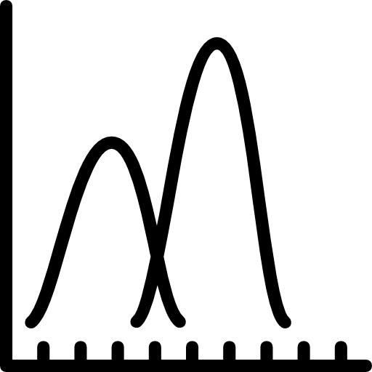

Replication aka Consensus
Replication aka Consensus | Three Pillars
Abstractions
Guarantees
Performance
HotOS’25
Under
submission
Notes:
I’d argue that
There’s three key pillars for consensus. <CLICK>
First, the abstractions of consensus protocols which is
the set of assumptions about the failures that can arise, and how the protocols see these failures
these describe the conditions under which the system will operate
Second, guarantees they can expect from the systems underneath when such failures arise
And third, of course we need them to provide good performance,
they should be able to sustain application workloads and scale as the number of users grow or the data grows.
We’ll talk about all three pillars in this talk! :D
Our recent work at HotOS for abstractions and guarantees
and metronome that improves performance
But FIRST, to paint an intuitive picture of consensus, <pause...> let me tell you a little bit about car insurance.

Slide 11



Insurance Policy
Notes:
Insurance policies follow a simple formula.
First, you need to consider what problems you might face in the real world
Then based on that you’ll have to pay some cost
But, as a result, you _will_ have protection for your view of the world.
For example,

Slide 12







Insurance Policy
Notes:
If you just bought a car, you might think the world is all sunshine and rainbows <>
And for this world view, you could get extremely affordable insurance <>
While still having protection. >?
However, this insurance will only protect us against sunshine and rainbows, so if someone breaks into your car <>
you won’t have protection against this because this scenario did not fit into my world view

Slide 13





Insurance Policy
Notes:
In contrast
If you’ve had bad experiences with car failures, you might think even meteors and earthquakes could be on the horizon!!
Getting coverage against this is going to be extremely expensive, BUT ! In this horrible reality, you, you still will be protected ☺
Now that same break-in from before is no issue, because that situation does fit into your world view.
<pause>
Now, why have I been talking to you about insurance? Its because....

Slide 14
Consensus is an Insurance Policy
Notes:
consensus [BREATHE] __IS__ an insurance policy. [1… 2…. 3… ]

Slide 15



Consensus is an Insurance Policy
Fault Model
Performance
and Cost
Guarantees
Notes:
Our world view maps to a fault model
Our budget is the desired performance and dollar cost
and our Guarantees are the traditional safety and liveness you have come to know and love, or hate <shrug>
So,

Slide 16



Consensus is an Insurance Policy
Fault Model
Performance
and Cost
Guarantees
$f=0$
Notes:
So, if all your machines are new and you would like to assume that you will not face any machine failures
then you’ll have amazing performance for cheap
and your systems will also work well...
BUT, a single machine failure WILL break our consensus guarantees, causing a deployment disaster

Slide 17




Consensus is an Insurance Policy
Fault Model
Performance
and Cost
Guarantees
$f=0$
$f$
Notes:
On the other hand,
If you assume tens of machines may fail at any time,
then you’d need a lot of money to run consensus on that huge cluster
But now your systems will be protected against multiple machine faults.
So, a single server failure will not cause any issues because this situation fits into your world view.

Slide 18

Consensus is an Insurance Policy
Fault Model
Performance
and Cost
Guarantees
$f=0$
$f$
You buy protection for your world view!
Notes:
The point that I really want to get across is that with consensus -- You are buying protection for your view of the world!!!

Slide 19
Fault Models Must Match Reality
Notes:
That means!!! your world view -- better -- match reality. <MORE DRAMAAAA>
If you’re in Zurich, you may not have to worry about earthquakes but if you’re in Berkeley you must!

Slide 20


Fault Models Must Match Reality
Optimistic
Reality
Pessimistic
$f=0$
$f$
Notes:
If in reality only one machine will fail
But my model is too optimistic -- and thinks no machines will fail, then my system is quite likely to break
On the other hand, if my fault model is too pessimistic thinking tens of machines will fail -- then my system will work, but my boss is going to be awfully unhappy with how much money I'm costing them
[Pause LONGGGGGG]

Slide 21
Current fault models do not accurately capture reality ☹
Protocols overpay for protection or do not fully protect against failures!
Notes:
And the real problem with consensus [breath] is that current consensus fault models, [pause] no matter how you configure them, [pause] do not and can not accurately capture reality.
And as a consequence, consensus protocols either overpay for protecting systems or do not fully protect them against failures that do arise in practice!
So we address this mismatch in our current work:

Slide 22
Real Life is Uncertain. Consensus Should Be Too!
HotOS’25
Notes:
I want to convince you that Consensus <pause> must take inspiration from Real Life!

Slide 23

Consensus in the Real World
I. Log Replication
II. Log Agreement
Application
Persistent store
…
Notes:
First, to understand how consensus operates, I want you to focus on two main ideas:
log replication and log agreement
To start from where we left off earlier: [ONLY ONE CLICK] <>
Applications interact with a persistent store and that store internally replicates data onto multile servers

Slide 24
Consensus in the Real World
I. Log Replication
II. Log Agreement
Application
Operations
Persistent store
Replicated log
…
Notes:
Applications interact with the store by sending a series of operations
The store using the consensus protocol will store the operations in a log
the protocols helps coordinate the group of machines to order these operations and persist them

Slide 25

Consensus in the Real World
I. Log Replication
II. Log Agreement
Application
Write (k, v)
Materialize
Etcd with Raft
Read/Write op log
…
Notes:
Now to make it really concrete:
if applications send read and write requests,
a persistent store like etcd, with the help of the consensus protocol like RAFT
will order these operations in a log, and coordinate with the group of machines to store them correctly despite a few machine failures
these operations in consensus logs when re-executed in order,
will materialize into the latest application state

Slide 26
Consensus in the Real World
I. Log Replication
II. Log Agreement
Application
Guarantees
Operations
Persistent store
Safety: Operations commit in the same global order
Replicated log
…
Liveness: Every operation eventually commits
Notes:
In order for this log to be useful, consensus provides two guarantees.
First – every machine in the protocol agrees on the order of operations in the log. This property is called Safety.
Second, every operation given to consensus will eventually appear in the log. This property is called liveness
With these two properties, we can use consensus to build complex applications

Slide 27

Consensus in the Real World
I. Log Replication
II. Log Agreement
Application
Fault Model
Guarantees
Operations
Persistent store
Safety: Operations commit in the same global order
Replicated log
$$f=1$$
…
Liveness: Every operation eventually commits
Notes:
But careful there,
these guarantees hold under specific assumptions of your worldview: or the fault model
if you assume that at most a single machine can fail,

Slide 28
Consensus in the Real World
I. Log Replication
II. Log Agreement
Application
Fault Model
Guarantees
Operations
Persistent store
Safety: Operations commit in the same global order
Replicated log
$$f=1$$
Liveness: Every operation eventually commits
28
Notes:
then your consensus protocol will replicate across 3 machines,
and provide guarantees as long as two or more machines do NOT crash together

Slide 29
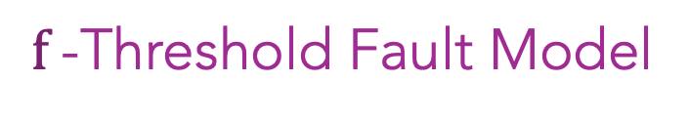

Consensus in the Real World
$f$-Threshold Fault Model
Consensus Guarantees
when #faults$≤f$
29
Notes:
As a result, we say these systems use an f-threshold fault model
Meaning they only provide their guarantees when the real number of faults in a system is <= f
Even in this f threshold model, there are many variations on what a fault means.

Slide 30
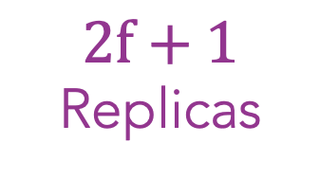
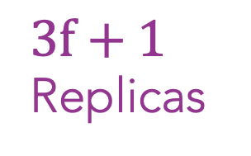
Consensus in the Real World
$f$-Threshold Fault Model
Consensus Guarantees
when #faults$≤f$
Crash and Byzantine
Faults
Crash
Faults
Byzantine
Faults
$2f+1$ Replicas
$3f+1$ Replicas
Upright Replication
Notes:
For example, Crash Fault Tolerance uses a network of 2f+1 nodes to withstand f __crash__
Crash faults where faulty machines stop working
Byzantine Fault tolerance can handle f __byzantine__ faults where faulty machines may deviate from the protocol
And there are models like upright which mix the two to handle some number of crash and byzantine faults
All of these build on the same f-threshold fault model

Slide 31



Key Observations
The f-threshold fault model fails to captures reality
In practice, machine failures are probabilistic
Protocols cannot provide better than probabilistic guarantees
Notes:
In our work studying f-threshold fault models, we make three key observations!
Current <> f-threshold fault models poorly align with reality
Because fundamentally, everyone (sheepishly: except consensus researchers ofc!) <> think about failures in terms of probabilities
And when faults are probabilistic… protocols can provide NO better than <> probabilistic guarantees!
Let’s take a closer look at each of them!

Slide 32






$f$-Threshold Fault Model Fails to Capture Reality
Nodes are either correct or faulty
All nodes can fail
Faults are uniform
Some nodes are more likely to fail
…
…
…
Notes:
As we mentioned earlier,
a fault model defines the assumed world view of the consensus protocol.
Today, developers make assumptions about the network, the type of faults, and the number of faults.
In effect, <> protocols are designed to view nodes as either correct or faulty
And they protect against failures as if they are uniformly distributed amongst all nodes!
But…, in practice… all nodes can fail <> and some nodes <> are more likely to fail than others.

Slide 33
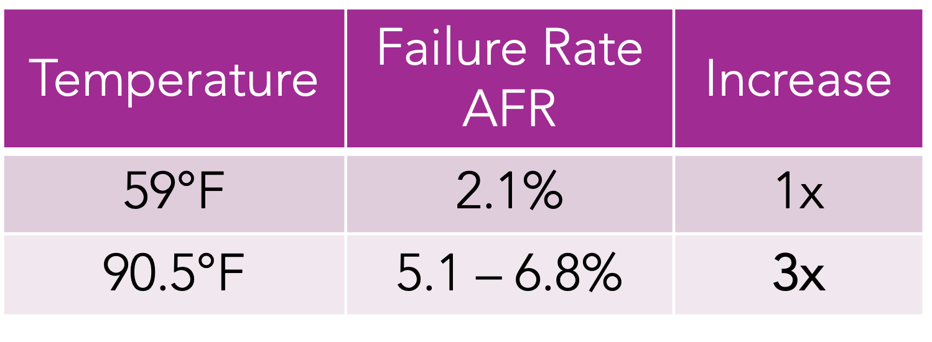
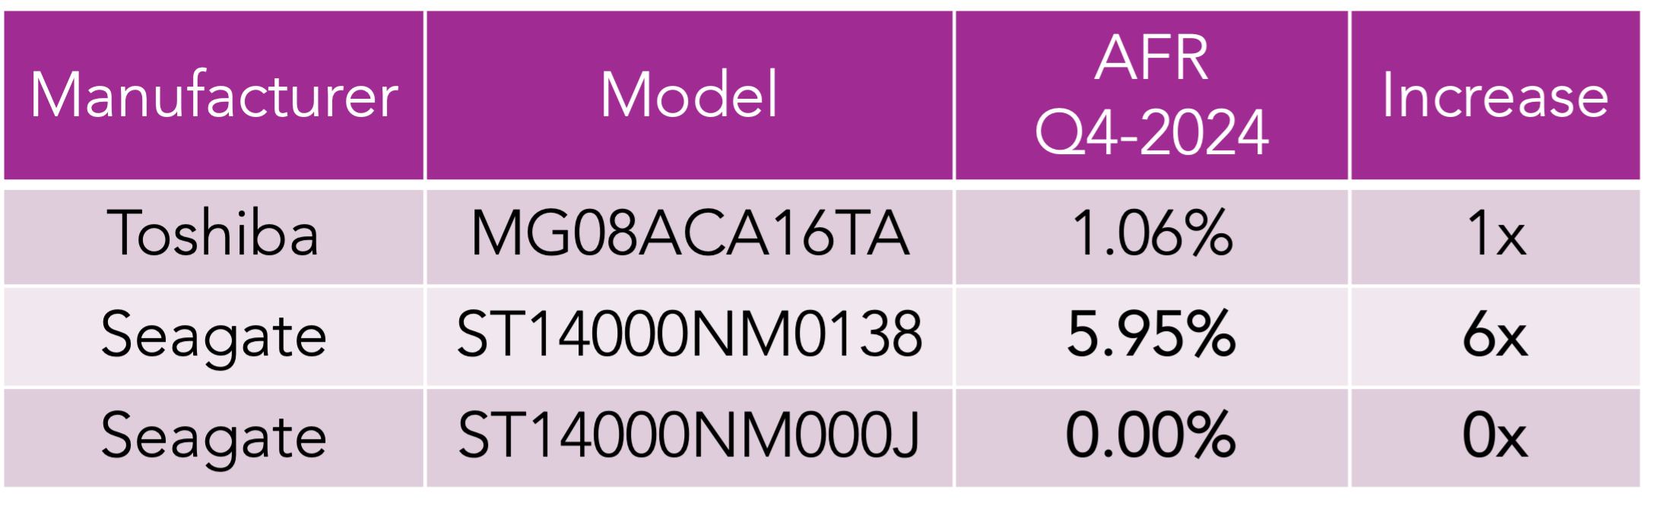
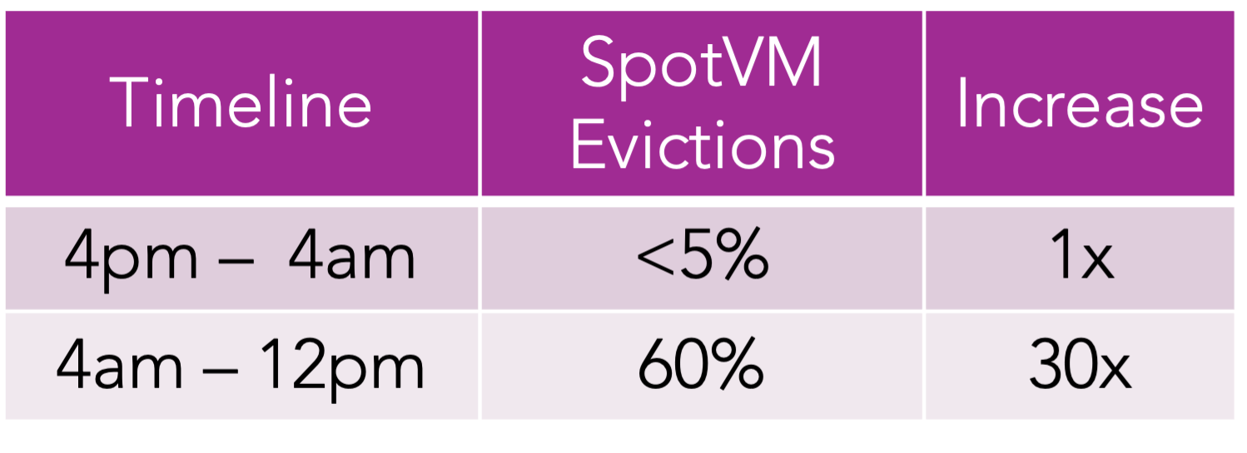
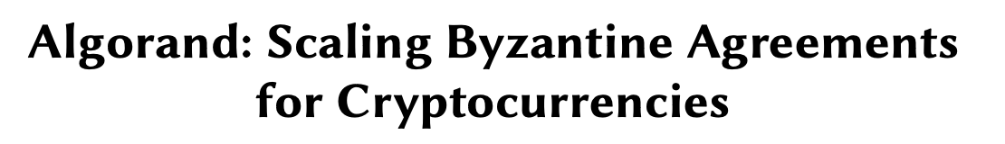
(a) Fault rates are not uniform
Temperature | Failure Rate AFR | Increase
59°F | 2.1% | 1x
90.5°F | 5.1 – 6.8% | 3x
Manufacturer | Model | AFR Q4-2024 | Increase
Toshiba | MG08ACA16TA | 1.06% | 1x
Seagate | ST14000NM0138 | 5.95% | 6x
Seagate | ST14000NM000J | 0.00% | 0x
Timeline | SpotVM Evictions | Increase
4pm – 4am | <5% | 1x
4am – 12pm | 60% | 30x
[1] https://blocksandfiles.com/2024/05/02/disk-failure-rates-in-data-centres-are-falling-says-backblaze/
[2] https://www.backblaze.com/blog/backblaze-drive-stats-for-2024/
[3] Memory-Harvesting VMs in Cloud Platforms, ASPLOS’22
[4] Snape: Reliable and Low-Cost Computing with Mixture of Spot and On-Demand VMs, ASPLOS’23
Notes:
This is because faults are not uniform… and they are RARELY homogenous!
For example, machines that are improperly cooled experience higher fault rates.
Here, an AFR or annual fault rate of 2.1%, means that 21 of your 1000 disks will fail over the course of one year! At higher temperatures, __68__ out of 1000 disks could fail in a year.
<>
faults also often depend on both the exact hardware model and manufacturer.
<>
Now if we consider the cloud with different compute offerings, a spotVM is far more likely to fail than a standard VM, depending on the time of day!
In some systems, these non-uniform failure rates capture more complex, trust dynamics.
In stake-based blockchains, for example, all parties need not be trusted uniformly: If I have a higher stake, I have more to lose if the system fails, I’d be a better bet to avoid failures!

Slide 34
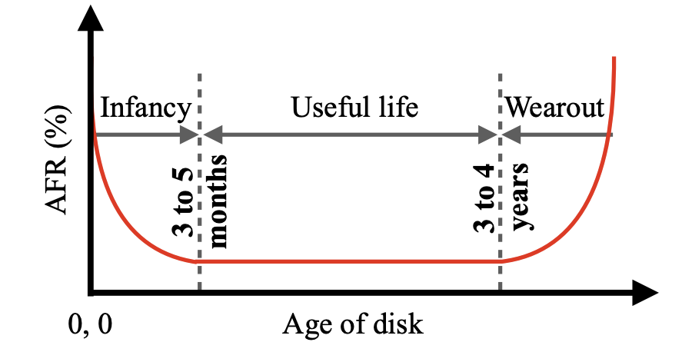

(b) Fault rates evolve over time
VMs | Evictions 10 mins | Evictions 1 day
SpotVMs | 10% | 55.3%
[1] Cluster storage systems gotta have HeART: improving storage efficiency by exploiting disk-reliability heterogeneity
[2] https://www.backblaze.com/blog/drive-failure-over-time-the-bathtub-curve-is-leaking/
[3] Snape: Reliable and Low-Cost Computing with Mixture of Spot and On-Demand VMs, ASPLOS’23
Notes:
In practice, fault rates are almost always changing with time! <slow>
The fault rate increases with a machine’s age, usage, and load on the system!
For example, <> disks follow a bath-tub curve: they have three unique phases:
a high infant mortality rate, a stable useful life, and a wear-out phase –with a high fault rate. This is trend holds for most hardware.
If we look at SpotVMs, their eviction rate also changes throughout their lifespan!
In systems with complex-trust dynamics, the changing geo-political scenario could also change how trustworthy different parties are!
------------
55.31% of the evicted spot VMs and 32.80% of the deleted spot VMs live longer than one hour.

Slide 35


(c) Faults may be correlated
https://blogs.microsoft.com/blog/2024/07/20/helping-our-customers-through-the-crowdstrike-outage/
https://www.techtarget.com/whatis/feature/Explaining-the-largest-IT-outage-in-history-and-whats-next
Notes:
Even worse, Machine faults can be correlated! (this is a reaaaal pain!!!)
Often, they are not exactly bound by “f” either!
Consider the recent crowdstrike outage at Microsoft.
New software updates caused a widespread downtime of multiple servers at Microsoft
leading to up to 5.4 Billion dollars in lost revenue!
-------------------
a faulty software update from the cybersecurity firm CrowdStrike. This update, intended for Falcon Sensor security software, caused widespread crashes and unresponsiveness
$5.4 billion

Slide 36
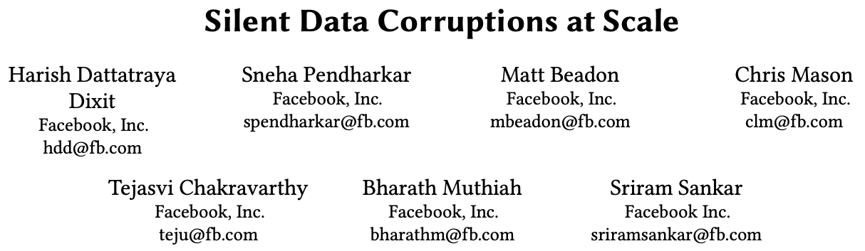
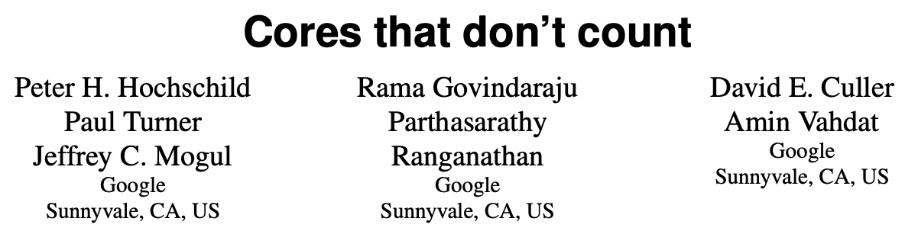
(d) Faults are complex
[1] Cluster storage systems gotta have HeART: improving storage efficiency by exploiting disk-reliability heterogeneity
[2] https://www.backblaze.com/blog/drive-failure-over-time-the-bathtub-curve-is-leaking/
Notes:
Faults are also complex!
Recent works highlight that silent compute errors and data corruptions
Are a phenomenon which can occur scale!

Slide 37

$f$-Threshold Fault Model Fails to Capture Reality
(a) Fault rates are not uniform
(b) Fault rates evolve over time
(c) Faults may be correlated
(d) Faults are complex
In practice, machine faults are probabilistic
Notes:
Overall, the point I want to emphasize is that,
In practice, faults ARE probabilistic and
In other domains, we have already been reasoning about machine faults using probability curves.
<pause>
So we ask - <look around> - why should consensus be any different?

Slide 38
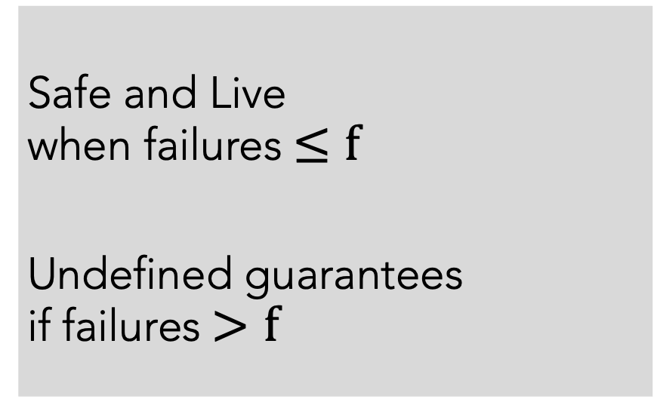
Consensus Guarantees are Mismatched
All-or-nothing guarantees
Safe and Live
when failures$≤f$
Undefined guarantees
if failures$>f$
Notes:
If we take a step back… and look at the guarantees of consensus protocols TODAY <>
They provide all... or nothing... guarantees.
Systems are guaranteed to be safe and live with less than f node failures
And provide no guarantees whatsoever... if the number of failures exceed f.

Slide 39
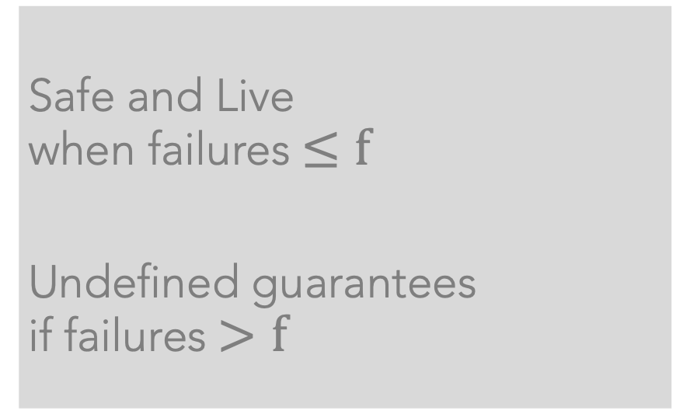
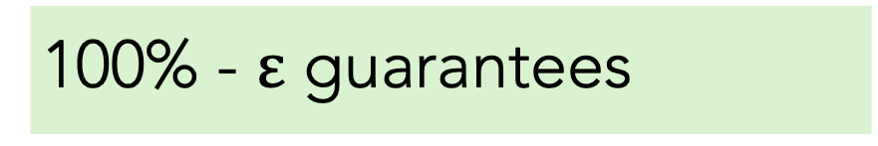
Consensus Guarantees are Mismatched
All-or-nothing guarantees
100% - $ε$ guarantees
Safe and Live
when failures$≤f$
Undefined guarantees
if failures$>f$
Safe: Every node has a non-zero failure probability and eventually all nodes will fail
No protocol can do better than probabilistic guarantees
Notes:
But, in practice,
it is always possible for failures to exceed f!
<> So no consensus protocol can provide a guarantee stronger than probabilistic safety and liveness.
<>Every node has a non-zero probability of failure and eventually every node WILL fail.
<>So, no system can make 100% guarantees!
-------
[For longer talks, add slide to describe mismatched guarantees]
More fundamentally, safety and liveness properties do not match with how applications think about guarantees!
For example, a system that is Live could also be 0% available… making it unusable for the application.
So, ideally, we want probabilistic guarantees that are a better match with application demands!

Slide 40
Consensus Guarantees are Mismatched
All-or-nothing guarantees
100% - $ε$ guarantees
Safe and Live
when failures$≤f$
Undefined guarantees
if failures$>f$
Raft is only 99.97% [safe&live] in three-node deployments if nodes suffer a 1% fault rate!
Notes:
We’ll spare you the math details here…
But on real hardware… consensus is already probabilistic, like it or not! <pause>
In our paper we conducted a probabilistic analysis and found that in a three node deployment where each node suffers a 1% fault rate, Raft, a popular crash-fault tolerant protocol, is only 3-nines [safe and live]

Slide 41
Consensus Guarantees are Mismatched
AWS | Standard S3 | S3 Intelligent Tiering | S3 Express One Zone
Designed for availability | 99.99% | 99.9% | 99.95%
Availability SLA | 99.9% | 99% | 99.9%
S3 is designed to exceed 11 nines of data durability
Google Spanner is designed to support 5 nines of availability
[1] https://aws.amazon.com/s3/storage-classes/
[2] https://www.frictionlesspost.com/p/google-spanner-serves-trillions-of-rows-with-99-999-reliability
Notes:
Storage systems recognize this reality already.
S3, for instance, describes its guarantees to exceed 11 9s of durability
And they customize their availability to exceed applications’ availability SLA or service level agreement
So again we ask– why should consensus be any different?

Slide 42
Our Vision: Probabilistic Consensus for the Real World!
Probabilistic fault models
that accurately capture reality
Notes:
Our vision,
is probabilistic consensus for the real world!
<>
We want to utilize existing knowledge of machine faults to design probabilistic fault models that accurately capture reality

Slide 43
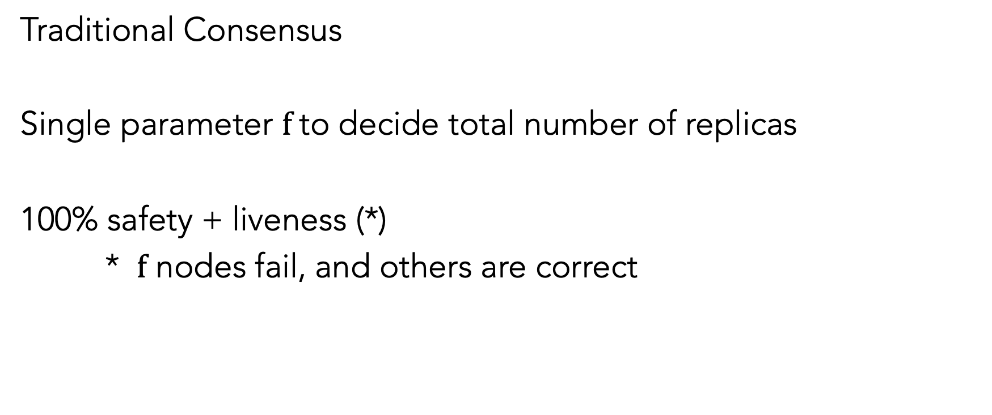
Simple Abstractions: Key Challenge
Traditional Consensus
Single parameter $f$to decide total number of replicas
100% safety + liveness (*)
* $f$ nodes fail, and others are correct
Notes:
The main challenge to realize our vision,
is to avoid making consensus protocols more complex or less useful as a consequence!
The biggest strength of the existing f threshold fault model is that it is SIMPLE.
A single parameter $f$ decides the number of replicas and faults,
and you get 100% guarantees if parameter this matches reality
So for a probabilistic fault model to be useful, we NEED to have simple abstractions for failure

Slide 44
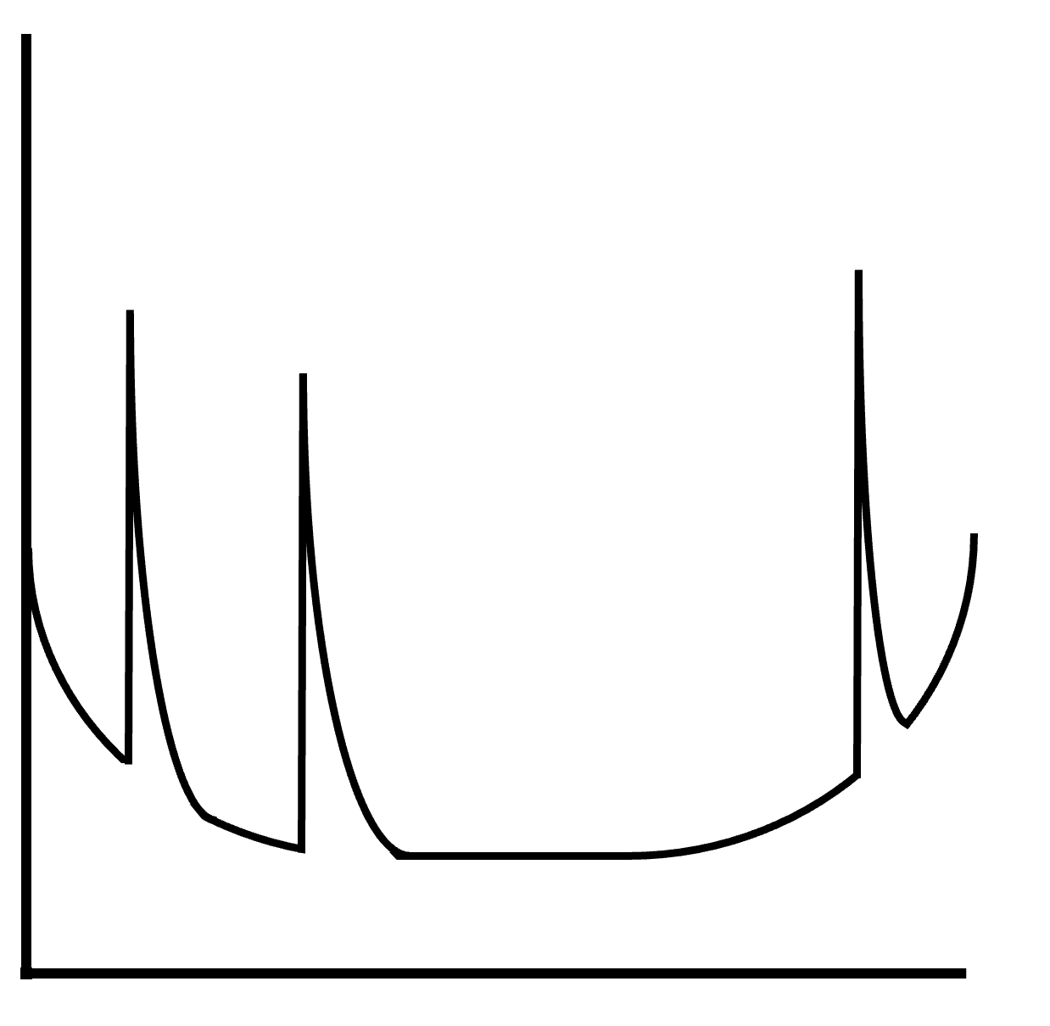
Accurate Per-Node Fault Curves
Software Update
Cluster Reconfiguration
Node Restarts
Probability of Failure
Time
Notes:
Our key idea to accomplish this is by providing the abstraction of a per-node fault curve
this would provide system designers with how a machine’s fault rate changes over time
It will look something like this: We have time on the x-axis and the fault probability of a machine on the y-axis
If there are planned software updates, node restarts, or cluster reconfiguration,

Slide 45
Accurate Per-Node Fault Curves
Software Update
Cluster Reconfiguration
Node Restarts
Probability of Failure
Time
Notes:
They cause the fault rate of the machine to increase for those brief time periods
We can create this model because datacenters have tons of historical data about hardware, software, and operational failure rates
And we can rely on these fault curves to accurately capture reality

Slide 46
Potential Opportunities
Protocols can better utilize reliable nodes
Larger clusters of less reliable nodes can help
Explore constant instead of linear size quorums
Exploit the tradeoff between safety and liveness
Notes:
I’ll now outline a few potential opportunities If consensus protocols are aware of the probabilistic nature of faults
from our preliminary analysis
Starting simple,, They can better utilize reliable nodes
Larger clusters of less reliable nodes can help
<pause…>
And More radically… they might even be able to do better than Linear size quorums
In the interest of time, I'll just focus on these three opportunities in this talk

Slide 47
Potential Opportunities
Protocols can better utilize reliable nodes
Larger clusters of less reliable nodes can help
Explore constant instead of linear size quorums
Exploit the tradeoff between safety and liveness
Notes:
In our paper, we also explore the hidden trade-off between safety and liveness;
And we encourage all of you to check it out for more details

Slide 48

1. Protocols can better utilize reliable nodes
Cluster-1
Cluster-2
Both clusters guarantee safety and liveness
Cluster-2 tolerates $f=3$ faults
Notes:
First, Consider two clusters:
One on the left with 3 nodes and one on the right with seven nodes
Traditional consensus guarantees that both these clusters provide safety and liveness
But the second cluster can tolerate more failures so IF YOU DIDN’T KNOW ANYTHING about failure rates, you might consider it to be more reliable.
But!! if you bring that back into the picture,

Slide 49
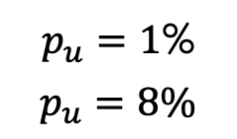
1. Protocols can better utilize reliable nodes
$p_{u}=1$%
$$p_{u}=8\%$$
Cluster-1
Cluster-2
Three 9s
Two 9s
With fault rates, they achieve 9s of safety and liveness
Notes:
If the second cluster has a higher failure rate of 8% shown here in dark red, compared to the first cluster’s more reliable 1% failure rate shown in light red
Then our probabilistic analysis shows us that the first cluster is actually 10 times more likely to be safe and live despite tolerating a lower f failures.
---------
Raft and
PBFT are oblivious to fault curves. Consider a seven node
cluster with 𝑝𝑢 =8% nodes running Raft. This cluster is 99.88%
safe (Table 2). If we replace three nodes with more reliable
ones (𝑝𝑢 =1%)—almost half of the nodes—safety improves
only to 99.98% (not shown in table). As Raft does not know
which nodes are more reliable, it may persist data only on
the unreliable nodes. If we required quorums to include at
least one reliable node (by leveraging knowledge of fault
curves), data durability would increase to 99.994%.

Slide 50
1. Protocols can better utilize reliable nodes
$p_{u}=1$%
$$p_{u}=8\%$$
Cluster-3
Leader selection from more reliable nodes
Skewing quorums to include reliable nodes
Three 9s
Protocols can leverage accurate fault rates for better guarantees
Notes:
And in more realistic scenarios where you have non-uniform servers…
You could use fault probability knowledge to select leaders more effectively
<>
or even skew quorums to include more reliable nodes
This can help provide better guarantees for applications
<>

Slide 51
2. Larger clusters of less reliable nodes can help
$p_{u}=1$%
$$p_{u}=8\%$$
Cluster-1
Cluster-2
Cluster-2
Three 9s
Two 9s
Three 9s
Notes:
Now if we return to our prior example, we find that even though, the right cluster has less reliable nodes,
We actually CAN match guarantees between the clusters. We just need to add two more nodes <>
While this may seem like a tough sell, there are situations where you may want to use less reliable nodes.
For example, they can be far cheaper to operate, and making use of older, less reliable, hardware can be more sustainable than using brand new machines.
Now, I’ve told you two ways how fault probabilities can change the way we work with existing consensus protocols, now let me share a more radical direction

Slide 52

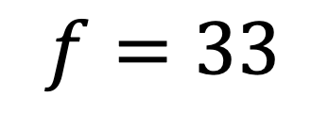
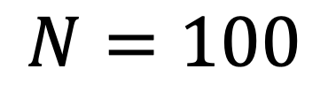
3. Exploring constant size quorums
$$N=100$$
$$f=33$$
$$Q=34$$
Notes:
In traditional consensus, we assume a large portion of the network is faulty.
Here, <> if this diagram represents a large <> 100 node Byzantine Fault Tolerant consensus deployment, then the F threshold model tells us that one in three nodes<> may fail
So to reach a correct node we <> __must__ reach out to more than a third of our network. <>
However! Even if we are suffering what is effectively a 33% fault rate, each individual machine is more likely than not to be correct!!

Slide 53

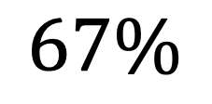
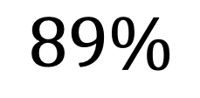
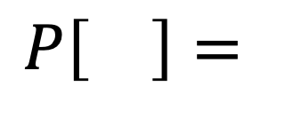
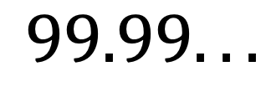


3. Exploring constant size quorums
$$N=100$$
$$f=33$$
$$Q=2$$
$$Q=1$$
$$Q=18$$
$$Q=34$$
$$99.99...$$
$$67\%$$
$$P\left[\right]=$$
$$89\%$$
✅
Notes:
This means that if I reach out to a single machine,
Then I'm more than likely to have already reached a correct node
Then if I talk to two nodes our probability of success will exponentially increase…
Until if I reach out to 18 nodes, half the amount from before, I will have reached a correct node with 10 nines of probability.

Slide 54
Probabilistic Consensus for Real World!
Current fault models fail to accurately capture reality
Today, consensus is probabilistic – like it or not!
Accurate fault curves for better fault modeling
Probability-native consensus protocols
More efficient, cost-effective, and sustainable, and reliable
Notes:
<KEEP QUESTIONS SHORT SHORRRRTTTTT>
So overall
I hope I’ve convinced you that current fault models fail to accurately capture reality
Consensus is already probabilistic
And that we can improve fault modeling in consensus by leveraging existing knowledge
Then, in the long run, we want to design Probability-native consensus protocols
that are more efficient, cost-effective, sustainable, and reliable!
<KEEP QUESTIONS SHORTTTTTT>

Slide 55

Probabilistic Consensus: Ongoing efforts
Realistic application-level guarantees and inherent tradeoffs
Five consensus replicas or 3 replicas with 2 active backups
Availability vs durability with % failure probability
Probability-native consensus protocol
Notes:
Currently, we are actively thinking about
Realistically, what guarantees do applications receive?
And what are the inherent trade-offs between different design choices?
For example… if we compare a 5-node consensus cluster against a 3-node cluster with 2 active backups, what is the availability and durability guarantees that applications receive?
With that understanding, we are hoping to soon design a
Probability-native consensus protocol
For those who may be thinking that this is similar to some of the work they’ve seen in the storage space: this is infact an effort to reason about fault tolerance in consensus similar to how researchers have been looking at reliability with storage systems

Slide 56
Replication aka Consensus
Replication aka Consensus | Three Pillars
Abstractions
Guarantees
Performance
HotOS’25
Under
submission
Notes:
Taking that same vision and applying it to the third pillar of consensus: performance,
but this might be a good place to pause for questions or any clarifications...

Slide 57
Metronome: IO-Efficiency with Consensus-Aware Logging
Ongoing | Under submission
Notes:
I’d argue that
consensus is not IO-efficient ... and
Now I discuss our ongoing work where we change that with:
Metronome: an IO-efficient logging library for consensus

Slide 58
Consensus: Replicated log of operations
I. Log Replication
II. Log Agreement
Notes:
Recall that, consensus stores operations as a log and replicates this log on multiple servers!

Slide 59
Consensus: Replicated log of operations
I. Log Replication
T1: Update dataset
T2: Update model
T1
T2
T1: Write, A, +100
T2: Write, A, -100
T1
T2
T1
T2
Notes:
Now lets understand what happens when a failure does arise,
<> Say if users perform two operations: T1 -> to first update their dataset, and T2→ to then update their model weights,
Consensus (in a three-node cluster) <> replicates these operations in the same order across every server <>

Slide 60


Consensus: Replicated log of operations
I. Log Replication
II. Log Agreement
T1: Update dataset
T2: Update model
T1
T2
T1
T2
T3
T4
Service
remains available!
T1
T2
T1
T2
T3
T4
T1
T2
T1
T2
Notes:
Next, consensus always guarantees that these replicas agree on the committed set of operations even if a few servers crash
<> Let’s say a server crashes at this point,
The remaining servers can continue to log and commit operations <>
and for an end-user the service remains available despite a server crash!

Slide 61

Consensus: Replicated log of operations
Keeps crash recovery simple
T1
T2
T3
T4
T3
T4
T1
T2
T3
T4
T1
T2
Notes:
To keep recovery simple, these logs are stored on disks!
A crashed server, on reboot, can get the latest application state from its local log <>
... it then fetches the remaining operations from another server
... re-executes them to get the latest application state and
is now ready to re-join the consensus cluster

Slide 62
I/O Bottleneck: Pain point of consensus
Keeps crash recovery simple
N-way replication to disks
M operations
T1
T2
T3
T4
N replicas
Disk writes: M x N
T1
T2
T3
T4
Replicas flush all operations even if they’re committed!
T1
T2
T3
T4
Notes:
But the fundamental problem with consensus is that it is bottlenecked on IO and is too slow:
Consensus protocols PERSIST EVERY operation to disk – at each replica!
So for M operations across N replicas, systems perform M x N writes to disk….
And worse, every replica flushes all operations...
(which sometimes means that operations that are technically already committed
continue to wastefully demand disk IO bandwidth)!

Slide 63
I/O Bottleneck: Pain point of consensus
Keeps crash recovery simple
N-way replication to disks
M operations
etcd Logging | Latency (ms) | Throughput (Kops/s)
Default: On disk | 6.3 | 16
In memory | 4.1 | 28
I/O Overhead (%) | 54% | 48%
T1
T2
T3
T4
N replicas
Disk writes: M x N
T1
T2
T3
T4
Replicas flush all operations even if they’re committed!
T1
T2
T3
T4
Notes:
To estimate the overhead of such logging,
We look at etcd, a popular data store that uses the RAFT consensus protocol
we allow replicas to store logs in memory instead of their default mode on disk and measure the changes in latency and throughput
We observe that on-disk consensus logs lower the latency <> and throughput <> by about 50%

Slide 64
Opportunity: Recovery is infrequent
Crash recovery is inefficient
Why trade-off common case?
Can we do better than N writes to disk for each operation in the common path?
Hugging Face (90 days) | % Uptime | # Failures
Git Hosting and Serving | 99.928 | 2
HF Inference | 99.263 | 7
Notes:
But like I mentioned earlier, the number of failures applications experience is in fact low!
So why trade-off the common path then?
So, we address the question -- can we do better than N writes to disk for each single operation in the common path?

Slide 65


Consensus: Quorums of replicas
Replica A
A
Any two quorums overlap in
at least one replica
Replica B
A
C
Replica C
C
A
Key insight: Logging can also be based on quorums
Notes:
If we take a closer look at consensus: it is based on quorums of replicas.
For example, to elect a leader that drives log replication: protocols require a QUORUM or a majority of servers to vote for them!
<> And since any two quorums overlap in at least one replica, it is guaranteed that only a single replica is chosen as a leader!
In this example, replica B can only vote for one of the replicas to become a leader and both of them need replica B's vote to become the leader <>.
replica B breaks the tie and elects replica A! <>
Key insight: Logging can also be based on quorums! This will still guarantee that only a single operation is committed at every log position

Slide 66
Metronome: Log Shuffling
Higher throughput and lower latency
Traditional Consensus
Metronome
A
T1
T2
T3
T4
T5
T6
A
T1
T2
T4
T5
B
T1
T2
T3
T4
T5
T6
B
T1
T3
T5
T6
C
T1
T2
T3
T4
T5
T6
C
T2
T3
T4
T6
~40% better I/O efficiency
Notes:
Let me demonstrate how we realize this insight,
In traditional consensus on the left, each replica logs operations in the same order and every replica logs every operation.
<> It takes 6 logging rounds to commit 6 operations
And in metronome on the right <> if we allow only a majority of replicas to log an operation, we are able to achieve higher throughput and lower commit latency! <>
Theoretically, we our estimates show up to 40% better IO efficiency and higher performance!

Slide 67
Metronome: Log Shuffling
A
T1
A
T1
T2
T4
B
T1
B
T1
T3
T5
C
T2
C
T2
T3
T4
A
T1
T2
A
T1
T2
T4
T5
B
T1
T3
B
T1
T3
T5
T6
C
T2
T3
C
T2
T3
T4
T6
Log shuffling enables logging in parallel
Notes:
Lets look at it in more detail;
With our metronome logging library,
replicas,A and B first log operation T1 while replica 2 works on logging the next operation T2
Similarly, in the next round, while replica A works on committing T2, replicas B and C commit another operation T3.
So with metronome, in two rounds of logging, we are able to commit 3 operations.
Similarly, in the following two logging rounds, 3 more operations are committed! And each committed operation is available at a majority of replicas.
Overall, Log shuffling enables replicas to log different operations in parallel and improves the performance of the system
Hope y’all see why we name our system metronome :’)

Slide 68


Metronome: Network Recovery
A
T1
A
T1
T2
T4
B
T1
B
T1
T3
T5
C
T2
C
T2
T3
T4
T1
T2
T4
T5
A
T1
T2
A
T5
T1
B
T1
T3
B
T1
T3
T5
T6
C
T2
T3
C
T2
T3
T4
T6
Notes:
Now at this point, if a replica crashes,
Then that replica has to recover the missing entries from other replicas before it can rejoin the cluster.
<> With METRONOME, replica C recovers missing log entries from both replica A and replica C over the network (this happens IN PARALLEL)
So this way, metronome ALSO keeps the recovery overhead low!

Slide 69
Metronome: Key challenges
Uniform load across replicas
Low-overhead recovery
A
A
Deterministic shuffling
scheme
Parallel recovery from the
latest snapshot
B
B
C
C
Work stealing from stragglers Configurable logging quorums
Notes:
Well, amazing! With log shuffling we now have higher performance and better IO efficiency.
But metronome must tackle two challenges before it can realize these benefits in real systems:
In reality, like we explored in our earlier work, not all replicas are equal. And some could just be slow!
So to handle this, METRONOME allows healthy replicas to steal the work of slow/straggler nodes with a technique we call “work stealing”
And to avoid slow replicas from increasing the commit latency of operations, we allow applications to configure the size of their logging quorums!
On the other hand, to keep the recovery overheads low, METRONOME operates with a deterministic log shuffling scheme – which enables replicas to recover from crashes quickly and in parallel

Slide 70
Metronome: Promising early results
We measure throughput and latency benefits in two systems:
OmniPaxos and etcd
Setup: Five-node clusters on standard VMs with SSDs on GCP
Operations 1kB | Throughput (ops/s)
OmniPaxos | 646
Metronome | 898
Benefits | 39.96%
Operations 16kB | Throughput (ops/s)
etcd | 1.6K
Metronome | 2K
Benefits | 27%
Notes:
To give a quick insight into the promising benefits of the metronome logging library
We implement metronome in two systems: OmniPaxos and etcd
We measure the performance improvement on five node clusters, on GCP VMs with standard SSDs <>
In Omnipaxos, we observe the performance benefits to match the theoretical esitmates – metronome improves e2e performance by up to 40%
In etcd, the key-value store used by systems like Kubernetes, we observe that the end-to-end performance improves by up to 27%

Slide 71
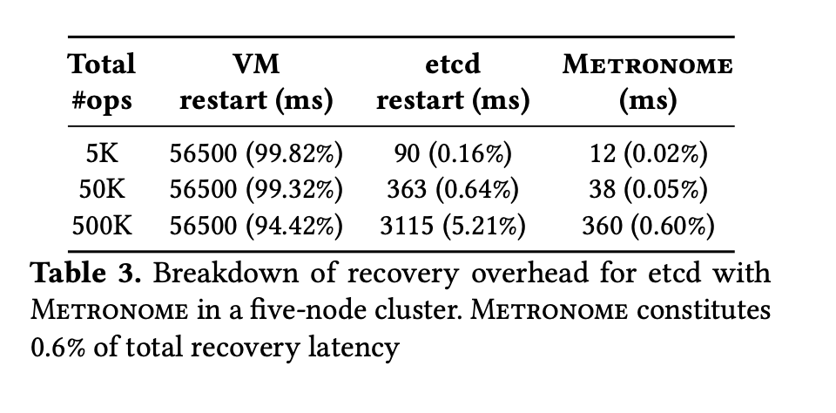
Metronome: Promising early results
Metronome does not impact application snapshotting
Recovery overhead for 500K operations is still < 1%
Metronome missing operations | Recovery overhead
5K | 0.02 %
50K | 0.05 %
500K | 0.6 %
Notes:
Under peak load, we force application on top of etcd to snapshot its state: we do not see any additional performance overheads from metronome
and if we measure the recovery overhead and the efficiency of parallel recovery:
metronome replicas are able to fill the hotels in logs with 500K operations with less than 1% overall recovery overhead.

Slide 72

Metronome: Summary!
Metronome: Consensus-aware logging library
Log shuffling for I/O efficiency
Work stealing to deal with stragglers
Log recovery in parallel over the network
Higher performance in the common path
Notes:
And to summarize the key-takeaways of this talk:
We built metronome: an IO-efficient consensus library:
It proposes log shuffling to minimize IO operations and parallelize logging at replicas
It introduces work stealing to handle weak and straggler replica
Metronome keeps recovery overheads low
And achieves higher performance in the common path

Slide 73
Metronome: Ongoing efforts
State snapshotting is not IO-efficient
Replicas can take IO-efficient snapshots
Complete snapshot can be reconstructed if failures arise
Pushing our ideas into systems
TiKV at Databricks
Kubernetes at IBM
CockroachDB
Notes:
we realize the 27% overhead is from applications storing a lot more than consensus logs to disk
but can actually make snapshotting IO efficient, and partially flush shuffled snapshots
complete snapshots can be restitched if failures arise
As next steps, we are very interested in having more applications use METRONOME and improve their IO-efficiency and performance.
We’re currently evaluating the benefits it unlocks for TiKV and Kubernetes and CockroachDB: a distributed database... and are in discussion with industry to push these ideas for their upstream applications

Slide 74
What’s Next?
Probability-native consensus | Metronome in real systems
Notes:
Alongside our efforts to design probability-native consensus protocols
and having more systems benefit from IO-efficient consensus
I want to take a quick minute to also describe some ideas I am currently exploring
But i have to warn you -- this is very very very preliminary, I have not really done much work on any of these ideas, but if you have thoughts I would love to hear them :D

Slide 75
Just some thoughts but quite exciting!
Probabilistic network verification might help
Map probability of server crashes to network link failures
NetDice: Probability that a property φ holds
SIGCOMM’20 | ETH Zurich
Nines are not Enough: Meaningful Metrics for Cloud
Jeff Moghul and John Wilkes, HotOS’19
Notes:
Probabilistic network verification might help
Map probability of server crashes to network link failures
NetDice: Probability that a property φ holds
SIGCOMM’20 | ETH Zurich
Nines are not Enough: Meaningful Metrics for Cloud
Jeff Moghul and John Wilkes, HotOS’19

Slide 76
Just some thoughts but quite exciting!
GPUs are very prone to failures
How can you build elastic and reliable GPU clusters?
NVIDIA’s dynamo uses etcd today
Abstractions, guarantees, and performance
Notes:
And in the interest of now exploring how failures impact AI/ML platforms and overall,
to understand and address the broader challenges of building fault-tolerant large-scale ML platforms
We’ve realized GPUs are very prone to failures
How can you build elastic and reliable GPU clusters?
NVIDIA’s dynamo uses etcd today
Abstractions, guarantees, and performance

Slide 77







The Larger Team!
Notes:
So I want to also take this opportunity to recognize my absolute priviledge to work with my amazing collaborators
And with that Im ready to answerany questions you may have!

