Slide 1
Digital Portfolio
STUDENT NAME: Soujanya Bagali
DEPARTMENT: CSE
COLLEGE: Visvesvaraya Technological University

Slide 2
PROJECT TITLE
Interactive Digital Portfolio

Slide 3


AGENDA
Problem Statement
Project Overview
End Users
Tools and Technologies
Portfolio design and Layout
Features and Functionality
Results and Screenshots
Conclusion
Github Link
3/21/2024 Annual Review

Slide 4

PROBLEM STATEMENT
Many developers struggle to present their skills and projects in an engaging way. A traditional resume lacks interactivity and visual appeal. This project solves that by creating a dynamic, personalized portfolio website. It will include sections like About Me, Skills, Projects, and Contact with smooth navigation and animations.

Slide 5

PROJECT OVERVIEW
Brief summary of your project.
What your portfolio contains (About Me, Projects, Skills, Contact).
Main idea: Showcase personal achievements, skills, and projects.

Slide 6

WHO ARE THE END USERS?
Students (academic projects, resumes).
Job seekers (to share with recruiters).
Freelancers (to show clients).
Professionals (to highlight experience and achievements).

Slide 7

TOOLS AND TECHNIQUES
HTML → Structure (pages, sections).
CSS → Styling (colors, layouts, responsiveness).
JavaScript → Interactivity (navigation menu, animations, form validation).
Mention code editor (VS Code) or CODEPEN and hosting platform (GitHub Pages).

Slide 8
POTFOLIO DESIGN AND LAYOUT
Header / Navbar
Home Section (#home)
Resume Section (#resume)
About Me Section (#about)
Skills Section (#skills)
Projects Section (#projects)
Certificates Section (#certificates)
Contact Section (#contact)
Footer
8

Slide 9
FEATURES AND FUNCTIONALITY
Navigation bar with smooth scrolling.
Project showcase with images/details.
Contact form (with validation).
Responsive design for all devices.

Slide 10
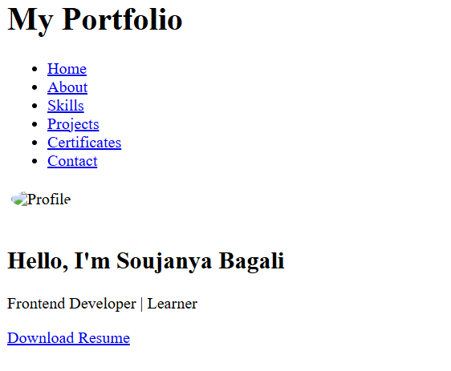

RESULTS AND SCREENSHOTS
3/21/2024 Annual Review
10

Slide 11
CONCLUSION
Showcases skills, projects, and achievements clearly.
Intuitive navigation with sections: About Me, Skills, Projects, Certificates, Resume, Contact.
Responsive design for desktop and mobile devices.
Interactive elements enhance user engagement.
Professional presentation reflects technical skills and creativity.
Acts as a strong personal branding tool for future opportunities.
11

