Slide 1
E-Commerce Customer Behavior Insights
This presentation summarizes the uploaded ecommerce dataset in a stakeholder-friendly format.
The dataset includes 420 rows and 18 columns of customer, channel, and behavioral information.
Average conversion / purchase rate is 38.3%.
Notes:
Introduce the dataset story and frame the deck as a business-ready summary of customer behavior patterns.

Slide 2
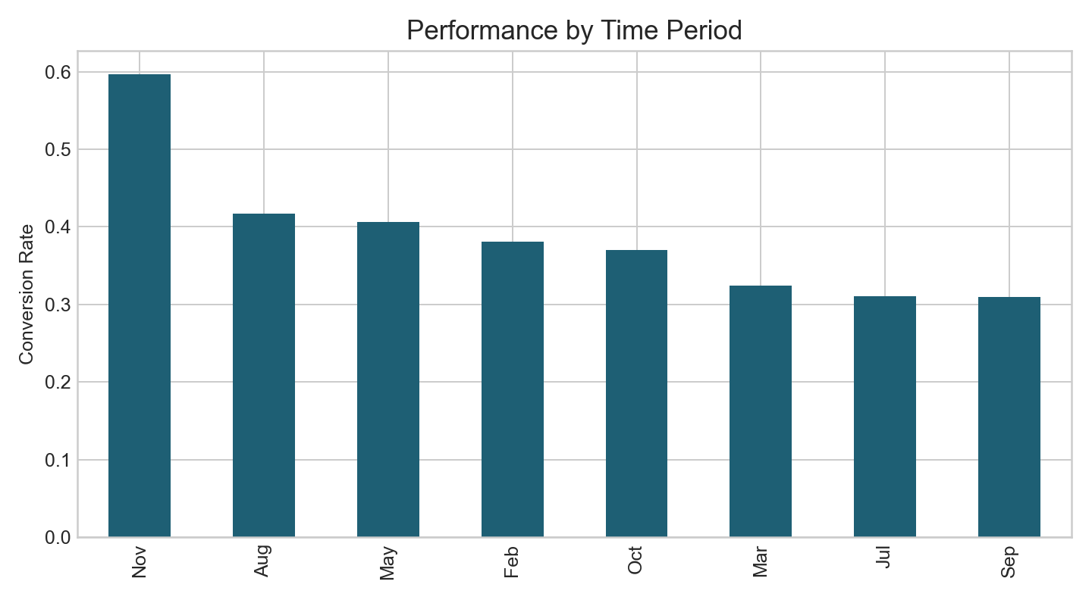
Dataset Snapshot
The dataset has been automatically profiled to detect customer segments, channel information, and business outcomes.
Peak performance currently appears in Nov.
Most informative customer grouping detected: VisitorType.
Most informative acquisition grouping detected: TrafficType.
Notes:
Explain how the uploaded dataset was interpreted and which fields drove the analysis.

Slide 3
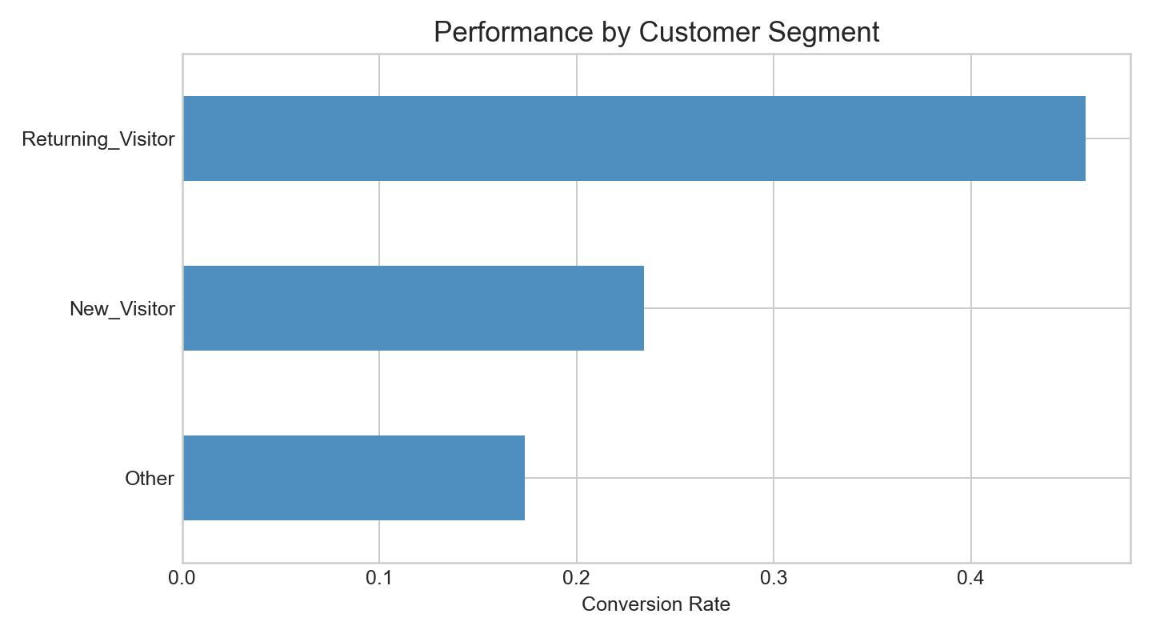
Target Customers
The strongest customer segment in the uploaded data is Returning_Visitor.
The strongest acquisition or channel grouping is 2.
Priority audiences are the segments that combine stronger conversion signals with stronger engagement behavior.
These segments are the best candidates for campaign prioritization and personalized targeting.
Notes:
Highlight which customers appear most valuable and where acquisition quality is strongest.

Slide 4
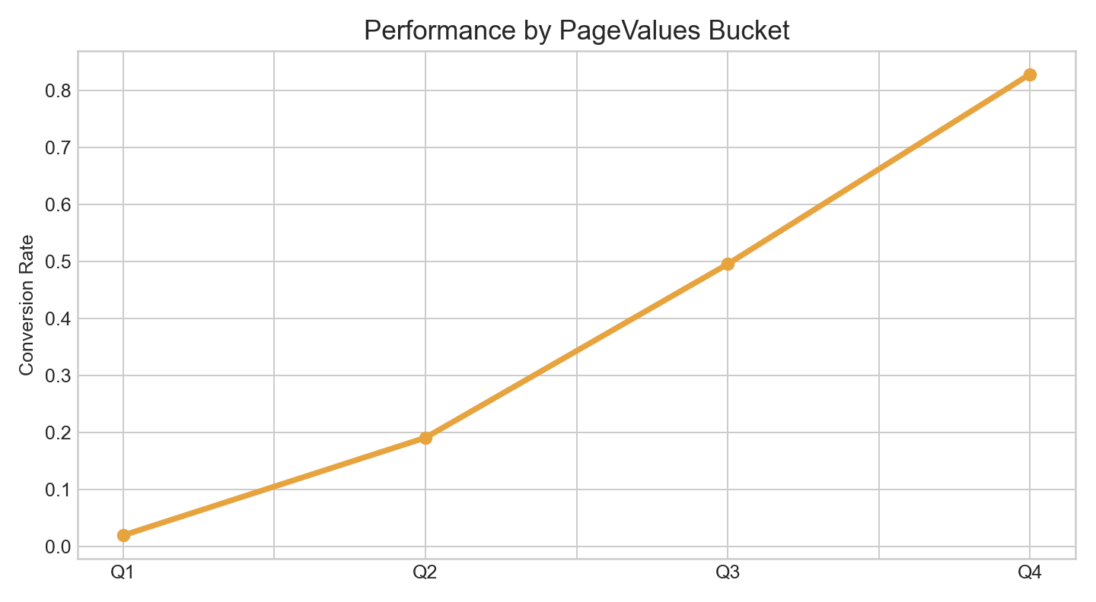
Behavioral Patterns
PageValues is higher for converting sessions (21.05 vs 6.81).
BounceRates is lower for converting sessions (0.043 vs 0.048).
Bucket analysis based on PageValues shows where commercial performance improves.
Behavior and customer quality are working together rather than independently.
Notes:
Use this slide to explain the behavioral signals that separate stronger sessions from weaker ones.

Slide 5
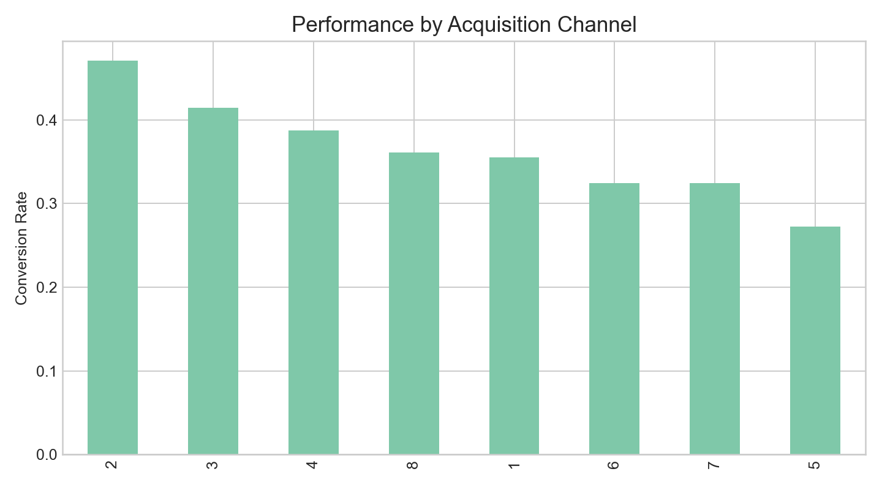
Key Findings
Top time period: Nov.
Top customer segment: Returning_Visitor.
Top channel grouping: 2.
The dataset suggests that acquisition quality and on-site engagement both influence business outcomes.
Notes:
Condense the analysis into the most portable executive findings.

Slide 6
Recommendations
Focus budget on the strongest channels and customer groups identified in the analysis.
Improve weak customer journeys by reducing friction and strengthening discovery paths.
Use high-intent engagement signals to trigger tailored offers, retention flows, or remarketing.
Track the same dimensions over time to validate whether conversion improves after changes.
Notes:
Translate the patterns into actions across marketing, merchandising, and experience optimization.

Slide 7
Conclusion
The uploaded ecommerce dataset can be turned into a clear commercial story without manual chart building.
Target segments, channel quality, and engagement behavior are the main drivers surfaced by the analysis.
This workflow is designed to help analysts move quickly from raw data to presentation-ready outputs.
Notes:
Close by emphasizing speed, clarity, and repeatability for future ecommerce datasets.

