Slide 1
BB88 Social Challenge ​ Design Thinking for Social Innovation​
​

Slide 2
CONTENT:
1. community visit
2. Observations
3. Stakeholder map
4.Questions to be asked
5. Stakeholder personas
6.Affinity map
7.Empathy map
8.Brainstorming
9.Scamper
10.Effort versus feasibility
11.Idea evaluation
12.Progress in prototyping
13.Plan of action for testing

Slide 3
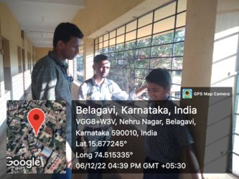
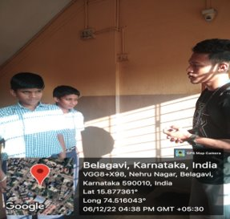
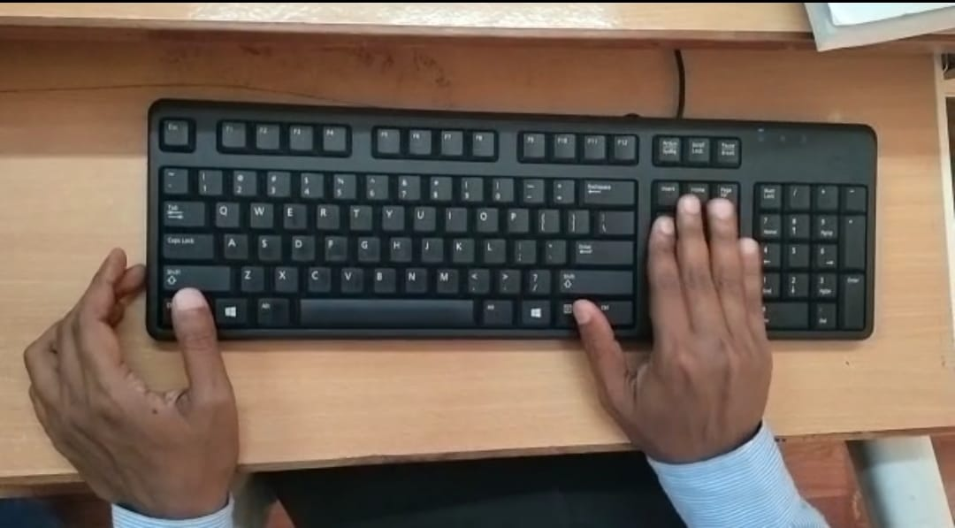
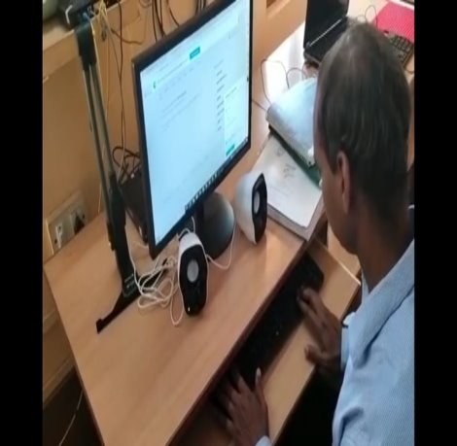
Community visit
Geotagged photos related to the social challenge identified

Slide 4
observations
We observed that there is immense need of braille keyboard because it is difficult for the students as well as teachers to teach and grasp things easily.​
Changes that needs to be incorporated in the design:​
Fonts to be in 3D​
Keys like enter shift etc. also should have 3D keys.​

Slide 5
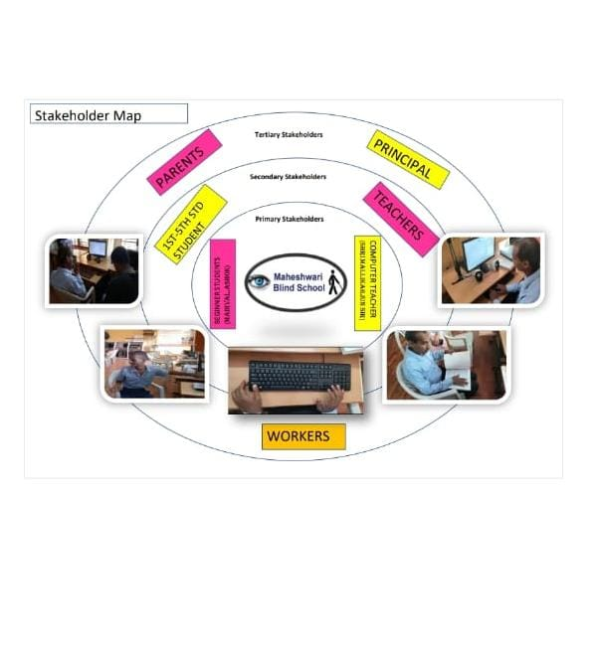
Stakeholders map

Slide 6
Questions to be asked
1. Is Braille keyboard being a substitute to normal keyboard a good idea?​
Yes, it would be helpful to type easily by sensing the keys.​
​
2. Whom will this model be helpful ?​
The model will be helpful for the beginner students because they can easily sense the keys.​
​
3.What suggestions would you like to give for the modification of BB88?​
It would be better if the keys like enter, shift, etc. too have 3D touch.​
​
4.How will this model be helpful for the teachers?​
This model is really very helpful as it makes the teaching process easy and students too can grasp things quickly.​
​

Slide 7
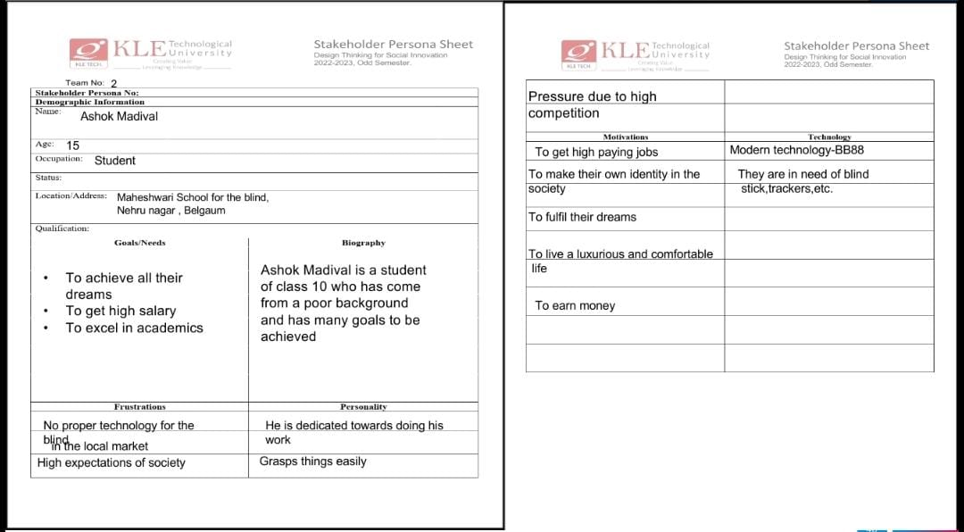
Stakeholders personas
2

Slide 8
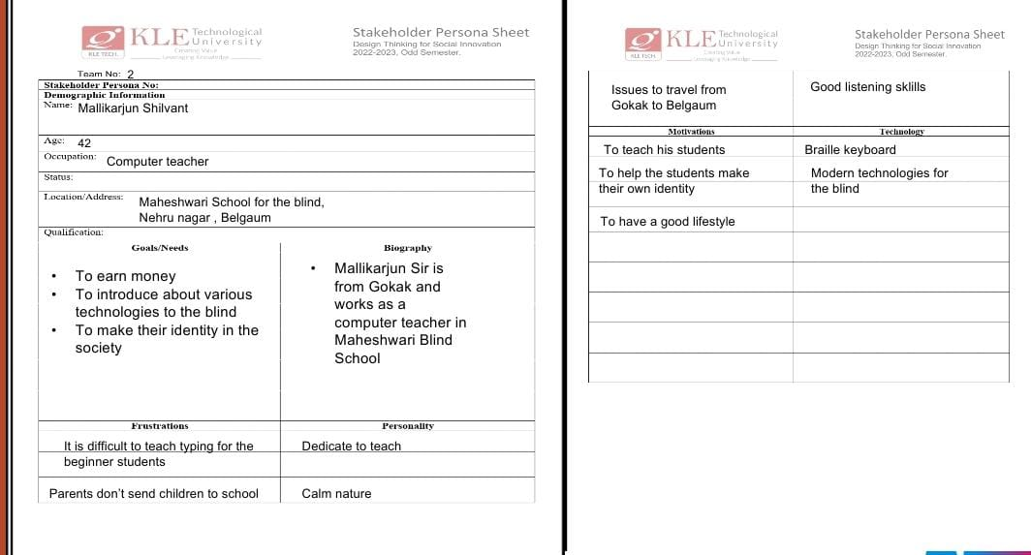
Stakeholders personas
2

Slide 9
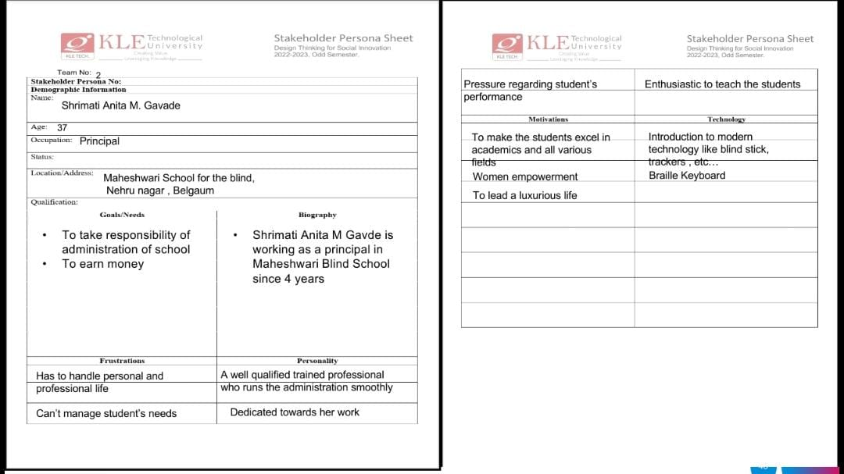
Stakeholders personas
2

Slide 10
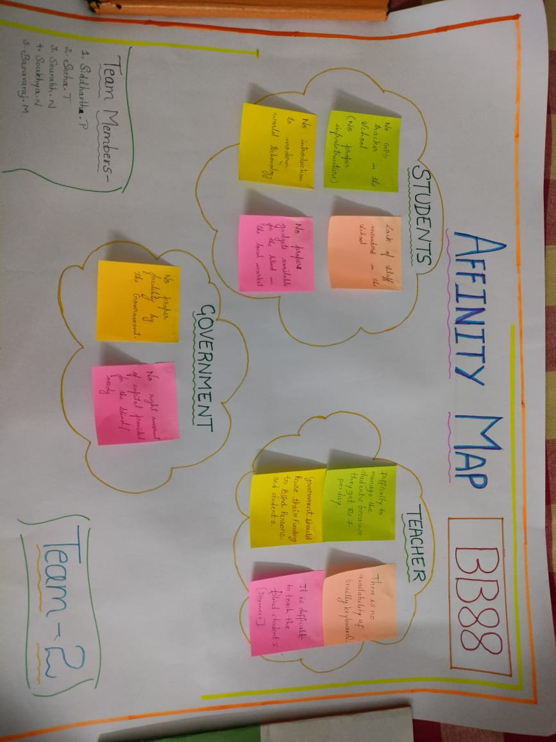
Affinity map

Slide 11
Empathy map
Say and Do👄​ Sports is not a career​ Excel in all various fields​ Children are burden ​ Succeed with flying colours​ Grades aren’t important​ Grades matter for certain criteria ​ like eligibility , interviews , etc​ ​ Blind are not a part of the society​ Make their own unique identity​ ​ ​ | See👀​ Low income of parents​ Students are pressurised​ Parents Struggle ​ High expectations​ high standards​ Low self esteem​ great potential​ Helpless ​ Limited facility​ Extraordinary talent​ ​
Think and feel🤔💭​ Isolated​ Pressurised​ high competition​ good lifestyle​ Good career​ Lack of motivation ​ Will be judged by the society​ ​ Enthusiastic to try new things​ ​ | Hear👂​ Children are burden​ Get out of your comfort zone​ ​ Become a doctor​ Get a degree​ Grades are important ​ ​

Slide 12
BB88
Keyboard with Joystick
Colourful keyboard
Eco-friendly keyboard
Keyboard with 3D keys
Voice typing
Auto correction keyboard
Self cooling keyboard
Portable Keyboard
Lighting keyboard
Keyboard with headphones
Braille keyboard
Wireless keyboard
Touchpad keyboard
Rubber keyboard
Telepathy keyboard
Smart keyboard(AI)
GPS trackers
Keyboard with sharp and smooth keys
Braille app
Touch screen technological keyboard
Keyboard with speakers

Slide 13
scamper
Keyboard with headphones , speakers and GPS trackers
Touch screen technology keyboard
Lighting keyboard , wooden keyboard
S
substitute
A
Adapt
P
Put to another use
R
Rearrange
C
Combine
M
Modify
E
Eliminate
Braille Keyboard
Braille app , Eco friendly keyboard
Smart keyboard and Other apps
Wireless/Portable keyboard
Centre for Engineering Education Research
56

Slide 14
Effort v/s feasibility
Can be chosen
Lighting keyboard
Transparent keyboard
Blind stick
Colourful keyboard
Keyboard with bold symbol and fonts
GPS trackers
Yes
Braille app
Eco friendly keyboard
Keyboard with inbuilt speakers
Portable keyboard
Braille keyboard with 3D keys
Keyboard with headphones
Impact
No
Auto correction keyboard
Rubber keyboard
Voice typing
Touchpad keyboard
Wooden keyboard
Maybe
Keyboard with inbuilt mouse
Wireless keyboard
Folding keyboard
Low
Low
High

Slide 15
Idea evaluation
Criteria​ | Ranking(1-5)​ | Braille keyboard with 3D keys​ |  | Braille app​ |  | Keyboard with inbuilt speakers​ |  | Eco friendly keyboard​ |  | Portable keyboard​
​ | A​ | Score B​ | C=A*B​ | Score D​ | C=A*D​ | Score E​ | C=A*E​ | Score F​ | C=A*F​ | Score G​ ​ | C=A*G​
Reachability​ | 4​ | 4​ | 16​ | 5​ | 20​ | 3​ | 12​ | 2​ | 8​ | 4​ | 16​
Rate of usability​ | 5​ | 4​ | 20​ | 4​ | 20​ | 4​ | 20​ | 3​ | 15​ | 3​ | 15​
Effort in creation​ | 3​ | 3​ | 9​ | 2​ | 6​ | 4​ | 12​ | 3​ | 9​ | 4​ | 12​
Durability​ | 4​ | 4​ | 16​ | 3​ | 12​ | 3​ | 12​ | 4​ | 16​ | 3​ | 12​
Cost​ | 4​ | 4​ | 16​ | 3​ | 12​ | 4​ | 16​ | 3​ | 12​ | 4​ | 16​
​ | ​ | 77 . ​ |  | 70​ |  | 72​ |  | 60​ |  | 71​
Idea selected: Braille keyboard with 3D keys​

Slide 16
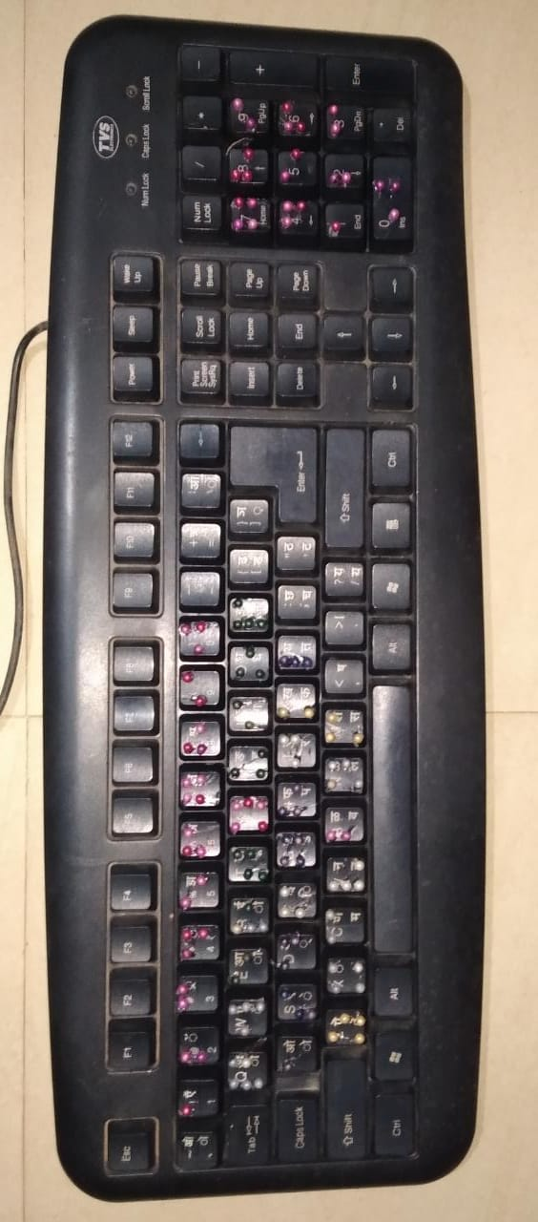
Progress in prototyping

Slide 17
Plan of action for testing

Slide 18
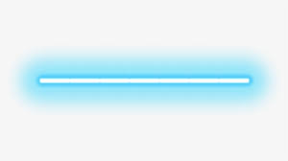
THANK YOU!
Presented by : Team 2
Siddharth Pedanekar
Sneha Tarale
Sourabh Nayak
Soukhya Nayak
Basavraj Mujagoni

