Slide 1

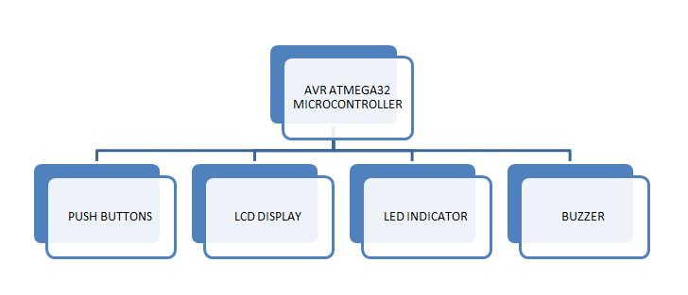
Department of C.S.E and C.S.E. (AI)
Electron Voting Machine
Soukhya N, Sharanamma K, Abhishek A, Prem V
Team No: A13
Problem statement
Methodology
Components Used
A community society needs a reliable and secure electronic voting machine to facilitate the election of their president. The goal is to ensure a fair, transparent, and accessible voting process that allows all members, including those with disabilities, to participate effectively in choosing a leader who will guide the society towards positive development and well-being.
The system utilizes an "ATMEGA32" microcontroller based on RISC architecture as the core of the system. It is responsible for receiving input from push buttons, sensing inputs, handling serial communication, and controlling a buzzer for sound notifications.
The LCD Display receives strings from the microcontroller via serial communication and displays the names and votes of the candidates. The display is updated in real-time to show the current vote count for each candidate.
Push Buttons are used by voters to cast their votes. Each button corresponds to a candidate. When a button is pressed, the vote count for the respective candidate is incremented.
AVR ATmega32 microcontroller for controlling and commanding the objects
LCD Display receives strings from the microcontroller via serial communication and displays the names and votes of the candidates.
These are used by voters to cast their votes. Each button corresponds to a candidate. When a button is pressed, the vote count for the respective candidate is incremented.
The buzzer is activated to provide audio feedback whenever a vote is cast.
LEDs are used to indicate the status of the voting machine, such as when a vote is successfully cast or when the system is in a delay mode to prevent multiple rapid votes.
.
Objectives
Guarantee that the voting machine accurately records and counts each vote, minimizing errors and discrepancies in the election results.
Provide features that allow for transparent auditing and verification of the voting process to build trust among the society members.
Incorporate an LCD display to professionally present the list of candidates participating in the election and show the result.
Automatic buzzer sounds when an vote is cast ed.
Block Diagram
Conclusions
The electronic voting machine project successfully provides a secure, accurate, and user-friendly solution for conducting elections within a community society. This innovation enhances accessibility and reliability, fostering trust and participation among all society members.
Microcontroller: Programming and Interfacing Project Worklet -2023-24

