Slide 1


Slide 2

Project Description
Create, edit, and upload a team of 7
Customize teams by: Type, Category, Links, and Rarity
View, like, and comment on teams made by other users

Slide 3
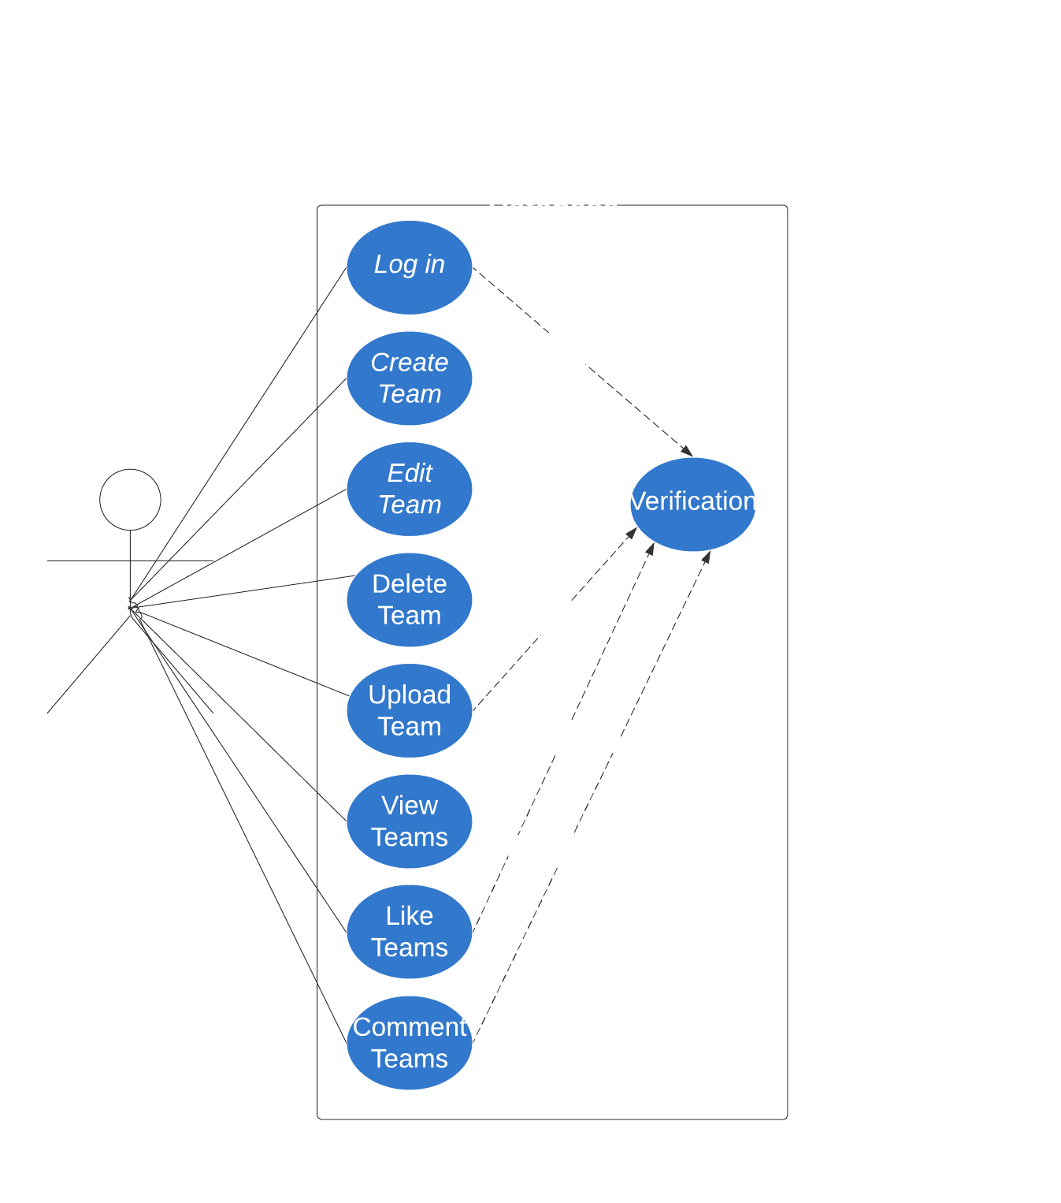

Slide 4
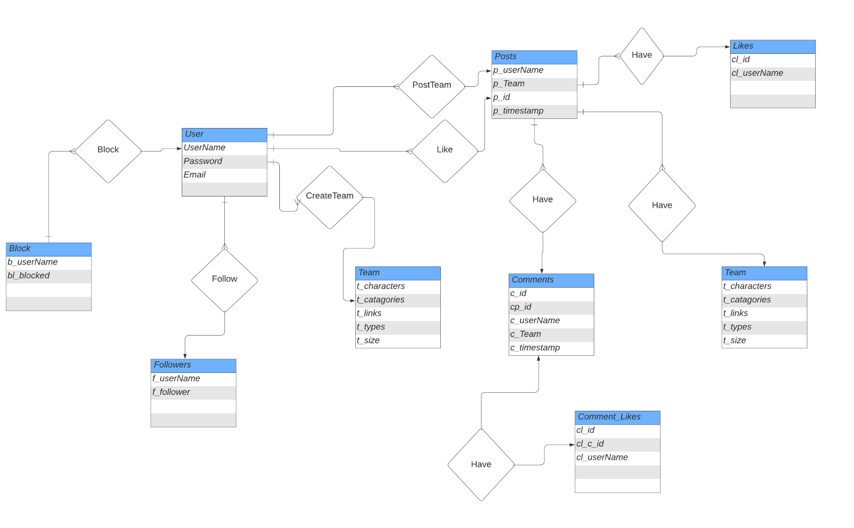

Slide 5
Relational Schema
Team
-t_character, t_type, t_links,t_catagories,t_size
User
-u_userName,u_Password, u_Email
Block
-b_userName, b_blocked
Followers
-f_userName, f_follower
Posts
-p_team, p_userName,p_id,p_timestamp
Comments
-c_userName, c_id, cp_id, c_team, c_timestamp
Comment Likes
-cl_id, cl_c_id, cl_userName
Likes
-cl_id, cl_userName

Slide 6
Github Repository
https://github.com/Soul091/Dokkan-Battle-TeamBuilder.git

