Slide 1
Predicting accident severity
Accident severity prediction is useful for the city.
We can see the causes of an accident being severe or not.
We can take countermeasures to prevent these accidents from happening
We can also look at conditions of the road and maybe use that to give drivers warnings or err to the side of caution

Slide 2
Data information
Main CSV file from seattle's open data website
Seattle collision information
Geodata and shape of Seatlle
URL :
https://s3.us.cloud-object-storage.appdomain.cloud/cf-courses-data/CognitiveClass/DP0701EN/version-2/Metadata.pdf
http://data-seattlecitygis.opendata.arcgis.com/datasets/5b5c745e0f1f48e7a53acec63a0022ab_0

Slide 3
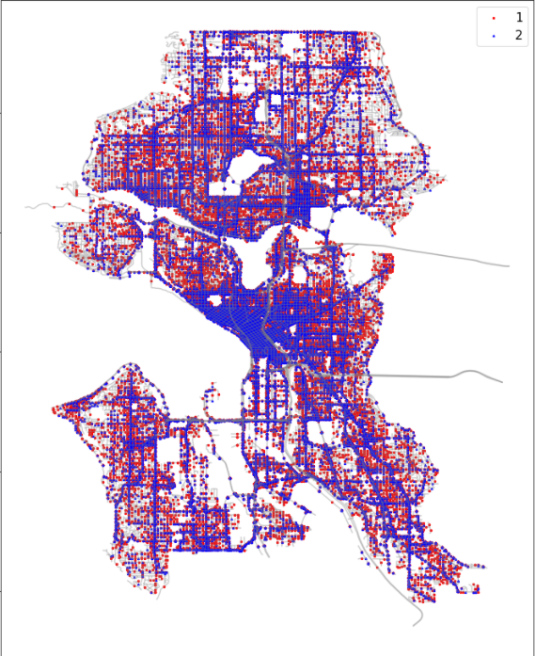
Map of Seattle and its accidents
Red represents lower severity, and blue represents higher severity.
While there are a lot of accidents throughout the entire city, a lot of blue seems to be concentrated on the center area of Seattle.
We can note that the dense area contains a lot of intersections, which probably causes a larger amount of severe accidents.
Also, most of the red dots seem to be very sporadic in where they are. All over the city there are red, and blue is mainly where roads are.

Slide 4
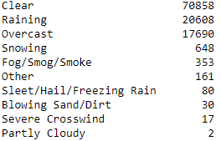
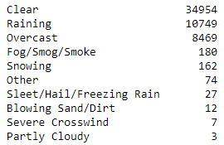
Feature checking:
Weather vs severity
Severity 1
Severity 2
Weather data doesn't show too many differences between each severity level.

Slide 5
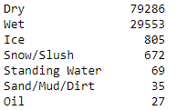
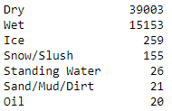
Feature checking:
Road condition vs severity
Severity 1
Severity 2
The ratio of dry:wet road conditions in both are around the same. We cannot say that the road conditions have a direct impact towards one severity or the other.

Slide 6


Feature checking:
Address type vs severity
0 = Block
1= Intersection
Severity 1
Severity 2
Address type is where it gets really interesting. Just as proven with the map,
the location of where the accident occurs has quite a bit of correlation with the
level of severity. While accidents on blocks also occur in severity 2, it's much
closer to a 50:50 ratio.

Slide 7
Modeling: imbalanced data
Dataset for severity 0 is 77290
For 1 is 38268
We will apply SMOTE technique to get equal datapoints.

Slide 8
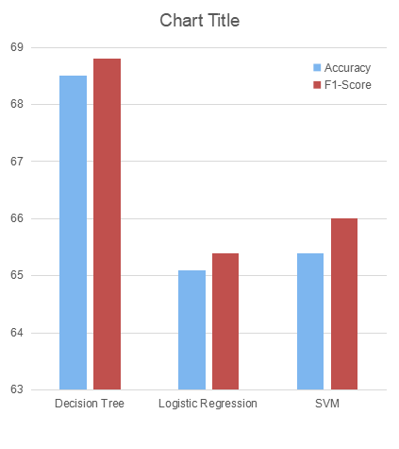
Model predictions
Of the three models, Decision tree has the highest of both accuracy and F1-score. However, since it's only around 70%, we should look at ways to improve its accuracy.

Slide 9
Conclusion
Our model isn't too bad in predicting the level of severity in an accident.
The accuracy can use some work though.
Some things that can improve accuracy : Better recording of date/time. Recording the driver's age or whether or not they have any pre-existing conditions or illness.
Some ways to reduce traffic is maybe adding some extra safety measures on intersections. Some kind of way that allows you to see incoming traffic on your blind side either through mirrors or lights.

