Slide 1
Applications of LLMs in Library Information Organization
Instructors: Lingzi Hong & Jinyu Liu

Slide 2
Learning Objectives
Understand the foundational concepts and background of large language models (LLMs).
Explore the application of LLMs in library information organization tasks, including classification and subject analysis.
Understand training strategies for LLMs, such as few-shot learning, fine-tuning, and Chain-of-Thought reasoning.
Learn to apply LLMs in subject analysis by structuring outputs to meet user needs.
Notes:
Understand foundational concepts
Trough this session, we will have a clear understanding of what large language models are, how they are trained, and why they are transforming the way we work with language and knowledge.
Explore applications in libraries
We will learn how LLMs can be applied to library information tasks, especially in subject analysis, and how they can support librarians in organizing and managing knowledge more effectively.
Learn training strategies
We will look at important strategies for working with LLMs—such as few-shot learning, fine-tuning, and chain-of-thought reasoning—and understand how each of these improves model performance in practical tasks.
Apply LLMs to subject analysis
Last, we will learn how to take the outputs from LLMs and structure them in ways that meet real user needs by a code example.

Slide 3
Table of contents.
01 | Foundations Of LLM Training
02 | Application of LLMs in Library Information Organization
03 | Demo Showcase
04 | Q&A
Notes:
We will begin with some background on large language models, including their origin, development, and why they matter in today’s information environment.
Next, we will explore how LLMs are trained, looking at concepts like few-shot learning, fine-tuning, and chain-of-thought reasoning.
Then we will turn to practical applications, showing how LLMs can support subject analysis, and other library organization tasks.
After that, we will walk you through a short demo to show how these concepts actually work in practice.
Finally, here will be a QA part.

Slide 4
Foundations of LLM Training
01

Slide 5




Milestones in LLM Evolution
2018
2019
2020
2022
2023
2024
2025
BERT
GPT-2
T5,GPT-3
BLOOM
GPT-4/LLaMA 1 & 2
Gemini 1.5
DeepSeek
110M, Masked Language Modeling (MLM), bidirectional transformer,
1.5B, Decoder-only Transformer, autoregressive text generation
T5: up to 11B; GPT-3: 175B, few-shot and zero-shot learning
GPT-4: estimated ~1T, LLaMA 2: 7B, 13B, 70B, improved reasoning;
300B+, Long-context processing; multimodal
176B, Multilingual Transformer;
671B, advanced reasoning modules
Notes:
From 2018 to 2025, LLMs evolved from context-aware understanding to large-scale multilingual and instruction-tuned reasoning model. Impoving in long context dealing, multimodal capabilities, and logical reasoning ability.
2018 BERT – introduced masked language modeling and became the foundation of modern NLP.
2019 GPT-2 – showed fluent text generation with 1.5B parameters.
2020 GPT-3 / T5 – scaled up to 175B, enabling few-shot and zero-shot learning.
2022 BLOOM – open-source, multilingual LLM with 176B parameters.
2023 GPT-4 & LLaMA – GPT-4 improved reasoning; LLaMA made smaller, efficient models widely available.
2024 Gemini 1.5 – focused on long-context and multimodal reasoning.
2025 DeepSeek – pushing advanced reasoning with 671B parameters.

Slide 6

Some “tricks” in LLMs
Prompt engineering
Few-shot learning
Chain-of-thought reasoning
Fine-tuning
Post-editing
Notes:
When we work with large language models, there are a few useful tricks to make them more effective.
First, prompt engineering helps us frame the question in the right way so the model gives better answers.
Second, through few-shot learning, we can show the model just a handful of examples, and it can generalize to similar tasks.
Third, we use chain-of-thought reasoning, which means guiding the model to explain its steps and think logically, instead of just giving a final answer.
Then, with fine-tuning, we can train the model on domain-specific data, making it much more accurate for our own use cases.
And finally, post-editing allows humans to step in, review, and refine the output, ensuring it meets real-world quality standards.

Slide 7
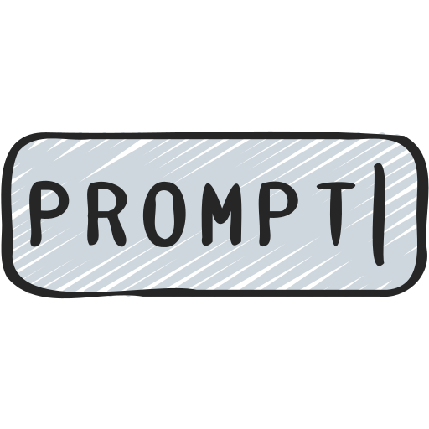
Prompt Engineering
“Prompt Engineering” is Refine the input we give to an LLM so that it produces the desired output.
This includes choosing the right wording, structure, and context.
Refined Prompt:
“You are a professional librarian. Read the following book description and assign the most accurate Library of Congress Subject Headings, including broader and narrower terms where appropriate.
Result:
Climate change—Agricultural aspects
Agriculture—Environmental aspects
Sustainable agriculture—Adaptation
Basic Prompt:
Assign a subject heading to this book
Result: "Climate change"
VS
Notes:
Prompt engineering is about refining the way we ask questions.
If we give a very basic prompt like “Assign a subject heading to this book”, the model gives us only a single and general label, for example “Climate change.”
But if we provide a refined prompt, with more context and clear instructions—like asking the model to act as a professional librarian and include broader and narrower terms—it produces a much richer result.
Here we can see subject headings such as Climate change—Agricultural aspects, Agriculture—Environmental aspects, and Sustainable agriculture—Adaptation.
So the difference is clear: a simple prompt leads to a simple answer, while a carefully designed prompt can unlock far more useful and structured information.

Slide 8
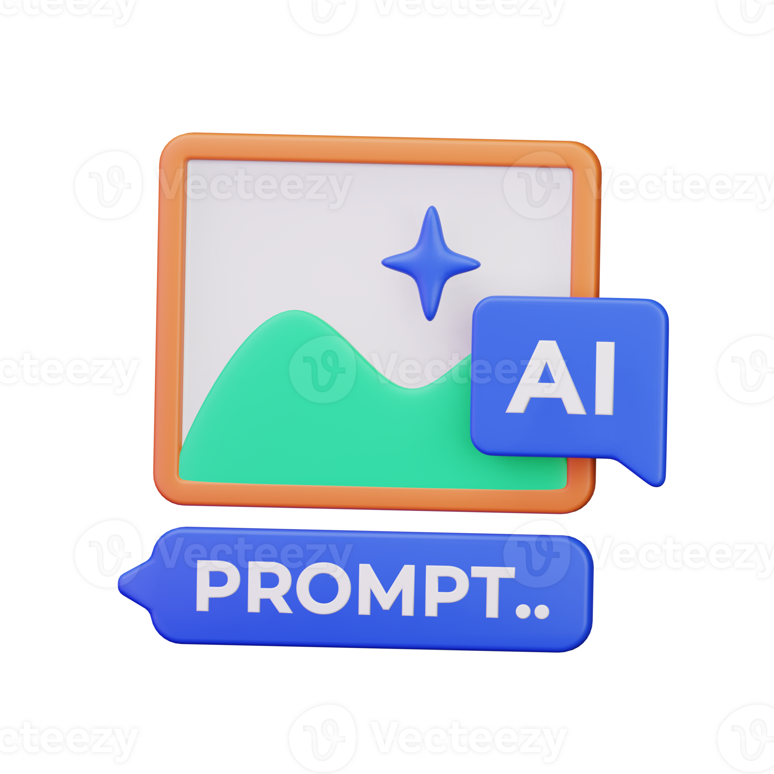
What is “Prompt” ?
“Prompt” is the input we give to a Large Language Model—it can be a question, a request, or an instruction.
The model uses this prompt as the starting point to generate a response.
Notes:
A prompt is simply the input we give to a large language model.
It can be a question, a request, or an instruction—basically, the way we talk to the model.
The model then takes this prompt as the starting point and generates a response.
So, the quality of the output always depends on how we phrase the input.

Slide 9

Why we need “Prompt”?
A prompt works as the starting signal for LLM.
When we type a prompt, the model converts your words into numerical representations (embeddings).
It then predicts the next word step-by-step, guided by the context we provided, until the answer is complete.
The quality, clarity, and structure of the prompt will directly influence the model’s output.
Notes:
A prompt is essential because it acts as the starting signal for the model.
When we type a prompt, the model first converts our words into numerical representations, called embeddings.
From there, the model predicts the next word step by step, guided by the context we provided, until it forms a complete response.
This means that the clarity, quality, and structure of our prompt will directly influence the quality of the model’s output.

Slide 10
Why we need “Prompt”?
LLM outputs are context-sensitive—the way we ask is as important as what we ask.
We use prompt for:
Guide the model’s thinking
Control the output format
Improve accuracy and relevance
Notes:
LLM outputs are highly context-sensitive—so the way we ask is just as important as what we ask.
That’s why prompts matter. We use them to guide the model’s thinking, so it follows the direction we want.
Prompts also help us control the output format, for example, making sure the answer comes as a list, a summary, or a table.
And most importantly, a well-crafted prompt can improve accuracy and relevance, giving us answers that are much closer to what we actually need.

Slide 11

Few-Shot Learning
Few-shot learning is teaching LLMs with a few examples.
It allows LLM to learn a new task or desired output format using just a few examples(usually 3 to 5).
The examples are directly put inside the prompt.
Then the models will learn from the examples.
Notes:
Few-shot learning means teaching a model with just a few examples.
Instead of retraining the whole model, we simply put 3 to 5 examples directly inside the prompt.
The model then follows these examples as patterns, and learns how to produce outputs in the same format.
It’s like showing a student a few solved problems, and then asking them to solve a new one by analogy.

Slide 12
Few-Shot Learning Prompt
"You are a librarian. Assign the most accurate Library of Congress Subject Headings (LCSH) to each book description based on the given examples."
Example 1:
Description: "A detailed history of the Silk Road and its role in cultural exchange between East and West."
Subject Headings: Silk Road—History; Cultural relations—Asia—Europe
Example 2:…
Example 3:…
Now classify: Description: "A study of the economic and social impacts of climate change on rural farming communities."
Notes:
Here we can see how few-shot learning actually works.
We start with an instruction: the model is told to act as a librarian and assign accurate Library of Congress Subject Headings.
Then we give a few examples — for instance, a book about the Silk Road, along with the correct subject headings.
After seeing two or three such examples, the model learns the pattern.
Finally, when we give it a new description — in this case, about climate change and rural farming — the model can generate subject headings by following the style of the earlier examples.

Slide 13
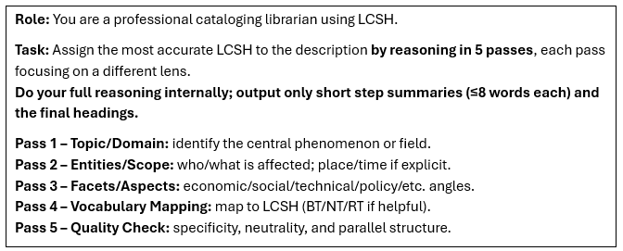
Chain-of-Thoughts reasoning
CoT is a strategy encourage model to generate intermediate reasoning steps before giving the final answer.
Useful in complex tasks.
Helps avoid “shortcut” answers.
Notes:
Chain-of-Thought(CoT), is a strategy where we encourage the model to think step by step before producing the final answer.
This is especially useful for complex tasks, because it prevents the model from jumping to quick, shallow answers.
In the example here, the model is asked to assign subject headings in five passes: starting with the topic, then scope, then aspects, followed by vocabulary mapping, and finally a quality check.
By breaking the reasoning into steps, we get results that are clearer, more accurate, and more reliable.

Slide 14
Fine-tuning
Want to create your own models?
Fine-tuning is the process of continuing the training of LLM on a smaller, task-specific dataset.
The goal is to adapt the model to perform a specific task better.
Fine-tuning updates the model’s weights and changes the model ’itself.
Adjust the model’s internal parameters using additional and domain-specific data.
Notes:
Fine-tuning means continuing the training of a large language model on a smaller, task-specific dataset.
The purpose is to adapt the model so it performs much better on a particular task.
Unlike prompt engineering, fine-tuning actually updates the model’s internal weights, changing the model itself.
By feeding it domain-specific data, we make the model more accurate, more consistent, and better aligned with our needs.
In other words, if you want to create a model specialized for your field, fine-tuning is the way to do it.

Slide 15
Fine-tuning
Method | What it does? | Pros | Cons
Full Model Fine-tuning | Updates all model parameters on your dataset | Maximum adaptation; works for major domain shifts | Resource issues(GPU, memory, time), risk of overfitting
LoRA Fine-tuning (Low-Rank Adaptation) | Freezes most weights, adds small trainable adapter layers | Much faster & cheaper; less storage; can apply multiple LoRA modules for different tasks | Less flexible for domain changes
Notes:
There are two main ways to fine-tune a model.
Full Model Fine-tuning updates all model parameters with our dataset.
This gives maximum adaptation and works well for big domain shifts, but it requires huge resources—GPU, memory, and time.
LoRA Fine-tuning, on the other hand, freezes most weights and only adds small trainable adapter layers.
It is much faster and cheaper, requires less storage, and allows us to plug in different LoRA modules for different tasks.
The trade-off is that LoRA is less flexible if the domain changes significantly.
In short: full fine-tuning is powerful but heavy, while LoRA is lightweight and practical.

Slide 16

Fine-tuning vs Zero-shot
Domain specialization
Improve task performance
Adapt tone/style
Reduce irrelevant answers
Notes:
Zero-shot means the model tries to handle a task without any training examples—just relying on its general knowledge.
This works in many cases, but it can give vague or irrelevant answers.
Fine-tuning, on the other hand, allows us to specialize the model for a domain.
It improves performance on specific tasks, helps adapt the model’s tone and style, and greatly reduces irrelevant or off-target answers.
In short: Zero-shot is flexible but general, while fine-tuning is targeted and reliable.

Slide 17
Application of LLMs in Library Information Organization
02

Slide 18
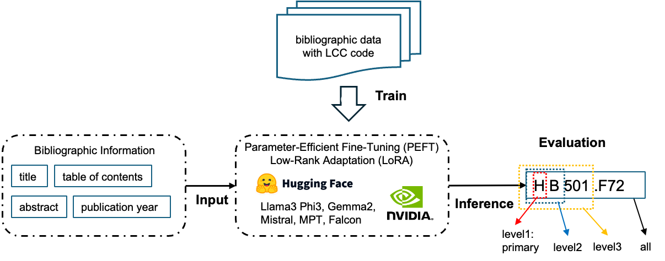
LLMs for Book Classification Tasks using LCCS
Explore how LLMs can be applied to predict the classification code of a book automatically.
Notes:
Research Questions:
How can LLM-based models be developed to categorize books at different granularity levels?
What is the performance of LLM-based models in assigning LCC classification codes across different domains/disciplines?

Slide 19
LLMs Applied in Subject Analysis
Generate accurate LCSH subject headings with Large Language Models (LLMs) with metadata fields
Assuming that you are a professional cataloger in a library, please assign several subject headings to a book by selecting from the list of candidate Library of Congress subject headings based on the book's title and abstract. Return the selected subject headings in JSON format without explanatory text.
Title: ```{{Title}}```
Abstract: ```{{Abstract}}```
Candidate Library of Congress subject headings:```
{{candidate_words}}
```

Slide 20
Benefits and Challenges
Benfits:
Automation Efficiency
Improved Discovery
Multilingual Support
User Interaction
Challenges:
Accuracy & Consistency
Bias & Hallucination
Data Privacy
Maintenance Cost
✅
⚠️
Notes:
Using LLMs in library settings brings several clear benefits.
They can improve automation efficiency, helping us save time on repetitive cataloging tasks.
They also support better discovery, making it easier for users to find relevant information.
With multilingual support, LLMs can break language barriers.
And through user interaction, they can provide a more engaging and personalized experience.
But at the same time, there are real challenges.
We need to ensure accuracy and consistency, since LLMs can sometimes produce errors.
They are also prone to bias and hallucination, which means they may generate misleading or invented content.
Data privacy is another key concern, especially when handling sensitive information.
Finally, there is the maintenance cost, since models require resources and constant updates.

Slide 21
Demo Showcase
03

Slide 22
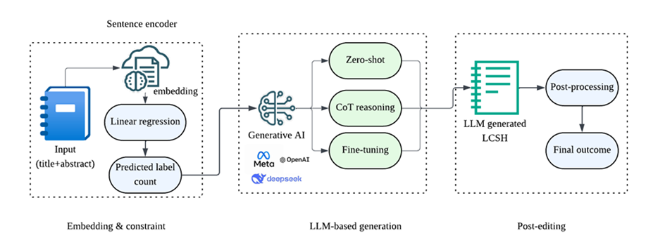
How we apply LLM in subject analysis?
Notes:
Here is an example of workflow in applying LLM in subject analysis. It’s just an example. You can modify what ever you want and design your own paplepine. In this workflow, first, we need paprare the input data. We select title and abstract as the input information. In the first stage-embedding, we will convert the text intoi nermeical information that can be understand by mechine. Then in the second stage, we use generative AI and apply some stargies like cot, few-shot learning and fine-tuning to improve the models’ performance. At last stage, we can also do some post-processing work to help us further enhance the performance.

Slide 23
Workflow in Subject Analysis
01
Input Preparation
02
Prompt dsesign
03
Strategies in LLM
04
Evaluation
Notes:
So, I devide the application of LLM in subject analysis into 4 steps, first prepare the input meta data and the target output. Then design the prompt based on our task and sepctific requirement, Third, use some strategies like we mentioned before to incress the performance. And last, we need evaluate the performance of LLM.

Slide 24
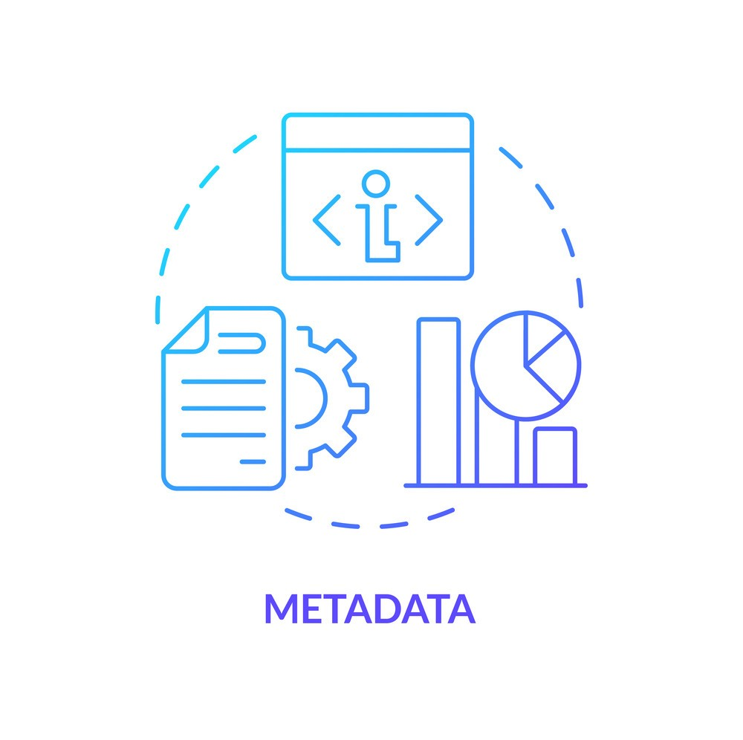
Input Preparation
Build Metadata for LLM Input.
Raw Data Sources:
Usually MARC records
Key fields: Title, Abstract/Summary, Author Info…
Notes:
Before using LLMs, we first need prepare the input metadata.” “ And in subject analysis, the raw data usually comes from MARC records.” MARC means Machine-Readable Cataloging. It is a standard format used by libraries to store and exchange bibliographic data. MARC records provide structured fields such as title, author, publication info, and subjects. You can select any of them as input filed if you think there are some kinds of relationship between them.

Slide 25
Prompt design
Be clear about the goal:
example: "Identify 3 Library of Congress Subject Headings for the following book summary."
Provide context:
"You are a helpful assistant predicting Library of Congress Subject Headings (LCSH) for books."
Define the output format:
"Respond only with the predicted LCSH labels separated by commas."
Notes:
Good prompts start with a clear goal, such as predicting a few subject headings.”
“We then provide the model with context, like telling it that it’s a helpful assistant for LCSH.”
“Finally, we define the output format so the results are consistent and easy to process.”

Slide 26

Strategies to increase performance
Few-shot learning:
Directly put a few example in the prompt.

Slide 27
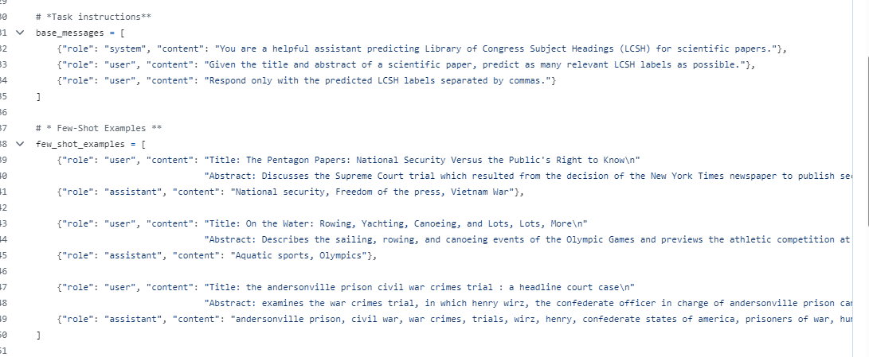

Strategies to increase performance
Prompt design
Few-shot examples

Slide 28
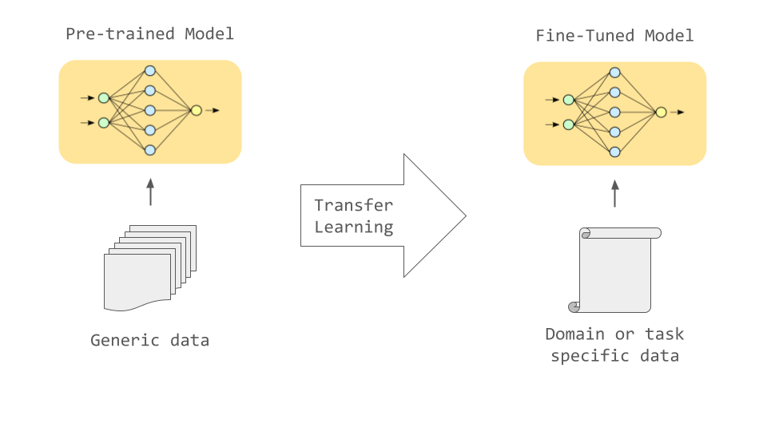
Strategies to increase performance
Fine-tuning:
Notes:
“Fine-tuning means adapting a pre-trained model to a specific domain or task.” “We start with a model already trained on large, general data, and then refine it using our task-specific dataset.”
“This can improve performance and makes the model more relevant to our needs.”

Slide 29
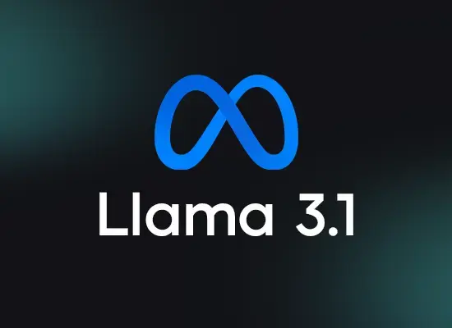
Strategies to increase performance
Our fine-tuned models
(already modify part parameters)
An open-sourced model
Training process
Our training set
Notes:
In our later demo, I will show you how to fine-tune an open sourced model- llama 3.1 8bs. Fine-tuning will update the paramapers in the modles, make it more adapter for our subject analysis task.

Slide 30
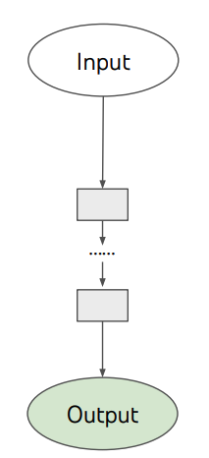
Strategies to increase performance
Chain-of-thought reasoning:
Refine the prompt by step-by-step reasonings.
Notes:
“Chain-of-Thought reasoning means asking the model to think step by step, instead of jumping directly to the final answer.” “By breaking the task into smaller reasoning steps, the model can improve accuracy and handle more complex problems in subject analysis.

Slide 31
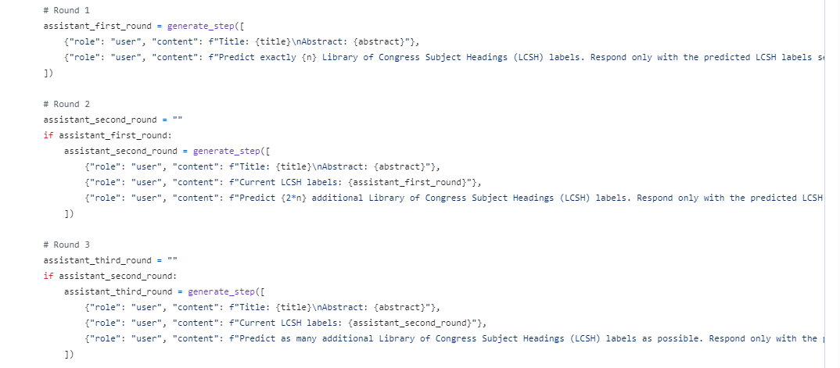
Strategies to increase performance
Frist round
Second round
Last round
Notes:
Here is our cot example promots. We divide the whole task into three rounds reasoning steps. In the first round, we ask models generate exactly n lcsh labels. And in the second round, based on the first round result’s and input fields, we ask the model to gengeate 2N additional lcsh labels. At last, we ask model to predict as many as possible to enhance the coverge of our results.

Slide 32


Evaluation Metrics in Subject Analysis
LCSH prediction is a multi-label classification task.
Each book/doc may match multiple labels.
Notes:
So, in this situation? What kinds of evaluation metrics are helpful?

Slide 33
Evaluation Metrics in Subject Analysis
Metric | Measures | Meaning
Precision | Correct predicted labels / total predicted labels | Avoids "hallucinated" or noisy terms
Recall | Correct predicted labels / total true labels | Measures coverage
F1-score | Harmonic mean of precision and recall | Overall balance of correctness and coverage
Notes:
We maily use precison, recall and F1 score to eva llm performance in subject analysis.

Slide 34
Evaluation Metrics in Subject Analysis
prediction
actual |  | 1 | 0
 | 1 | 3 | 2
 | 0 | 3 | 2
Key Metrics Used:
Precision: When it says 1 how often is it right
# TP/(#TP+#FP)
Accuracy: What fraction does it get right
# (TP+#TN)/# Total
Recall: What fraction of 1s does it get right
#TP/(#TP+#FN)
prediction
actual |  | 1 | 0
 | 1 | True positive | False Negative
 | 0 | False Positive | True Negative

Slide 35
Evaluation Metrics in Subject Analysis
Title: museum rhetoric : building civic identity in national spaces
Abstract: examines the role of museums in promoting cultural heritage and national identity…
Predict LCSH: Nationalism and collective memory, Nationalism, Civic improvement, Cultural property, Museum exhibits, Collective memory, Civic engagement, Communication in museology, Museums, Identity (Psychology), National characteristics, Group identity, Public spaces, Rhetoric
Original LCSH: museums; national museums; rhetoric; nationalism; cultural property
Notes:
Here is an example extract form our exppirment. This is title of a book and here it’s abstract. And the last line are it’s original lcsh lables provided by library. And this are LCSH terms predicted by LLM. We can see, there are 5 labels in original record and LLM give us 14 terms. And in the 14 terms, 4 lcsh terms are predicted correctly. So the precison will be 4/14. it’s 0.29. And in the original records, 4 out of 5 are predicted correctly, so the recall will 4/5, that’ measn 0.8. And the f 1 score is the mean of recall and precison. And it will be 0.43

Slide 36

Evaluation Metrics in Subject Analysis
Recall: 0.8 (4/5)
Precision: 0.29 (4/14)
F1-score: 0.43 [(2*0.8*0.29)/(0.8+0.29)]

Slide 37
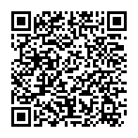

Slide 38
Thank you!
Do you have any questions?

