Slide 1

VISION-LANGUAGE MODELS (VLMS) FOR ARCHIVAL IMAGE SUBJECT TERM ASSIGNMENT
Instructors: Lingzi Hong & Jinyu Liu

Slide 2
Part1: Research Background & Motivation
Part2: VLM Foundations
Part3: Prompt Engineering and Archival Applications
Part4: Demo Showcase

Slide 3
Part1: Research Background & Motivation

Slide 4
MILLIONS OF ARCHIVAL IMAGES LACK SEARCHABLE SUBJECT TERMS
Scale
Archives hold millions of images with minimal or no subject metadata.
17M+
Photographs in the Library of Congress alone, the majority with limited metadata.
Bottleneck
Manual cataloging is costly and inconsistently
applied across collections.

Slide 5
MILLIONS OF ARCHIVAL IMAGES LACK SEARCHABLE SUBJECT TERMS
Discovery
Subject terms are the core discovery mechanism in archival catalogs.
17M+
Growth
The backlog of undescribed images grows faster than human cataloging capacity.
Photographs in the Library of Congress alone, the majority with limited metadata.
Solution
AI-assisted description offers a scalable path forward for visual heritage.

Slide 6
SUBJECT TERMS ARE THE SEMANTIC BRIDGE
Subject terms derive from controlled vocabularies like LCSH/AAT/TGM.
Controlled vocabulary enables consistent, cross-collection retrieval.
Subject terms are assigned by trained catalogers after careful image analysis.
Institutional taxonomies may supplement standard thesauri.

Slide 7
FOUR DIMENSIONS OF SUBJECT TERMS
TOPICAL
AAT
NAME
Describes what the image is about or the concepts it represents.
Identifies specific people, organizations, or corporate bodies.
"Floods"
"Roosevelt, Franklin D."
GEOGRAPHIC
FORM / GENRE
Specifies the location where the image was taken or depicts.
Describes what the item is, rather than what it is about.
"Chicago, Illinois"
"Portraits"

Slide 8
MOVING BEYOND SIMPLE OBJECT DETECTION
Traditional CV identifies objects (e.g., "Person") but misses archival context
(e.g., "Great Depression“.)
Need for semantic understanding to map visual content to high-level archival concepts.
VLM-assisted description offers a scalable path for visual heritage.

Slide 9
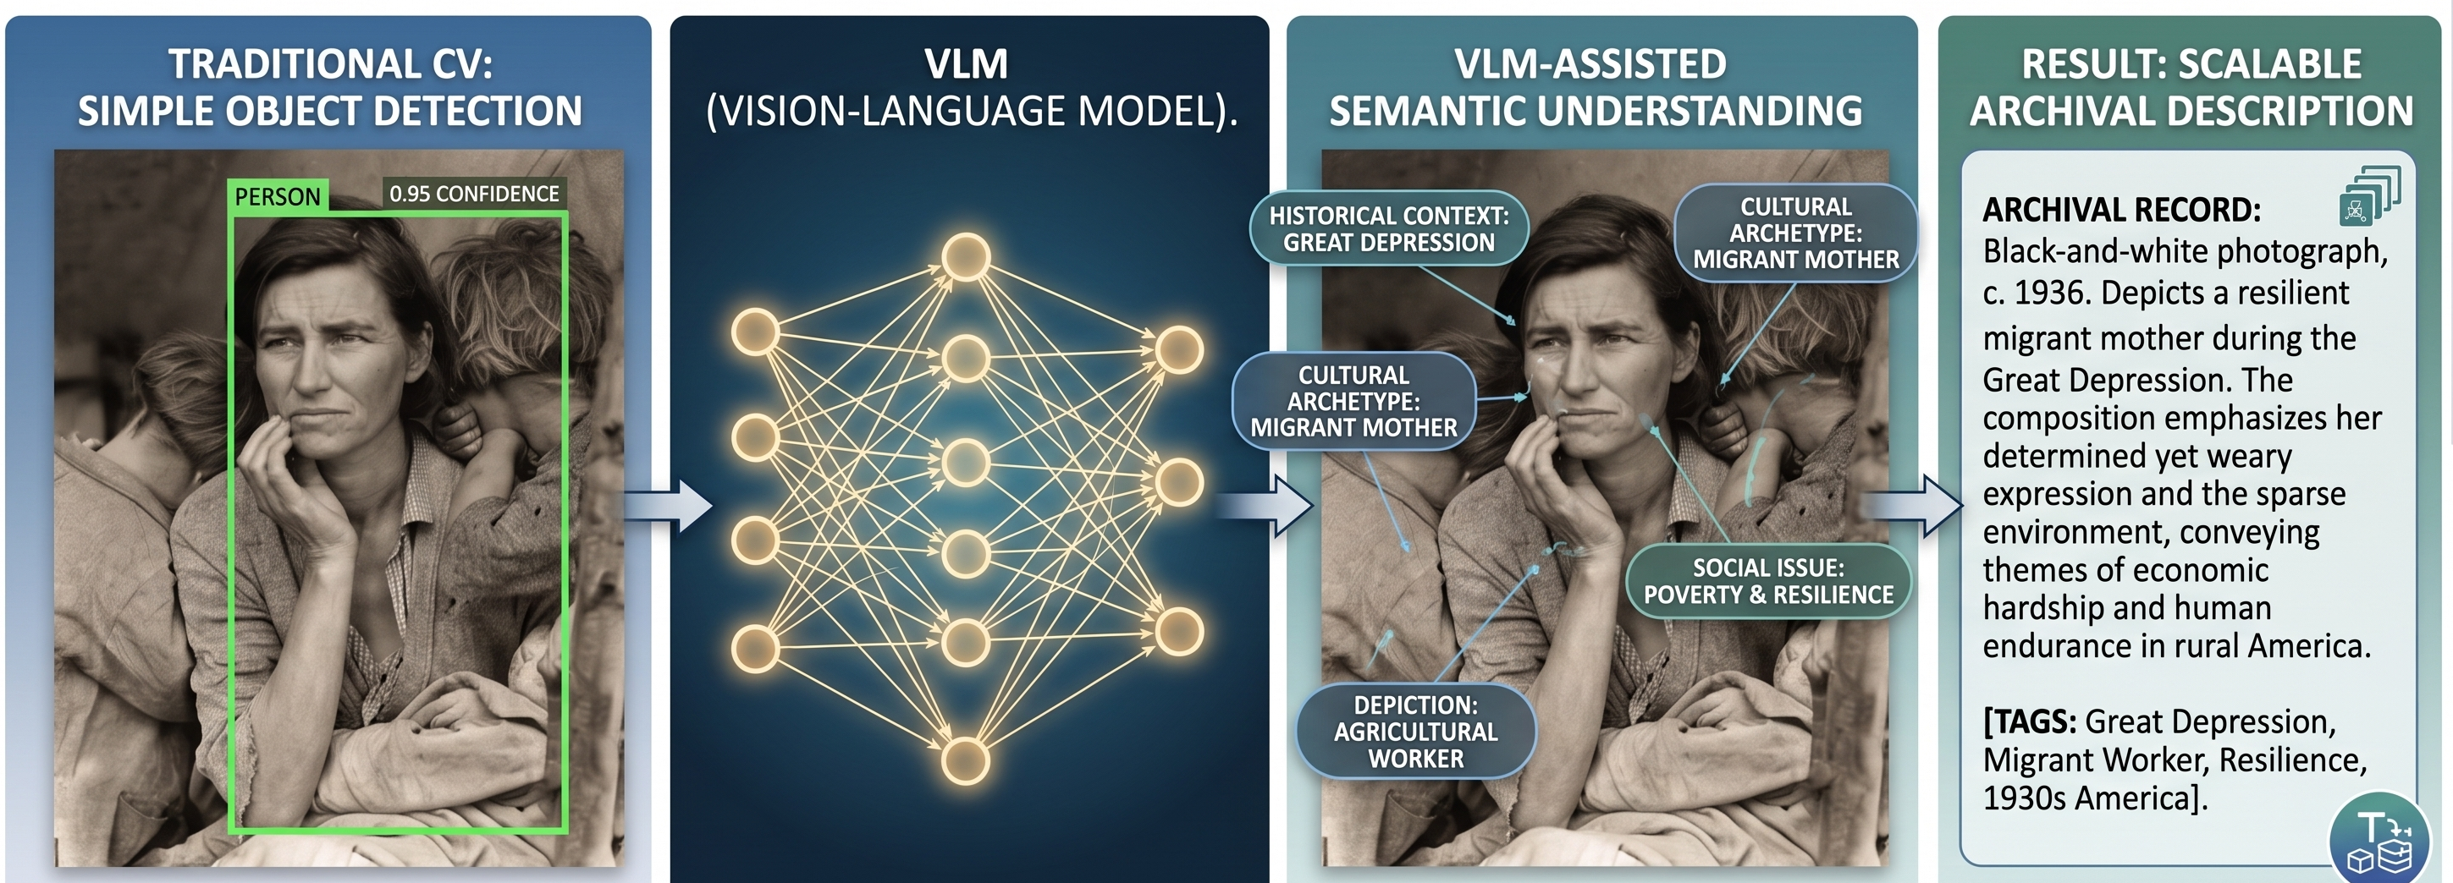
MOVING BEYOND SIMPLE OBJECT DETECTION

Slide 10
COMPLEXITY OF ARCHIVAL IMAGES: CHALLENGES
Physical Degradation & Noise:
Many archival images suffer from fading, physical damage, or digital artifacts. These requiring high robustness from VLMs.
Semantic & Contextual Depth:
Requires capturing deep semantics rather than only identify objects.
Domain-Specific Knowledge Needs:
Requires professional cataloging skills and knowledge.

Slide 11

AMBIGUITY, BIAS, AND VOCABULARY MISMATCH
SEMANTIC AMBIGUITY
HALLUCINATION
TRAINING DATA BIAS
A single image may legitimately warrant multiple valid subject terms across different facets (topic, geography, period, form), making definitive classification difficult.
Generative VLMs may produce highly confident but factually incorrect descriptions, inventing details that do not exist in the original archival image.
Inherent bias in training data can lead to the misrepresentation of non-Western, historical, or marginalized communities, perpetuating harmful stereotypes.
VOCABULARY MISMATCH
PRIVACY & COPYRIGHT
The natural language output of VLMs often diverges from strict institutional controlled vocabularies, requiring robust semantic matching and post-processing.
Using cloud-based VLM APIs raises significant concerns when processing sensitive, restricted, or copyrighted archival materials outside institutional boundaries.

Slide 12

HUMAN-AI COLLABORATION
CONFIDENCE SCORES
Surface model certainty to help prioritize cataloger attention on ambiguous or difficult cases.
TRANSPARENCY
HUMAN-IN-THE-LOOP
Clearly document AI-generated metadata in catalog records to maintain provenance and trust.
The recommended deployment model where VLMs generate candidate subject terms and trained catalogers review, accept, modify, or reject them.
BIAS AUDITS
Conduct regular reviews of VLM outputs to protect against harmful, inaccurate, or exclusionary descriptions.
MULTIMODAL CONTEXT
Combine image analysis with existing textual metadata (finding aids, donor notes) to significantly improve accuracy.

Slide 13
Part2: VLM Foundations

Slide 14
VLMS LEARN TO UNDERSTAND IMAGES AND TEXT SIMULTANEOUSLY
A Vision-Language Model (VLM) is a multimodal deep learning model trained on large datasets of paired images and text. Unlike traditional computer vision models, VLMs can generate free-form text descriptions, answer questions, and reason across modalities.
CORE ARCHITECTURE
1. Image Encoder
Extracts visual features (e.g., Vision Transformer)
↓
Trained on millions of image–text pairs to build shared understanding.
2. Multimodal Projector
Capable of image captioning, visual question answering, and classification.
Aligns image and text representations
↓
Can handle unseen categories without retraining.
3. Language Decoder
LIP-2
LLaVA
GPT-4V
Generates textual output (e.g., Large Language Model)

Slide 15
CORE ARCHITECTURE: THE THREE-PILLAR MODEL
1. IMAGE ENCODER
2. MULTIMODAL PROJECTOR
3. LANGUAGE DECODER
Vision Transformer (ViT) divides images into patches and encodes them into high-dimensional feature vectors.
Q-Former or linear projector bridges vision and language embedding spaces, aligning visual features with text tokens.
Large Language Model (LLM) generates text conditioned on both the aligned visual features and any text prompt provided.
▶
▶

Slide 16
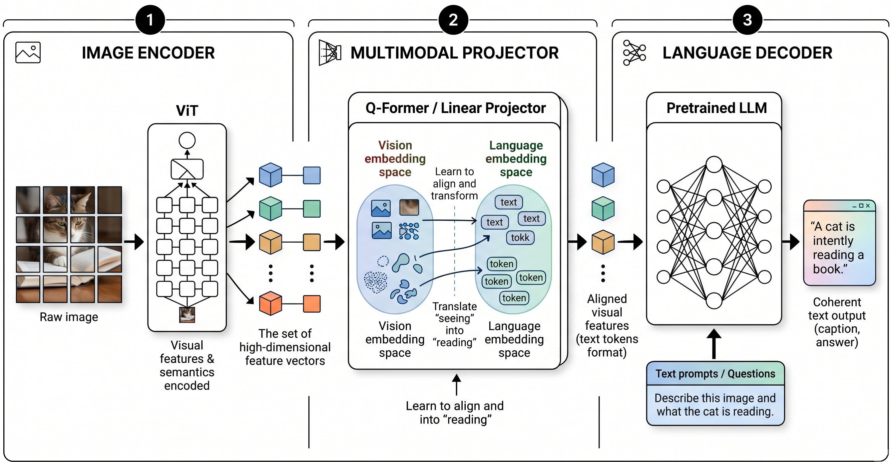
CORE ARCHITECTURE: THE THREE-PILLAR MODEL

Slide 17
INFORMATION REPRESENTATION: MULTIMODAL ALIGNMENT
Joint Vector Space:
VLMs map images and text tokens into a shared mathematical vector space via contrastive learning.
Translation from Pixels to Semantics:
The multimodal projector convert pixel logic from the image encoder into semantic tokens for the language decoder
Attention in Archival Analysis:
The model uses attention mechanisms to locate visual cues in complex scenes and align them with specific subject terms.

Slide 18
IMAGE ENCODER: FROM PIXELS TO VECTORS
Vision Transformers (ViT) in Action (The “Eyes”)
Acts as the system's visual cortex
Breaking down complex photographs into mathematical representations
Identifying key visual patterns.

Slide 19
MULTIMODAL PROJECTOR: BRIDGING THE SEMANTIC GAP
Aligning Vision and Language Spaces (The "Translator")
Acts as the crucial intermediary that translates pixel-based visual logic into text-based semantic logic.
Employs structures to map abstract image vectors directly onto the LLM's existing embedding space.
Aligns visual features with text tokens

Slide 20
LANGUAGE DECODER: THE ENGINE OF GENERATION
Text Generation(The "Brain")
Uses LLMs (like Llama or Qwen to understand historical context, relationships, and nuanced instructions.
Combine the visual tokens with specific user instructions.
Synthesizes these inputs to generate final text.

Slide 21
VLMS
MODEL
DEVELOPER
KEY STRENGTH
ARCHIVAL RELEVANCE
CLIP
OpenAI (2021)
Contrastive image-text matching
Zero-shot image search by subject term
BLIP-2
Salesforce (2023)
Bootstrapped language-image pretraining
Detailed image captioning
UW / Microsoft (2023)
Instruction-following visual chat
Conversational subject description
LLaVA
InstructBLIP
Salesforce (2023)
Instruction-tuned captioning
Structured metadata generation
GPT-4V
OpenAI (2023)
Broad reasoning and OCR
Complex archival document analysis
Alibaba Cloud (2023)
Open-weight architecture.
Secure local deployment
Qwen-VL

Slide 22
RESPONSIBLE AI: FROM TECHNICAL IMPLEMENTATION TO ETHICS
Challenges Beyond Automation:
Semantic ambiguity, model hallucinations, and inherent biases in training data.
Security and Privacy:
Protecting the privacy of sensitive collections, ensuring copyright compliance, and localized security architectures to prevent data leaks
The Mission:
Building a secure, transparent, and culturally sensitive AI-assisted framework for the community.

Slide 23
Part3: Prompt Engineering and Archival
Applications

Slide 24
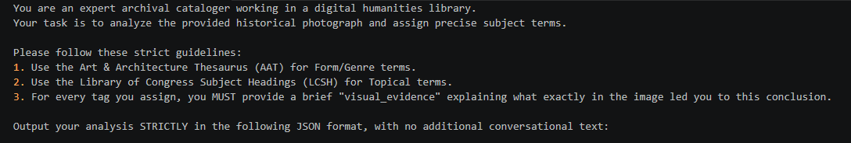
PROMPTING STRATEGIES FOR ARCHIVES
Zero-shot learning:
Directly asking the VLM to describe images.

Slide 25
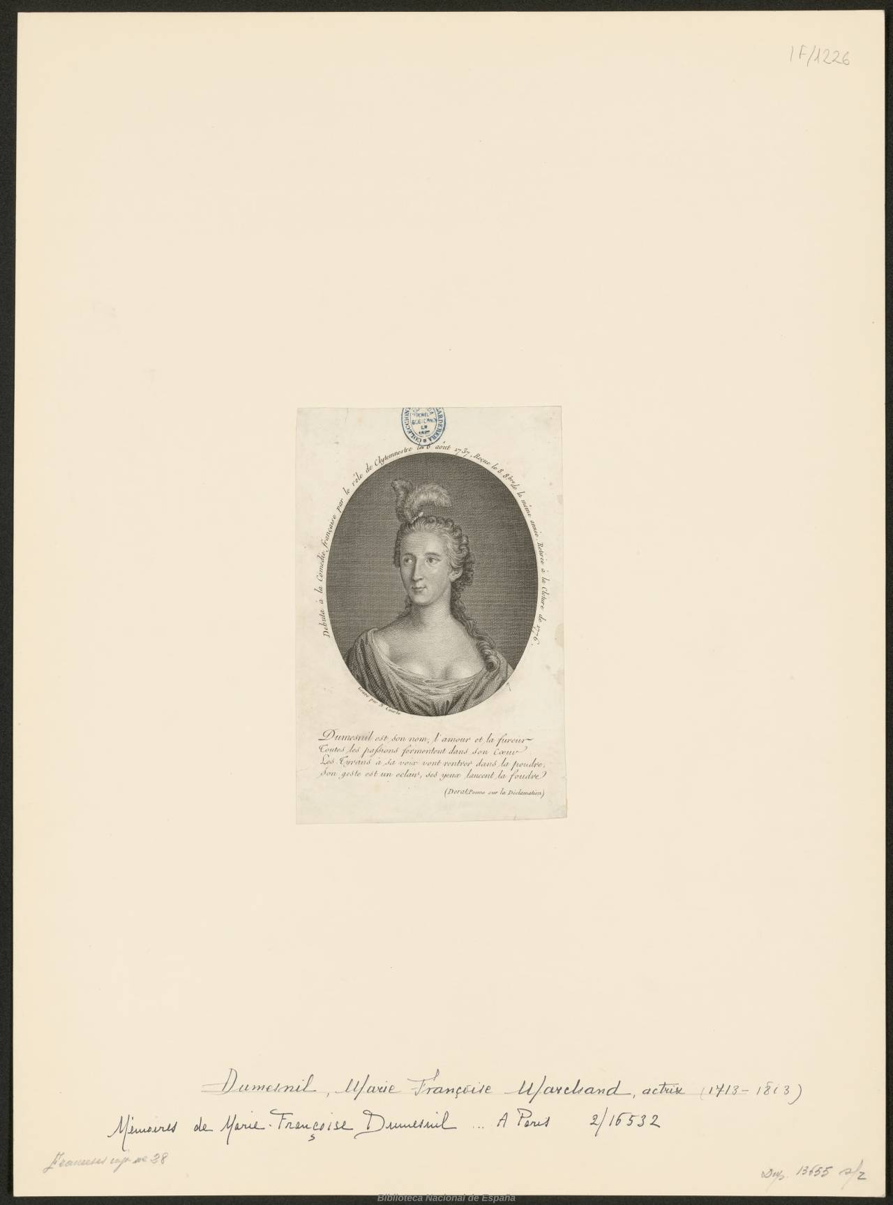
ZERO-SHOT LEARNING
Zero-shot prompt
Actrices; Grabados de retrato; Grabados de puntos

Slide 26
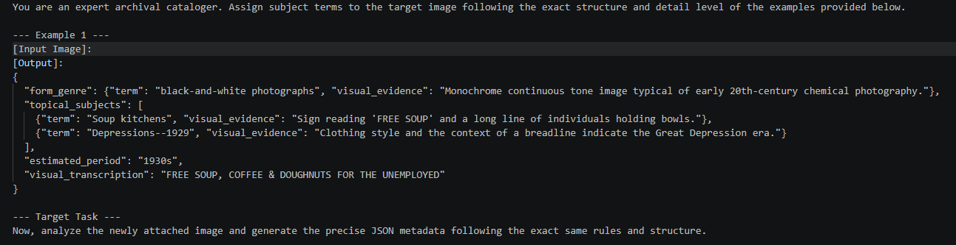
PROMPTING STRATEGIES FOR ARCHIVES
Few-shot learning:
Providing 2-3 "image-cataloging" pairs as examples to enhance understanding of specific styles

Slide 27
FEW-SHOT LEARNING
Few-shot prompt
Buriles; Grabados de retrato
Example1
Example2

Slide 28
DOMAIN-SPECIFIC FINE-TUNING
Overcoming Generic Model Limitations:
Generic models often fail to align with highly specialized institutional taxonomies or controlled vocabularies
Parameter-Efficient Fine-tuning (PEFT):
Using techniques like LoRA (Low-Rank Adaptation) or adapter layers allows for high-performance gains with minimal computational resources.

Slide 29
Part4: Demo Showcase

Slide 30
ENVIRONMENT SETUP & HARDWARE REQUIREMENTS
Software Stack:
Programming Language: Python.
Core Libraries: PyTorch (Deep Learning Framework), Transformers (Model Loading), Accelerate (Multi-GPU Acceleration)
Hardware Recommendations:
GPU: A graphics card with at least 24GB of VRAM.
Memory: 32GB+ RAM.
Deployment Mode:
API or local private deployment.

Slide 31
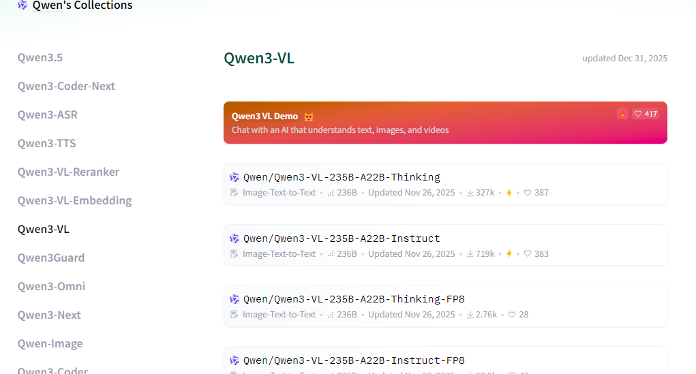
MODEL ACQUISITION
The Model Hub:
Access huggingface.co to search for open access VLM models.
Downloading Weights & Parameters:

Slide 32
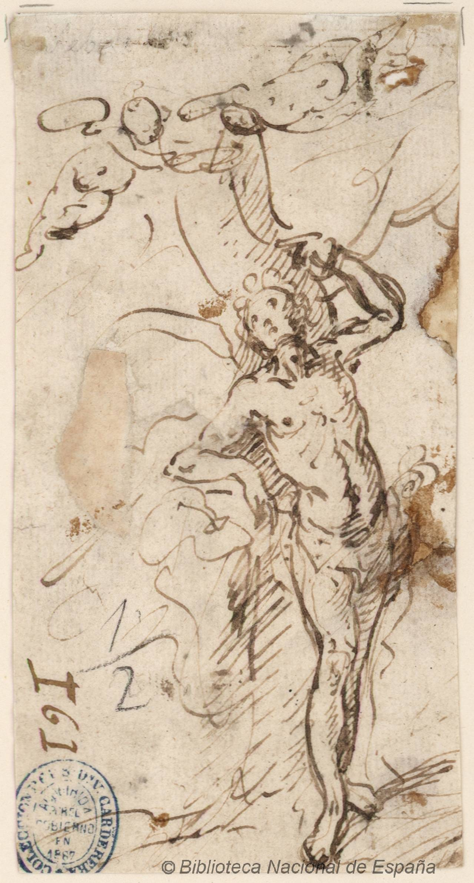
EXAMPLE USING VLM
San Sebastián
1. Document Type and Technique:
This image displays a vertical…
Prompt: Act as an expert visual cataloger…

Slide 33
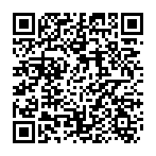

Slide 34
Thank you!

