Slide 1
Lab: Concurrent and Distributed Systems Himeno Benchmark and Mandelbrot Set
Colloquium
Fritz Louis Wilke
fritz.wilke@tu-dresden.de
4536116
M. Sc. Computer Science

Slide 2
Agenda
The Mandelbrot Set
Problem
(Unoptimized) Algorithm
Optimizations
Evaluation
The Himeno Benchmark
Problem
(Unoptimized) Algorithm
Optimizations
Evaluation

Slide 3

The Mandelbrot Set
https://commons.wikimedia.org/wiki/File:Mandel_zoom_00_mandelbrot_set.jpg

Slide 4

Problem The Mandelbrot Set
Set of complex numbers
$z_{0}≔0$
$z_{n+1}=z_{n}^{2}+c$
$M=\left\{c∈ℂ | \left|z_{n}\right|≤2 ∀n∈ℕ\right\}$
$c$ depends on pixel coordinate in image

Slide 5
Unoptimized Algorithm The Mandelbrot Set
input: uint rows, uint cols, uint nn
output: char[]
begin
let img = char[rows][cols]
for r in 0..rows:
for c in 0..cols:
let z = complex(0, 0)
let n = 0
while |z| < 2.0 and n < nn:
z = z*z + complex( c*2 / cols – 1.5, r*2 / rows – 1.0 )
n = n + 1
img[r][c] = (n == nn) ? ´#´ : ´.´
for r in 0..rows:
for c in 0..cols: print( img[r][c] )
print( ´\n´ )
end

Slide 6
Optimizations The Mandelbrot Set
General:
Simplifying calculations
Working directly with floats instead of std::complex<float>
Storing and reusing interim results
Aligning data structures to fit cache lines
Working on continuous memory (as image)
Parallelization:
Parallelize the pixel calculation (cols loop)
Provide work dynamically via queues
Each worker thread has one input- and output queue

Slide 7

Parallel Workflow The Mandelbrot Set
calculate
pixel
INPUT QUEUE
WORKER THREAD
OUTPUT QUEUE
INPUT THREAD
INPUT QUEUE
WORKER THREAD
OUTPUT QUEUE
OUTPUT THREAD
pull pixel
results
push pixel
numbers
INPUT QUEUE
WORKER THREAD
OUTPUT QUEUE

Slide 8
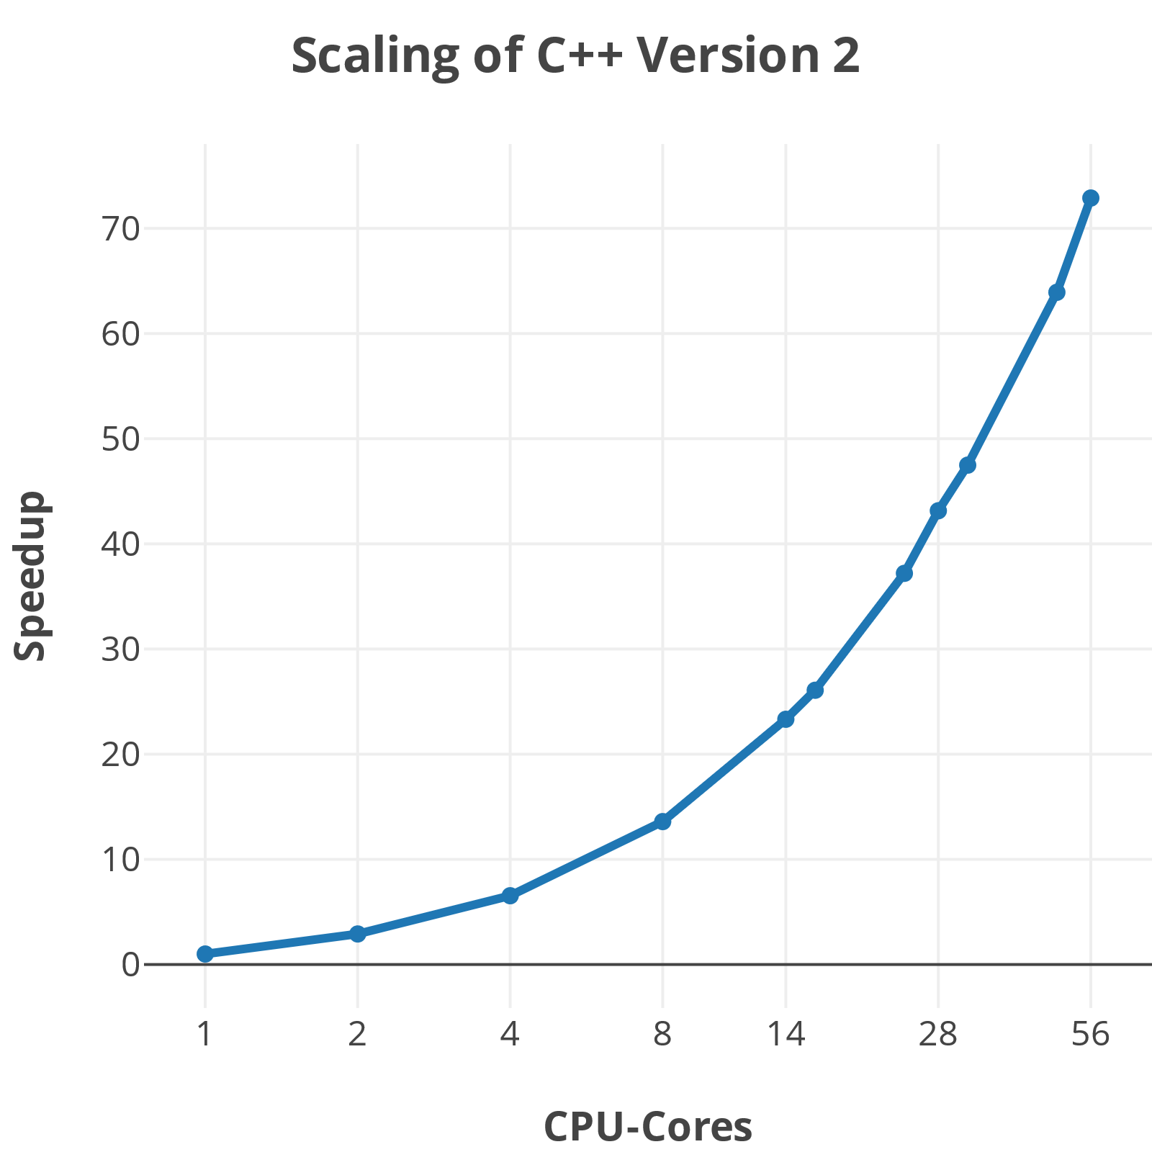
Evaluation The Mandelbrot Set
Unoptimized code as reference
C++ and C#
Scaled very well
No decline at 16 or 32 cores
Scales over 100% (cannot calculate parallel code)
Lang. | V | Measure. | Time | Abs. | Rel.
C++ | 0 | Unmodified | 207050 | 1x | 1x
 | 1 | I/O Threads | 2182 | 86x | 83x
 | 2 | + Simplified | 263 | 716x | 73x
C# | 0 | Unoptimized | 63332 | 1x | 1x
 | 2 | Both | 452 | 146x | 1798x

Slide 9
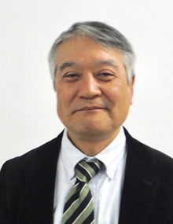
The Himeno Benchmark
http://www.isum2017.udg.mx/es/contenido/dr-ryutaro-himeno

Slide 10
Problem The Himeno Benchmark
A benchmarking program
Extremely memory intensive
Uses the Jacobi method for calculations
Works on several 4D-Matrices, where first 3 dimensions are same size

Slide 11
Unoptimized Algorithm The Himeno Benchmark
input: uint rows, uint cols, uint deps, uint nn
output: float
begin
initialize_matrices()
let gosa = 0.0
for n in 0..nn:
for r in 1..rows-1:
for c in 1..cols-1:
for d in 1..deps-1:
let ss = jacobi_iteration(r, c, d)
gosa += ss*ss
wrk2[0][r][c][d] = p[0][r][c][d] + 0.8*ss
wrk2.copy_to(p) // copy content of p to wrk2
print( gosa ) // print result (with a precision of 6)
end

