Slide 1
Fire Detection YOLOv8
Project Final AI Bootcamp

Slide 2
Objective
Spot Fires Quickly: The model aims to swiftly detect fires in images or videos, helping to catch potential dangers early on.
Get it Right: It's designed to accurately identify fires, even if they're partially hidden or in tricky lighting, to reduce false alarms and ensure safety.
Work Fast Everywhere: We're creating a model that can process lots of visual data quickly, so it can be used in many places like security cameras, factories, or forests to keep an eye out for fires.

Slide 3
Datasets
Datasets consist of 2509 images. For training 1004 images, valid 751 images and test 754 images. Resize it to 640 px by the model.
Link to the dataset: continuous_fire Image Dataset

Slide 4
YOLOv8 model
This model used YOLOv8n.pt from pretrained model with detection task to detect any object that has been trained with, in this case the model has been trained by fire images. The output of this model is to detect fire via image or video inputs. YOLOv8 based on CNN model to extract the features of an image.
Link to model: https://docs.ultralytics.com/models/

Slide 5
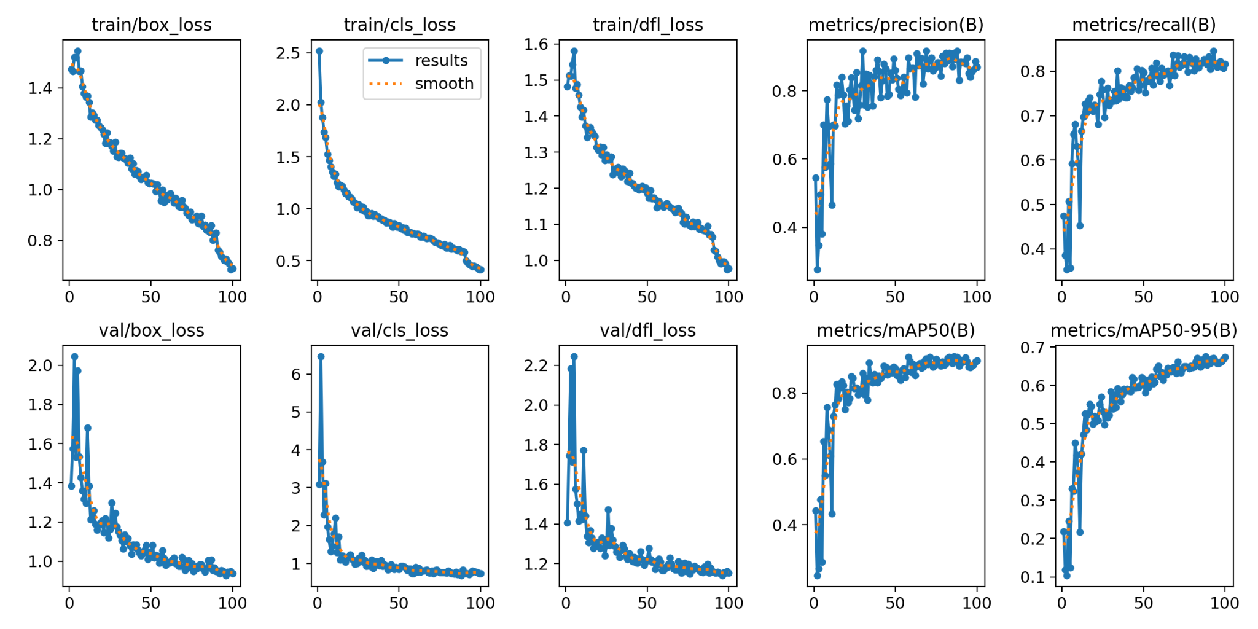
Training Result
Model trained on 100 epochs, image size 640 and batch size 8

Slide 6
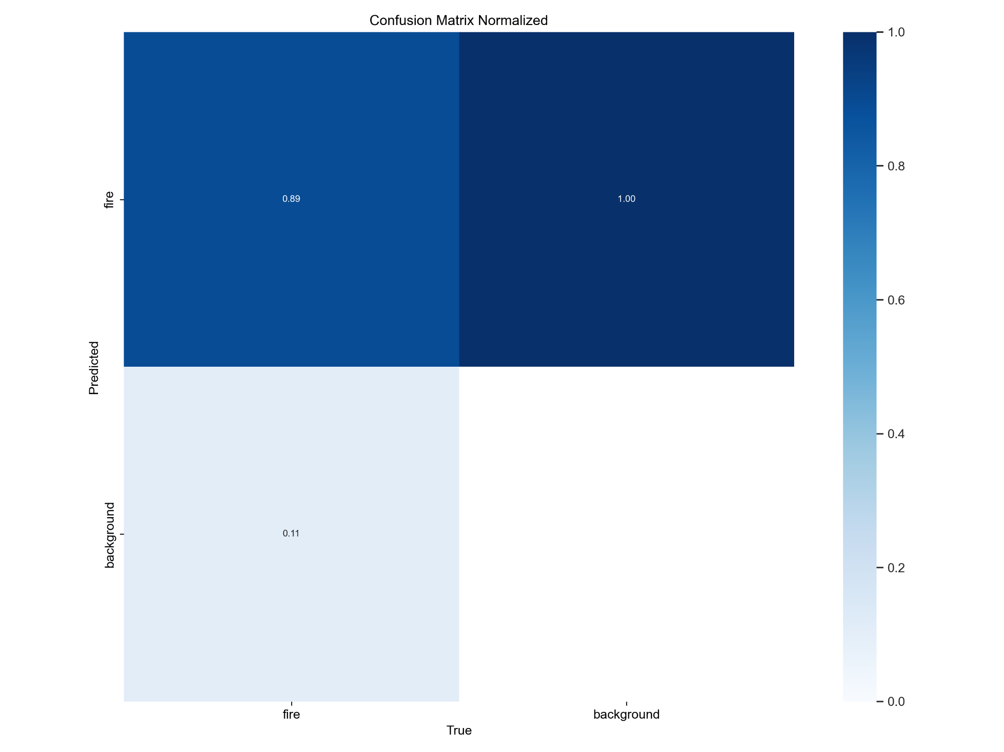
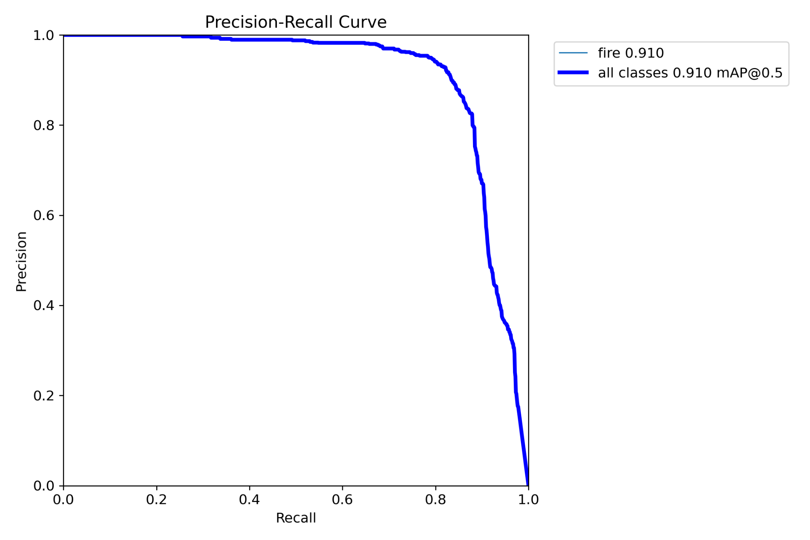
Validating Result
Model trained on 100 epochs, image size 640 and batch size 8

Slide 7
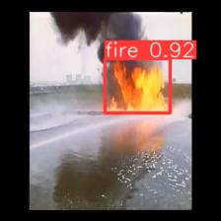
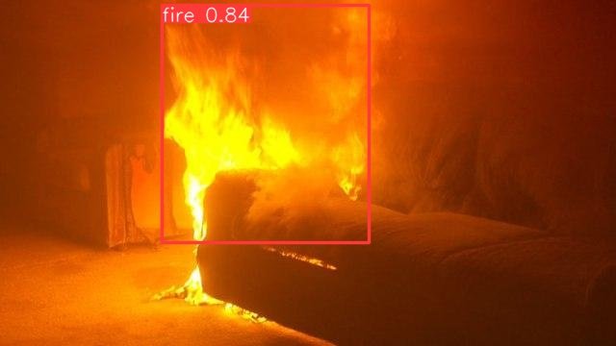
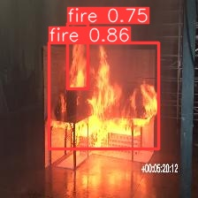

Slide 8

Demo:
Fire Smoke Detector - a Hugging Face Space by SoulPerforms

