Slide 1

Casa De Diamantes
Pitch Deck

Slide 2
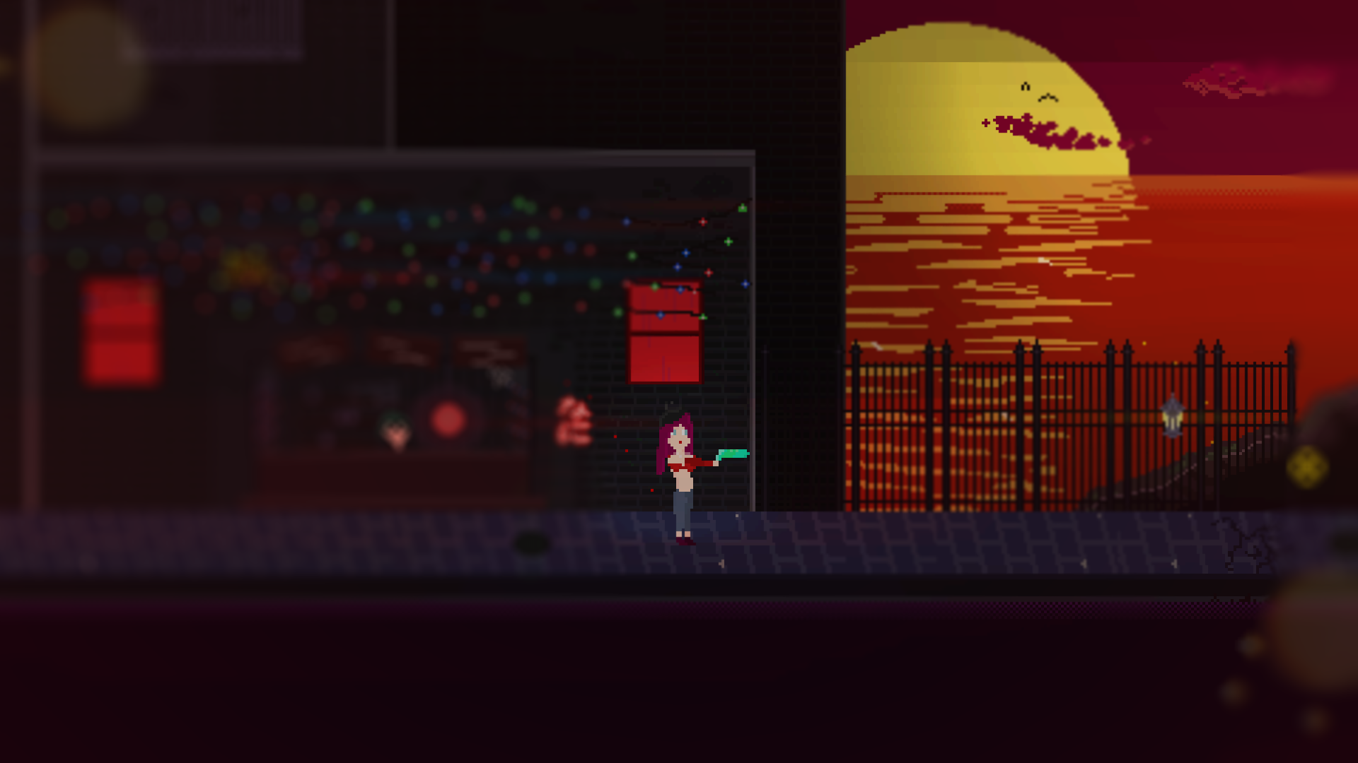
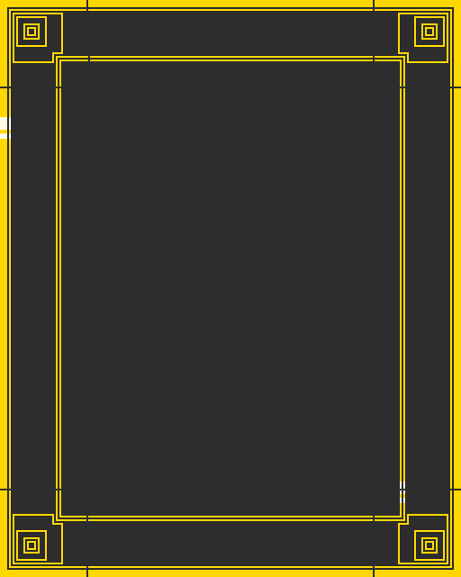
ABOUT
Casa De Diamantes is a 2d shooter with a focus on quick and momentum-based movement, aggressive and dangerous battle arenas and exploring an interconnected world full of characters and secrets.
You are playing as Steph, a former prostitute who grew up in a rough neighborhood, looking for a new career in the Casa De Diamantes.
The Casa De Diamantes is a huge casino and one of the last safe places on earth where people come to gamble and drink their problems away.

Slide 3
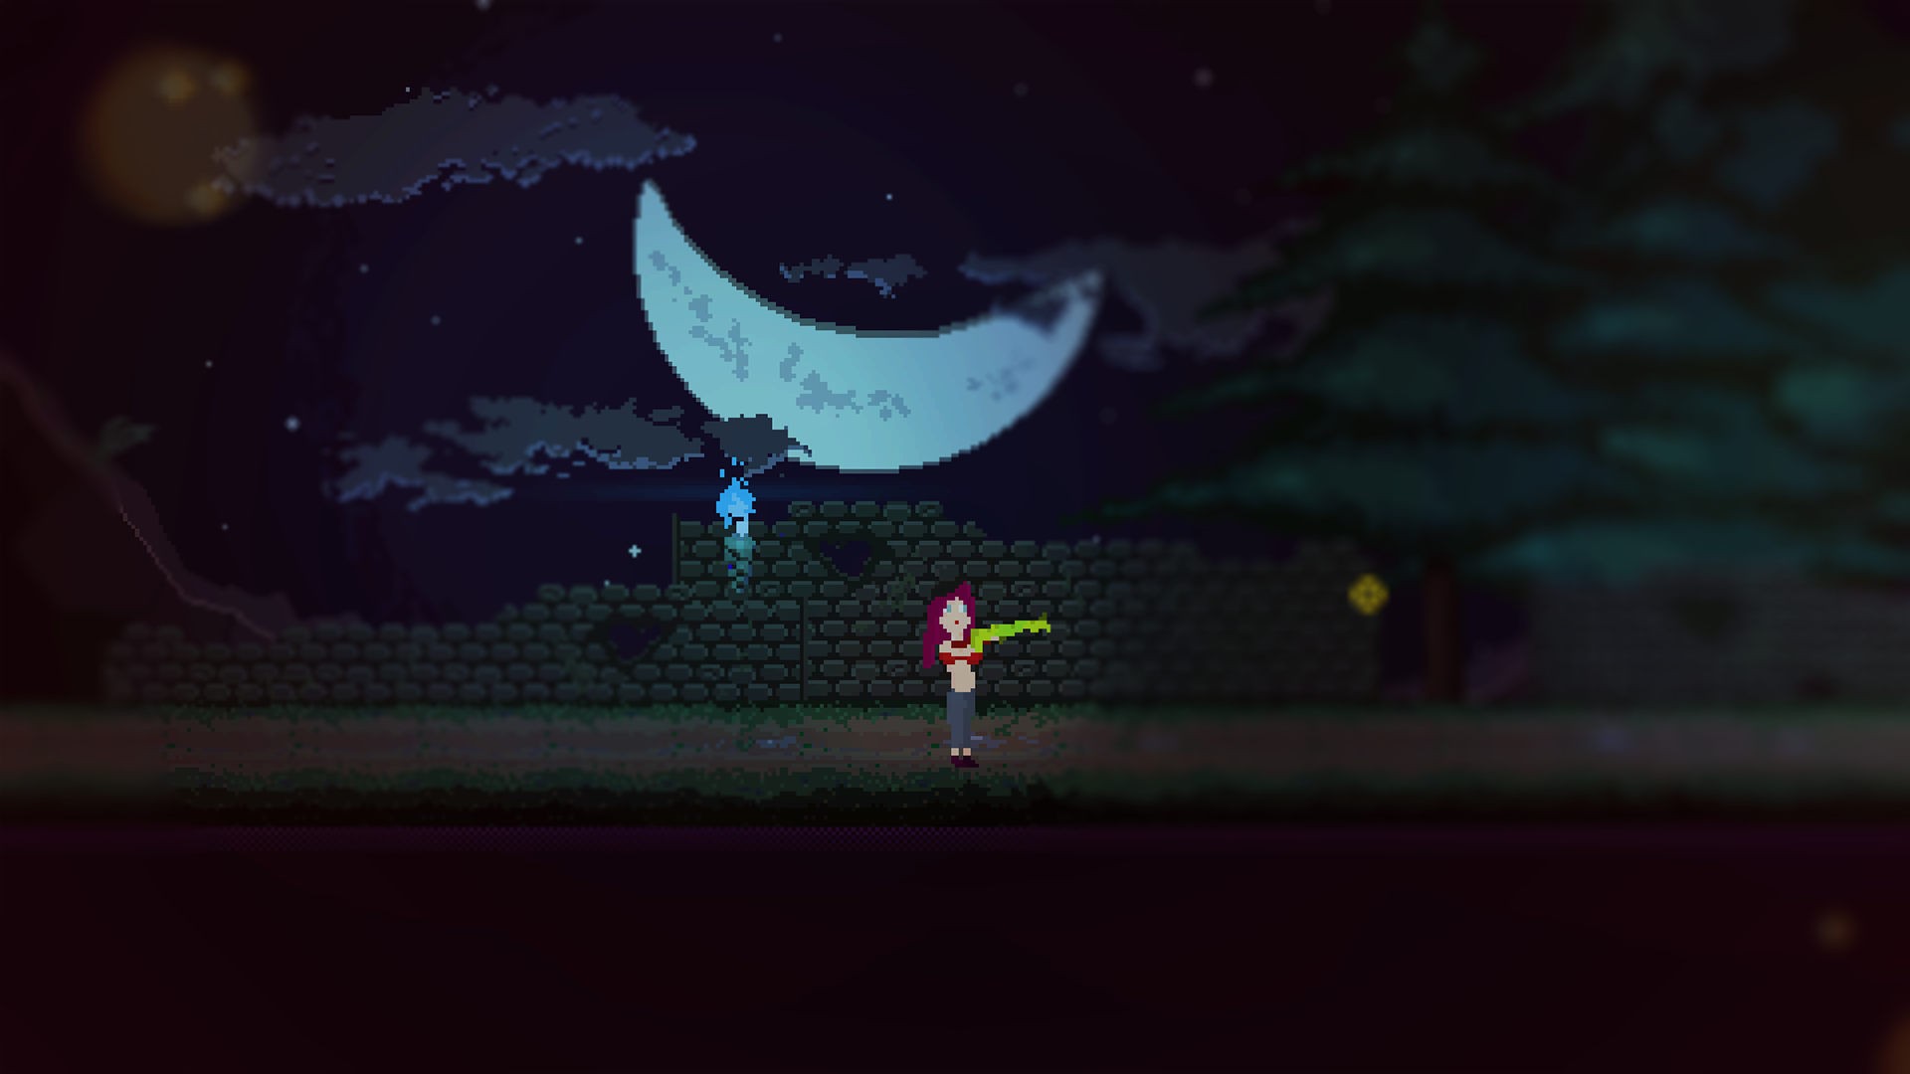
FEATURES
- Quick momentum-based movement
- Tight and satisfying shooter mechanics
- Different enemy types with diverse behavior and movement
- Characters with various quests and intentions
- Controlled dialogue scenes where the player decides the outcome
- Gambling and the use of your earned money for cosmetics and upgrades

Slide 4
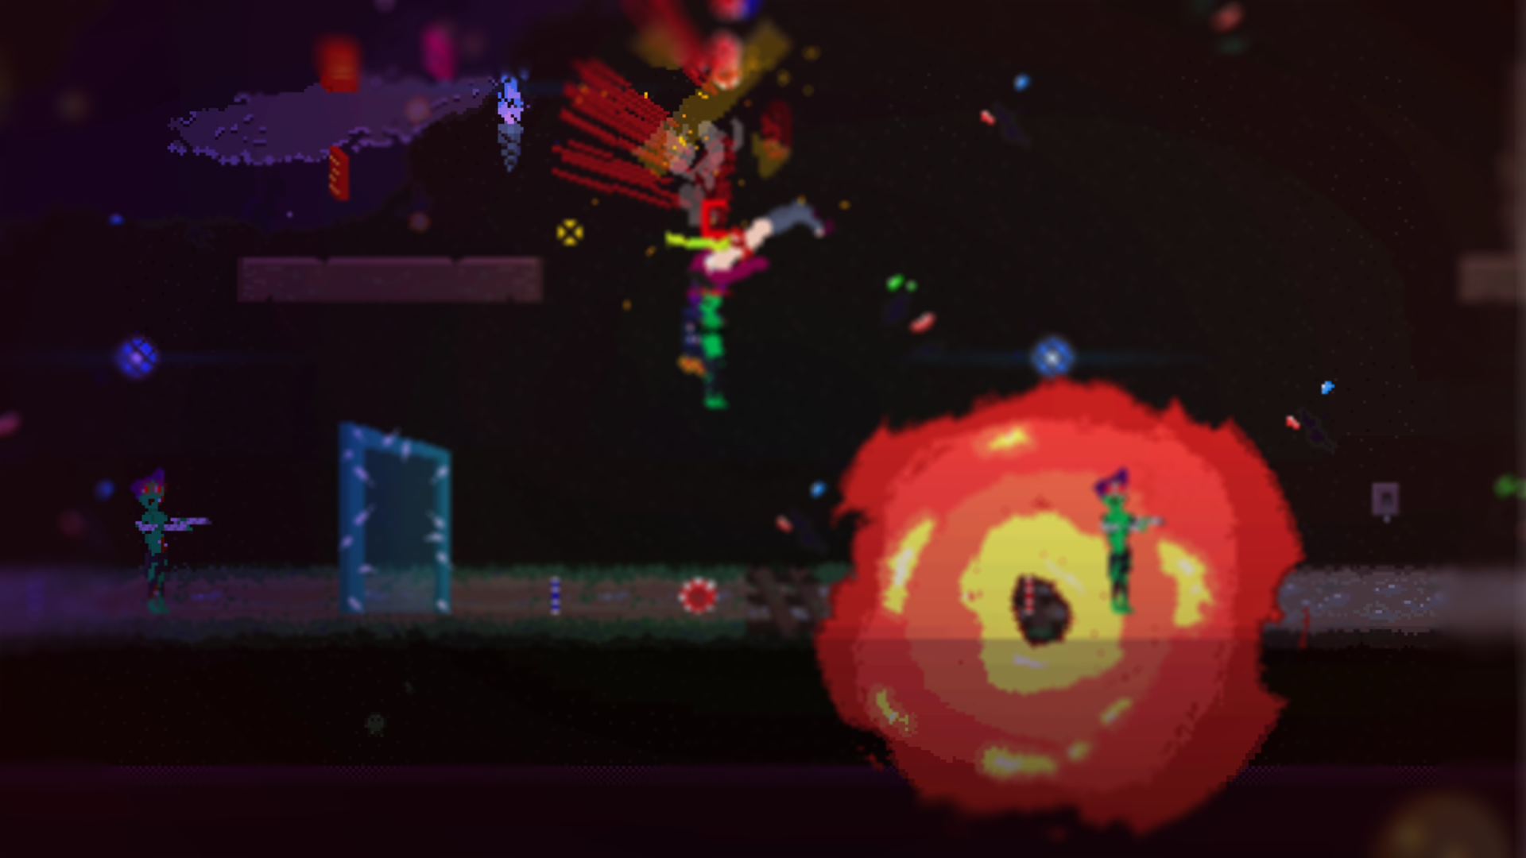
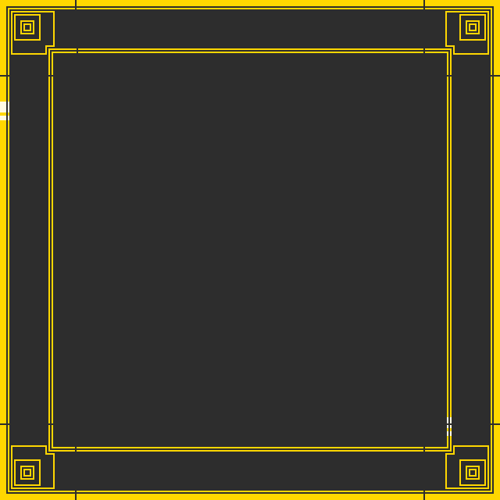
PRODUCTION
The current state of the game was developed by myself. I worked on it for 14 months in my free time. A huge chunk of the development time was used to develop the technical side of Casa De Diamantes. The content creation from this point on will be much faster.
The plan is to implement enough stages with diverse environments to be able to create a connected world. Every stage will be reused for multiple contracts and quests. The final playtime will also depend a lot on the usage of movement. But a 3–5-hour long adventure sounds reasonable.
A production time of around 24 months sounds reasonable but this is also our first game pitch, so we are definitely unexperienced. But we are making it up with out extreme motivation and love for the medium.

Slide 5
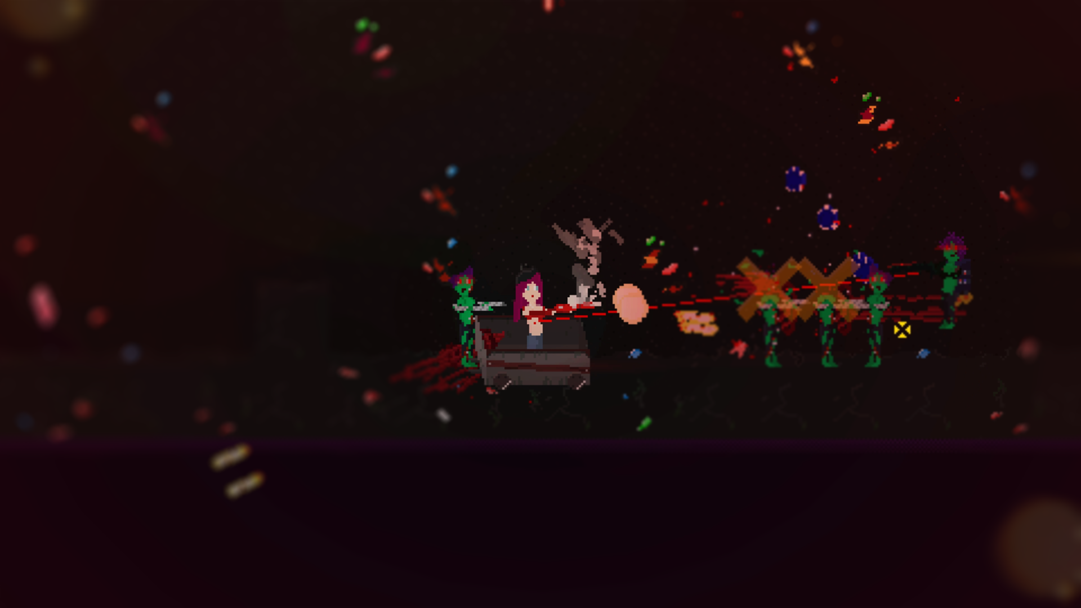
TEAM
Me and two of my friends have a passion for videogames and art in general. They were supporting me a lot during development. And now is the time where we all start fulltime development to finish the game.
William Djalal
- Lead Programmer, Lead Designer
A. Alkan Akarsu
- Gameplay Designer, Project Manager
Jana Lel
- Artist, Concept Artist

Slide 6
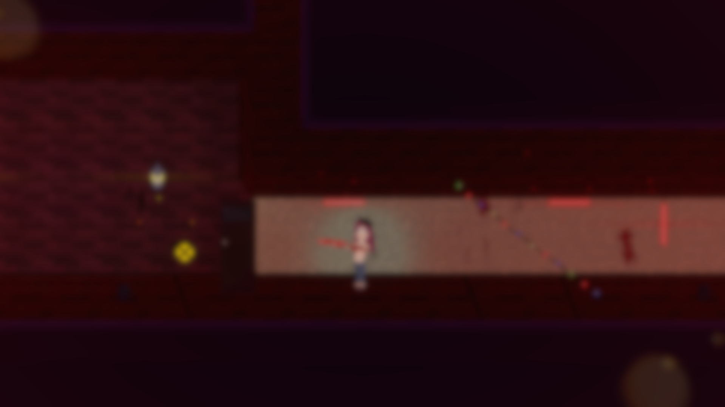
Thank you for your interest!

