Slide 1
Multithreading in PintOS
Ben Dunko, Wyatt Muller,
Lucas Nunn, Tayseer Hannan
Notes:
Lucas
Good morning. I’m Lucas, and these are my partners Ben, Wyatt, and Tayseer. We are presenting our open ended project: Multithreading in Pintos.

Slide 2
Introduction
By default, PintOS supports multiple threads running on multiple CPUs
But each process only contains 1 thread
Goal: Enable a single process to start and manage multiple threads
Splitting the monolithic thread control block into two parts - a process control block and a thread control block
System Calls to create and join threads
Adding user-level synchronization mechanisms
Adding user-level dynamic memory
Notes:
Lucas
In PintoOS, the kernel itself is multithreaded; it supports multiple processes running on multiple CPUS.
It has built in synchronization primitives and dynamic memory allocation.
User programs running on PintOS, however, do not have these luxuries.
The premise of our open ended project, was thus to add kernel support for multithreaded user programs; the goal being to write useful user programs that can create and manage multiple threads.
Support for multithreading required creating a distinction between processes and threads, one that initially didn’t exist, as well as new system calls for creating and joining threads.
To allow for actual useful and interesting programs, we created user level synchronization mechanisms and added user level dynamic memory allocation.

Slide 3
Splitting Thread
Base implementation: struct thread contains both thread and process specific information
No distinction between a process and a thread
Added a struct process
Contains a list of threads that this process contains
Contains shared information such as file descriptors
Modified thread_exit and process_exit accordingly.
Threads no longer call process_exit as part of thread_exit, instead process_exit is called when the last thread of a process exits.
Notes:
Wyatt:
The base implementation you are all familiar with contains only struct thread, since there is no distinction between a thread and a process
The first challenge we had to tackle was splitting these structs
This was done by identifying the fields that should be shared amongst threads, which largely includes file descriptors and the page directory
Other fields such as vruntime, for scheduling, the stack, status, and list of children are per thread
A pointer to the process is kept within the thread struct, and a list of threads is kept within the process
This allows threads to still access all of the shared resources
All of this means we had to modify the exit and create methods for both thread and process to take care of the proper fields
Logically, we switched process_exit to only be called when the last thread of that process exits

Slide 4
System Calls: Threads
Added 3 new system calls: thread_create, thread_join, thread_exit
int thread_create(void function (void * aux), void * aux)
Creates a new thread which will run the given function
Allows passing a void * parameter to the new thread
Returns the id of the created thread, for use with thread_join
int thread_join(int id)
Waits for the given thread to exit, then returns the exit code for that thread
Disallows joining a thread that was not created by the calling process
void thread_exit(int exit_code)
Terminates the calling thread with the given exit_code.
Notes:
Wyatt:
The first set of system calls we made allows the user to create, join and exit threads
System calls are added on the user and kernel sides, linked by their system call number
Thread_create mainly consists of two parts:
Setting up a stack in which we store the passed in function pointer and arguments
And calling thread_create with an added process argument to set up the thread’s pointer
This then returns the threads id number which is stored by the user for the thread_join system call
Join takes this id, iterates over the process’ thread list to find the one it is looking for, and waits on a semaphore down to obtain the return code
If the thread was not created by the calling process, join exits
The syscall for exiting a thread simply calls thread_exit with the given exit code

Slide 5
System Calls: Synchronization
Multithreaded user programs often need synchronization mechanisms to do useful work.
Added systems calls to create and use synchronization mechanisms (locks, semaphores, and condition variables)
int lock_init(), void lock_acquire(int), void lock_release(int)
int sema_init(), void sema_up(int), void sema_down(int)
Int cond_init(), void cond_wait(int), void cond_signal(int), void cond_broadcast(int)
The init functions return a “synchronization descriptor” number.
Numbers map to synchronization mechanisms inside the kernel
User does not have direct access to locks, semaphores, or condition variables
Notes:
Ben

Slide 6
Dynamic Memory
Multithreaded user programs often need dynamic memory allocation to do useful work.
Added a malloc and free implementation to the user library
Transferred over implementation from CS 3214: Computer Systems
Implemented sbrk system call
Added heap indices to process control block
Set heap start during program loading
Notes:
Lucas
In order to achieve anything useful, most programs need to make use of dynamically allocated memory on the heap. This holds true for multithreaded programs.
In order to carry out many important functions, such as using inodes, hash tables, bitmaps, an threads, the kernel has support for dynamic memory allocation.
User programs, however, are greatly constrained by the lack of a user level memory allocator.
To unlock the potential of our multithreaded user programs, we ported a malloc implementation written for CS 3214 to PintOS.
This required implementing the concept of heap space in our process control block, which initially didn’t exist.
We did this by tracking the executable data during program loading, and recording the start address of the heap.
Using this new heap space we implemented an sbrk system call, which allows user programs, specifically malloc, to allocate memory on the heap.

Slide 7
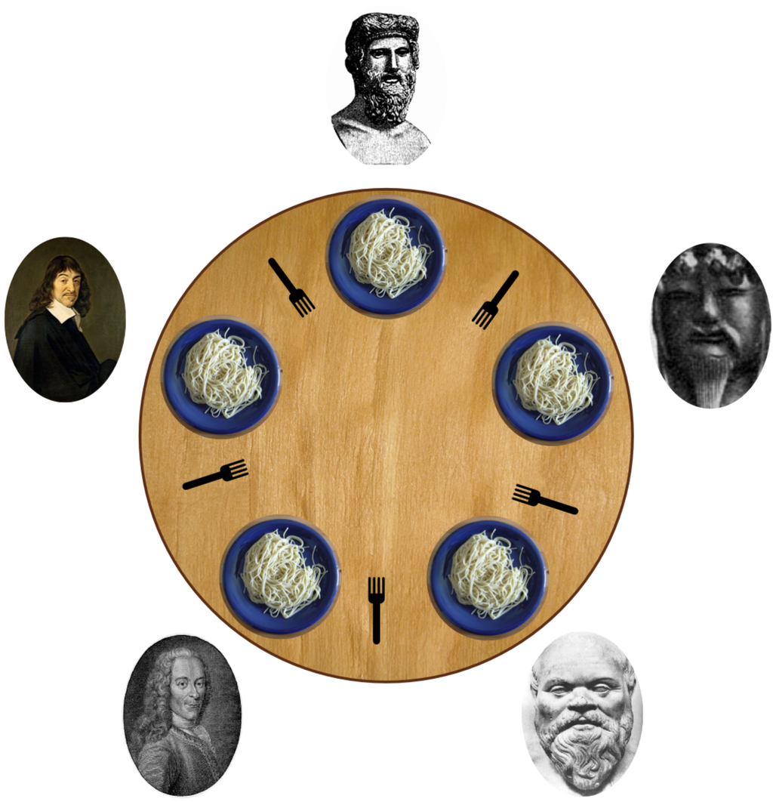
Demo: Dining Philosophers
Five philosophers sit around a circular dinner table.
Each philosopher has a fork to his left and to his right, shared with his neighbors.
The philosophers would like to eat from their plate of spaghetti, but require both forks in order to do so.
Dijkstra’s solution requires one lock, one semaphore per philosopher, and one state per philosopher.
Philosophers think for some amount of time, setting their state to Thinking.
Afterwards, philosophers set their state to Hungry
Philosophers attempt to pick up forks, blocking on semaphore if unable. If able, sets state to Eating.
After eating, the philosopher who just ate checks if the philosophers to his left and right now could eat, and if so, unblocks them and atomically sets their state to Eating.
Notes:
Ben

Slide 8
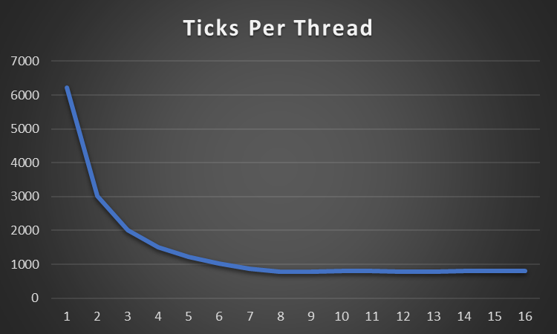
Demo: Simple Workers
Simple test program where workers increment a counter
Update shared counter every 1,000,000 additions.
Shared counter protected by lock.
Exit when shared counter reaches 999,999,999.
Total ticks required decreases as number of worker threads increases.
Notes:
Tay

Slide 9
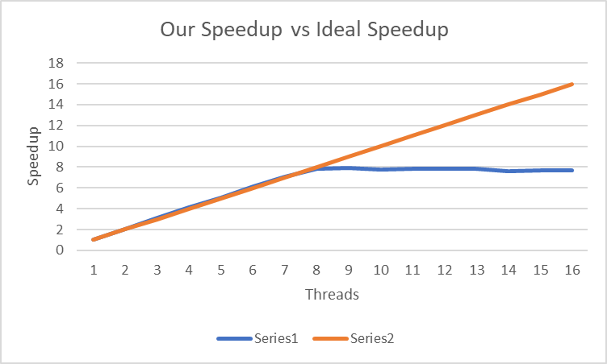
Speedup Continued:
Limitations to speedup, 8 cores available on pintos, thus max speedup seen at 8 threads.
Threads will compete for CPU time
Notes:
Tay

Slide 10
Limitations
Original exit system call doesn’t work with threads
Safely exiting each thread within a process is difficult
Some threads may be blocked on, for example, IO operations which will never complete
Synchronization through system calls is slow
Requires slow context switch, even for simple operations like taking an uncontested lock
Processes have a static stack size
Based implementation off of project 2, no stack growth
Notes:
Lucas
Although our additions allow for correct multithreaded user programs, there are some important limitations to keep in mind.
First, threads cannot use the default exit system call to exit the entire process, nor can they simply return at the end of their function.
We implemented a new system call, thread exit, to handle safe thread exiting.
Second, our synchronization mechanisms are implemented through system calls, mapping to kernel synchronization mechanisms. While correct, this is unfortunately rather slow, always requiring trapping into the kernel.
Finally, processes have a static stack size. This limits the usage of automatic variables, such as large arrays, in user programs.

Slide 11
Questions?
Notes:
Lucas
That concludes our presentation. We would now like to accept questions.

