Slide 1
Risk Online
The gaming bears
Caitlynd Krosch, Richard Baroni, Robert Ranseen

Slide 2

Our team
Caitlynd Krosch
Richard Baroni
Robert Ranseen

Slide 3
Our project: Risk
Risk is a strategy board game of diplomacy, conflict and conquest for up to six players.
Since its creation in 1957 by Albert Lamorisse, a French filmmaker, Risk has became one of the most popular board games in history.
Our application allows users to play Risk while also allowing profile customization and potential interaction with other players.

Slide 4
Features
What can our application do?
Lets a user create an account with which to play with
Lets a user buy and equip avatars for their profile
Lets a user play choose color to play as and number of opponents
Lets a user play risk
Lets a user save a game to come back to
Lets a user load a game to continue playing when they return

Slide 5
Taking a Look at the Design
Here we can put our diagrams and discuss how our front end communicates with our backend and our backend to our database
Front end react application
Backend spring boot application
MySQL database
Map made using inkscape, svg, jsx

Slide 6
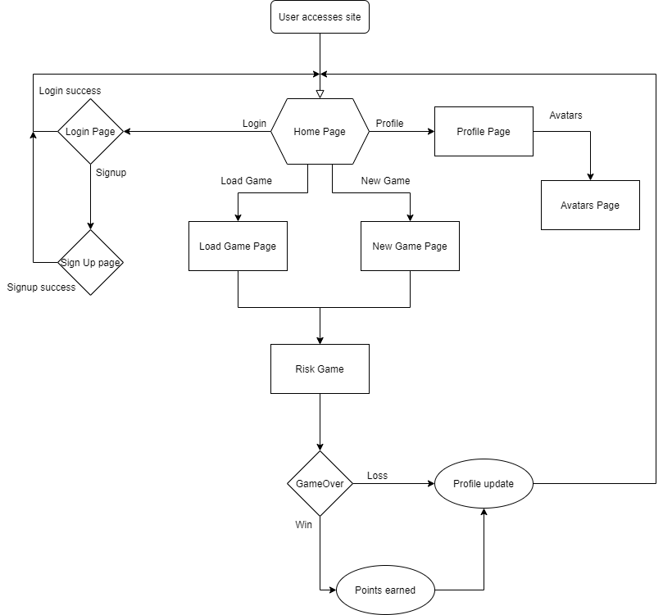

Slide 7
Demo Our App
Quick demo showing login in, avatars, then whatever gameplay we have working correctly

Slide 8
Challenges In Development
Here we should talk about the features we hoped to have made better, and why we were running into trouble in the allotted time.
CPU player moves
Resolving API calls
React Hooks
Mapping database to backend objects
Game state
Group design collaboration

Slide 9
Questions?

