Slide 1
CSC 244 • DATABASE SYSTEM DESIGN
FINANCIAL RISK
REVIEW
Role-based reviewers | SQL evidence | Human oversight
Phase 2 baseline + team presentation package
Team number and individual ownership: confirm before submission
NOVEMBER 2026

Slide 2
01 / PROBLEM
Problem and intended outcome
Review suspicious transactions without treating a risk flag as proof of fraud.
Accounting problem
Proposed solution
Human decision
A suspicious payment may have incomplete receipts, mismatched invoices, missing approval, or split amounts.
Four role-specific reviewers examine the same SQL evidence, then a Coordinator assigns a review priority.
An accountant sees evidence, votes and audit history, and records the final disposition.
Purpose: explainable triage of synthetic financial scenarios—not automated findings of fraud.
FINGUARD • SYNTHETIC DATA • VERIFIED REFERENCE BUILD
02

Slide 3
02 / STATUS
What is actually implemented?
Version supplied: Phase 2 Complete Working Demo ZIP; locally re-tested for this presentation.
VERIFIED IN UPLOADED SOURCE
NOT YET DEMONSTRATED
SQLite + synthetic dataset
4 Python role-based reviewers
Rule-based consensus
Local browser dashboard
Accountant disposition storage
10 original unit/integration tests
Running PostgreSQL backend
LangGraph orchestration
Autonomous LLM reasoning
Post-discussion agent re-votes
Real bank statement ingestion
Production access control
5 new HTTP integration tests added during packaging
FINGUARD • SYNTHETIC DATA • VERIFIED REFERENCE BUILD
03

Slide 4
03 / ARCHITECTURE
End-to-end data and review flow
Existing implementation: four independent reviewers with a single logged evidence-sharing round.
SYNTHETIC TRANSACTIONS
Seed six test scenarios
↓
SQLITE DATABASE
JOIN, aggregation and persisted audits
↓
FOUR REVIEWERS
Employee · Manager · CFO · Fraud Analysis
↓
COORDINATOR
Rule-based votes → LOW / MEDIUM / HIGH
↓
ACCOUNTANT DASHBOARD
Evidence, run history and saved human decision
FINGUARD • SYNTHETIC DATA • VERIFIED REFERENCE BUILD
04

Slide 5
04 / DATABASE WORK
SQL-backed evidence: detect linked transactions
The split-purchase scenario exercises the database layer rather than relying on only an individual amount.
SELECT split_group, COUNT(*),
SUM(amount) AS total
FROM transactions
WHERE split_group IS NOT NULL
GROUP BY split_group
HAVING COUNT(*) > 1
AND SUM(amount) > 5000;
LINKED PURCHASES
S-001 → $4,800
S-002 → $4,700
---------------------------
GROUP G-001 → $9,500
What professor can verify
Run `python show_audit.py`; query output reveals the GROUP BY / HAVING result from the actual SQLite database.
FINGUARD • SYNTHETIC DATA • VERIFIED REFERENCE BUILD
05

Slide 6
05 / AGENT DESIGN
Four reviewers; distinct responsibilities
These are implemented as Python functions, not LLMs.
Employee
Manager
Receipts • invoice support • timing
Approvals • split-purchase checks
CFO
Fraud Analysis
Thresholds • vendor and invoice controls
Cross-record patterns • anomaly signals
Coordinator rule: ≥3 HIGH votes → HIGH; otherwise any non-LOW → MEDIUM; all LOW → LOW.
FINGUARD • SYNTHETIC DATA • VERIFIED REFERENCE BUILD
06

Slide 7
06 / CASE TESTING
Seeded scenarios: expected review priority
A small controlled dataset is useful for functional tests, not a claim of real-world detection accuracy.
ID
SCENARIO
AMOUNT
RISK
L-001
Normal authorized payment
$850
LOW
F-001
High-value unauthorized, mismatched
$12,000
HIGH
S-001
First linked split purchase
$4,800
HIGH
S-002
Second linked split purchase
$4,700
HIGH
M-001
Missing receipt
$2,450
MEDIUM
V-001
Unestablished vendor
$1,750
MEDIUM
FINGUARD • SYNTHETIC DATA • VERIFIED REFERENCE BUILD
07

Slide 8
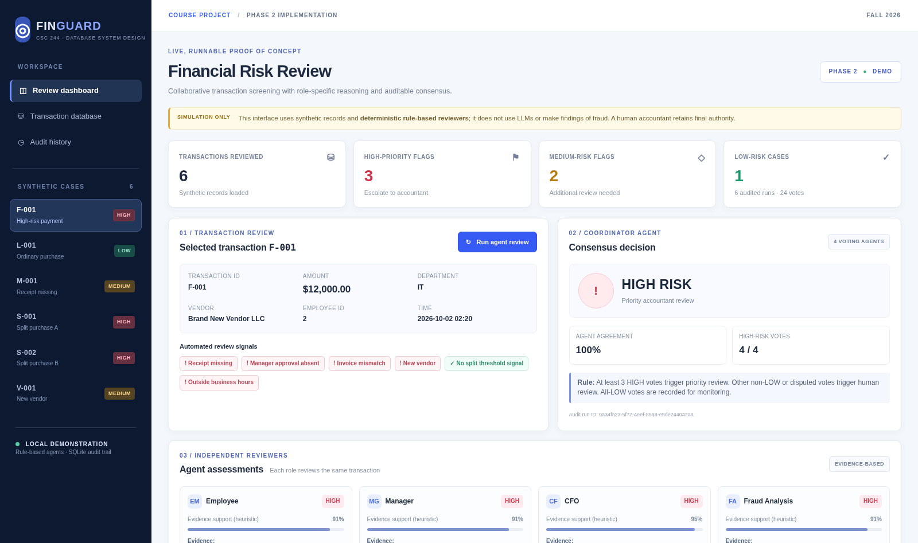
07 / SCREENSHOT
Live browser dashboard: working Phase 2 UI
Original captured screenshot shipped with the uploaded project—not a mockup.
Walkthrough
1. Select a synthetic case
2. Inspect four agent votes
3. Run a new review
4. Check persisted audit
5. Save an accountant decision
FINGUARD • SYNTHETIC DATA • VERIFIED REFERENCE BUILD
08

Slide 9
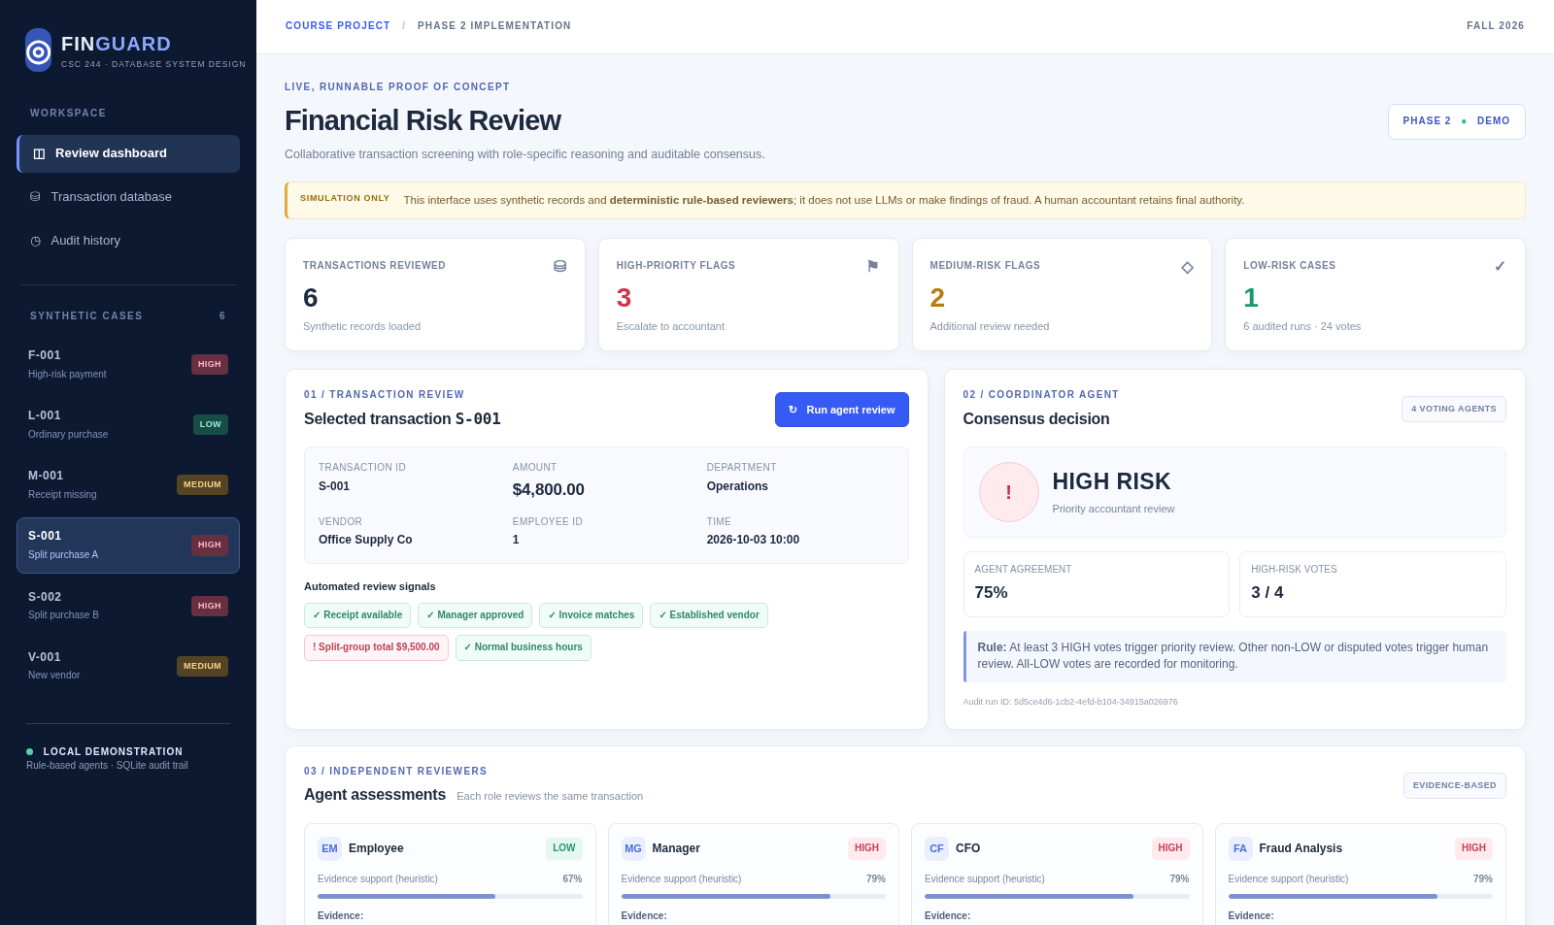
08 / SCENARIO DEMO
Split purchase: $9,500 across two transactions
S-001 and S-002 are each below $5,000, but their group total triggers a review.
Demonstrate
Select S-001.
Find $9,500 group evidence.
Compare four agent votes.
Run SQL GROUP BY / HAVING in terminal.
FINGUARD • SYNTHETIC DATA • VERIFIED REFERENCE BUILD
09

Slide 10
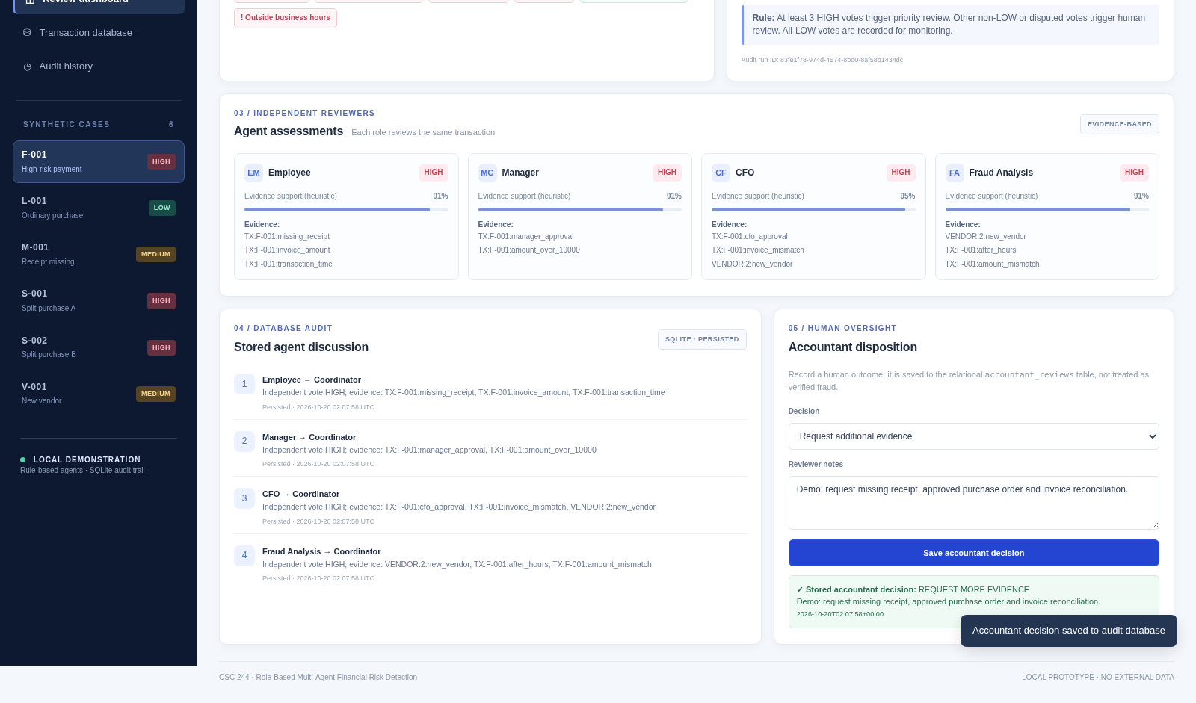
09 / AUDITABILITY
Persisted messages + human disposition
Auditable snapshots link each run to four assessments, messages, consensus, and accountant follow-up.
Verify live
Click Run agent review.
Note new run ID.
Save Request more evidence.
Refresh and confirm stored decision.
FINGUARD • SYNTHETIC DATA • VERIFIED REFERENCE BUILD
10

Slide 11
10 / SOURCE TESTS
Original test coverage: 10 / 10 passed
Re-executed from the uploaded files on November 9, 2026, using Python unittest.
5 × Backend tests
5 × Dashboard/database tests
Normal case LOW
Unauthorized high-risk controls
Linked split purchases
Missing receipt review
Four assessments + messages + consensus rows
Initial six reviewed transactions
SQL-backed split total $9,500
New review persisted
Accountant decision persisted
Invalid inputs rejected
Original source files: test_prototype.py + test_app.py
FINGUARD • SYNTHETIC DATA • VERIFIED REFERENCE BUILD
11

Slide 12
11 / INTEGRATION CHECKS
Added integration tests: 5 / 5 passed
These five HTTP tests were added while compiling the GitHub-ready package; they are not attributed to either partner.
HTTP API end-to-end
Combined verification
GET /api/dashboard → 200
GET / → serves HTML
POST /api/review → new persisted run
POST /api/accountant-review → saved decision
Invalid request → 400
15 tests executed
15 tests passed
0 failures / 0 errors
Local verified environment:
Python 3.13.5 (Linux)
GitHub CI targets Python 3.10 / 3.12
FINGUARD • SYNTHETIC DATA • VERIFIED REFERENCE BUILD
12

Slide 13
12 / REPRODUCIBILITY
Version control + GitHub Actions
GitHub is the collaboration and CI platform. The dashboard itself runs locally.
On every push / pull request
git init
git branch -M main
git add .
git commit -m "Import tested baseline"
git remote add origin <REPO-URL>
git push -u origin main
Check out source
Set up Python
Run complete unittest suite
Upload the test log
Run on Ubuntu + Windows
No cloud hosting, models, API keys or pip packages required
FINGUARD • SYNTHETIC DATA • VERIFIED REFERENCE BUILD
13

Slide 14
13 / PROFESSOR EVALUATION
Individual contribution evidence
The ZIP has no verifiable author breakdown. Confirm actual work and provide both students’ Git evidence.
Student A — Owner to confirm
Student B — Owner to confirm
File-level contributions and commits
Database and detection test evidence
Explanation of SQL and outputs
Live reproduction of an owned test
File-level contributions and commits
Workflow/UI test evidence
Explanation of HTTP endpoints and audit
Live reproduction of an owned test
Course rule: each partner must substantiate ≥45% of Phase 3 work. Do not invent ownership or percentages.
FINGUARD • SYNTHETIC DATA • VERIFIED REFERENCE BUILD
14

Slide 15
14 / LIVE DEMO
6-minute live demonstration runbook
Each partner should operate the component they actually contributed and explain how it was tested.
FIRST HALF
SECOND HALF
1 Start server: py -3 app.py
2 Open http://127.0.0.1:8501
3 Compare L-001 and F-001
4 Select S-001; explain $9,500 total
5 Click Run agent review
6 Save accountant disposition
7 Run: py -3 show_audit.py
8 Run: py -3 scripts/run_tests.py
Keep captured screenshots and terminal test log as backup if your live demonstration fails.
FINGUARD • SYNTHETIC DATA • VERIFIED REFERENCE BUILD
15

Slide 16
15 / CONCLUSION
Limits, next milestones, and questions
The prototype proves the auditable workflow on controlled data; Phase 3 enhancements remain separate.
DEMONSTRATED NOW
PLANNED AFTER BASELINE
SQL-based evidence and group detection
4 role-specific deterministic reviewers
Audit-friendly consensus and decisions
Local UI and reproducible tests
PostgreSQL production connection
True multi-round deliberation
LangGraph and optional local models
Expanded data and empirical comparison
QUESTIONS & DISCUSSION
FINGUARD • SYNTHETIC DATA • VERIFIED REFERENCE BUILD
16

