Slide 1

Task 07– Domain Model and Sequence Diagram
Team Yellow

Slide 2
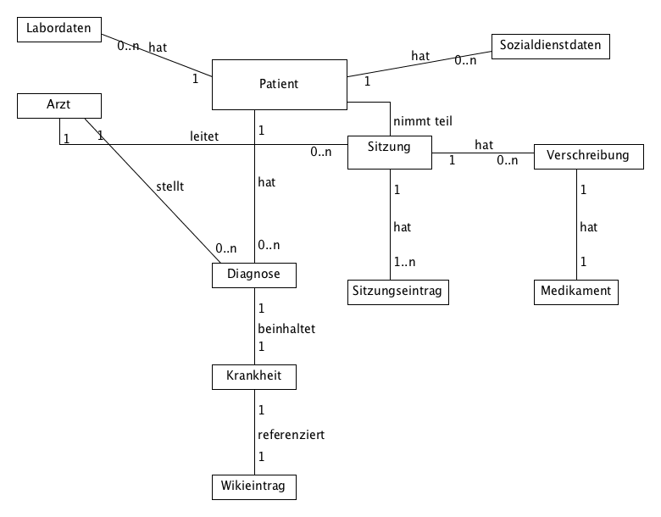
UML DOMAIN MODEL
Task 07– Domain Model and Sequence Diagram

Slide 3
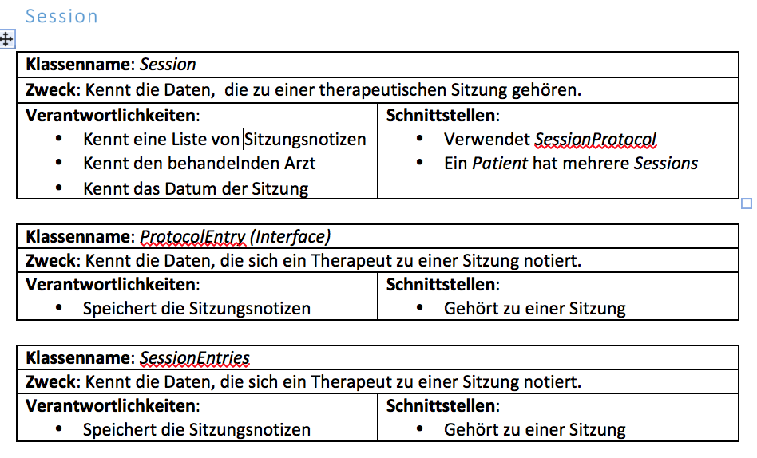
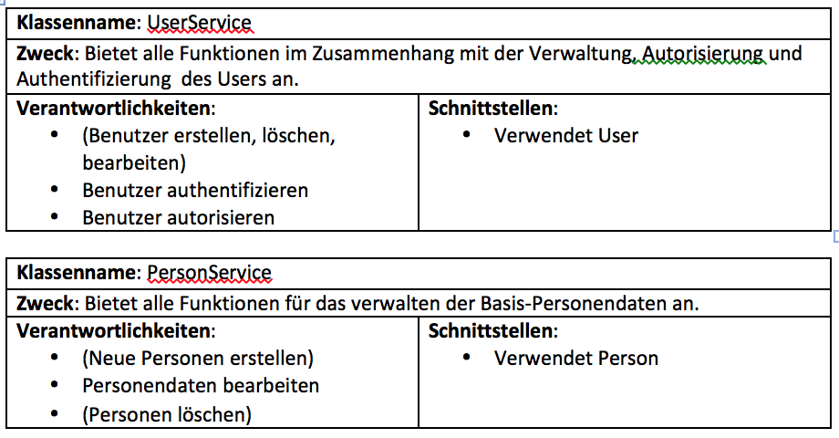
CRC CARDS (EXAMPLES)
Task 07– Domain Model and Sequence Diagram

Slide 4
UML SEQUENCE DIAGRAM (1) – DOCTOR ADD A PRESCRIPTION
Task 07– Domain Model and Sequence Diagram

Slide 6
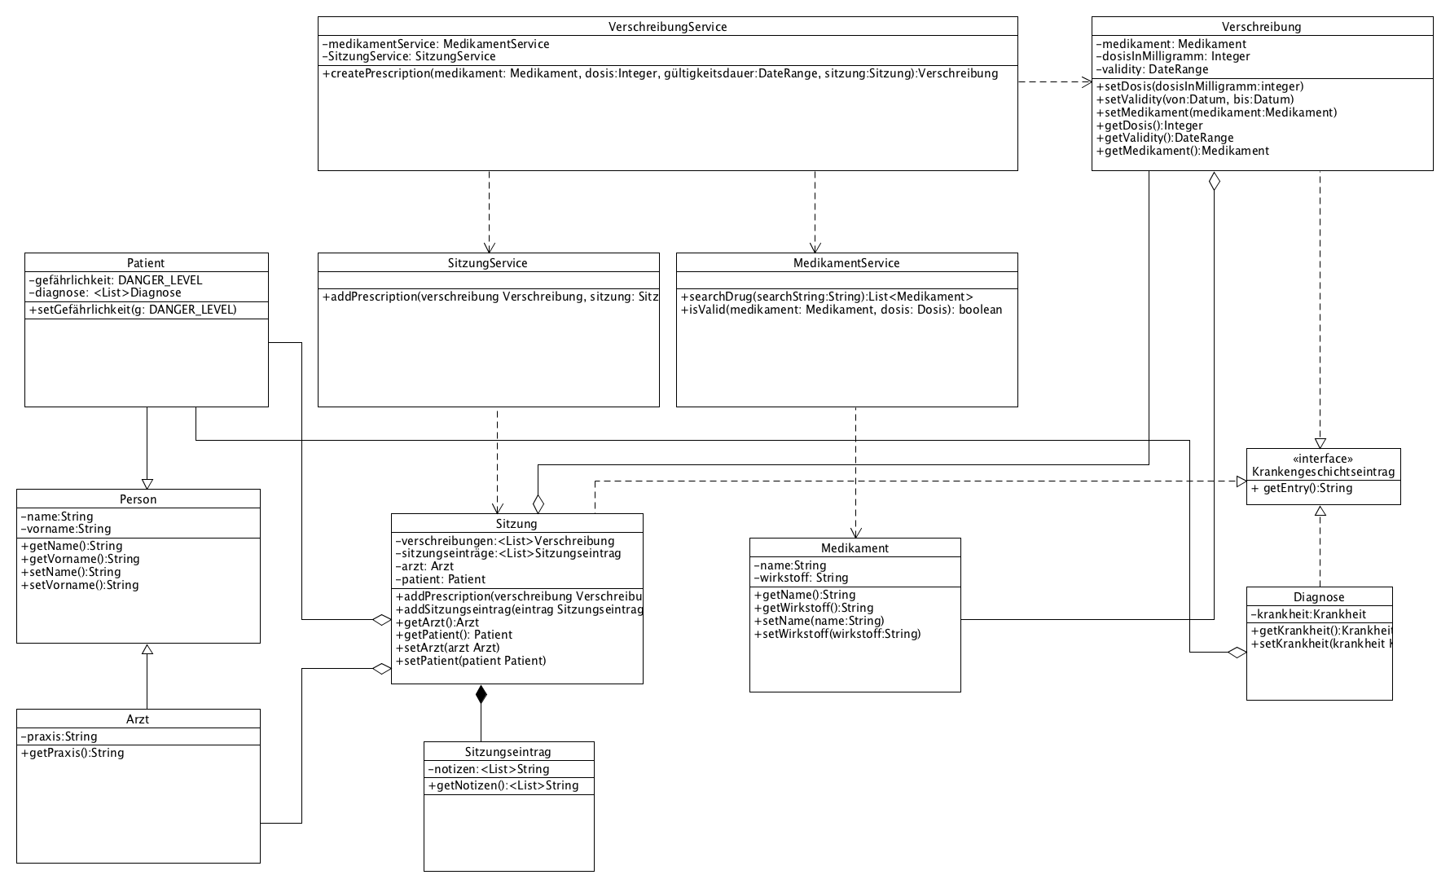
CLASS MODEL (1) - PRESCRIPTION
Task 07– Domain Model and Sequence Diagram

Slide 7
UML SEQUENCE DIAGRAM (2) – system alerts the DOCTOR
Task 07– Domain Model and Sequence Diagram

Slide 9
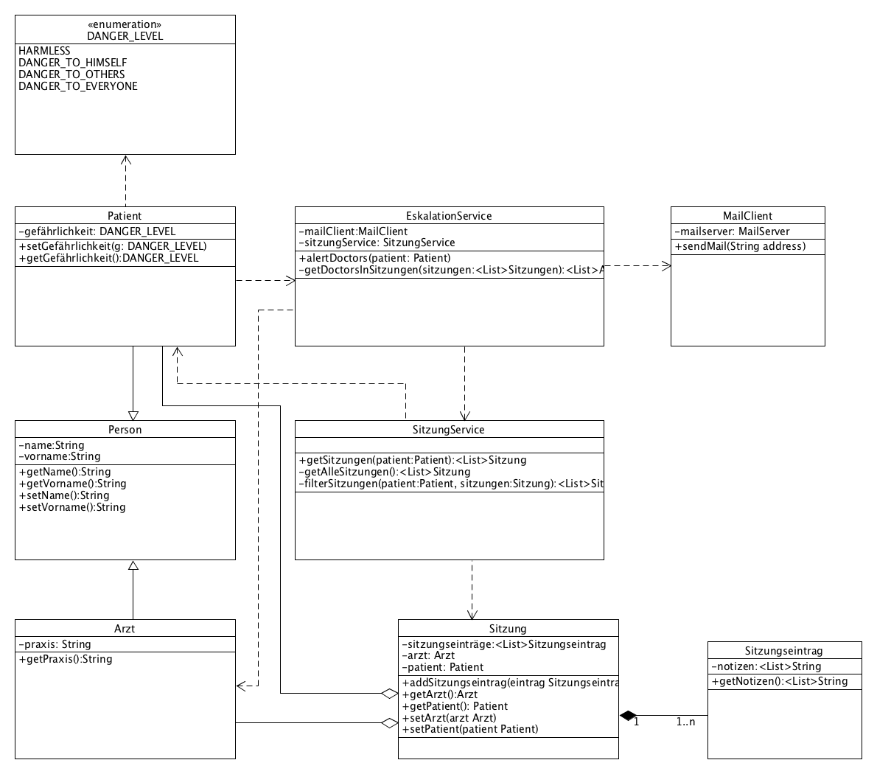
CLASS MODEL (2) - ESCALATION
Task 07– Domain Model and Sequence Diagram

