Slide 1

YouTube
ItTalents Season 12 Final Project

Slide 2
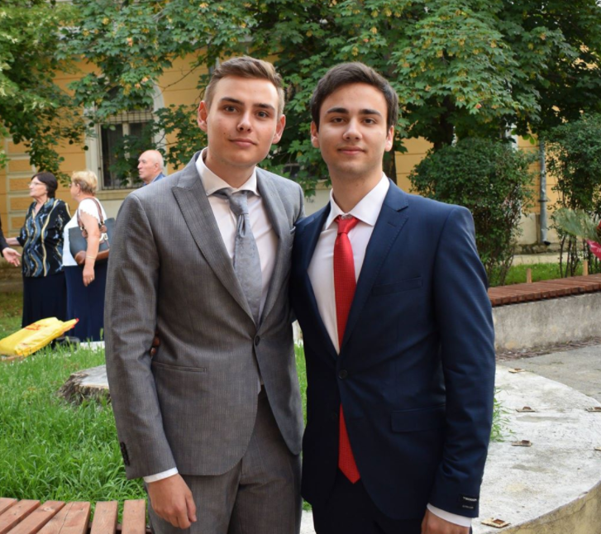
About us
We are Hristiyan Petkov and Boris Hristov

Slide 3

User
Register/Delete Account
Login/Logout
Subscribe/Unsubscribe
Edit Account
See uploaded videos of user
See created playlists of user

Slide 4

Videos
Create Video/Delete video
Upload Media File/Get Media File
Order by Upload date/Likes
Show views
Get video by name
Like/Dislike video

Slide 5

Playlist
Create/Delete playlist
Add/Delete video to/from playlist
Get playlist

Slide 6

Comments
Create/Delete comment
Edit comment
Like/Dislike comment
Show comments

Slide 7
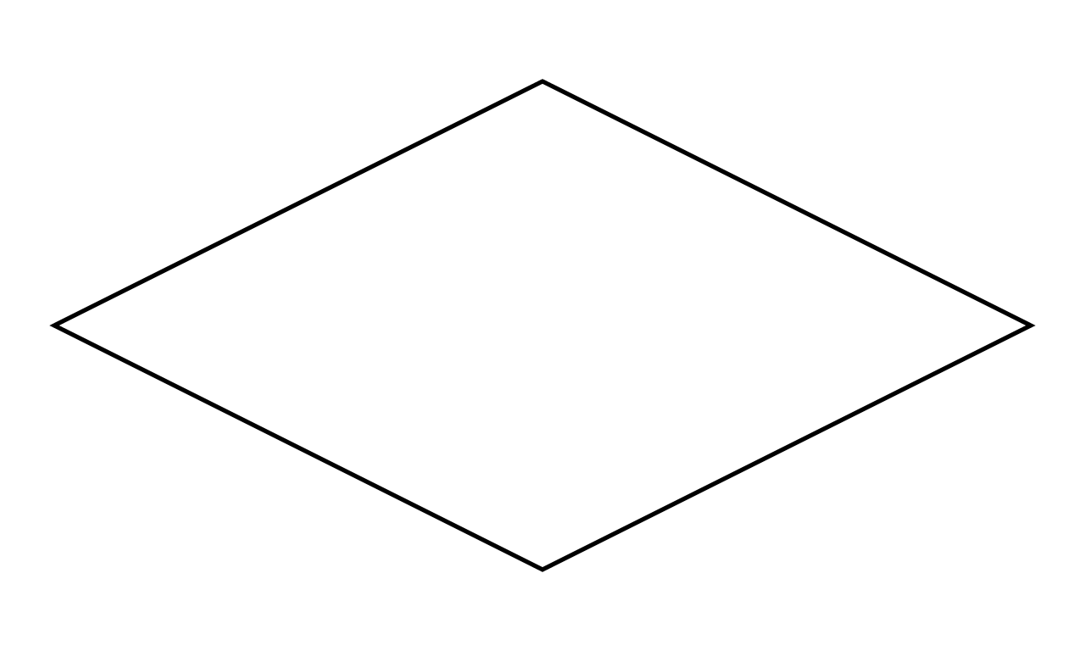
Technologies:
Spring
Lombok
MySQL
GIT
Hibernate
Java Mail
Log4J
Maven
Swagger
bCrypt
IntelliJ
Postman

Slide 8
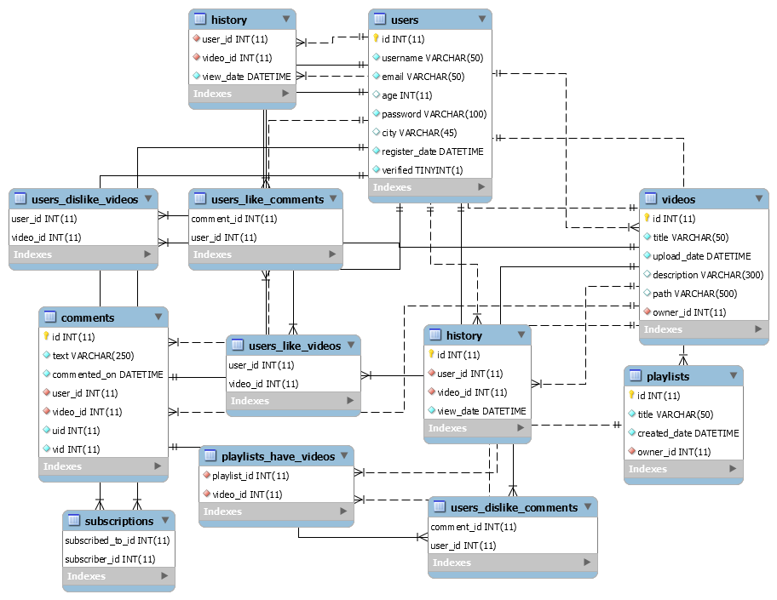
E/R Diagram

Slide 9
Class Diagram
Pojo
User
Video
Playlist
Comment
History Record
Controller
AbstractController
UserController
VideoController
CommentController
PlaylistController
SessionManager
Services
CommentService
EmailService
PlaylistService
UserService
VideoService

Slide 10
DTO’s
VideosDTOs
UploadVideoDTO
VideoWithoutIDAndDislikesDTO
VideoWithoutIDDTO
VideoWithoutOwnerDTO
SearchVideoDTO
VideoWithIDTitleDateDescDTO
VideoWithoutIDAndDislikesDTO
UsersDTOs
EditRequestUserDTO
LoginUserDTO
RegisterRequestUserDTO
RegisterResponseUserDTO
UserWithoutPasswordDTO
UserWithIDAndUsernameDTO
SearchUserDTO
CommentsDTOs
CommentDTO
EditedCommentDTO
PlaylistsDTOs
ResponsePlaylistDTO
PlaylistWithoutOwnerDTO
ErrorDTOs
ErrorDTO
GenericResponseDTO

Slide 11
Repositories
CommentRepository
HistoryRecordRepository
PlaylistRepository
UserRepository
VideoRepository
Utils
PairVideoInt
PlaylistValidator
UserValidator
VideoWithoutPathCleaner
FileValidator
Log4JLogger
VideoCredentialsValidator
Exeptions
AuthenticationException
NotFoundException
BadRequestException

Slide 12
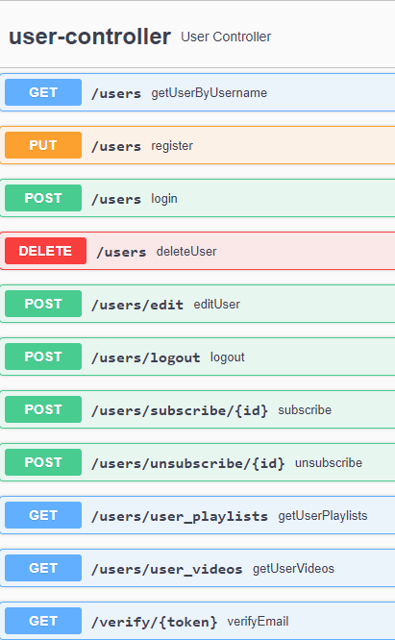
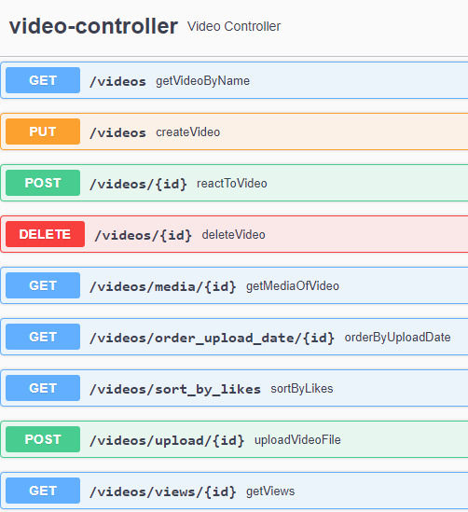
Postman requests

Slide 13
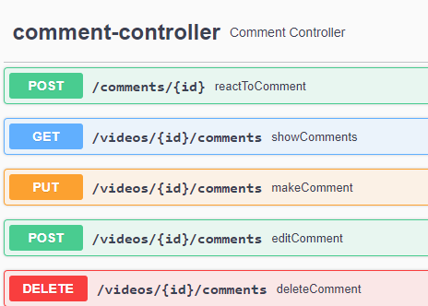
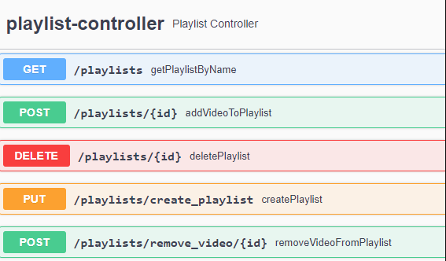

Slide 14
Thank you for the attention!

