Slide 1
Linked ECE
Romain Brisse
Alexis Martin
Gabriel Padis

Slide 2
Sommaire

Slide 3
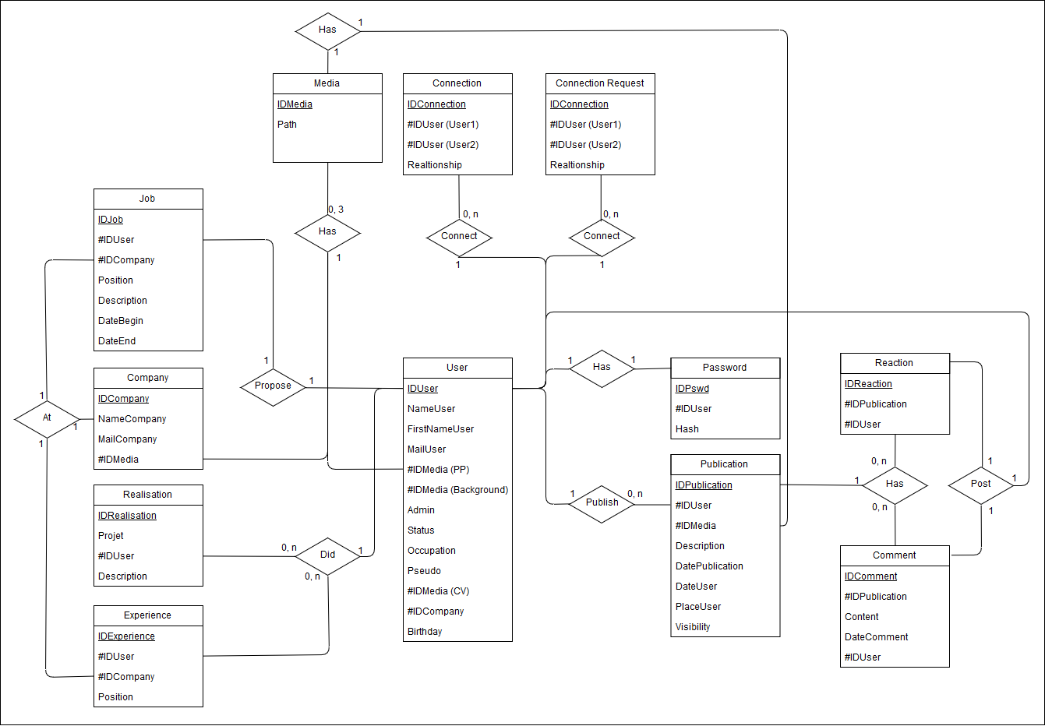
Backend

Slide 4
Frontend - 1

Slide 5
Frontend - 2

Slide 6
Frontend - 3

Slide 7
Solution Techniques - 1
MySQL

Slide 8
Solution Techniques - 2
PHP
JQuery

Slide 9
Solution Techniques - 3
Bootstrap CSS

Slide 10


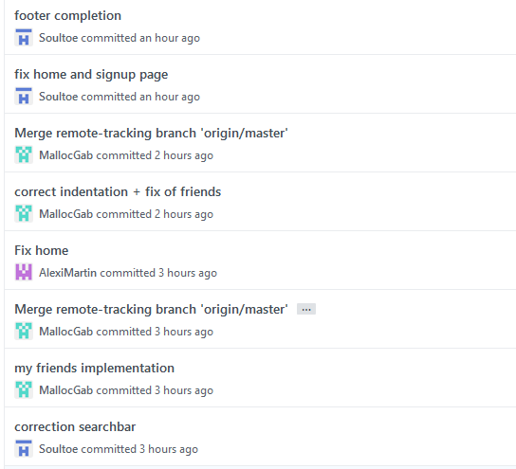
Git : GitHub
https://github.com/Soultoe/LinkedECE

Slide 11
Bilan Collectif
Plus sécurisé que Twitter
Intéressant mais réalisable seulement à 100% par les meilleurs élèves
Proof of concept plutot que quelque chose d’utilisable
Explication du CDC à revoir
Intéressant d’approfondir les interactions entre langages

Slide 12
Bilans Personnels
Romain Brisse | Alexis Martin | Gabriel Padis
Responsable Design : Bootstrap : Génial | Responsable User Information : | Responsable Base de Données :

Slide 13
Sources
https://work.smarchal.com/twbscolor/css/e74c3cc0392becf0f1ffbbbc0
https://openclassrooms.com/courses/prenez-en-main-bootstrap/elements-de-base
https://stackoverflow.com/questions/18529274/change-navbar-color-in-twitter-bootstrap
https://www.w3resource.com/php/function-reference/in_array.php
https://secure.php.net/manual/en/function.array-merge.php
https://secure.php.net/manual/en/function.strcmp.php
https://secure.php.net/manual/en/function.unlink.php
https://www.w3schools.com/jquery/jquery_selectors.asp
https://stackoverflow.com/questions/5404839/how-can-i-refresh-a-page-with-jquery
https://stackoverflow.com/questions/5470729/jquery-get-id-from-class-selector
https://api.jquery.com/jquery.ajax/
https://www.w3schools.com/jquery/jquery_ajax_get_post.asp
https://stackoverflow.com/questions/15576548/how-to-pass-parameters-in-get-requests-with-jquery
https://www.w3schools.com/jsref/met_loc_reload.asp
Louis Felix Galeota

