Slide 1
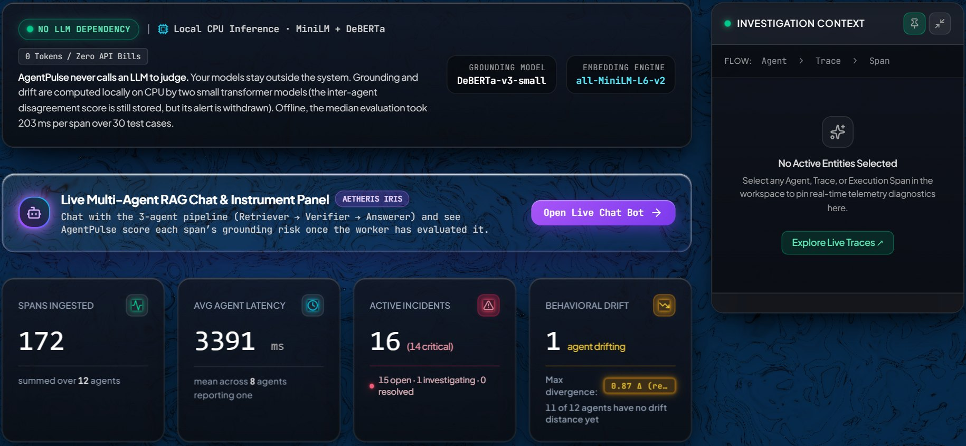
M.TECH (AIML) · FINAL REVIEW · 3 NOV 2026
AgentPulse
Self-hosted observability for multi-agent LLM pipelines. Every span is scored for grounding risk and drift by two small local models — no LLM judge.
The live console, Overview (screenshot 1 Nov 2026)
Somnath Reddy
agentpulse.centralindia.cloudapp.azure.com
github.com/Soum-Code/agentpulse
Notes:
and in SPEAKER_NOTES.md.
Keys: arrows / space / PageUp / PageDown move; N shows the speaker notes; Home / End jump.
Theme: change the :root variables below. Palette follows the live site's Dark + Obsidian look.
-->
<link rel="preconnect" href="https://fonts.googleapis.com">
<link rel="preconnect" href="https://fonts.gstatic.com" crossorigin>
<link href="https://fonts.googleapis.com/css2?family=Plus+Jakarta+Sans:ital,wght@0,400;0,500;0,600;0,700;0,800;1,500&family=JetBrains+Mono:wght@400;500;700&display=swap" rel="stylesheet">
<style>
/* ===========================================
THEME (matches the live site: Dark palette, Obsidian tint)
=========================================== */
:root {
--stage-bg: #020305;
--slide-bg: #06070a;
--surface: #0d1117;
--surface-2: #121823;
--line: rgba(255, 255, 255, 0.09);
--line-strong: rgba(255, 255, 255, 0.18);
--text: #f5f5f7;
--muted: #a3acbb;
--faint: #6f7a8c;
--mint: #3ddc97;
--mint-soft: rgba(61, 220, 151, 0.12);
--amber: #f5b841;
--amber-soft: rgba(245, 184, 65, 0.12);
--rose: #f25c7a;
--rose-soft: rgba(242, 92, 122, 0.12);
--blue: #4c8dff;
--blue-soft: rgba(76, 141, 255, 0.14);
--font-display: 'Plus Jakarta Sans', sans-serif;
--font-mono: 'JetBrains Mono', monospace;
--pad-x: 120px;
--ease: cubic-bezier(0.16, 1, 0.3, 1);
}
* { margin: 0; padding: 0; box-sizing: border-box; }
/* ===========================================
FIXED 16:9 STAGE: viewport-base.css (frontend-slides), included in full
=========================================== */
html, body { width: 100%; height: 100%; margin: 0; overflow: hidden; background: var(--stage-bg, #000); }
.deck-viewport { position: fixed; inset: 0; overflow: hidden; background: var(--stage-bg, #000); }
.deck-stage { position: absolute; left: 0; top: 0; width: 1920px; height: 1080px; overflow: hidden; transform-origin: 0 0; background: var(--slide-bg, #fff); }
.slide { position: absolute; inset: 0; width: 1920px; height: 1080px; overflow: hidden; display: block; visibility: hidden; opacity: 0; pointer-events: none; background: var(--slide-bg, #fff); }
.slide.active, .slide.visible { visibility: visible; opacity: 1; pointer-events: auto; z-index: 1; }
img, video, canvas, svg { max-width: 100%; max-height: 100%; }
.deck-controls { position: fixed; left: 50%; bottom: 22px; transform: translateX(-50%); z-index: 1000; }
@media print {
html, body { width: 1920px; height: auto; overflow: visible; background: #fff; }
.deck-viewport { position: static; overflow: visible; background: #fff; }
.deck-stage { position: static; width: auto; height: auto; transform: none !important; background: none; }
.slide { position: relative; display: block !important; visibility: visible !important; opacity: 1 !important; pointer-events: auto !important; width: 1920px; height: 1080px; break-after: page; page-break-after: always; }
.slide:last-child { break-after: auto; page-break-after: auto; }
.deck-controls { display: none !important; }
}
@media (prefers-reduced-motion: reduce) {
*, *::before, *::after { animation-duration: 0.01ms !important; transition-duration: 0.2s !important; }
}
/* ===========================================
SLIDE ATMOSPHERE: dark base and a faint blue glow (the site's marble, toned down)
=========================================== */
body { font-family: var(--font-display); color: var(--text); }
.slide {
background:
radial-gradient(1100px 700px at 88% -10%, rgba(40, 90, 200, 0.22), transparent 60%),
radial-gradient(900px 600px at -10% 110%, rgba(30, 70, 160, 0.16), transparent 60%),
var(--slide-bg);
}
.slide > * { position: relative; }
/* ===========================================
SHARED CHROME: kicker (section label), title, page tag, source line
=========================================== */
.frame { position: absolute; inset: 0; padding: 92px var(--pad-x) 0; }
.kicker {
font-family: var(--font-mono); font-size: 22px; letter-spacing: 0.14em; text-transform: uppercase;
color: var(--mint); display: flex; align-items: center; gap: 14px;
}
.kicker::before { content: ""; width: 10px; height: 10px; border-radius: 50%; background: var(--mint); }
.title { font-size: 66px; font-weight: 700; letter-spacing: -0.02em; line-height: 1.08; margin-top: 22px; max-width: 1560px; }
.title em { font-style: italic; font-weight: 500; color: var(--mint); }
.lede { font-size: 30px; line-height: 1.45; color: var(--muted); margin-top: 22px; max-width: 1400px; }
.pagetag { position: absolute; top: 96px; right: var(--pad-x); font-family: var(--font-mono); font-size: 20px; color: var(--faint); letter-spacing: 0.1em; }
.source {
position: absolute; left: var(--pad-x); right: var(--pad-x); bottom: 44px;
font-family: var(--font-mono); font-size: 17px; color: var(--faint); line-height: 1.5;
border-top: 1px solid var(--line); padding-top: 14px;
}
.source b { color: var(--muted); font-weight: 500; }
.mono { font-family: var(--font-mono); }
.mint { color: var(--mint); } .amber { color: var(--amber); } .rose { color: var(--rose); } .blue { color: var(--blue); } .muted { color: var(--muted); }
/* Cards */
.card {
background: linear-gradient(180deg, rgba(255,255,255,0.035), rgba(255,255,255,0.015));
border: 1px solid var(--line); border-radius: 22px; padding: 34px 36px;
}
.card h3 { font-size: 32px; font-weight: 700; letter-spacing: -0.01em; }
.card p, .card li { font-size: 25px; line-height: 1.45; color: var(--muted); }
.card p + p { margin-top: 12px; }
.label { font-family: var(--font-mono); font-size: 18px; letter-spacing: 0.12em; text-transform: uppercase; color: var(--faint); }
.chip {
display: inline-flex; align-items: center; gap: 10px; font-family: var(--font-mono); font-size: 20px;
padding: 8px 16px; border-radius: 999px; border: 1px solid var(--line-strong); color: var(--text);
}
.chip.mint { border-color: rgba(61,220,151,0.45); background: var(--mint-soft); color: var(--mint); }
.chip.amber { border-color: rgba(245,184,65,0.45); background: var(--amber-soft); color: var(--amber); }
.chip.rose { border-color: rgba(242,92,122,0.45); background: var(--rose-soft); color: var(--rose); }
.chip.neutral { border-color: rgba(163,172,187,0.45); background: rgba(163,172,187,0.10); color: #d5dbe5; }
/* Big stat */
.stat .num { font-family: var(--font-mono); font-size: 64px; font-weight: 700; letter-spacing: -0.02em; line-height: 1; }
.stat .cap { font-size: 22px; color: var(--muted); margin-top: 12px; line-height: 1.4; }
/* Screenshot frame */
.shot {
border-radius: 18px; overflow: hidden; border: 1px solid var(--line-strong);
box-shadow: 0 30px 80px rgba(0,0,0,0.55), 0 0 0 1px rgba(76,141,255,0.12);
background: #000;
}
.shot img { display: block; width: 100%; height: 100%; object-fit: cover; object-position: top left; max-height: none; }
.caption { font-family: var(--font-mono); font-size: 17px; color: var(--faint); margin-top: 14px; line-height: 1.45; }
/* Speaker notes: hidden; press N to show an overlay outside the slide design */
aside.notes { display: none; }
.notes-overlay {
position: fixed; left: 0; right: 0; bottom: 0; max-height: 38vh; overflow: auto; z-index: 2000;
background: rgba(8, 10, 14, 0.96); border-top: 1px solid #2a3140; color: #e6e9ef;
font: 15px/1.5 'JetBrains Mono', monospace; padding: 16px 24px; display: none; white-space: pre-wrap;
}
.notes-overlay.show { display: block; }
/* ===========================================
ANIMATION: one subtle staggered rise per slide; off under reduced motion
=========================================== */
.reveal { opacity: 0; transform: translateY(18px); transition: opacity 0.55s var(--ease), transform 0.55s var(--ease); }
.slide.visible .reveal { opacity: 1; transform: none; }
.slide.visible .reveal.d1 { transition-delay: 0.06s; }
.slide.visible .reveal.d2 { transition-delay: 0.14s; }
.slide.visible .reveal.d3 { transition-delay: 0.22s; }
.slide.visible .reveal.d4 { transition-delay: 0.30s; }
.slide.visible .reveal.d5 { transition-delay: 0.38s; }
@media (prefers-reduced-motion: reduce) {
.reveal { opacity: 1; transform: none; transition: none; }
}
@media print { .reveal { opacity: 1 !important; transform: none !important; } }
/* ===========================================
SLIDE-SPECIFIC LAYOUTS
=========================================== */
/* 01 title */
.s-title .left { position: absolute; left: var(--pad-x); top: 150px; width: 820px; }
.s-title h1 { font-size: 150px; font-weight: 800; letter-spacing: -0.045em; line-height: 0.95; margin-top: 40px; }
.s-title h1 span { color: var(--mint); }
.s-title .sub { font-size: 34px; line-height: 1.42; color: var(--muted); margin-top: 36px; }
.s-title .who { position: absolute; left: var(--pad-x); bottom: 92px; width: 820px; }
.s-title .who .name { font-size: 36px; font-weight: 700; }
.s-title .who .meta { font-family: var(--font-mono); font-size: 21px; color: var(--muted); margin-top: 14px; line-height: 1.6; }
.s-title .shot { position: absolute; right: -40px; top: 170px; width: 940px; height: 434px; }
.s-title .caption { position: absolute; right: 120px; top: 622px; width: 780px; text-align: right; }
/* 02 problem */
.chain { display: flex; align-items: center; gap: 0; margin-top: 56px; }
.node {
width: 300px; padding: 26px 28px; border-radius: 18px; border: 1px solid var(--line-strong);
background: var(--surface); text-align: left;
}
.node .label { font-size: 16px; }
.node .nm { font-size: 30px; font-weight: 700; margin-top: 8px; }
.node .st { font-family: var(--font-mono); font-size: 19px; margin-top: 12px; color: var(--mint); }
.node.bad { border-color: rgba(242,92,122,0.6); background: linear-gradient(180deg, rgba(242,92,122,0.10), var(--surface)); }
.node.bad .st { color: var(--rose); }
.arrow { width: 90px; height: 2px; background: var(--line-strong); position: relative; }
.arrow::after { content: ""; position: absolute; right: -2px; top: -6px; border-left: 12px solid var(--line-strong); border-top: 7px solid transparent; border-bottom: 7px solid transparent; }
.arrow.bad { background: var(--rose); } .arrow.bad::after { border-left-color: var(--rose); }
.http { font-family: var(--font-mono); font-size: 20px; color: var(--mint); margin-left: 30px; line-height: 1.5; }
.grid3 { display: grid; grid-template-columns: repeat(3, 1fr); gap: 28px; }
/* 03 architecture */
.pipe { display: grid; grid-template-columns: repeat(6, 1fr); gap: 18px; margin-top: 50px; }
.pipe .box { border: 1px solid var(--line-strong); border-radius: 18px; padding: 24px 22px; background: var(--surface); min-height: 300px; position: relative; }
.pipe .box .label { font-size: 15px; }
.pipe .box h4 { font-size: 27px; font-weight: 700; margin-top: 10px; line-height: 1.2; }
.pipe .box p { font-size: 20px; color: var(--muted); margin-top: 12px; line-height: 1.42; }
.pipe .box .code { font-family: var(--font-mono); font-size: 17px; color: var(--mint); margin-top: 12px; line-height: 1.5; }
.pipe .box.hl { border-color: rgba(61,220,151,0.55); background: linear-gradient(180deg, rgba(61,220,151,0.09), var(--surface)); }
.pipe .box:not(:last-child)::after {
content: "→"; position: absolute; right: -17px; top: 50%; transform: translateY(-50%);
font-size: 26px; color: var(--mint); background: var(--slide-bg); line-height: 1; padding: 2px 0; z-index: 2;
}
.traits { display: grid; grid-template-columns: repeat(3, 1fr); gap: 24px; margin-top: 34px; }
.traits .card { padding: 26px 30px; }
.traits .stat .num { font-size: 44px; }
.traits .stat .cap { font-size: 20px; }
/* 04 grounding */
.formula {
font-family: var(--font-mono); font-size: 46px; font-weight: 500; letter-spacing: -0.01em;
padding: 30px 40px; border-radius: 20px; border: 1px solid rgba(61,220,151,0.4); background: var(--mint-soft);
display: inline-block; margin-top: 40px;
}
.formula .w { color: var(--amber); font-weight: 700; }
.two { display: grid; grid-template-columns: 1.05fr 0.95fr; gap: 40px; margin-top: 34px; }
.verdicts { display: flex; gap: 14px; flex-wrap: wrap; margin-top: 16px; }
.statrow { display: grid; grid-template-columns: repeat(3, 1fr); gap: 20px; }
.statrow .card { padding: 26px 26px; }
.statrow .stat .num { font-size: 50px; }
.statrow .stat .cap { font-size: 19px; }
/* 05 drift */
.drift-vis { position: relative; height: 600px; border-radius: 22px; border: 1px solid var(--line); background: var(--surface); overflow: hidden; }
/* 06 results bars */
.bars { margin-top: 26px; }
.bar-row { display: grid; grid-template-columns: 330px 1fr; align-items: center; gap: 24px; margin-top: 22px; }
.bar-row .nm { font-size: 24px; color: var(--muted); }
.bar { height: 56px; border-radius: 10px; display: flex; align-items: center; padding: 0 18px; font-family: var(--font-mono); font-size: 24px; font-weight: 700; color: #06070a; }
.tbl { width: 100%; border-collapse: collapse; margin-top: 10px; }
.tbl td { font-size: 22px; padding: 13px 0; border-bottom: 1px solid var(--line); color: var(--muted); vertical-align: top; }
.tbl td.v { font-family: var(--font-mono); color: var(--text); text-align: right; white-space: nowrap; padding-left: 18px; }
/* 07 verified */
.checks { list-style: none; }
.checks li { font-size: 23px; line-height: 1.42; color: var(--muted); padding: 11px 0 11px 40px; position: relative; border-bottom: 1px solid var(--line); }
.checks li::before { content: "✓"; position: absolute; left: 4px; top: 10px; color: var(--mint); font-weight: 700; }
.checks li.note::before { content: "!"; color: var(--amber); left: 10px; }
.checks b { color: var(--text); font-weight: 600; }
/* 08 demo */
.steps { list-style: none; counter-reset: s; }
.steps li { counter-increment: s; font-size: 25px; line-height: 1.4; color: var(--muted); padding: 13px 0 13px 66px; position: relative; }
.steps li::before {
content: counter(s); position: absolute; left: 0; top: 10px; width: 44px; height: 44px; border-radius: 12px;
background: var(--mint-soft); border: 1px solid rgba(61,220,151,0.45); color: var(--mint);
font-family: var(--font-mono); font-size: 22px; font-weight: 700; display: grid; place-items: center;
}
.steps li b { color: var(--text); font-weight: 600; }
.url { font-family: var(--font-mono); font-size: 30px; color: var(--mint); margin-top: 18px; word-break: break-all; }
/* 10 limits */
.lim { display: grid; grid-template-columns: 1fr 1fr; gap: 24px; margin-top: 44px; }
.lim .card { padding: 28px 32px; }
.lim .card h3 { font-size: 28px; display: flex; align-items: center; gap: 14px; }
.lim .card p { font-size: 22px; margin-top: 10px; }
.dot { width: 14px; height: 14px; border-radius: 50%; flex: none; }
/* 12 conclusion */
.s-end .big { font-size: 92px; font-weight: 800; letter-spacing: -0.035em; line-height: 1.02; margin-top: 30px; max-width: 1500px; }
.s-end .big em { font-style: italic; font-weight: 500; color: var(--mint); }
.take { display: grid; grid-template-columns: repeat(3, 1fr); gap: 26px; margin-top: 60px; }
.take .card { padding: 30px 32px; }
.take .n { font-family: var(--font-mono); font-size: 22px; color: var(--mint); }
.take p { font-size: 25px; line-height: 1.42; color: var(--text); margin-top: 12px; }
.take p span { color: var(--muted); }
.endbar { position: absolute; left: var(--pad-x); right: var(--pad-x); bottom: 92px; display: flex; justify-content: space-between; align-items: flex-end; }
.endbar .url { margin-top: 0; font-size: 32px; }
/* Layout: kicker + title at the top, .body fills the rest and centres its content above the source line */
.frame { display: flex; flex-direction: column; padding-bottom: 150px; }
.body { flex: 1; display: flex; flex-direction: column; justify-content: center; gap: 0; min-height: 0; }
.body > :first-child { margin-top: 0 !important; }
.s-end .frame { padding-bottom: 260px; }
/* Projection sizes (bigger than the first draft) */
.card p, .card li { font-size: 27px; }
.card h3 { font-size: 36px; }
.stat .num { font-size: 76px; }
.stat .cap { font-size: 24px; }
.pipe .box { min-height: 360px; padding: 28px 24px; }
.pipe .box h4 { font-size: 30px; }
.pipe .box p { font-size: 22px; }
.pipe .box .code { font-size: 19px; }
.traits { margin-top: 44px; }
.traits .stat .num { font-size: 52px; }
.traits .stat .cap { font-size: 22px; }
.statrow .stat .num { font-size: 58px; }
.statrow .stat .cap { font-size: 21px; }
.tbl td { font-size: 26px; padding: 17px 0; }
.checks li { font-size: 26px; padding: 15px 0 15px 42px; }
.steps li { font-size: 28px; padding: 16px 0 16px 68px; }
.lim .card h3 { font-size: 31px; }
.lim .card p { font-size: 25px; }
.take p { font-size: 29px; }
.node { width: 330px; padding: 30px 30px; }
.node .nm { font-size: 34px; }
.node .st { font-size: 21px; }
.http { font-size: 23px; }
.bar-row .nm { font-size: 26px; }
.bar { height: 66px; font-size: 27px; }
/* Per-slide fill tuning */
.chain .node { width: 370px; }
.body > .grid3 { margin-top: 80px !important; }
.drift-vis text { font-size: 24px; }
.bar-row { grid-template-columns: 400px 1fr; margin-top: 30px; }
.label { font-size: 20px; }
/* backup marker */
.backup-tag { font-family: var(--font-mono); font-size: 19px; color: var(--amber); letter-spacing: 0.14em; }
/* Deck chrome outside the stage */
.progress { position: fixed; left: 0; top: 0; width: 100%; height: 3px; background: var(--mint); z-index: 1001; transform-origin: 0 0; transform: scaleX(0); transition: transform 0.3s var(--ease); }
.counter { position: fixed; right: 18px; bottom: 14px; font: 13px 'JetBrains Mono', monospace; color: #6f7a8c; z-index: 1001; }
</style>
</head>
<body>
<div class="progress" id="progress"></div>
<div class="counter" id="counter"></div>
<div class="notes-overlay" id="notesOverlay"></div>
<div class="deck-viewport">
<main class="deck-stage" id="deckStage">
<!-- =========================================================
01 TITLE
========================================================= -->
<section class="slide s-title active" data-time="0:20">
<div class="left">
<div class="kicker reveal d1">M.Tech (AIML) · Final review · 3 Nov 2026</div>
<h1 class="reveal d2">Agent<span>Pulse</span></h1>
<p class="sub reveal d3">Self-hosted observability for multi-agent LLM pipelines. Every span is scored for grounding risk and drift by two small local models&nbsp;— no LLM judge.</p>
</div>
<div class="shot reveal d4"><img src="assets/live_overview.jpg" alt="The live AgentPulse console, Overview view"></div>
<p class="caption reveal d4">The live console, Overview (screenshot 1 Nov 2026)</p>
<div class="who reveal d5">
<div class="name">Somnath Reddy</div>
<div class="meta">agentpulse.centralindia.cloudapp.azure.com<br>github.com/Soum-Code/agentpulse</div>
</div>
<aside class="notes">0:00-0:20. Name, programme, title. "AgentPulse watches multi-agent LLM pipelines and scores every step for grounding risk and drift, with two small models on a CPU, no LLM judge. It is live; I will show it in a few minutes."
Screenshot: live Overview, Dark palette, taken 2026-11-01 with headless Chrome (presentation/viva/assets/live_overview.jpg). The counters in it (172 spans, 16 incidents) are the live database on that day, not a benchmark.

Slide 2
Multi-agent pipelines fail silently
01 · THE PROBLEM
AGENT 1
AGENT 2
AGENT 3
every call: 200 OK
no exception
latency normal
Retriever
Verifier
Answerer
200 OK
claim not in evidence
builds on it
Grounding failure
Behavioural drift
Quality is an add-on
An agent states something its own evidence does not support, and the next agent builds on it.
An agent's answers move away from how it used to answer, after a model or prompt change. Nothing errors.
Existing tools trace tokens, latency and cost well, but treat quality evaluation as optional and sampled.
Goal of this project: score every span, cheaply enough for a CPU, and show plainly what was not measured. Framing from README.md (intro paragraph).
Notes:
0:20-1:10. The failure that motivates the project: a pipeline returns a fluent answer, every service reports success, and the answer is not supported by what was retrieved. The diagram is a schematic, not a measurement.
Third card: README.md intro: "Existing LLM observability tools trace tokens, latency, and cost well, but treat quality evaluation as an optional, sampled add-on."
No numbers on this slide.

Slide 3
Score every span, locally
02 · WHAT AGENTPULSE IS
YOUR PROCESS
FASTAPI
STORAGE
WORKER · CPU
RULES
REACT 19
SDK
Ingest API
SQLite (WAL)
Evaluator
Alerts
Console
Decorator, OpenAI / Anthropic wrapper, LangGraph adapter.
Accepts and queues. Runs no model.
Spans plus a durable job queue the worker leases from.
MiniLM-L6-v2 embeddings + DeBERTa-v3-small NLI.
Thresholds per signal; one alert per agent and type in 15 min.
REST + WebSocket. Traces, incidents, drift, Lab.
→
→
→
→
→
bounded buffer,
fail-open
POST /v1/ingest
at-least-once
grounding · drift
cooldown 900 s
unmeasured = "—"
202.94 ms
0.005 ms
0
median per case, AgentPulse evaluator, vs 3,170.39 ms for an LLM judge (Qwen3-8B, CPU), 30 cases
SDK decorator overhead per call (P50 over 2,000 calls)
LLM calls in the evaluator: two small models, run on the CPU of the same VM
Sources: LLM_JUDGE_COMPARISON_REPORT.md (median latency table, 2026-08-26) · benchmarks/benchmark_results.json (2026-08-18) · HOW_IT_WORKS.md (buffer 10,000 spans, drop-oldest; cooldown 900 s) · README.md "Architecture in short"
Notes:
1:10-2:20. Walk left to right. The SDK never blocks the agent: a bounded buffer (10,000 spans by default, oldest dropped; HOW_IT_WORKS.md). The API only accepts and queues; the worker leases jobs from a table in the same SQLite file and runs the two models. Alert rules have a 900 s cooldown per (alert type, agent) (HOW_IT_WORKS.md, alerting).
Numbers: 202.94 ms vs 3,170.39 ms = median latency over 30 cases, AgentPulse NLI pipeline vs Qwen3-8B-GGUF Q4_K_M via llama.cpp on CPU (LLM_JUDGE_COMPARISON_REPORT.md; README "Numbers and where they come from"; date 2026-08-26). One judge model, one machine: do not generalise to all LLM judges.
0.005 ms: SDK decorator overhead, P50 over 2,000 calls, benchmarks/benchmark_results.json, 2026-08-18.
Four signals exist in code (grounding, drift, tool-claim, disagreement); only the first two held up on real data (slide 10).

Slide 4
Grounding risk: an NLI model, not a judge
03 · SIGNAL 1 · GROUNDING
risk = P(contradiction) + 0.3 × P(neutral)
DeBERTa-v3-small compares an agent's output with the evidence it was given. 0 = safe, 1 = risky. High above 0.7, medium above 0.4.
0.963
0.927 / 0.952
contradicted
unverifiable
supported
F1 on the 30-case test split (FPR 0.059: 1 of 17 supported cases)
F1 on 47 truly held-out cases (at 0.7 / at 0.4), FPR 0.074
The verdict is whichever probability is highest. Unverifiable = the evidence neither supports nor contradicts. A status, not a pass.
68
0.3 is a design choice, not a fit: weights 0.0 to 0.3 cannot be told apart on this data.
hand-labelled cases behind these numbers (39 supported, 29 failures). 5 of the 30 test cases copy dev cases. Small sample, not production traffic.
Source: GROUNDING_RECALIBRATION_2026-10.md (tables T3c, T3d, section 3.6; analysis 2026-10-22) · HOW_IT_WORKS.md (verdict rule) · backend/app/services/grounding.py (NEUTRAL_RISK_WEIGHT = 0.3)
Notes:
2:20-3:30. The score is the NLI model's probabilities, not an LLM's opinion. Contradiction counts fully; neutral counts 0.3. Cut-offs 0.7 (high) and 0.4 (medium), strict ">".
Say plainly: 0.3 is a design choice. On the corrected labels, weights 0.0 to 0.3 give identical results; the one case that separates them is val_17. At 0.5 the medium band flagged 7 of 17 supported test cases (FPR 0.412), which is why 0.5 was dropped (GROUNDING_RECALIBRATION_2026-10.md, finding 4; backup slide B1).
Unverifiable: argmax of the three probabilities is neutral. It says nothing about truth; it is shown next to the score (HOW_IT_WORKS.md "The verdict, next to the score").
Numbers: F1 0.963, FPR 0.059 (1/17), test split of 30, 5 copy dev = T3c; held-out 47: F1 0.927 at 0.7, 0.952 at 0.4, FPR 0.074 (2/27) = T3d; 68 cases = 39 supported + 29 failures. All from GROUNDING_RECALIBRATION_2026-10.md, analysis dated 2026-10-22, and the README table.

Slide 5
Drift: how far an agent has moved from itself
04 · SIGNAL 2 · DRIFT
MiniLM embeds each output. Per agent, the mean of its first 20 outputs is the baseline; the mean of its latest 12 is the window. DRIFT_DETECTED fires above a cosine distance of 0.30.
cosine distance > 0.30
1.5%
91.9%
24.5%
false alarms
detection
of real sessions long enough to measure at all
baseline: first 20
window: latest 12
Offline, an external real-trace corpus, held-out split, measured once.
schematic, not data
Source: DRIFT_REAL_TEXT_DIAGNOSIS_REPORT.md sections 11.3 and 11.5 (2026-08-27) · README.md "What it does" · HOW_IT_WORKS.md (baseline 20, window 12, threshold 0.30)
Notes:
3:30-4:10. Drift compares an agent with its own past, not with a reference answer. Baseline = mean embedding of its first 20 outputs; window = mean of its latest 12; DRIFT_DETECTED when the cosine distance between the two means is above 0.30.
Numbers: 1.5% false alarms, 91.9% detection, 24.5% of sessions long enough (32 outputs) to report a distance at all. DRIFT_REAL_TEXT_DIAGNOSIS_REPORT.md 11.3 and 11.5, 2026-08-27, offline, held-out split of an external real-trace corpus, measured once. The 24.5% is the honest catch: most real sessions are too short.
The picture is a schematic (says so on the slide).

Slide 6
Cheap enough to run on every span
05 · RESULTS · COST
MEDIAN EVALUATION TIME PER CASE, 30 CASES, CPU
SINGLE RUNS, ONE WINDOWS 11 MACHINE, CPU, PYTORCH
SDK decorator overhead (P50, 2,000 calls) | 0.005 ms
MiniLM embedding (P50, 100 runs) | 15.1 ms
DeBERTa NLI (P50, 50 runs) | 88.5 ms
Two grounding models, per case (30 cases) | 151.19 ms
Full pipeline, per case (30 cases) | 165.18 ms
One judge model on one machine: not a claim about every LLM judge.
180 ms
live median evaluation time over 172 spans on the deployed worker (ONNX), as the Settings view showed it on 27 Oct 2026
Sources: LLM_JUDGE_COMPARISON_REPORT.md (2026-08-26) · benchmarks/benchmark_results.json (2026-08-18) · experiments/results/ablation_results.json (2026-09-18) · docs/E2E_TEST_2026-10-27.md item 23 (180 ms). Each is one run on one machine, not a constant.
Notes:
4:10-5:00. The point: evaluating every span is affordable without an LLM judge.
Bar: 202.94 ms vs 3,170.39 ms median per case over 30 cases (LLM_JUDGE_COMPARISON_REPORT.md; the report computes 15.6x). Bar widths are to scale (202.94/3170.39 = 6.4%); the short bar's label sits beside it.
Table: 0.005 ms, 15.1 ms, 88.5 ms from benchmarks/benchmark_results.json (2026-08-18, Windows 11, 16 logical cores, CPU, PyTorch, not ONNX). 151.19 ms and 165.18 ms per case from experiments/results/ablation_results.json (30-case ablation, 2026-09-18). An older run of that script measured 215.9 ms; do not quote it (README).
The live worker uses the ONNX backend; these are PyTorch numbers. If asked about live latency: Settings on the live site showed a live median of 180 ms over 172 spans on 2026-10-27 (docs/E2E_TEST_2026-10-27.md, item 23).

Slide 7
Tested, and checked live
06 · RESULTS · VERIFICATION
END-TO-END TEST OF THE LIVE SITE, 27 OCT 2026, FROM OUTSIDE
628
✓
Health: /v1/health, /v1/health/ready, /chat/health all 200
backend tests passed (pytest, 4 min 12 s)
✓
Closed routes: /v1/keys and 3 path variants, ingest without key, PUT /v1/simulate: all 401
✓
Chat: one turn 6.35 s, all three agents answered by Groq; the worker scored all three spans
404
✓
Telemetry Lab: hallucination scenario raised HIGH alerts for verifier (0.971) and analyst (0.999)
dashboard tests passed (35 files), tsc clean
✓
Console: every view in Dark and Chalk scripted for NaN / undefined / null: 0 found
Re-run 27 Oct 2026, author's machine
!
Two real bugs found and fixed (SVG arrowhead, header at 1366 px); one noted (stale worker count)
Sources: README.md "Testing and benchmarks" (628 / 404, re-run 2026-10-27) · docs/E2E_TEST_2026-10-27.md items 1-25 and findings F1-F3 · SESSION_HANDOFF.md 29.19
Notes:
5:00-5:40. 628 backend tests (pytest tests/, 4 min 12 s) and 404 dashboard tests (35 files, tsc --noEmit clean), re-run on 2026-10-27 on the author's machine (README "Testing and benchmarks"; SESSION_HANDOFF 29.19.4). These replace the older 422 / 136.
E2E on the live site, 2026-10-27 ~12:55-13:10 UTC (docs/E2E_TEST_2026-10-27.md): items 1-4 health; item 7 four key paths 401; items 8-9 ingest and PUT simulate 401; item 10 chat turn 6.35 s by curl (stream total 6,148 ms; retriever 3,340, verifier 559, answerer 682 ms; all Groq gpt-oss-20b), spans scored 0.306 unverifiable / 0.135 / 0.027 supported; item 11 Lab hallucination: HIGH_HALLUCINATION_RISK and GROUNDING_FAILURE for verifier 0.971 and analyst 0.999; items 14-24 console views. F1 SVG arrowhead and F2 header at 1366 px fixed in PR #112; F3 "1 of 22 alive" open.
Another single turn the same day took 1.6 s (SESSION_HANDOFF 29.17.3). Neither is "the" latency.
Honest gap: the deploy is not gated on the test suite (see limits).

Slide 8
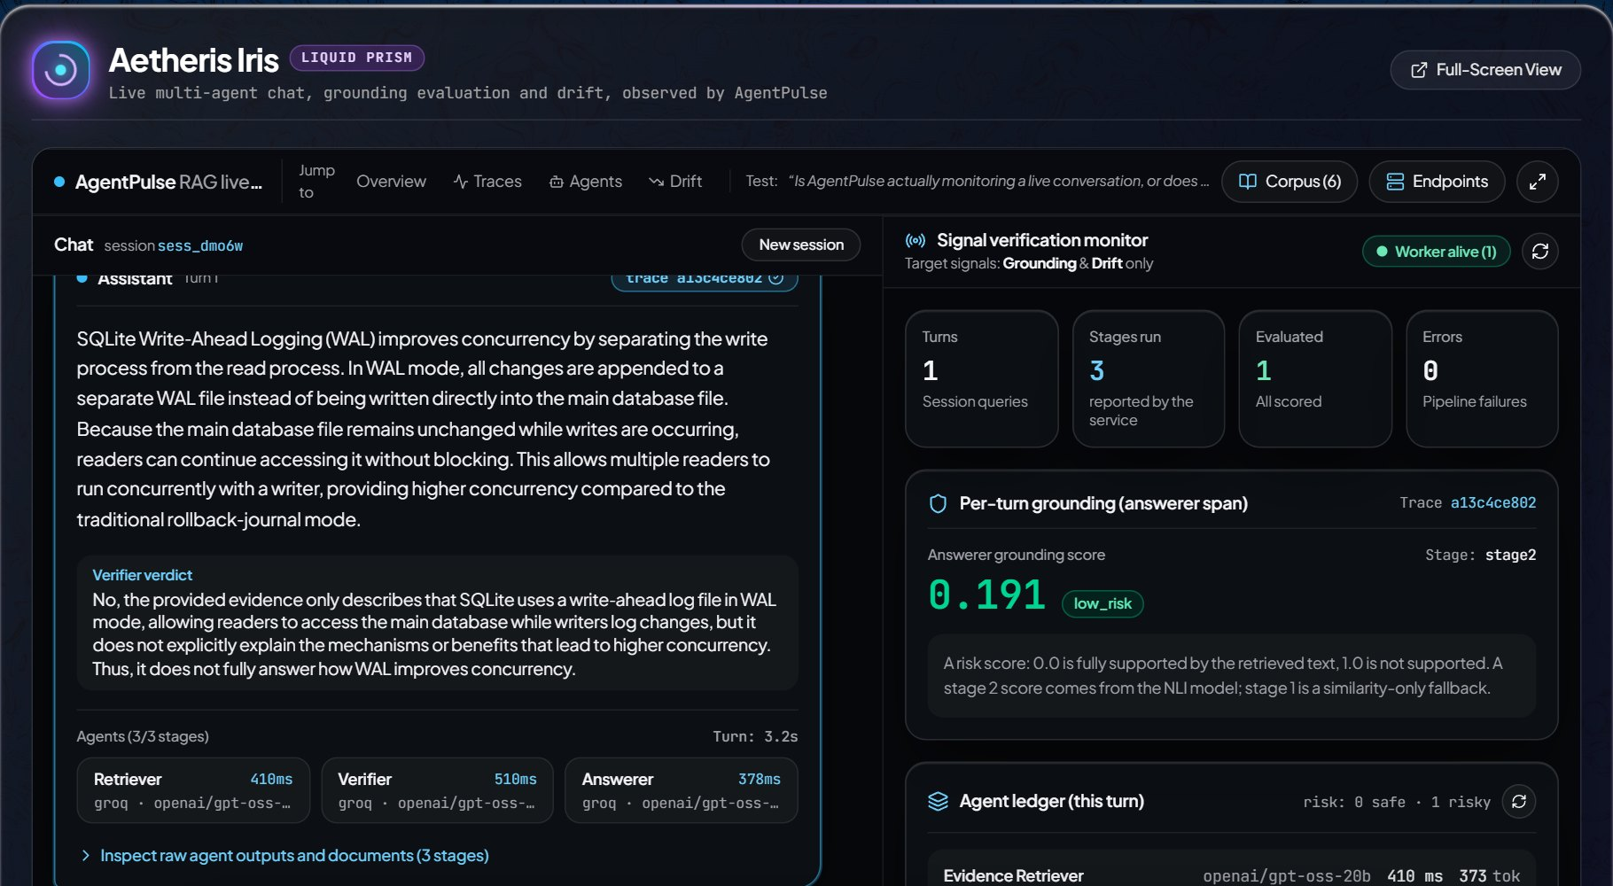
See it on the live site
07 · LIVE DEMO
https://agentpulse.centralindia.cloudapp.azure.com
1
Launch App → RAG Live. Ask "how does SQLite WAL improve concurrency?"
2
Three stages: retriever, verifier, answerer, each with time, provider, model.
3
Agent ledger: grounding risk and verdict per span; what "Unverifiable" means.
4
Out of corpus: "who won the 2022 football world cup?" Read the ledger.
5
Traces → newest trace → X exports the JSON.
A real turn, 1 Nov 2026: 3.2 s, all three agents on Groq; answerer grounding 0.191 (low risk). One turn, not a rate.
Notes:
5:40-8:10. Follow DEMO_GUIDE.md, steps 1, 2, 3, 4, 5 (the Telemetry Lab step 6 only if time is left). Say only what the screen shows.
1. Launch App, RAG Live. Ask the WAL question. The answer comes from the retrieved document "SQLite Write-Ahead Logging (WAL) Architecture".
2. Point at the three stages: time in ms, provider and model, failovers.
3. Agent ledger: rows stay "pending" until the worker has scored them; alerts line says "Unknown so far" until every span is scored. Unverifiable = the evidence neither supports nor contradicts; common here because the retriever's premise is short.
4. Out-of-corpus question: read the verdicts from the screen; do not predict them.
5. Traces, newest trace, press X: "Everything on these screens is in this file. Nothing in it is computed in the browser."
Screenshot (fallback if the network fails): live RAG view, 2026-11-01, one turn of 3.2 s with stages 410 / 510 / 378 ms, all groq openai/gpt-oss-20b, answerer grounding 0.191 low_risk (presentation/viva/assets/live_rag.jpg). Earlier single turns: 1.6 s and 6.1 s on 2026-10-27 (README).
If something fails: DEMO_GUIDE.md "If something goes wrong" table (limit reached = 5 a minute per IP; providers at their limit; evaluator offline). Never call a failure a success.
Before the talk: curl /chat/health and /v1/health/ready (both 200); one warm-up question.

Slide 9
Deployed, automated, locked down
08 · ENGINEERING
DEPLOYMENT
CI / CD
SECURITY
One Azure VM
GitHub Actions
Closed by default
Standard_B2als_v2 (2 vCPU, 4 GB), Central India.
Docker Compose: Caddy (TLS), nginx + dashboard, FastAPI backend, evaluator worker, chat service.
Nightly database backup.
Pull requests run the full pytest suite and the dashboard's tsc + vitest.
A push to main deploys: rebuild changed images, test the new backend on a copy of the live database, swap, roll back if unhealthy.
Every write needs the Caddy write password, except the chat and POST /v1/simulate. Key routes: 401 on every case variant. Refuses to start with the placeholder key.
Rate limits per IP: chat 5/min, 40/day; Lab 6/hour, 30/day; 300/day per site.
Sources: deploy/azure/README.md (VM size) · .github/workflows/tests.yml, dashboard.yml, deploy-azure.yml · deploy/azure/Caddyfile · README.md "What works live" · SESSION_HANDOFF.md 29.17.2 and the #109 entry in 29.18
Notes:
8:10-8:50. Deployment: Standard_B2als_v2, 2 vCPU / 4 GB (deploy/azure/README.md); five containers: caddy, dashboard (nginx), backend, worker, chat. Nightly backup at 02:17 UTC, on the same disk (a limit).
CI: tests.yml runs pytest tests/ on pull requests touching backend/demo/tests/sdk; dashboard.yml runs tsc and vitest on dashboard changes; deploy-azure.yml on push to main runs deploy/azure/deploy.sh over SSH: rebuild only changed images, test the new backend against a copy of the live DB, swap, put the previous images back if unhealthy.
Security: Caddy basic_auth (bcrypt) on every write; the only exemption is exactly POST /v1/simulate (a "not expression" on method and raw path: Caddy's path matcher ignores case and merges slashes, so the plain matcher let nine variants through; SESSION_HANDOFF 29.17.2). /v1/keys, /V1/keys, //v1/keys, /v1/keys/1 all 401 (E2E item 7). Backend refuses to start with the placeholder key when local dev mode is off (README "Docker deployment"; PR #109). Limits: chat 5 a minute, 40 a day per IP, 300 a day for the site, 500 characters (README); Lab 6 per IP per hour, 30 per IP per day, 300 a day for the site (README; simulate_guard.py). Size limits on ingest and the WebSocket (PR #109).

Slide 10
What did not hold up, said first
09 · HONEST LIMITS
Inter-agent disagreement
Tool-claim check
Found 0 of 10 labelled contradictions on real traces (AUC 0.457 without the planner). Alert withdrawn; score only stored.
F1 0.000 on real traces: no claim found in 8,353 prose spans. It only reads counts written in digits.
Small labelled set
Drift coverage
Grounding quality rests on 68 hand-labelled cases; only one is a neutral failure, so the data cannot say what the 0.3 weight buys.
Only 24.5% of real sessions were long enough to report a drift distance at all.
One small deployment
One VM, one SQLite file, one evaluator worker; backup on the same disk; deploy not gated on the test suite; the chat runs on free LLM tiers and can be slow or refused.
Sources: README.md "Known limits" · COMPETITIVE_POSITIONING.md 5.2 · SESSION_HANDOFF.md 24.9.5 · TOOL_CLAIM_EXTERNAL_TEST_REPORT.md section 10 · GROUNDING_RECALIBRATION_2026-10.md · DEMO_GUIDE.md "The honest limits"
Notes:
8:50-9:25. Say these before being asked.
Disagreement: 0 of 10 independently labelled contradictions on real multi-agent traces; with the planner excluded AUC 0.457 (chance). Alert withdrawn (COMPETITIVE_POSITIONING.md 5.2; SESSION_HANDOFF.md 14.1, 24.9.5).
Tool-claim: F1 0.000 on a real-data benchmark, no claim extracted from 8,353 prose spans; 0.842 on 19 hand-written cases that used the phrasing its regex expects (TOOL_CLAIM_EXTERNAL_TEST_REPORT.md section 10).
Grounding: 68 hand-labelled cases (39 supported, 29 failures), only one neutral failure (val_17), so the 0.3 weight cannot be measured (GROUNDING_RECALIBRATION_2026-10.md; DEMO_GUIDE.md).
Drift: 24.5% coverage (DRIFT_REAL_TEXT_DIAGNOSIS_REPORT.md 11.5).
Deployment: README "Known limits"; deploy not gated on tests (SESSION_HANDOFF 29.16.6 follow-up list).
These are why the live monitor header says "Grounding & Drift only".

Slide 11
Next, in order of what the limits ask for
10 · FUTURE WORK
GROUNDING
THE TWO FAILED SIGNALS
More labelled data
Redesign or remove
A larger labelled set drawn from real traces, with neutral failures, then re-run the ablation at the 0.3 weight.
Claim extraction from prose instead of digits for tool-claim; a different formulation for disagreement, tested on real traces first.
SCALE AND SAFETY
REACH
Beyond one VM
More frameworks
A server database instead of one SQLite file, several workers, an off-VM backup, deploys gated on the test suite.
LangChain and CrewAI adapters (today: decorator, OpenAI / Anthropic wrapper, LangGraph).
Notes:
9:25-9:40. Each item follows from a limit on the previous slide; none is done.
Re-running experiments/ablation.py at weight 0.3 is listed as not done in SESSION_HANDOFF.md 29.16.4. LangChain and CrewAI adapters are "still not implemented" (README "What it does"). Off-VM backup and deploy gating are open items (SESSION_HANDOFF 29.16.6, 29.18).
No numbers on this slide.

Slide 12
CONCLUSION
Two signals that held up,
measured, live, and honest about the rest.
01
02
03
Every span scored by two local models on a CPU. No LLM judge: 202.94 ms vs 3,170.39 ms median per case.
Grounding and drift held up. F1 0.963 on the test split; two other signals failed on real traces and are labelled so.
Live on Azure and tested. 628 + 404 tests; chat, Telemetry Lab and console open to examiners.
LIVE SITE
agentpulse.centralindia.cloudapp.azure.com
Thank you · Questions?
github.com/Soum-Code/agentpulse
Notes:
9:40-10:00. Read the three cards in one breath, then leave this slide up for Q&A.
Numbers repeat earlier slides: 202.94 / 3,170.39 ms (LLM_JUDGE_COMPARISON_REPORT.md); F1 0.963 (GROUNDING_RECALIBRATION_2026-10.md T3c); 628 + 404 tests (README, 2026-10-27).
For questions about the two failed signals or the 0.3 weight, go to the backup slides (End key, then back).

Slide 13
The label-order bug, and why the weight is 0.3
BACKUP B1 · Q&A
Before 21 Oct the code read DeBERTa's entailment and neutral probabilities swapped. PR #69 reads the label order from the model config; every grounding figure was re-measured.
At the 0.7 cut-off, weights up to 0.6 give identical results: high alerts do not depend on the weight. Only the medium line does.
Live rows re-scored at 0.3: 90 low / 7 medium / 19 high (at 0.5: 12 / 81 / 23).
TEST SPLIT, CUT-OFF 0.4, CORRECTED LABELS
weight | F1 | false-positive rate
0.0 – 0.3 | 0.963 | 0.059
0.4 | 0.897 | 0.176
0.5 | 0.788 | 0.412
At 0.5, 7 of 17 supported test cases were flagged medium.
Source: GROUNDING_RECALIBRATION_2026-10.md (banner, findings 4-7, T3c, T5b, T7) · SESSION_HANDOFF.md 29.11.3 · PR #69, PR #89
Notes:
Backup. GROUNDING_RECALIBRATION_2026-10.md finding 4: test split, cut-off 0.4, corrected labels: w 0.0-0.3 F1 0.963, FPR 0.059; w 0.4 0.897 / 0.176; w 0.5 0.788 / 0.412 (7 of 17). At 0.7 every weight up to 0.6 identical. Finding 7 and the banner: live rows at 0.3 = 90 low / 7 medium / 19 high / 1 without label; at 0.5 they were 12 / 81 / 23. PR #69 = label order from config (contradiction 0, entailment 1, neutral 2). PR #89 set NEUTRAL_RISK_WEIGHT = 0.3 (model_version v1.2).

Slide 14
Two signals measured, and withdrawn
BACKUP B2 · Q&A
TOOL-CLAIM VALIDATION
INTER-AGENT DISAGREEMENT
0.842 → 0.000
0 / 10
F1 on 19 hand-written cases → F1 on a real-data benchmark
labelled contradictions found on real multi-agent traces
Compares a count the output states with the tool's recorded result count. On real agent traces it extracted no claim from 8,353 prose spans: agents do not write counts in digits.
NLI between agents' outputs in one trace. With the planner excluded, AUC 0.457: chance. The alert was withdrawn; the score is still stored, not alerted on.
Sources: TOOL_CLAIM_EXTERNAL_TEST_REPORT.md section 10 · COMPETITIVE_POSITIONING.md 5.1, 5.2 · SESSION_HANDOFF.md 14.1, 24.9.5 · README.md "What it does"
Notes:
Backup. Tool-claim: 0.842 on 19 hand-written cases, 0.000 on a real-data benchmark, 8,353 prose spans with no claim extracted (TOOL_CLAIM_EXTERNAL_TEST_REPORT.md section 10; COMPETITIVE_POSITIONING.md 5.1). Disagreement: 0 of 10, AUC 0.457 without the planner (COMPETITIVE_POSITIONING.md 5.2; SESSION_HANDOFF.md 14.1, 24.9.5). Why keep them in the code: they are measured negative results, reported rather than hidden; the Telemetry Lab still has the scenarios so the mechanism can be shown on synthetic text.

Slide 15
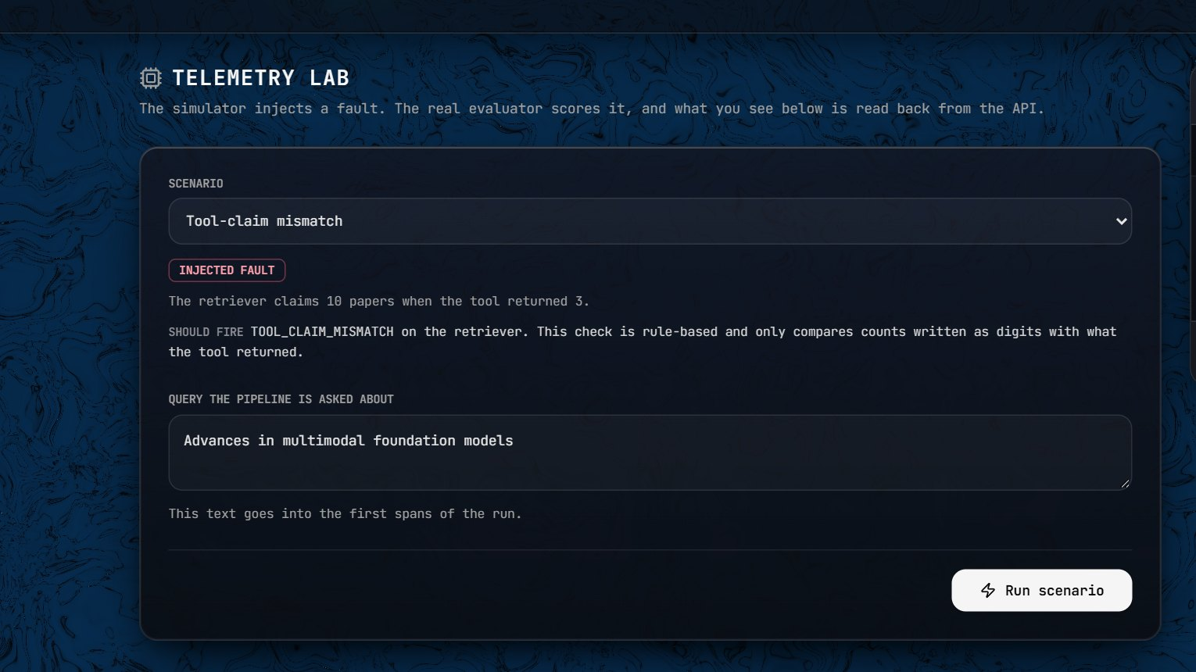
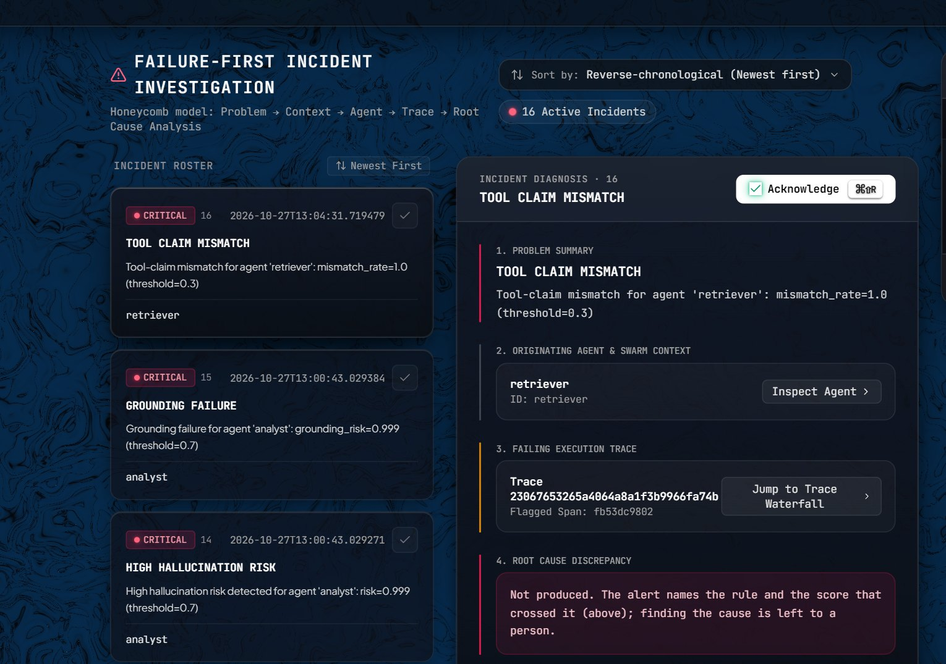
Telemetry Lab: a fault in, an incident out
BACKUP B3 · Q&A
Five scenarios: clean, hallucination, tool-claim mismatch, drift, disagreement. Agent text is a fixture; the evaluator is real.
Incidents from Lab runs on 27 Oct: GROUNDING_FAILURE and HIGH_HALLUCINATION_RISK for analyst, risk 0.999.
Sources: HOW_IT_WORKS.md (Telemetry Lab; fixture text in routers/ingest.py) · docs/E2E_TEST_2026-10-27.md items 11, 12, 22 · README.md (Lab limits 6/h, 30/day per IP)
Notes:
Backup. The Lab injects one of five scenarios into a five-agent pipeline; the text is a fixture (string literals in backend/app/routers/ingest.py), everything downstream is real (HOW_IT_WORKS.md). E2E item 11: hallucination raised HIGH_HALLUCINATION_RISK and GROUNDING_FAILURE for verifier 0.971 and analyst 0.999. Item 12: a repeat within 15 minutes scores the spans but raises no new alert (cooldown 900 s). Screenshots: live site, 2026-11-01; the incidents shown are from the 2026-10-27 test runs. Open to visitors: 6 runs per IP per hour, 30 per day, 300 per day for the site.

