Slide 1
After a label-order bug was fixed, 0.5 flagged 7 of 17 correct answers; 0.3 flags 1
BACKUP B1
ONLY IF ASKED
BACKUP · THE 0.3 WEIGHT
NEUTRAL WEIGHT | F1 | FALSE ALARMS
0.0 to 0.3 | 0.963 | 0.059
0.4 | 0.897 | 0.176
0.5 | 0.788 | 0.412
Before 21 October the code read two DeBERTa labels in swapped order. PR #69 fixed it; every figure was re-measured.
Test split, cut-off 0.4, corrected labels. At the 0.7 cut-off every weight up to 0.6 gives the same result.
SOURCE GROUNDING_RECALIBRATION_2026-10.md, banner and findings 4-7 (T3c, T5b, T7); PR #69; PR #89.
Notes:
BACKUP, only if asked.
SAY:
- Until 21 October the code read DeBERTa's "entailment" and "neutral" outputs in the wrong order. It was found, fixed (PR #69), and every grounding number was re-measured.
- With correct labels, a weight of 0.5 flagged 7 of 17 correct answers as medium risk. 0.3 flags only 1.
- Weights from 0 to 0.3 give identical results, so 0.3 is a choice inside that range, not a fitted value.
- High-risk alerts (above 0.7) do not change for any weight up to 0.6.
- The live database was re-scored: 90 low, 7 medium, 19 high (it was 12, 81, 23 at 0.5).
IF ASKED "How do I know other numbers are not also wrong?": The recalibration report lists every result the bug touched; anything built only on the contradiction probability was unaffected.
SOURCES: GROUNDING_RECALIBRATION_2026-10.md finding 4 (w 0.0-0.3: 0.963 / 0.059; 0.4: 0.897 / 0.176; 0.5: 0.788 / 0.412, 7 of 17), finding 7 and banner (live rows 90/7/19 and 1 without label at 0.3; 12/81/23 at 0.5), finding 5 (contradiction-only results unaffected); PR #69 (label order from the model config), PR #89 (weight 0.3).

Slide 2
Both withdrawn signals looked good on hand-written cases and failed on real traces
BACKUP B2
ONLY IF ASKED
BACKUP · NEGATIVE RESULTS
SIGNAL | HAND-WRITTEN | REAL TRACES
Tool-claim check, F1 | 0.842 | 0.000
Inter-agent disagreement | — | 0 of 10 found
Real agents write counts in words, not digits; the tool-claim check only reads digits.
Tool-claim: 19 hand-written cases; no claim found in 8,353 real prose spans. Disagreement: AUC 0.457 without the planner, which is chance.
SOURCE TOOL_CLAIM_EXTERNAL_TEST_REPORT.md section 10; COMPETITIVE_POSITIONING.md 5.1, 5.2; SESSION_HANDOFF.md 14.1, 24.9.5.
Notes:
BACKUP, only if asked.
SAY:
- Tool-claim check: it compares a count that the agent writes ("I found 12 papers") with the count the tool really returned. On 19 hand-written cases F1 was 0.842. On real traces it found no claim at all in 8,353 steps, because real agents write in words, not digits. F1 0.000.
- Disagreement: it compares agents' outputs in one trace with NLI. On real multi-agent traces it found 0 of 10 labelled contradictions; without the planner agent its AUC was 0.457, which is chance (0.5 = a coin toss).
- So I withdrew both alerts. The scores are still stored for study.
IF ASKED "Why did disagreement fail?": Point to the diagnosis in DISAGREEMENT_FORMULATION_DIAGNOSIS_REPORT.md rather than guessing; the measured fact is 0 of 10 and AUC 0.457.
SOURCES: TOOL_CLAIM_EXTERNAL_TEST_REPORT.md section 10 (0.842 on 19 hand-written cases; 0.000 real; 8,353 prose spans; only fires on counts written in digits: README "What it does"); COMPETITIVE_POSITIONING.md 5.1, 5.2; SESSION_HANDOFF.md 14.1, 24.9.5 (0 of 10; AUC 0.457 without the planner).

Slide 3
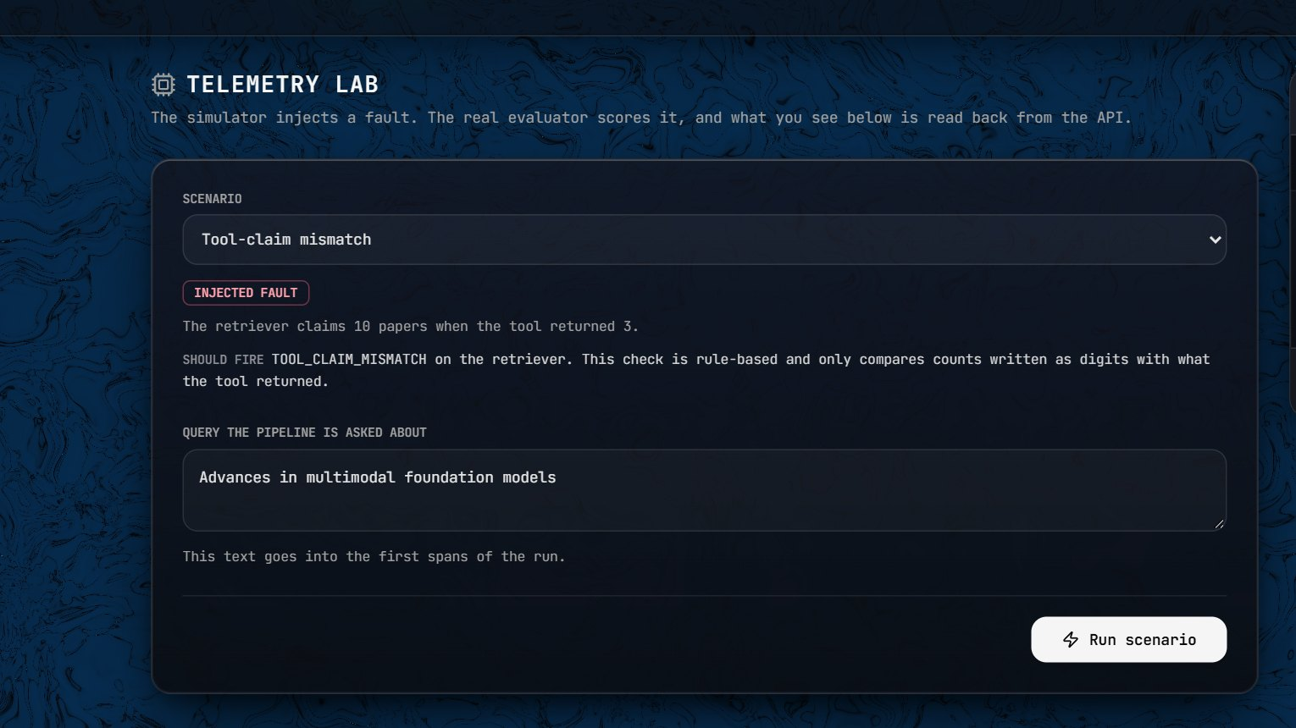
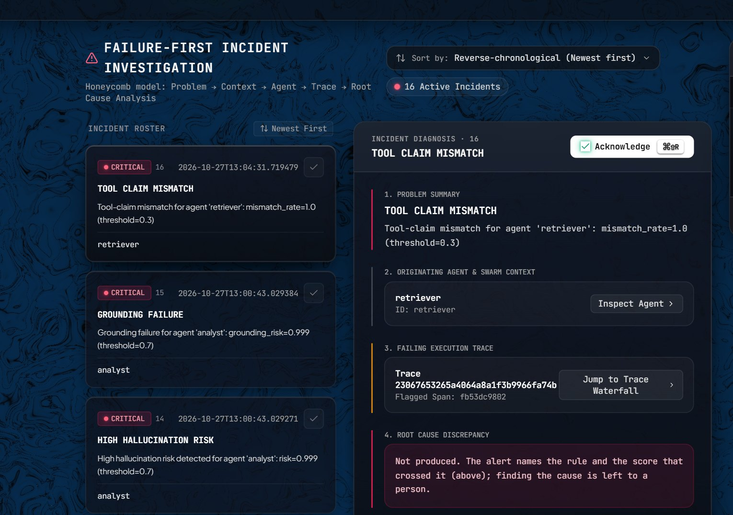
A fault injected in the Lab becomes a scored trace and a HIGH incident
BACKUP B3
ONLY IF ASKED
BACKUP · TELEMETRY LAB
Five scenarios; the agent text is fixed, the evaluator is real. PHOTO: LIVE SITE
Lab runs of 27 October: GROUNDING_FAILURE for analyst, risk 0.999. PHOTO: LIVE SITE
SOURCE HOW_IT_WORKS.md, Telemetry Lab; docs/E2E_TEST_2026-10-27.md, items 11, 12 and 22.
Notes:
BACKUP B3, only if asked or if the live demo fails.
SAY:
- The Telemetry Lab lets anyone inject one of five faults: clean, hallucination, tool-claim mismatch, drift, disagreement.
- The agent text is fixed in the code; everything after it (scoring, alerts) is the real system.
- On 27 October the hallucination run raised HIGH alerts: verifier 0.971, analyst 0.999.
- If you run it twice within 15 minutes you see the scores but no new alert, because of the 15-minute cooldown.
IF ASKED "Is the Lab data real?": The text is a fixture; the scores and alerts come from the real evaluator.
SOURCES: HOW_IT_WORKS.md (fixture text in backend/app/routers/ingest.py); docs/E2E_TEST_2026-10-27.md item 11 (verifier 0.971, analyst 0.999), item 12 (no alert on a repeat within 15 min, cooldown 900 s), item 22; screenshots 2026-11-01.

Slide 4
Every figure in this deck comes from these documents in the repository
REFERENCES
ONLY IF ASKED
REFERENCES
README.md (state of 2026-10-27)
docs/E2E_TEST_2026-10-27.md
GROUNDING_RECALIBRATION_2026-10.md
DRIFT_REAL_TEXT_DIAGNOSIS_REPORT.md
LLM_JUDGE_COMPARISON_REPORT.md
TOOL_CLAIM_EXTERNAL_TEST_REPORT.md
COMPETITIVE_POSITIONING.md
HOW_IT_WORKS.md; DEMO_GUIDE.md
benchmarks/benchmark_results.json
experiments/results/ablation_results.json
deploy/azure/README.md; .github/workflows/
SESSION_HANDOFF.md, sections 14, 24, 29
Models: sentence-transformers/all-MiniLM-L6-v2; cross-encoder/nli-deberta-v3-small
SOURCE Repository github.com/Soum-Code/agentpulse; model names from HOW_IT_WORKS.md.
Notes:
BACKUP B4. Show only if asked where a number comes from.
SAY:
- Every number in this deck comes from a document in the repository; each slide names its source at the bottom.
- The two models are public Hugging Face models: all-MiniLM-L6-v2 for embeddings and nli-deberta-v3-small for NLI.
IF ASKED "Is there a paper?": Show the paper-communication proof you brought separately; this deck does not claim a publication.
SOURCES: HOW_IT_WORKS.md (model table).

