Slide 1
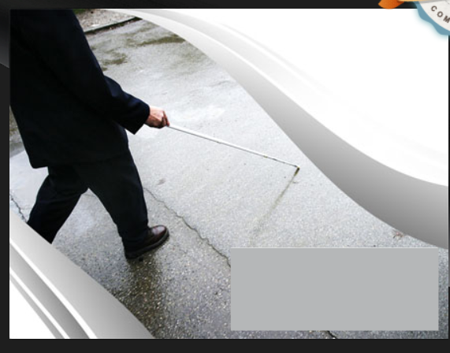
Enabling Technologies for Visually Impaired
Team Name: Sparkling Buds
Team Members: Soumiya .A
Susithra .K

Slide 2
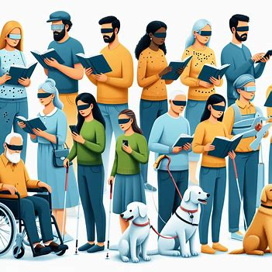
PROBLEM STATEMENT
Visually Impaired people often face challenges in navigating unfamiliar environments and accessing visual information, limiting their independence and participation in daily activities.

Slide 3
OBJECTIVES
To enlighten the vision of impaired people by bringing mobility in outdoor space without stick
To bloom a positive aspect in their life to lead a normal people life without any distinguish of their disabilities
To thrive self-esteem and self-dependent on themselves, without relying on others especially in their independence and participation in daily activities like walking , crossing roads etc.

Slide 4
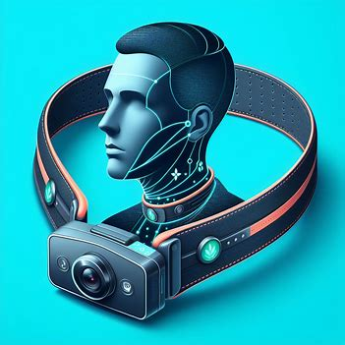
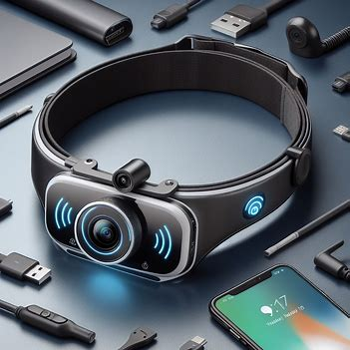
SOLUTION OVERVIEW
A camera integrated into the Smart Belt captures images of the user's surroundings.
The user can interact with the Smart Belt through audio prompts or commands to customize preferences or seek specific information about their surroundings.
Upon detecting objects, the Smart Belt converts the visual information into audio feedback, providing the user with real-time updates about their surroundings.
Advanced object detection algorithms such as YOLO V5 and Convolution Neural Network (CNN) for real-time object detection are employed to identify objects present in the environment.

Slide 5
ARCHITECTURAL DIAGRAM
Image Capturing
Image Processing
Object Training using Pre-Trained Dataset
Using YoloV5 Algorithm to detect object
Recognizing object and producing alert through sound or vibration
If
YES
NO
No obstacles

Slide 6
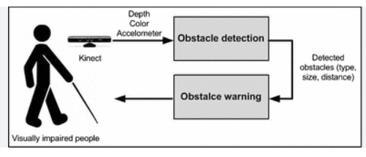
Obstacle Detection
Yolov5 & IoT sensor

Slide 7
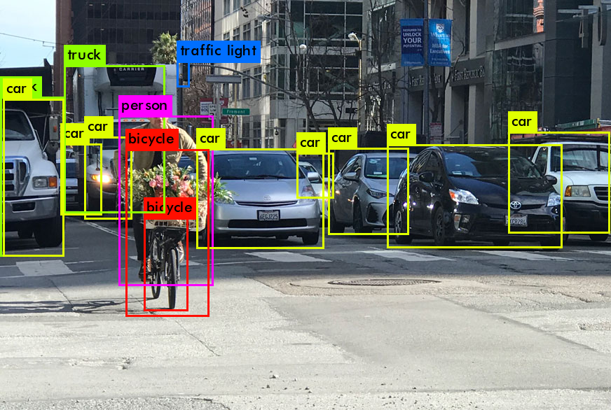
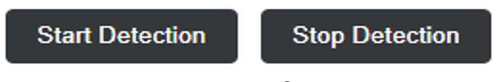
Working model using yolov5 Algorithm

Slide 8
Scalability & feasibility
Scalability:
The Smart Belt for the Visually Impaired is easily replicable and adaptable across diverse environments and user demographics, owing to its modular design and use of accessible hardware components and advanced object detection algorithms.
Feasibility:
Leveraging off-the-shelf hardware like webcams, & YoloV5 algorithm and Convolutional Neural Network for classification, along with open-source software libraries, ensures cost-effectiveness and accessibility.
Collaborations with relevant organizations and user feedback sessions further enhance usability and address specific user needs, making the project both technically and economically viable.

Slide 9
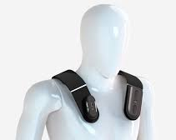
Future Impact on Society
Creates a frustration less, environment, by automating their mobility in outdoor space
Technology will change their life opportunities for greater accessibility than ever before
Helps to expand their social circle , to learn new skills, and to find entertainment
To enable them to communicate with outside world without any hassle

Slide 10
Thank you

