Slide 1


UART via
+3.3V
GND
External Power Supply
STM32L476RG
(Stepper Motor Control and User Interface)
STM32L476RG
(Resistance Measurement)
Voltage Divider Circuit
CNC Machine loaded with the sample under test
Rx
Tx
ADC
+
Tx
Rx
RTS
RTR
RTR
RTS
GND
-
GND
GND
+25V
GND
External Power Supply
Stepper Motor Driver
PUL
A+
DIR
A-
GND
B+
B-

Slide 2
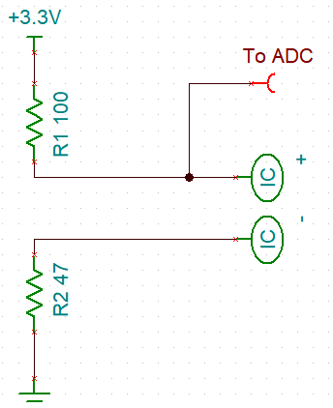
Sample

