Slide 1
Capstone automation
Name- Soumalya Das
Batch – 3
Domain – Java Selenium

Slide 2
SauceDemo Website Automation
Tools Used:
Java 21
Selenium
TestNG
Cucumber
Extent Reports
WebDriverManager
Jira (Agile Planning & Test Management with Zephyr)
Jenkins (CI/CD Pipeline Integration)
GitHub – Version Control and Collaboration

Slide 3
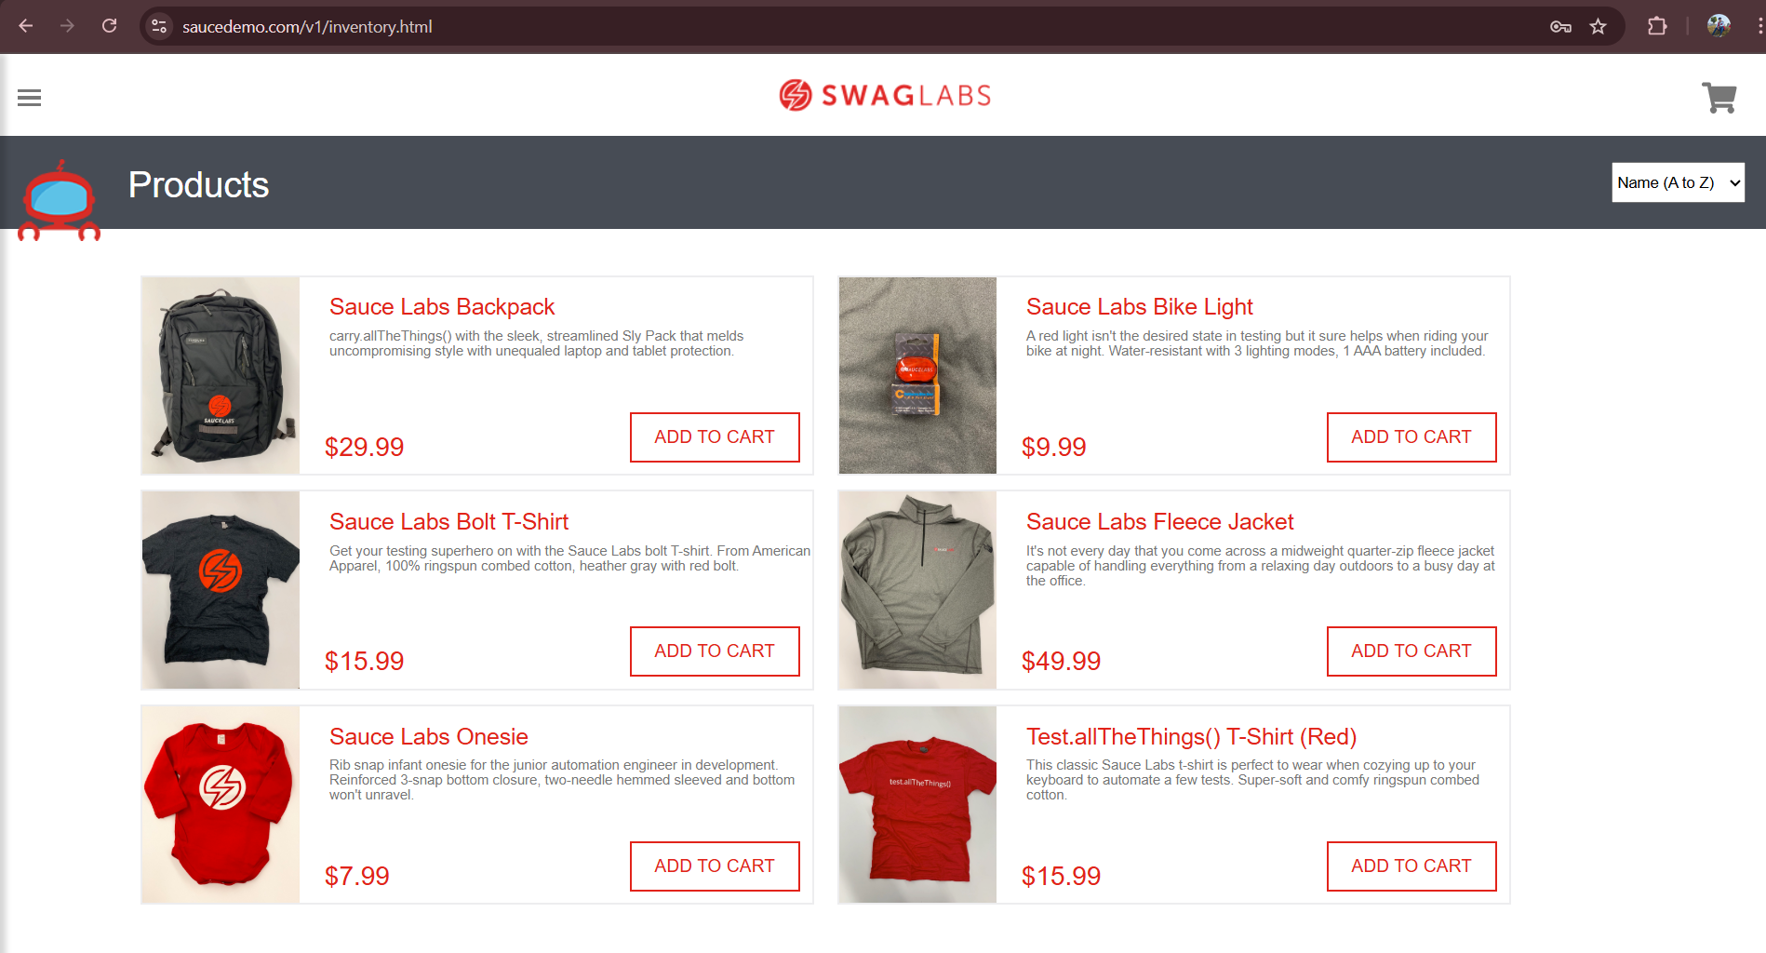
SauceDemo Website Look

Slide 4
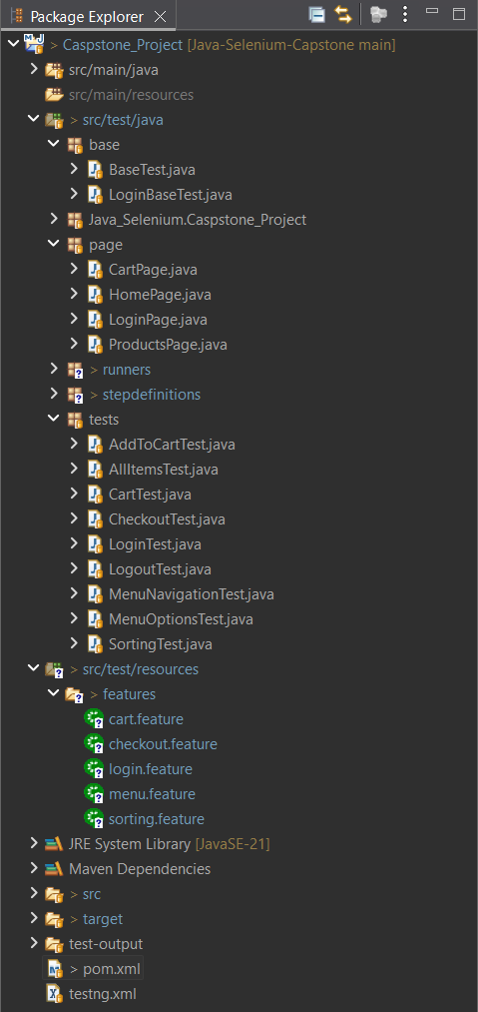
File Structure

Slide 5

Output of Automation

Slide 6
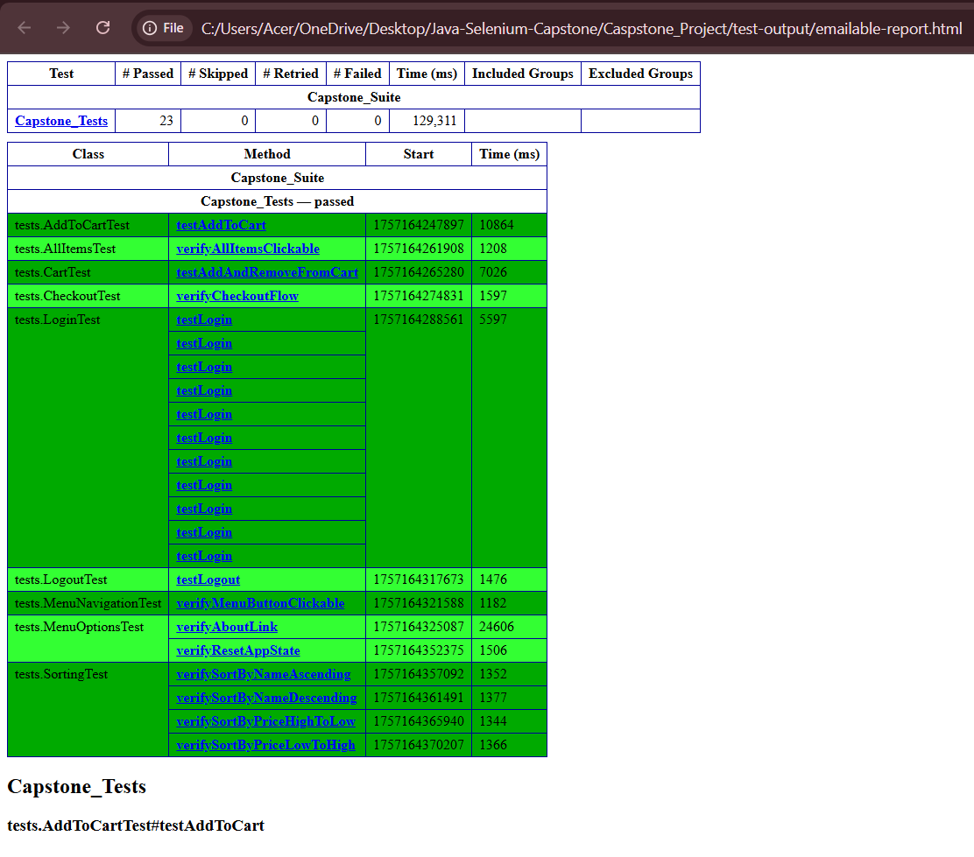
Report Of Test Cases

Slide 7
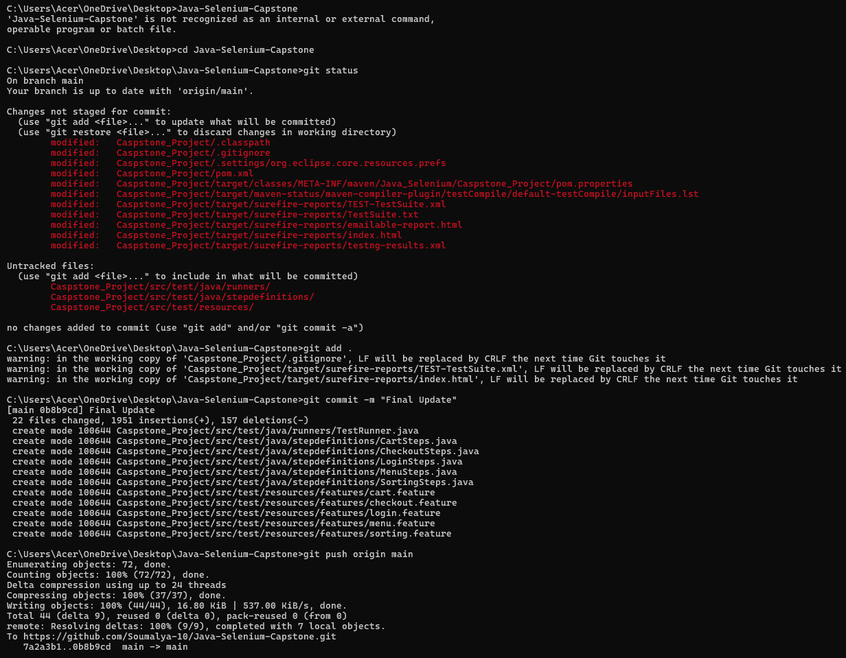
GitHub Add Files To Repository

Slide 8
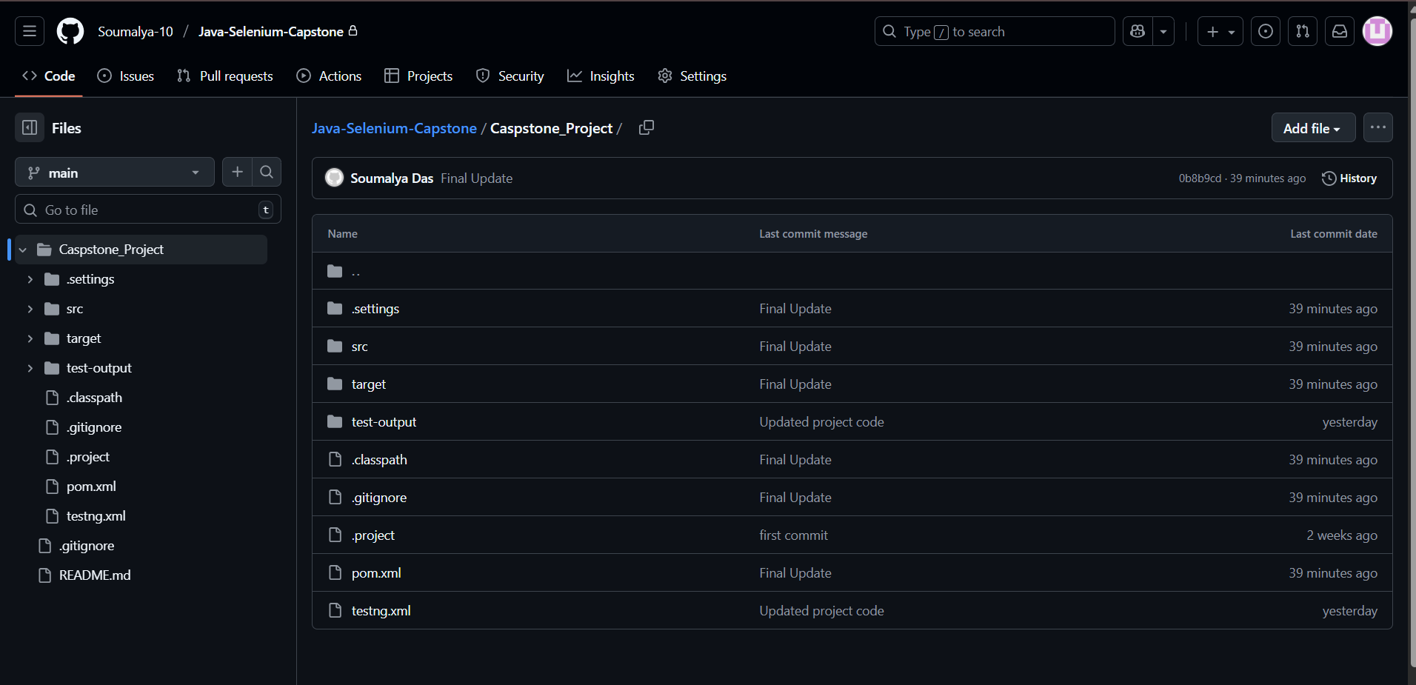
GitHub

Slide 9
Jira and Zephyr Essentials
Jira used for –
Epics
Stories
Subtasks
Test case management via Zephyr Essentials
Agile Work Flow -> Backlog → Sprint Planning → Execution → Test Cycles → Reports

Slide 10
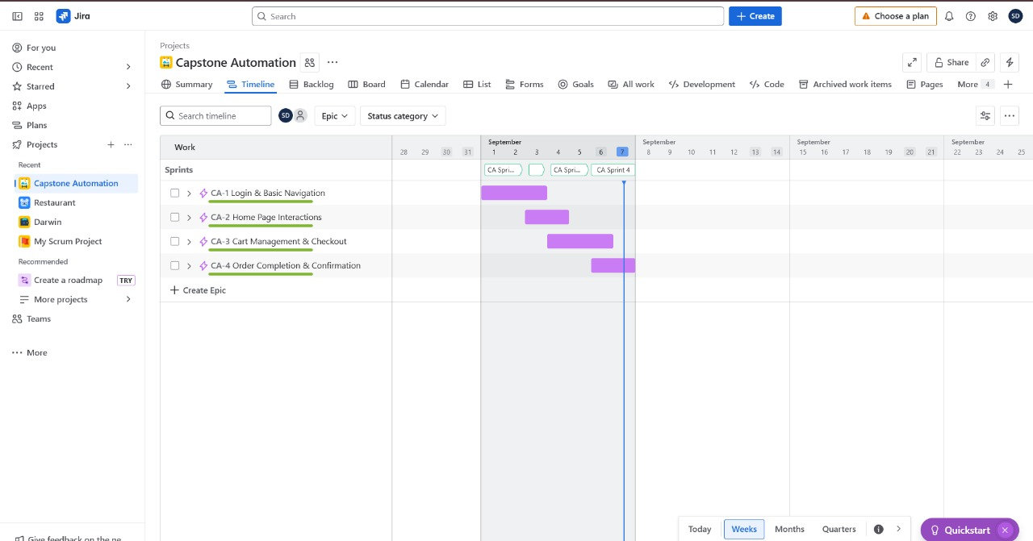
Jira Screenshots - Sprint

Slide 11
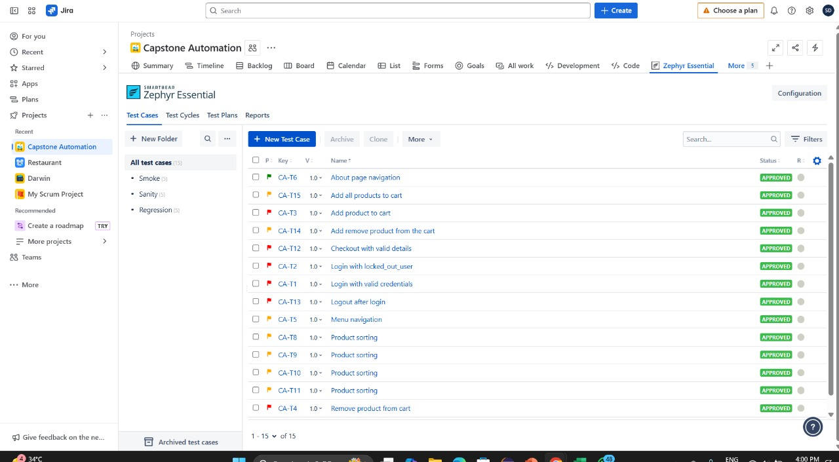
Jira Screenshot – Test Cases

Slide 12
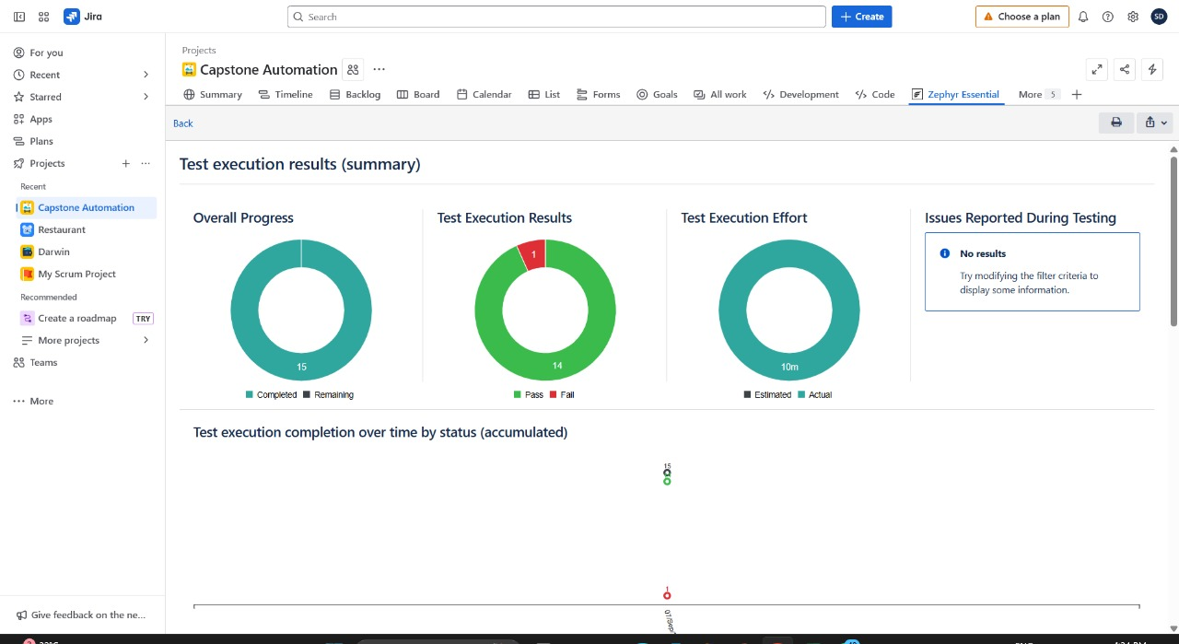
Jira – Test Execution Result

Slide 13
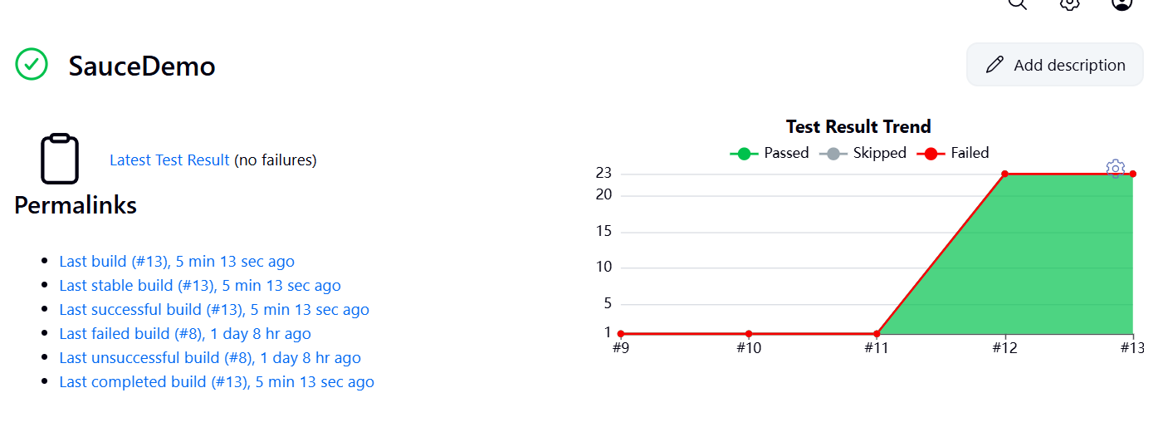
Jenkins

Slide 14
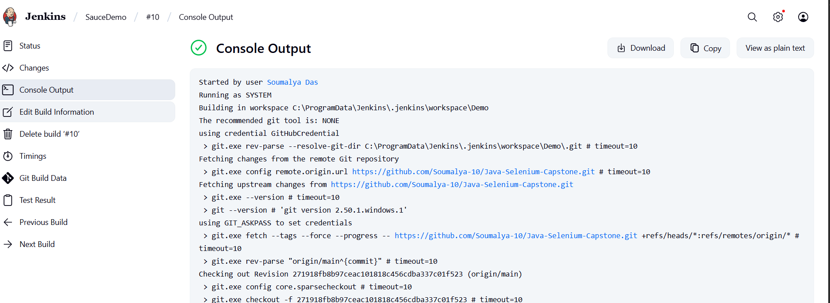
Jenkins – Manual Build

Slide 15
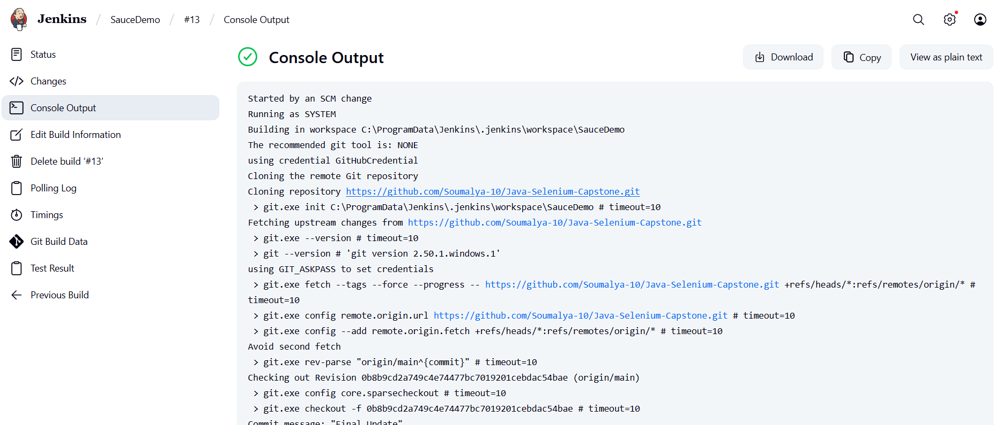
Jenkins – Automated Build (SCM change)

Slide 16
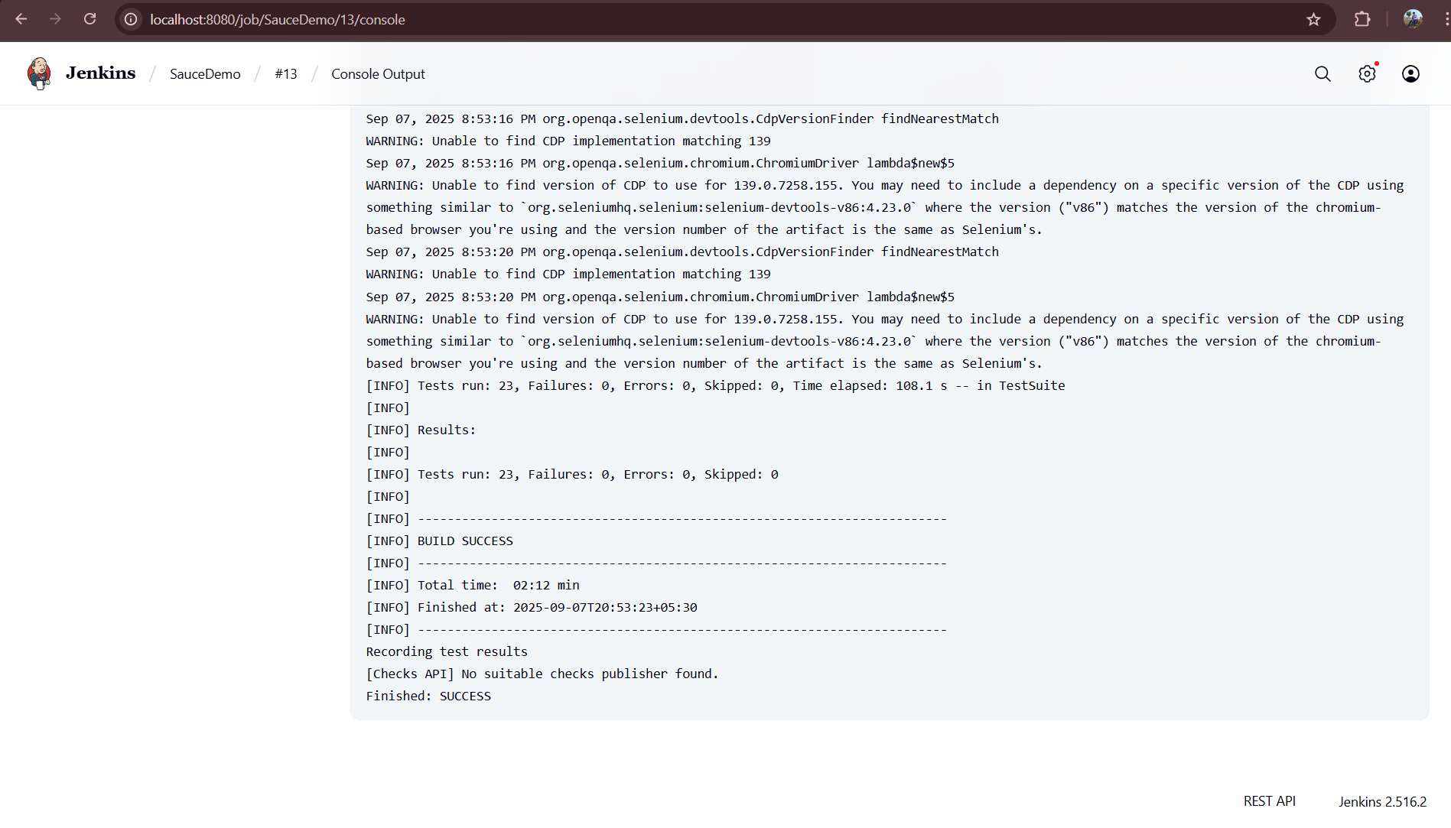
Build Success

Slide 17
Thank You

