Slide 1
Capstone automation
Name- Soumalya Das

Slide 2
SauceDemo Website Automation
Tools Used:
Java 21
Selenium
TestNG
Cucumber
Extent Reports
WebDriverManager
Jira (Agile Planning & Test Management with Zephyr)
Jenkins (CI/CD Pipeline Integration)
GitHub – Version Control and Collaboration

Slide 3
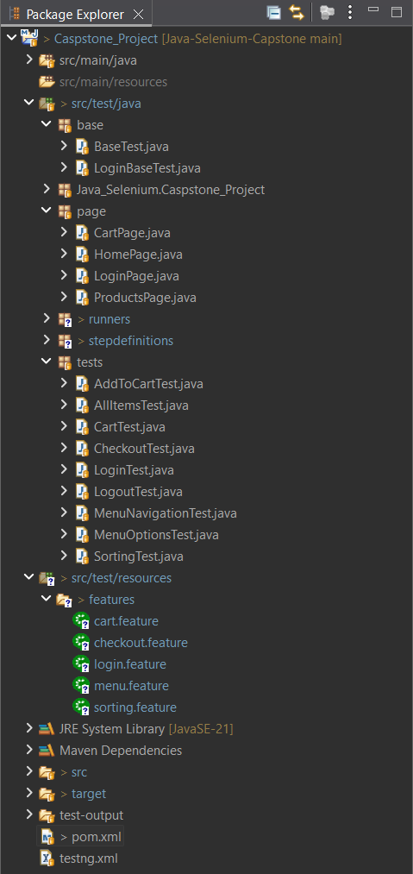
File Structure

Slide 4

Output of Automation

Slide 5
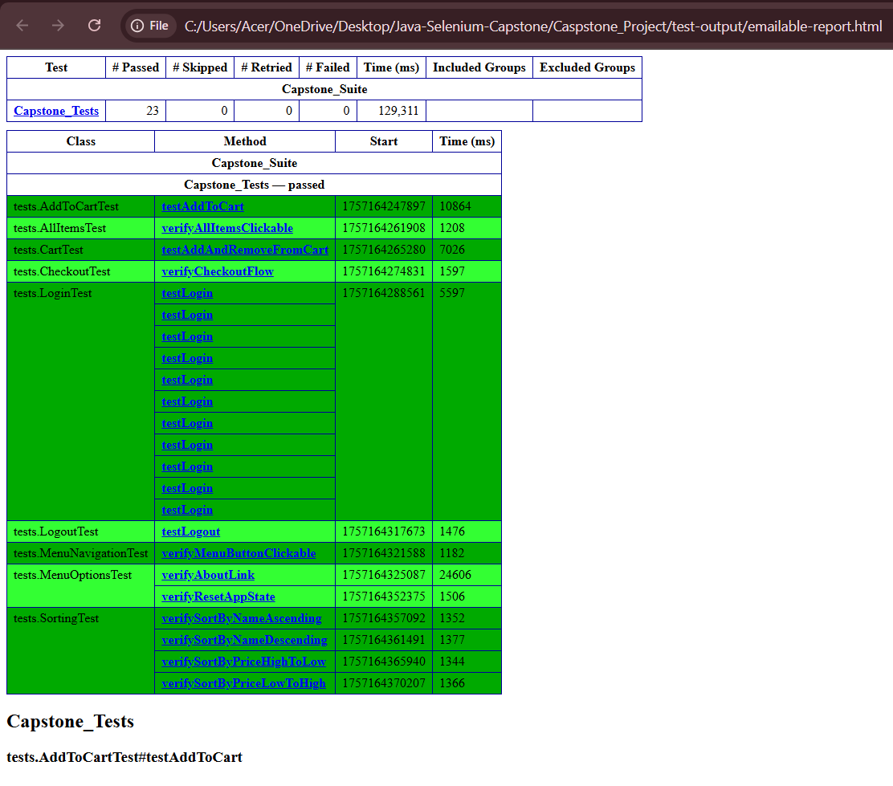
Report Of Test Cases

Slide 6
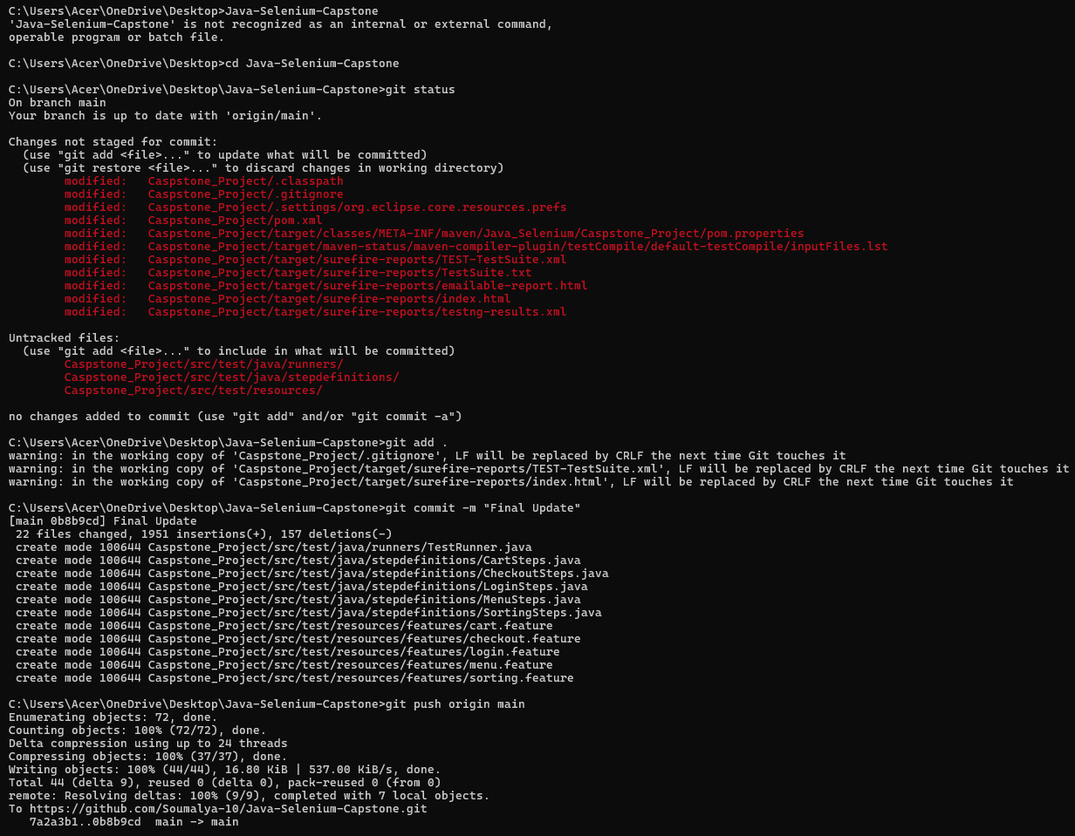
GitHub Add Files To Repository

Slide 7
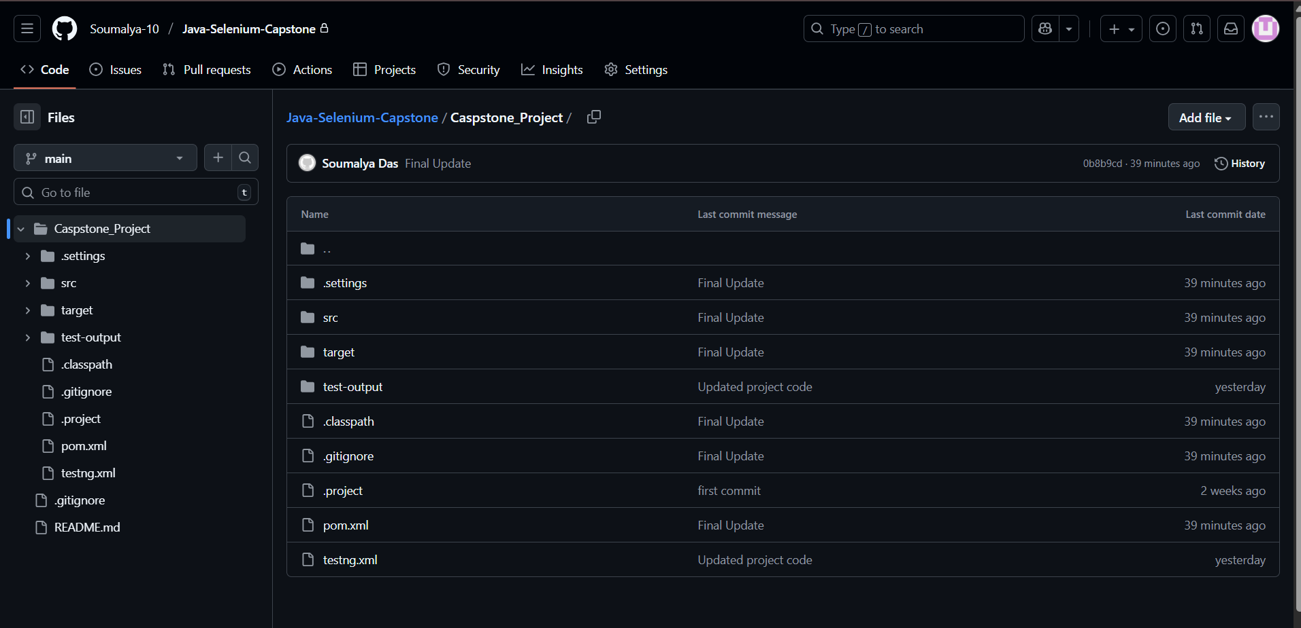
GitHub

Slide 8
Jira and Zephyr Essentials
Jira used for –
Epics
Stories
Subtasks
Test case management via Zephyr Essentials
Agile Work Flow -> Backlog → Sprint Planning → Execution → Test Cycles → Reports

Slide 9
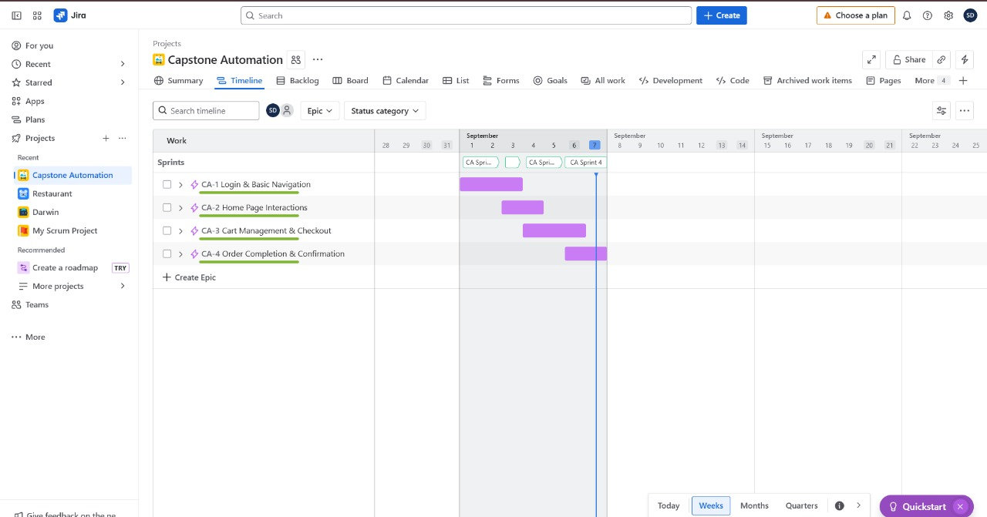
Jira Screenshots - Sprint

Slide 10
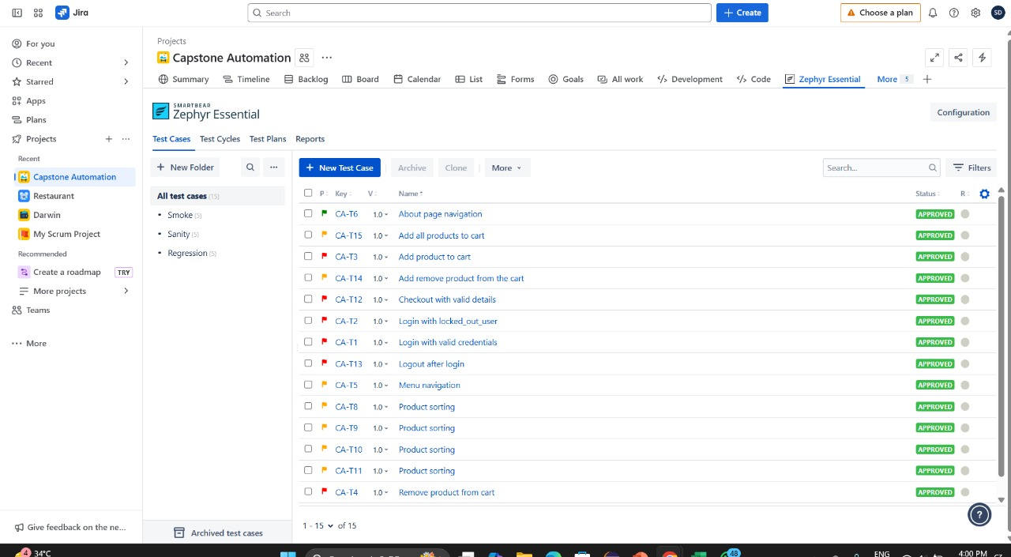
Jira Screenshot – Test Cases

Slide 11
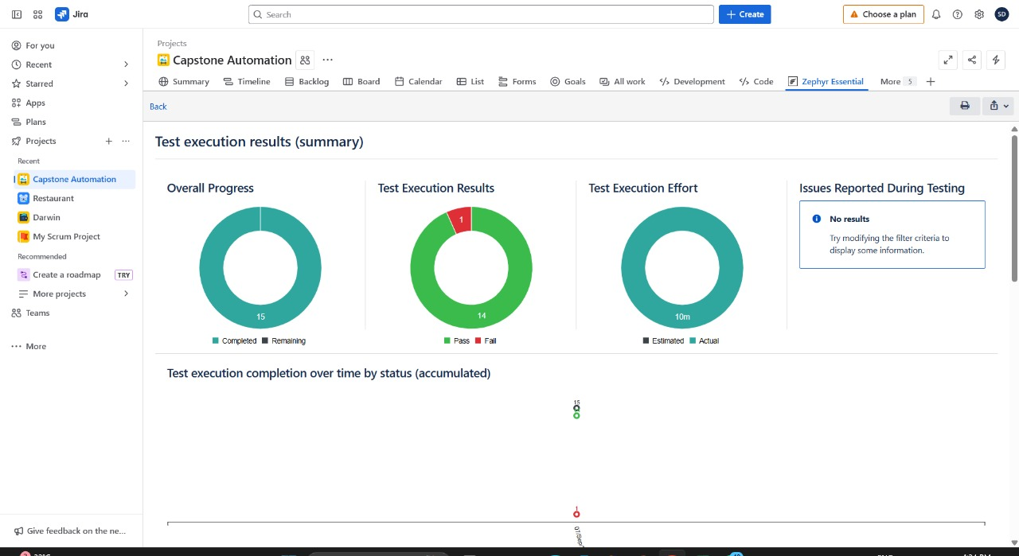
Jira – Test Execution Result

Slide 12
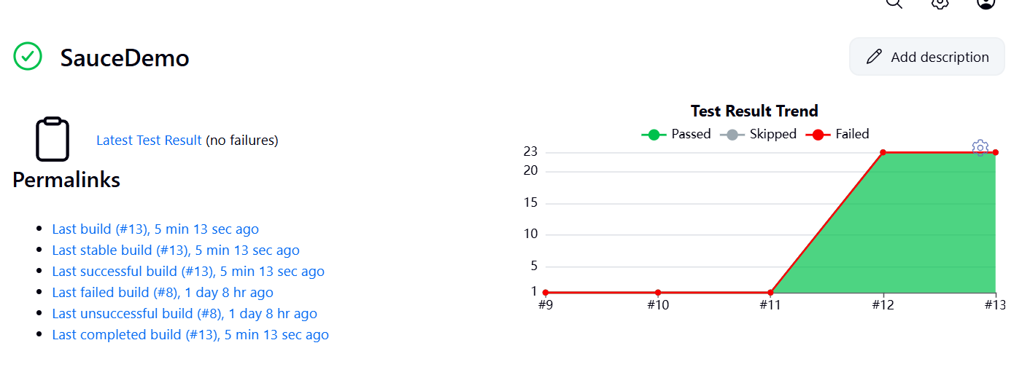
Jenkins

Slide 13
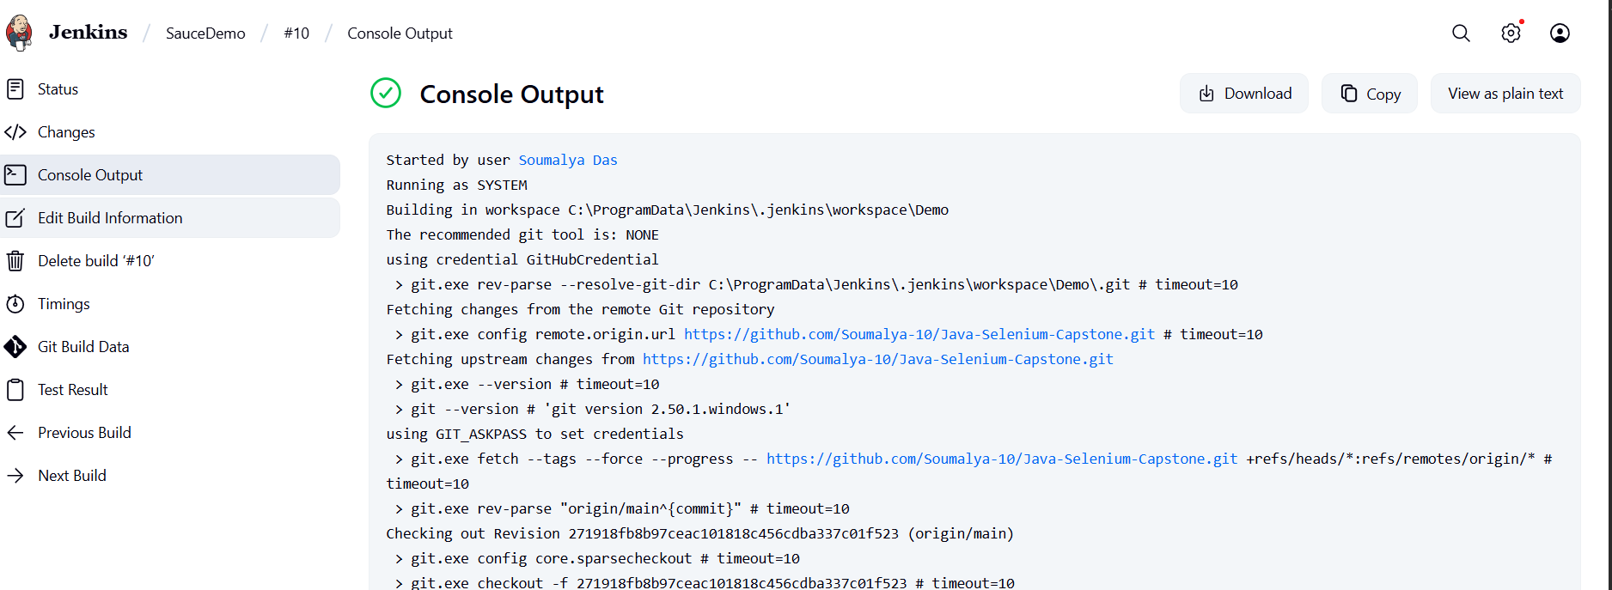
Jenkins – Manual Build

Slide 14
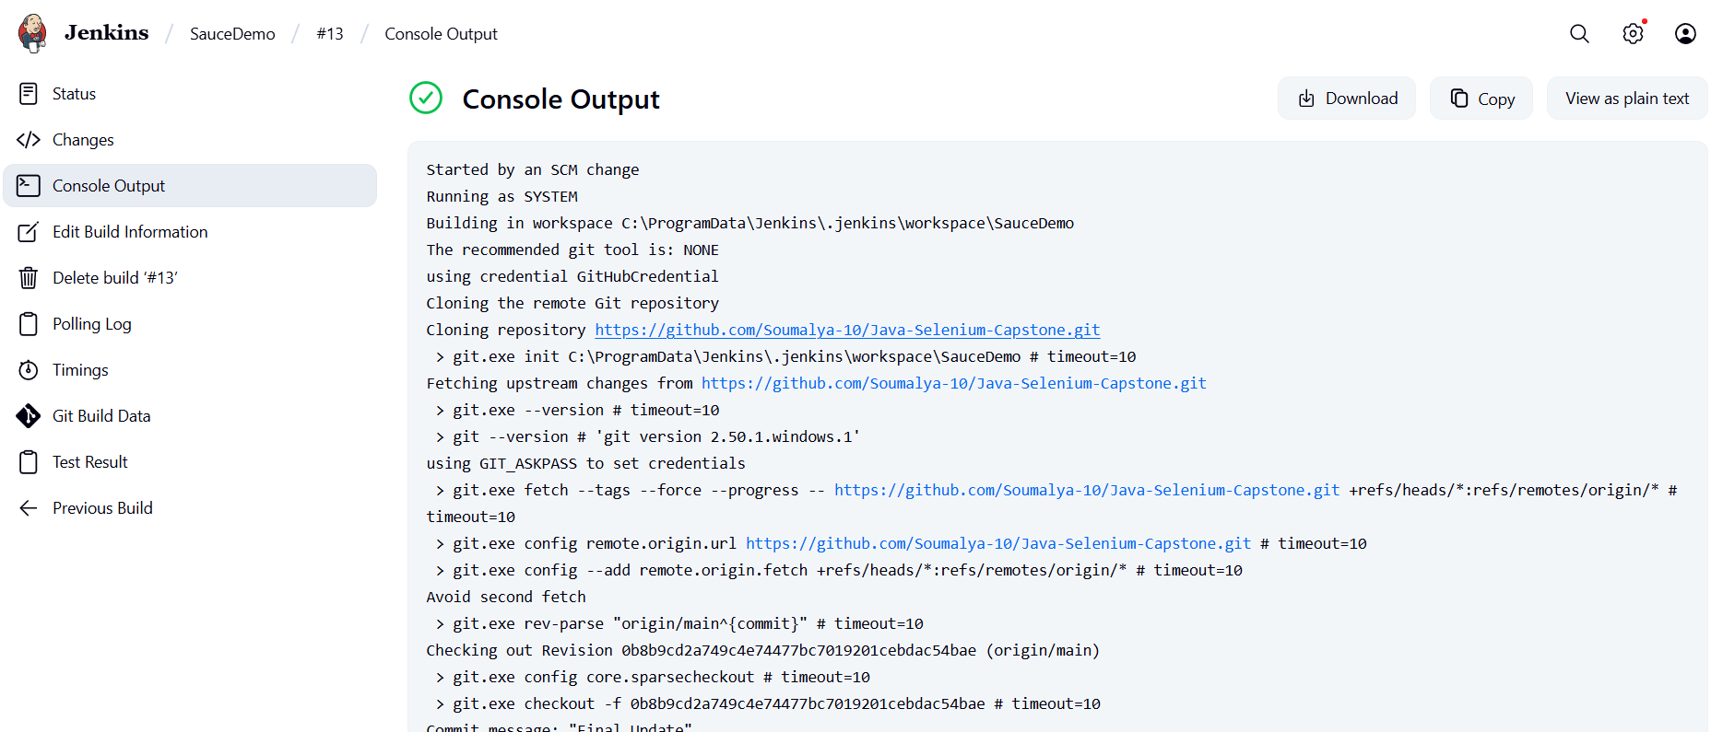
Jenkins – Automated Build (SCM change)

