Slide 1

Basic Details of the Team and Problem Statement
Team ID: R2_HMED_C51
Track Name: MEDICAL DEVICES AND EQUIPMENTS
Problem Statement Title: Designing a device that can automatically dispense medication and track patient adherence to medication schedules
ROUND #2

Slide 2
Idea/Approach Details
Describe your idea/Solution/Prototype here:
The smart medicine vending machine , “MEDIBOT” is designed and developed as a reliable yet affordable with portability features to help the needy people.
Smart medicine vending machine can track and monitor each dose taken by the user with maintained schedule time using Real Time Clock (RTC) module in the system. This information can be helpful for caregivers or healthcare providers to ensure medication adherence and identify any patterns or issues that may arise.
It should be able to store and dispense a wide variety of medications having different labelled compartments or shelves for organizing different medications.
Setting the time interval of doses in a smart medicine vending machine that can help users manage their medication schedules effectively.
We Implement a reminder in the form of visual prompts on the machine's display, audio cues, or even SMS notifications to a designated caregiver or family member when it's time to take their medication.
It provide clear, step-by-step instructions on how to operate the machine, including how to refill medications, troubleshoot common issues.
Describe your
Technology stack here:
HARDWARE :
Microcontroller (Arduino NANO & Node MCU)
Servo & DC Motor with motor driver
RTC Module
LCD Display
Input keypad
Speaker & Buzzer
GSM Module
Cellular Phone
SOFTWARE:
Arduino IDE
Proteus
Message system
IoT based mobile app

Slide 3
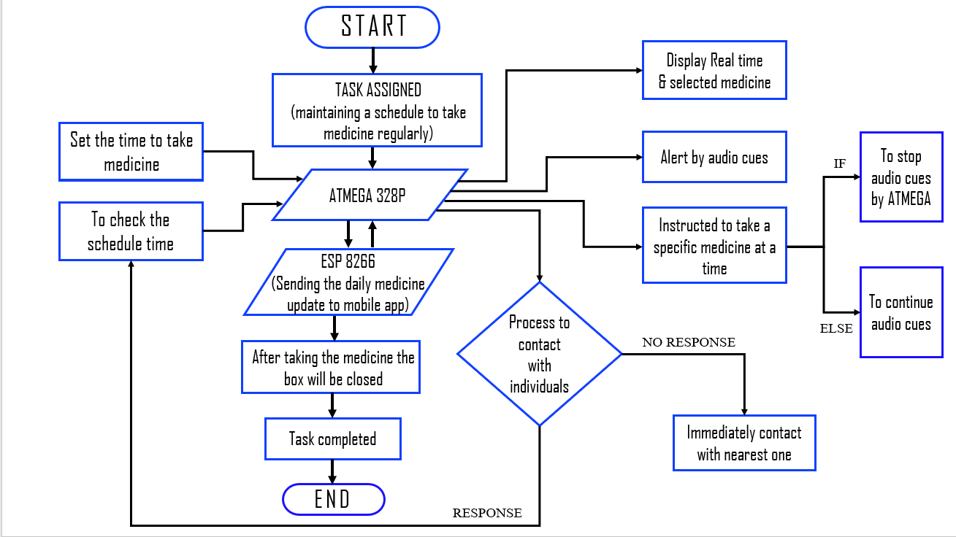
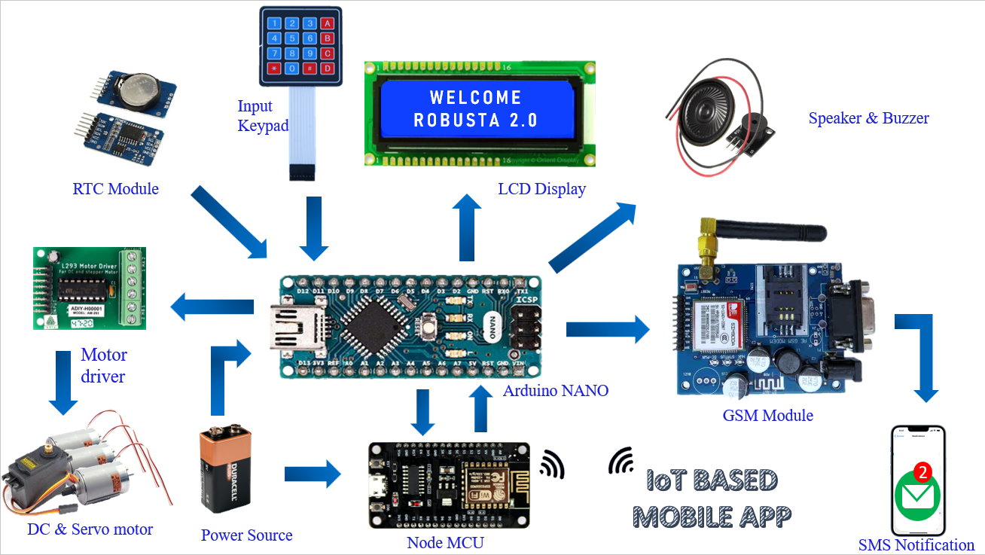
Idea/Approach Details
Add process flow chart or simulated image of prototype or any relevant image related to your idea
FLOW CHART
SCHEMATIC DIAGRAM

Slide 4
Idea/Approach Details
Describe your Use Cases here
Describe your Dependencies / Show stopper here
Smart medicine vending system can be highly useful for selecting medicines at a certain times for elderly people when it comes to managing medication and promoting medication adherence.
People with dementia can potentially benefit from using a smart medicine vending machine to help manage their medication as dementia can cause memory loss and difficulties in following complex routines including taking medications as prescribed.
A smart medicine vending machine designed specifically for paralyzed individuals can be a valuable and convenient solution to help them manage their medication needs effectively.
A smart medicine vending machine for missed dose cases is a novel concept that could help patients adhere to their medication schedules and reduce the risk of missing doses.
Smart medicine vending machine connect to a companion mobile app that provides additional features like medication schedules, refill reminders, dosage instructions, and the ability to track medication history and enable users to share medication data with healthcare professionals or family members for better support and monitoring.
In case a dose is missed or not taken within a specified time, this device can send alerts to designated individuals, such as caregivers or family members that ensures prompt intervention and helps prevent medication gaps or potential health risks.
The system automatically dispenses the right medications at the prescribed times, eliminating the need for manual pill sorting and organizing. This feature helps prevent medication errors and ensures that the individual takes the correct dose at the right time.
It enable remote monitoring capabilities to allow caregivers or healthcare professionals to track medication usage, monitor refill needs, and address any issues remotely using Wi-Fi or cellular network.
In corporate this system can verify prescriptions before dispensing the medication. This can be done through barcodes, QR codes, or electronic prescription systems to ensure that only authorized medications are provided.

