Slide 1



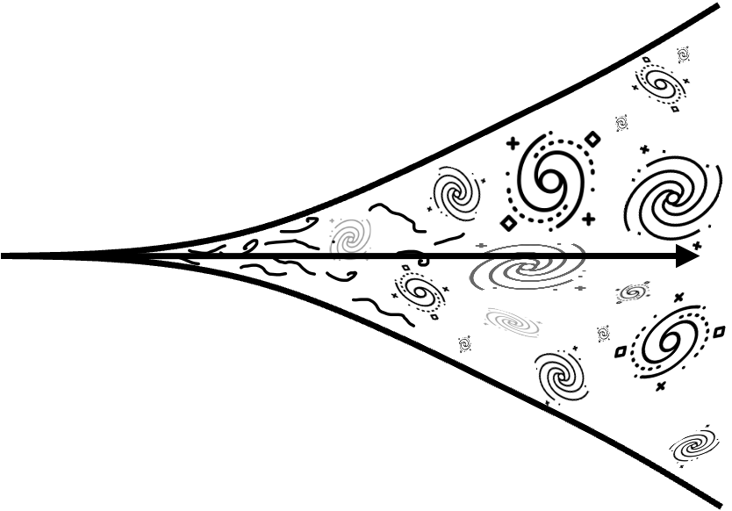



Shape of m₁ function
mass ratio
q
Effective spin
$$χeff$$
$\text{q}−χeff$
relation
z evolution
x
Channel
(shallow)
rise
peak at
34
Sharp
drop
equal mass
<$χeff$> $≈0.1$
unconfirmed
with SFR
~
~
~
P-PISN
I) Pile up
?
~
~
II) shoulder
~
III) CCSN-transition
Globular clusters
~
Hierarchical
?
?
Chemically Homogeneous
I) pure
~
~
II) quasi
Pop III
You shouldn’t go much smaller than this
Notes:
Why does the stable mass transfer channel drop below a certain mass?
Well in essence this is caused by the mass ratio dependence of mass transfer stability. Mass transfer is more stable for equal masses, and gets less stable at extreme mass ratios.
The stable MT channel is pretty fun because we can basically reduce it to a cartoonish representation of the key evolutionary steps.
This is possible because, compared to e.g. common envelopes, the stable channel is well constrained!
It turns out that the reverse mass transfer being stable, is a very crucial constraint in this channel and imposes a minimum on the BH mass.
I won’t bore you with the derivation

